Slide 1
Numerology for 11ax
Date: 2015-03-09
Authors:

Slide 2
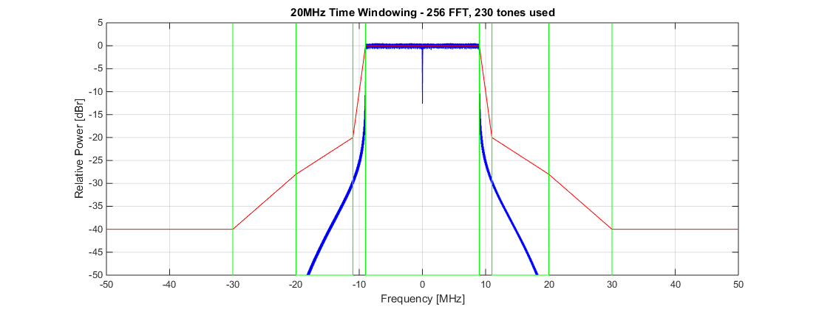
Number of Available Tones
As an example in [1], number of available tones was discussed for 78.125kHz subcarrier spacing.
It was shown that up to 230 subcarriers (excluding a single DC tone) can be used and power spectral mask can be met.

Slide 3
Frequency Resource Allocation Granularity for OFDMA
Depending on the frequency resource granularity for OFDMA, e.g. 1.25 MHz, 2.5 MHz, etc, we will need to divide up 20/40/80/160 MHz into several bandwidth chunks.
For example, support of 5 MHz resource granularity may require the total number of available tones in a OFDM symbol to be divisible by 4. Therefore, 230 tones should not be chosen for this case.
The following is a table of number of tones candidate in 20 MHz
# of Tones in 20 MHz | 1.25 MHz (divide by 16) | 2 MHz (divide by 10) | 2.5 MHz (divide by 8) | 4 MHz (divide by 5) | 5 MHz (divide by 4) | 10 MHz (divide by 2)
230 | NO | YES | NO | YES | NO | YES
228 | NO | NO | NO | NO | YES | YES
226 | NO | NO | NO | NO | NO | YES
224 | YES | NO | YES | NO | YES | YES
222 | NO | NO | NO | NO | NO | YES

Slide 4
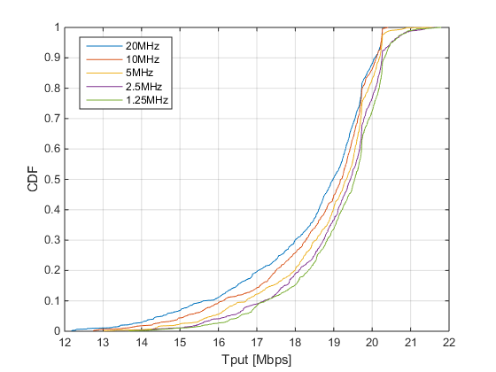
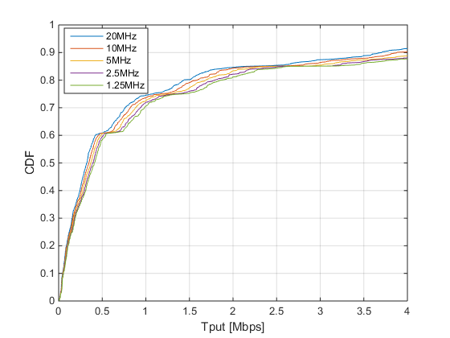
User Diversity Gain
TGac D
ITU NLOS UMi
Gain over 20MHz
10 MHz: 1.1%
5 MHz: 2.4%
2.5 MHz: 3.5%
1.25 MHz: 4.0%
Gain over 20MHz
10 MHz: 5.6%
5 MHz: 11.1%
2.5 MHz: 16.6%
1.25 MHz: 21.3%
Frequency selectivity gain simulations
No MAC protocol overhead assumed (just pure comparison of user diversity gain)
1 AP, and maximum of 8 STAs in OFDMA
STAs are uniformly distributed in 25m / 250m radius
Non-continuous resource allocation was allowed

Slide 5
Number of DC Tones in 20MHz
Number of DC tones in the 12.8us OFDM symbols will depend on the residual frequency offset after CFO compensation from the preamble.
According to 11ac studies [2], residual CFO std. deviation is between 0.07 ~ 0.13 ppm (depending on the integrated phase noise assumption) in indoor channel models of the highest SNR regime.
Unless residual CFO is larger than ½ of the subcarrier spacing (i.e 7.8 ppm in 5GHz), a single DC tone should be sufficient.
Note that this does not necessary mean we should only have 1 DC tone.
Further simulation check on outdoor environments and in low SNR regime will be needed to determine the number of DC tones.

Slide 6
Proposed Numerology Baseline for 20 MHz
Choice of frequency resource granularity depends on
signaling complexity/overhead
system performance
Granularity below approximately 2 ~ 2.5 MHz is not necessary
Suggested Candidates for 20 MHz
Option 1) 230 data/pilot tones, 1 DC tone, and (13 + 12) Guard tones
Option 2) 228 data/pilot tones, 1 DC tone, and (14 + 13) Guard tones
Option 3) 228 data/pilot tones, 3 DC tone, and (13 + 12) Guard tones
Option 4) 224 data/pilot tones, 1 DC tone, and (16 + 15) Guard tones
Option 5) 224 data/pilot tones, 3 DC tone, and (15 + 14) Guard tones
Option 6) 224 data/pilot tones, 5 DC tone, and (14 + 13) Guard tones

Slide 7
Expansion to 40/80 MHz
Alternative 1
Direct multiplication of 20 MHz
No further optimization to use the guard subcarriers between bands
Ease to scale sub-channel definitions for OFDMA
Alternative 2
Optimized to use all available spectrum
sub-channel definitions for OFDMA becomes complicated
Unused
40 MHz
Guard Band Gap:
Approximately 2 MHz of spectrum
5.6% of potential capacity for 40 MHz
8.3% of potential capacity for 80 MHz
20 MHz
20 MHz
40 MHz

Slide 8
Example of Alternative 1 - based on option 4 -
Data + pilot 112
20MHz
Right Guard Tone 15
+1
+112
-112
56
-1
40MHz
Data + pilot 224
-240
56
-16
+16
+240
80MHz
Data + pilot 448
-496
-272
-240
-16
+16
+240
+272
+496
56
Left Guard Tone 16

Slide 9
Example of Alternative 2 - based on option 4 -
Data + pilot 112
20MHz
Right Guard Tone 15
+1
+112
-112
56
-1
40MHz
Data + pilot 240
-240
60
-1
+1
+240
80MHz
Data + pilot 496
-496
-1
+1
+496
62
Left Guard Tone 16

Slide 10
Numerology Baseline for 40/80 MHz
The majority of the OFDMA is likely stem from protocol enhancement for MU transmissions. Only 2~20% user diversity gain from ideal situations.
Therefore, it may be very important to support STAs operating in different operating bandwidth (for power saving reasons)
Maximum spectral efficient gains is available only when each user is SINR saturated (i.e. maximum MCS).
Maximum spectral efficiency gains for Alternative 2 is around 6% ~ 11%. Actual gains depends on the number of pilots vs data tones.
The power of each tone is normalized, slightly small number of tone usage result in higher transmit power spectrum density for each tone.
The cost of complexity in designing OFDMA systems that can scale between 20 MHz ~ 160 MHz seems to be far more important than SE gains in SINR saturated scenarios, which is not the main target for TGax.

Slide 11
Numerology for 160 MHz
Given that 11ac supports 80+80 MHz, where the 80 MHz chunks can be discontinuous in frequency, 11ax should also support 80+80 MHz operations.
To avoid numerous implementation options, we propose to 160 MHz numerology as two 80 MHz operations (same design method as in 11ac)
This allows the use of the same power spectral mask definitions
DC Tones (not available for data)
160 MHz
80 MHz
80 MHz

Slide 12
Straw Poll #1
Do you agree to add to the TG specification framework document?
x.y.z. The 40 MHz HE PPDU numerology (i.e. number of data and pilot tones, DC tone, and guard tones) is defined by aggregating two 20MHz HE PPDU numerology in frequency.
YES
NO
ABS

Slide 13
Straw Poll #2
Do you agree to add to the TG specification framework document?
x.y.z. The 80 MHz HE PPDU numerology (i.e. number of data and pilot tones, DC tone, and guard tones) is defined by aggregating four 20MHz HE PPDU numerology in frequency.
YES
NO
ABS

Slide 14
Straw Poll #3
Do you agree to add to the TG specification framework document?
x.y.z The 20MHz HE PPDU numerology is defined by [230, 228, or 224] usable (i.e. data or pilot) tones with [1, 3, or 5] DC tones.
Note that TGax will down select later among the numbers in brackets.
YES
NO
ABS

Slide 15
Straw Poll #4
Do you agree to add to the TG specification framework document?
x.y.z. The 160 MHz HE PPDU numerology (i.e. number of data and pilot tones, DC tone, and guard tones) is defined by aggregating two 80MHz HE PPDU numerology in frequency.
YES
NO
ABS

Slide 16
References
[1] Daewon Lee, et. al., “OFDM Numerology for 11ax” IEEE 802.11-15/0079r1
[2] Kai Shi, et. al., “Phase Tracking During VHT-LTF” IEEE 802.11-10/0771r1

