Slide 1
In Situ Frame Size Measurements
Date: 2015-02-26
Authors:

Slide 2
Abstract
Several contributions to SGhew and TGax [1] [2] [3] [4] [5] and papers in the literature [6][7] have shown that small frames and small burst sizes dominate 802.11 traffic for normal use
This contribution adds in situ measurements of an enterprise office, 70K seat stadium, and IEEE Jan Interim meeting in Atlanta
In 802.11 MAC design, the minimum payload size necessary to exceed 50% or more of airtime in a TXOP is dangerously unrealistic.

Slide 3
Tech Company Admin Building
Date/Time/Duration
  300 people work in building. 40 people within 30 meters
  02/11/2015, 30 minutes, Wednesday 03:30 pm – 04:00 pm
Network Configuration
    VHT40 on 36+, 44+, 132+, 161+
    Jumbo frames not enabled on LAN
Capture Equipiment
    MacBook Pro Retina (3x3 11ac) – Wireless Diagnostics Tool

Slide 4
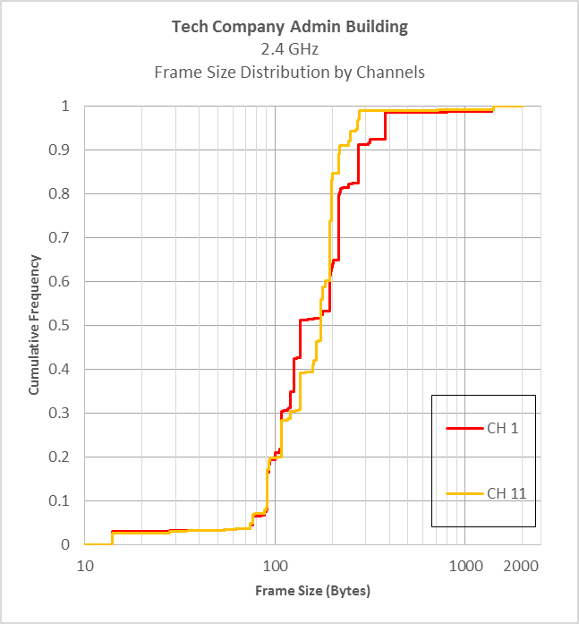
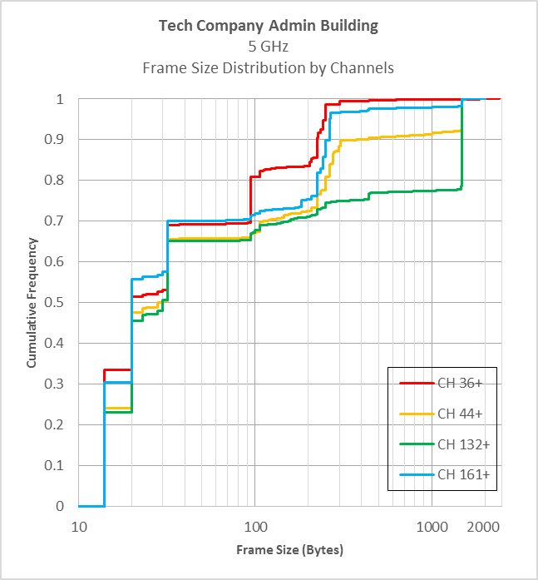
Frame Size Distribution by Channels
Enterprise Office
(frame size in logarithmic scale)
Large payloads
Ack
Beacon
BA
RTS
CTS

Slide 5
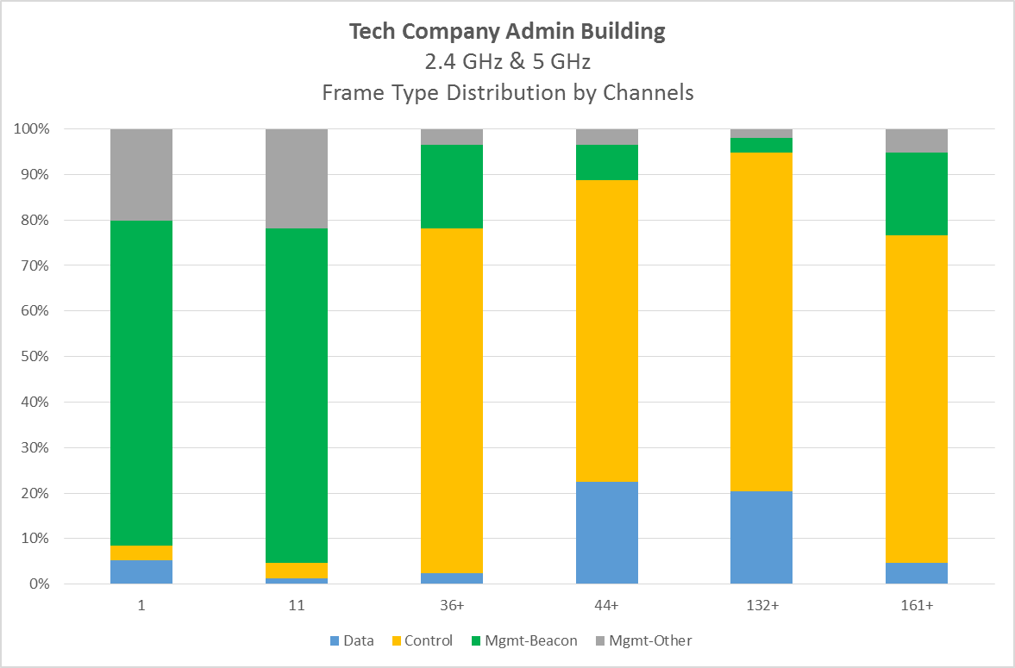
Frame Type Distribution by Channels
Enterprise Office
Very limited data as % of frames. (includes acks)

Slide 6
American NFL Football Game
Date/Time/Duration
  Outdoor stadium
  December, 2015 - 62,797 attendance
  Capture @ 1PM before gates open, @7:40PM middle of 3rd Quarter
  13,700 peak concurrent users, 20,100 unique users
Network Configuration
    VHT20 on 21 5-GHz channels and 3 2.4-GHz channels
    Jumbo frames not enabled
Capture Equipiment
    MacBook Pro Retina (3x3 11ac) – Wireless Diagnostics Tool
    Channels monitored – 1, 11, 36, 52, 100, 108, 149, 165

Slide 7
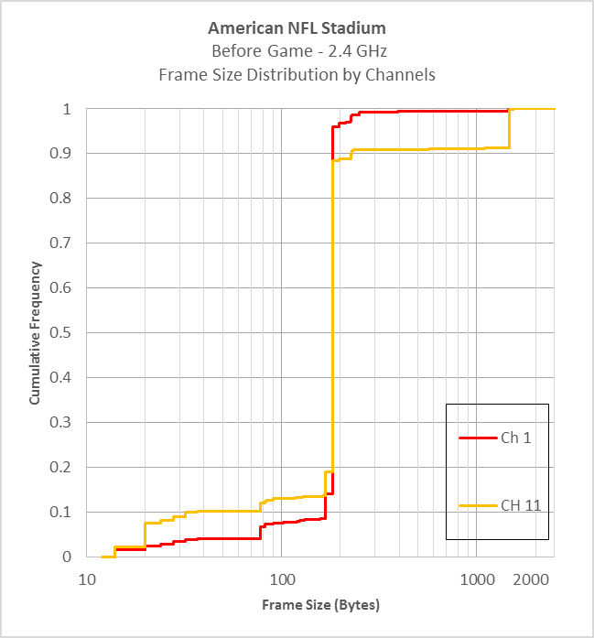
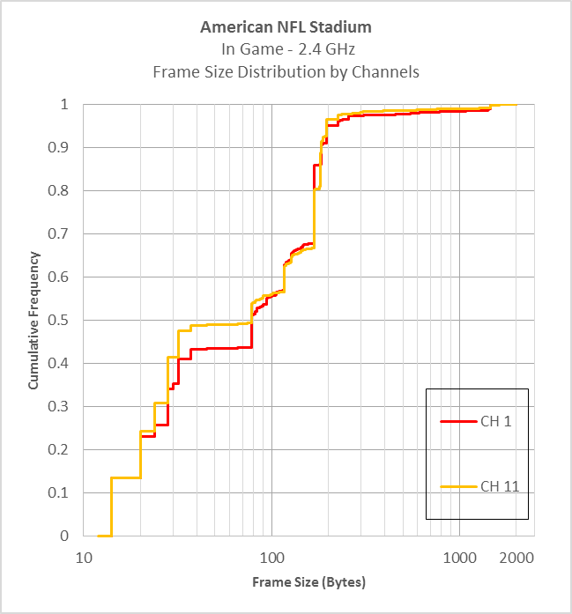
Frame Size Distribution by Channels
2.4-GHz with Stadium Empty & Full
(frame size in logarithmic scale)
Beacon

Slide 8
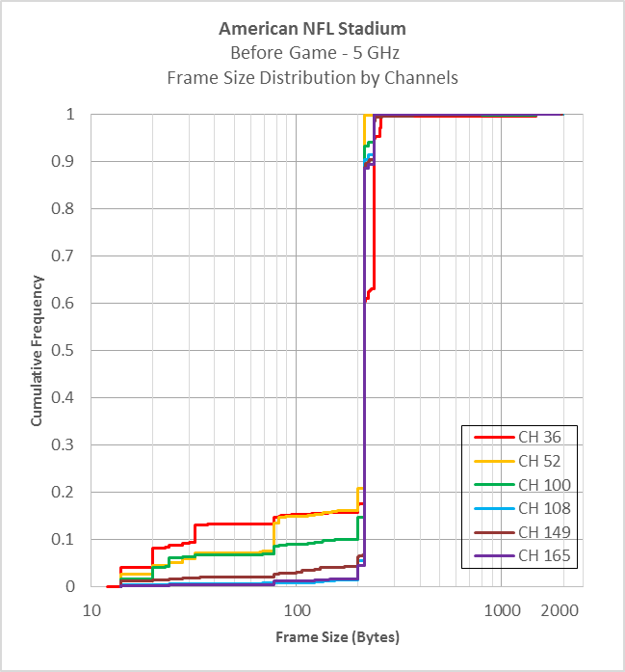
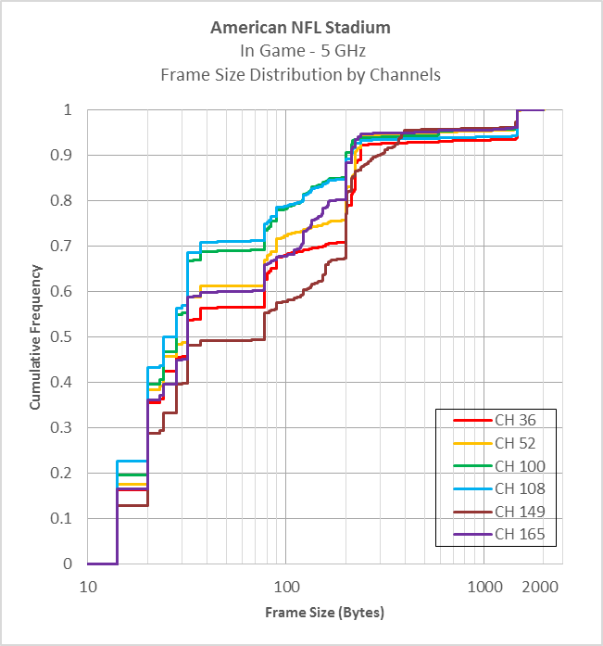
Frame Size Distribution by Channels
5-GHz with Stadium Empty & Full
(frame size in logarithmic scale)
Large payloads
Beacon
Beacon

Slide 9
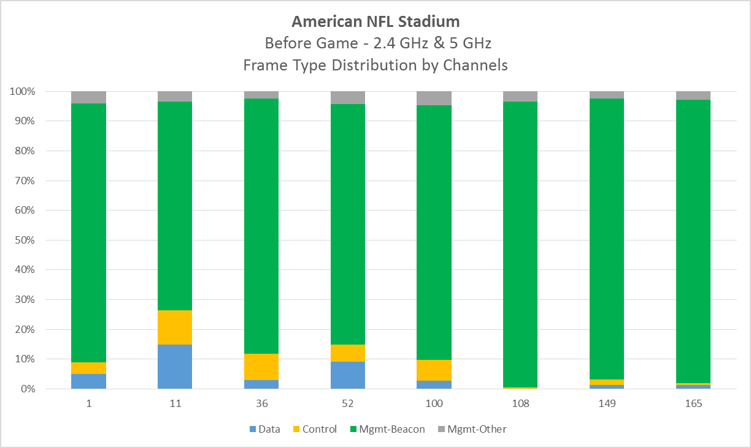
Frame Type Distribution by Channels
Empty stadium
When empty, most traffic is beacons

Slide 10
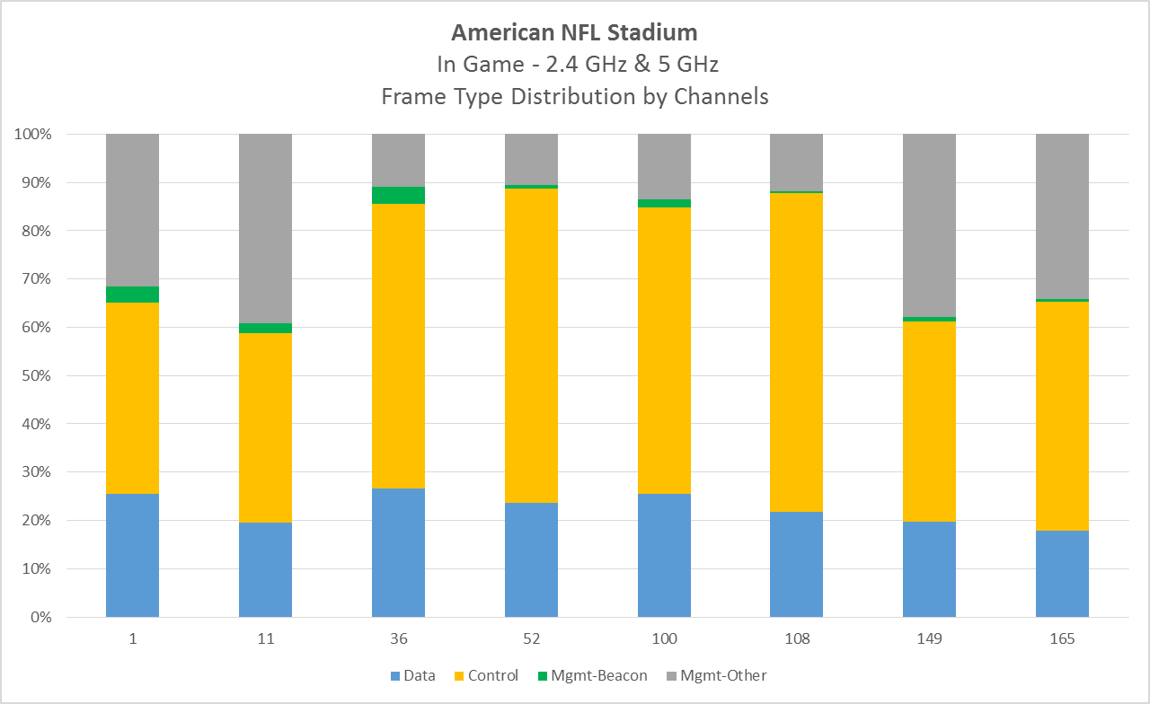
Frame Type Distribution by Channels
In Game
When full, most traffic is control & mgmt
Data is <= 25%

Slide 11
Jan 2015 IEEE Plenary - Atlanta
Date / Time / Duration
  Midweek Plenary
  5G capture – 10m46s
  2.4G capture – 14m50s
Network Configuration
  HT20 on 1, 6, 11
  HT40 on 36+, 44+, 149+, 161-
Capture Equipment
  Windows Laptop, Omnipeek 8.0, NetGear A6210 2x2 11ac USB

Slide 12
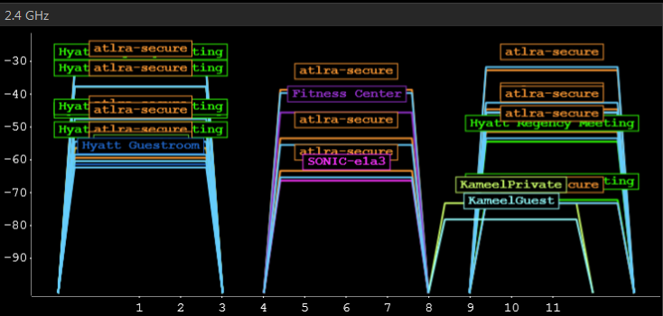
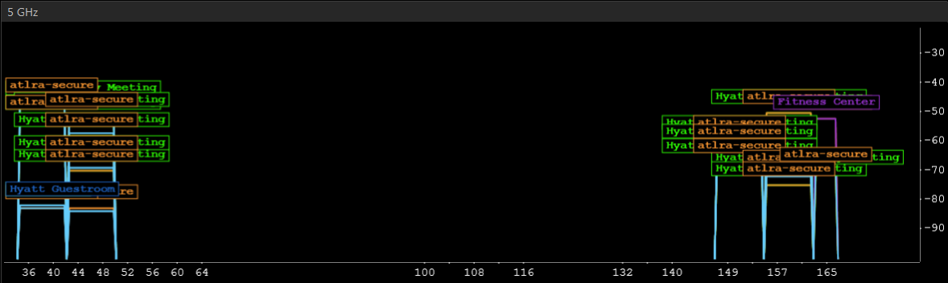
Atlanta Meeting Wi-Fi
SSID “Hyatt Regency Meeting”
2.4-GHz Channels
  1
  6
  11
5-GHz Channels
  36+
  44+
  149+
  161-

Slide 13
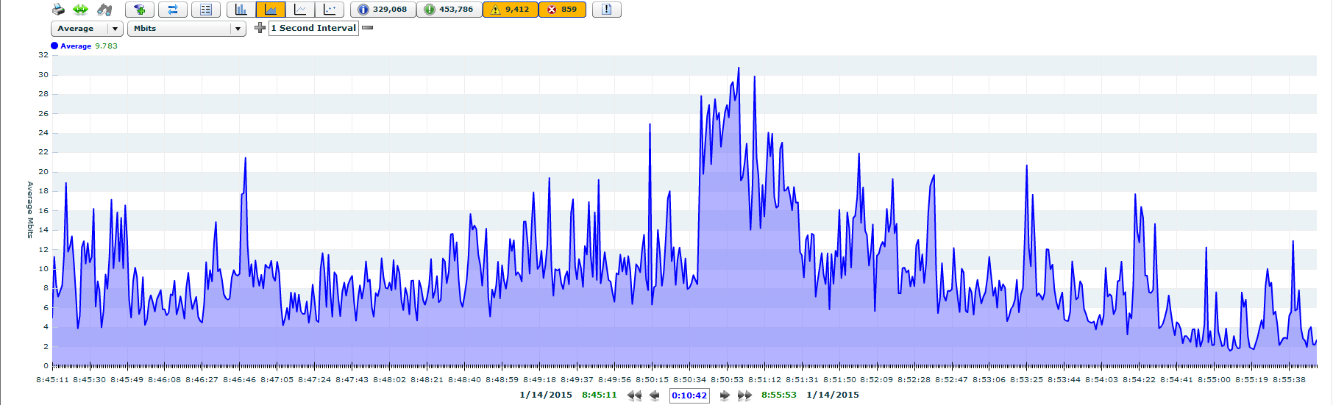
Bandwidth Chart and Device Totals
Day 3 Midweek Plenary – 5 GHz Capture
5G capture = 10m46s
230 users on 5-GHz, 98 users on 2.4-GHz. Total = 328
Headcount = 186. Avg device/person = 328/186 = 1.76
Avg bandwidth on 5G = 9.78Mbps. Peak = 30.7 Mbps

Slide 14
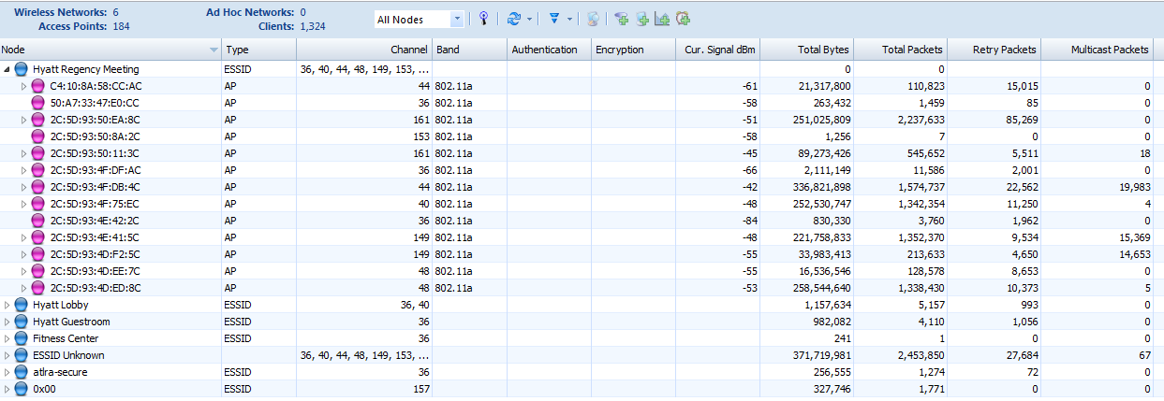
Bytes, Packets, Retries & Multicast Distribution by AP
Day 3 Midweek Plenary – 5 GHz Capture
230 users on 7 BSSIDs. Max=57 / Min=3 / Avg = 32.8

Slide 15
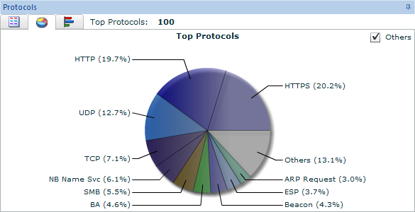
User Traffic Protocol Distribution (All Channels)
Day 3 Midweek Plenary – 5 GHz Capture

Slide 16
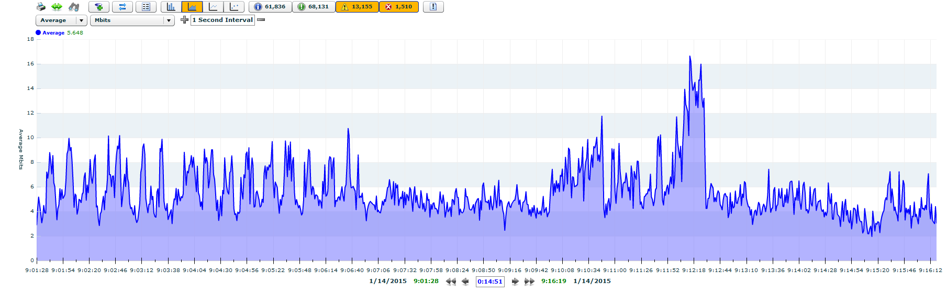
Bandwidth Chart and Device Totals
Day 3 Midweek Plenary –2.4 GHz Capture
Channels 1 / 6 / 11
Avg bandwidth on 5G = 5.6Mbps. Peak = 16.6 Mbps

Slide 17
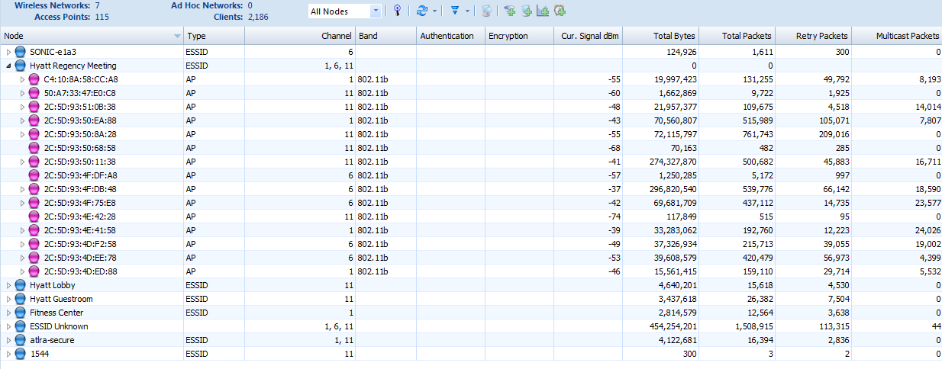
Bytes, Packets, Retries & Multicast Distribution by AP
Day 3 Midweek Plenary – 2.4 GHz Capture
98 users on 10 BSSIDs. Max=19 / Min=2 / Avg= 9.8

Slide 18
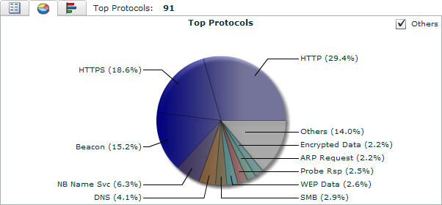
User Traffic Protocol Distribution (All Channels)
Day 3 Midweek Plenary – 2.4 GHz Capture

Slide 19
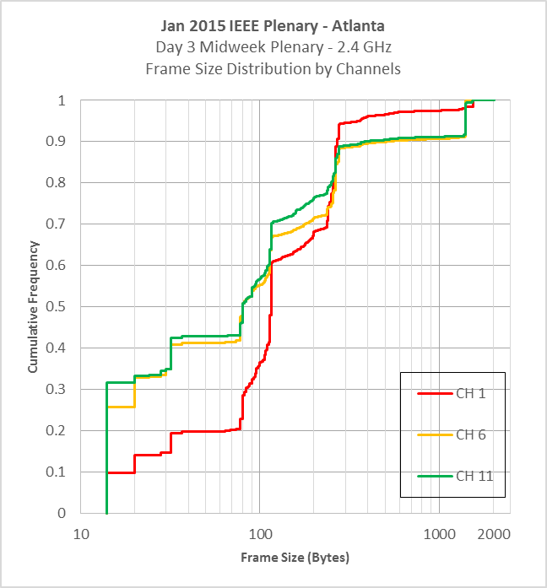
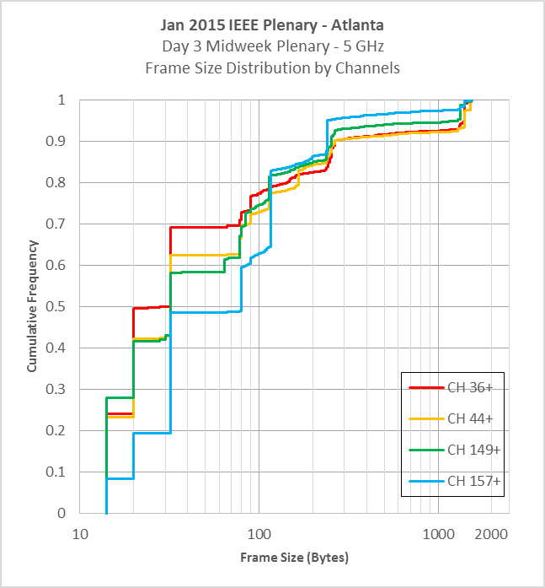
Frame Size Distribution by Channels
Day 3 Midweek Plenary – 2.4 GHz & 5 GHz
(frame size in logarithmic scale)
Large payloads
Beacon
BA
RTS
CTS

Slide 20
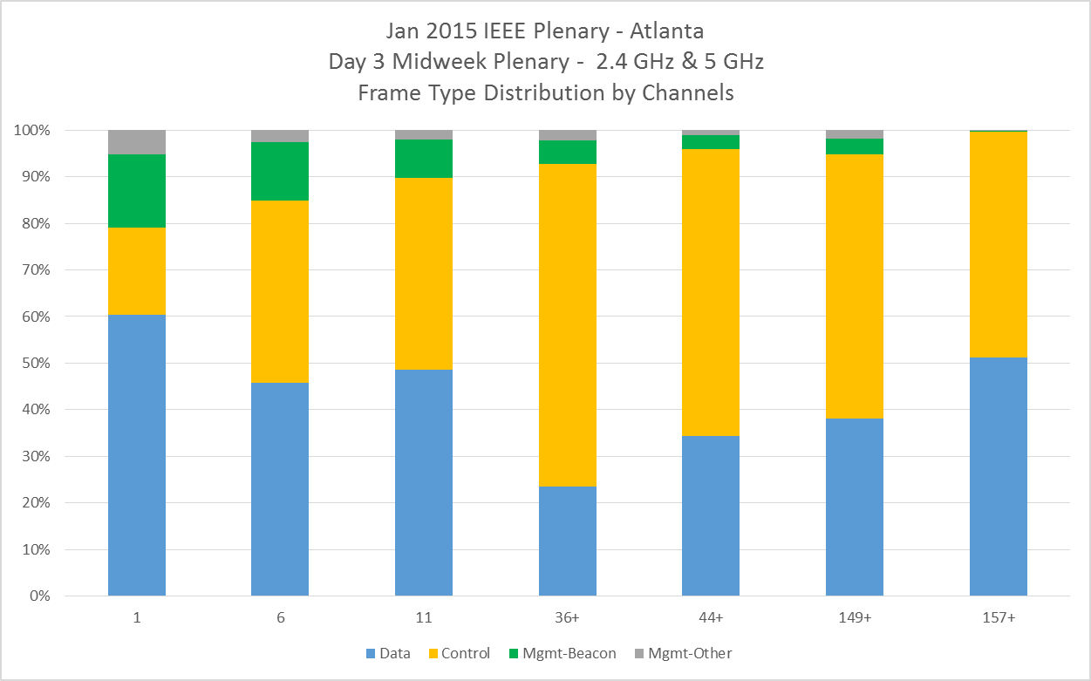
Frame Type Distribution by Channels
Day 3 Midweek Plenary – 2.4 GHz & 5 GHz

Slide 21
Analysis
Bonded channels not warranted for common applications and network usage profiles in high density areas
  Vast majority of airtime (µsec) for TX of A-MPDU is legacy rate control frames
  Limited practical gain for bonded rates during payload portion
Ratio of control & mgmt frames to payload frames is too high. Implies unexploited efficiency gains in MAC given better knowledge of real world client behavior
Emphasis needs to be on smaller channel widths and optimizing for smaller frames
Implies MU setup overhead may be unwarranted relative to potential gain for small frame sizes

Slide 22
References
[1] 13/1438r0, “Traffic Observation and Study on Virtual Desktop Infrastructure”, L Yingpei, P Barber et al (Huawei), Nov 2013
[2] 14/1144r1, “Simplified Traffic Model Based On Aggregated Network Statistics”, W Carney, K Agardh et al (Sony, Ericsson), Sep 2013
[3] 14/1232r1 “On MU Aggreggation Mechanism for 11ax”, R Hedayat Y Kwon et all (Newracom), Sep 2014
[4] 14/546r1, “Packet Traffic Measurements Around Boulder, Colorado”, J Lansford (CSR), May 2014
[5] 14/1223r1, “Stadium Measurements”, B Hart, M Swartz et al (Cisco), Sep 2014
[6] “Anatomy of WiFi Access Traffic of Smartphones and Implications for Energy Saving Techniques”, International Journal of Energy, Information and Communication (IJEIC), 3(1):1-16. February, 2012.
[7] “A First Look at Traffic on Smartphones”, IMC '10 Proceedings of the 10th ACM SIGCOMM conference on Internet measurement

