Slide 1
In Situ Frame Size Measurements
Date: 2015-02-26
Authors:

Slide 2
Abstract
Several contributions to SGhew and TGax [1] [2] [3] [4] and papers in the literature [5][6] have shown that small frames dominate 802.11 traffic for normal use
This contribution adds in situ measurements of an enterprise office, 70K seat stadium, and IEEE Jan Interim meeting in Atlanta
Payload size requirements of 802.11 MAC design to exceed >50% of airtime in a TXOP are dangerously unrealistic.

Slide 3
Tech Company Admin Building
Date/Time/Duration
  300 people work in building. 40 people within 30 meters
  02/11/2015, 30 minutes, Wednesday 03:30 pm – 04:00 pm
Network Configuration
    VHT40 on 36+, 44+, 132+, 161+
    Jumbo frames not enabled
Capture Equipiment
    MacBook Pro Retina (3x3 11ac) – Wireless Diagnostics Tool

Slide 4
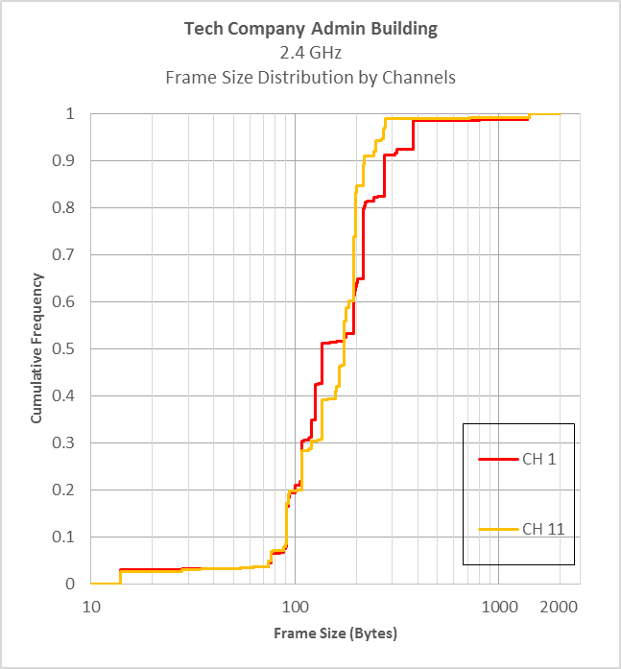
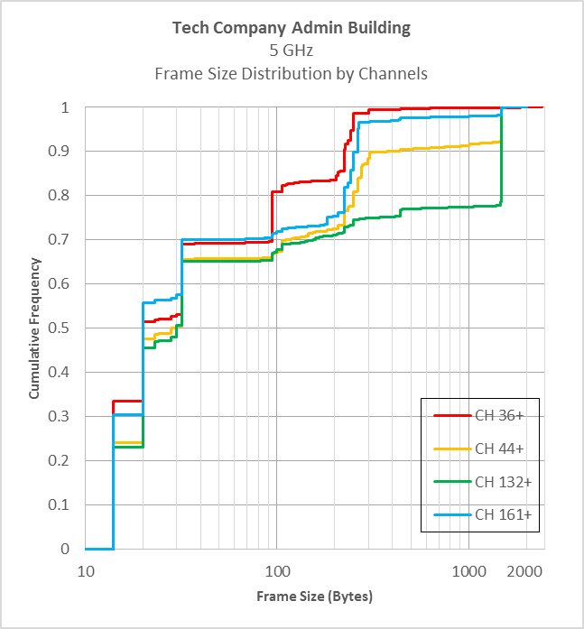
Frame Size Distribution by Channels
Enterprise Office
(frame size in logarithmic scale)

Slide 5
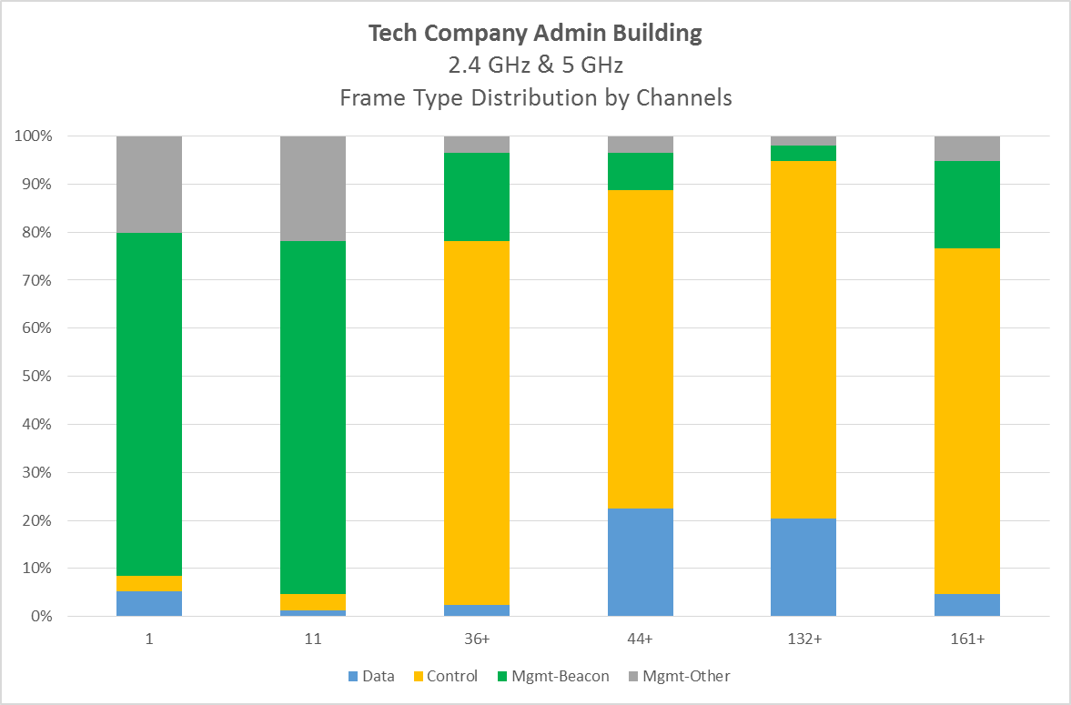
Frame Type Distribution by Channels
Enterprise Office

Slide 6
American NFL Football Game
Date/Time/Duration
  Outdoor stadium, 68.5K
  December, 2015
  Capture @ 1PM before gates open, @7:40PM middle of 3rd Quarter
  13,700 peak concurrent users, 20,100 unique users
Network Configuration
    VHT20 on 36, 52, 100, 108, 149, 165
    Jumbo frames not enabled
Capture Equipiment
    MacBook Pro Retina (3x3 11ac) – Wireless Diagnostics Tool

Slide 7
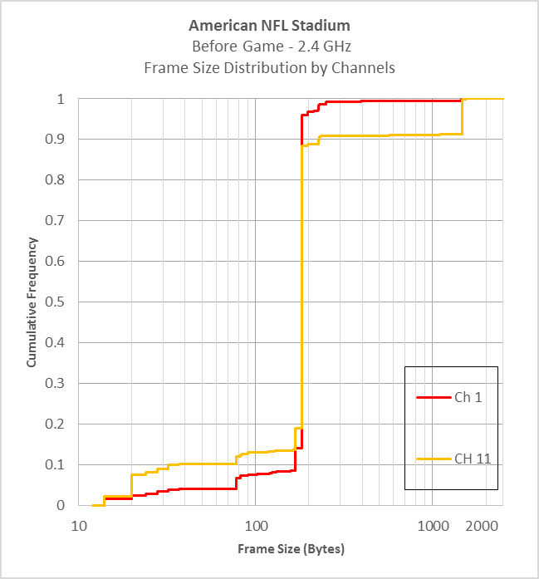
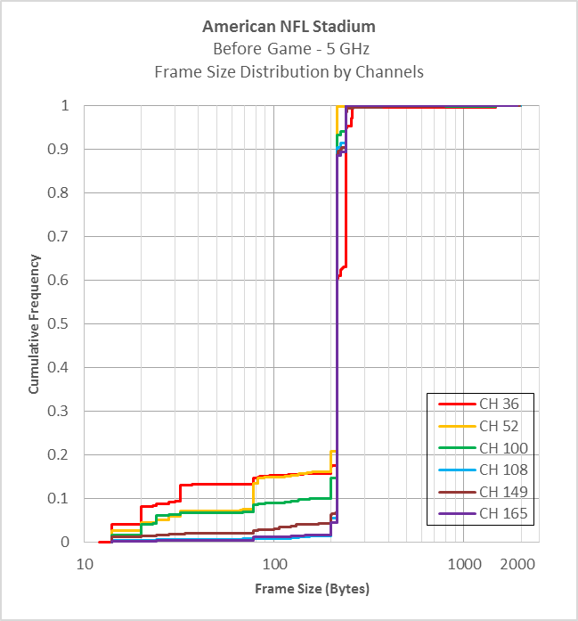
Frame Size Distribution by Channels
Empty Stadium
(frame size in logarithmic scale)

Slide 8
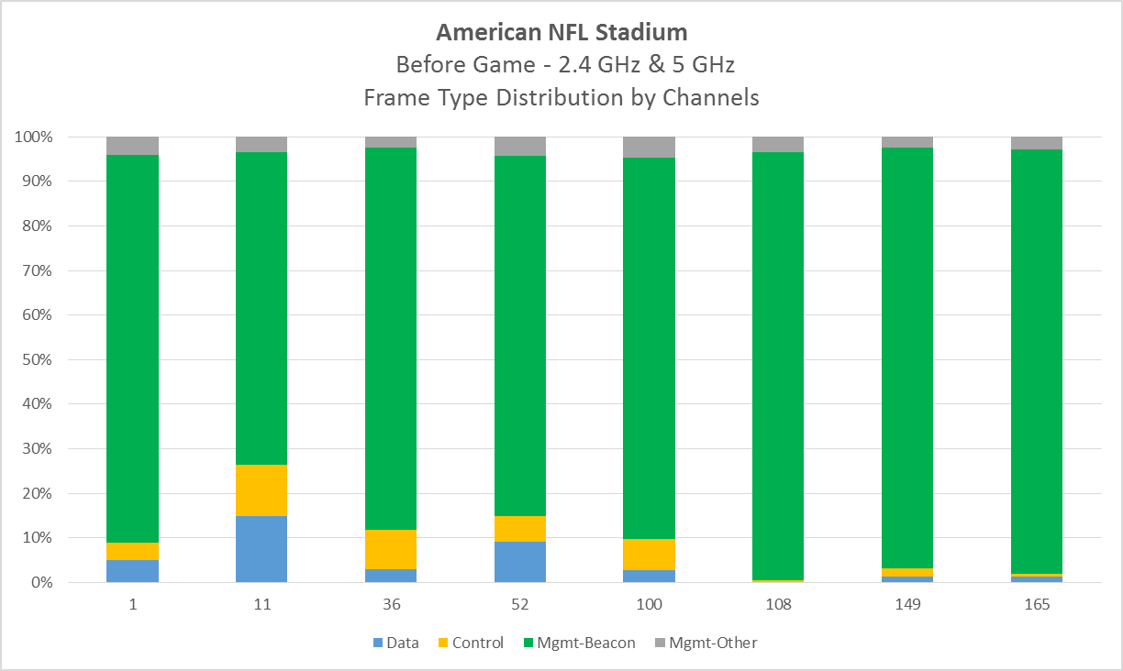
Frame Type Distribution by Channels
Empty stadium

Slide 9
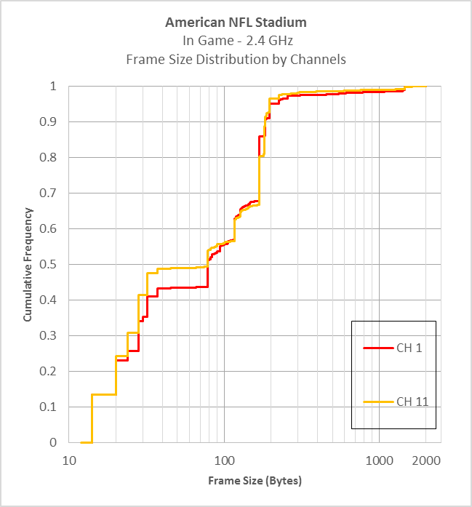
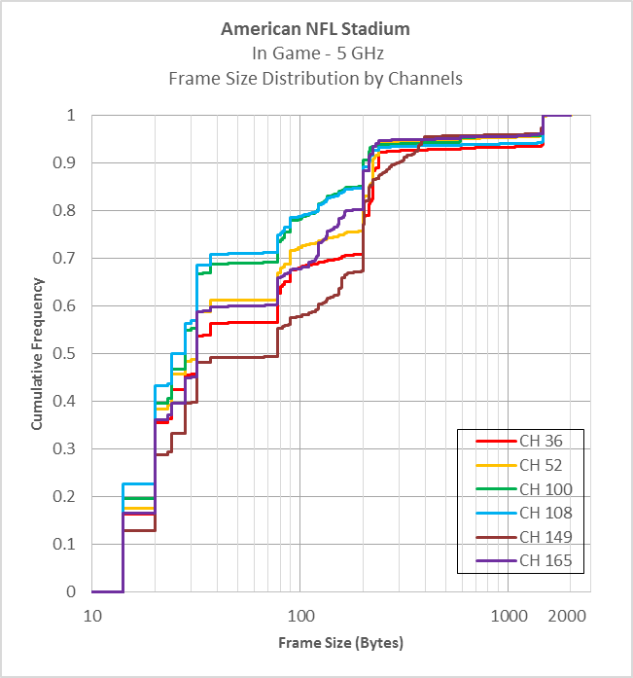
Frame Size Distribution by Channels
In Game
(frame size in logarithmic scale)

Slide 10
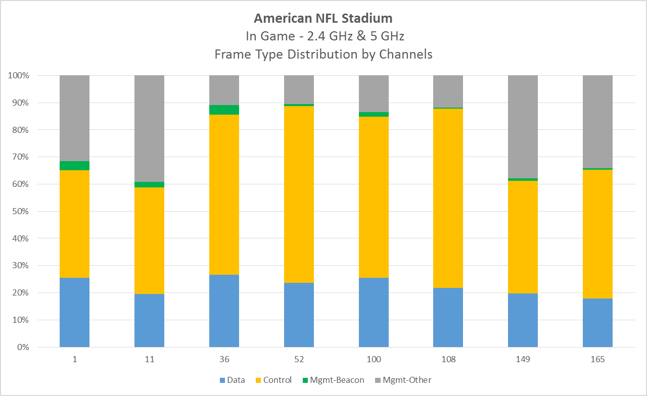
Frame Type Distribution by Channels
In Game

Slide 11
Jan 2015 IEEE Plenary - Atlanta
2 sessions
  TGax Day 1 PM1 – 5-GHz
  Midweek Plenary – 5-GHz & 2.4-GHz
  10 minute captures
Network Configuration
  HT40 on 36+, 44+, 149+, 157+
Capture Equipment
  Windows Laptop, Omnipeek 8.0, NetGear A6210 2x2 11ac USB

Slide 12
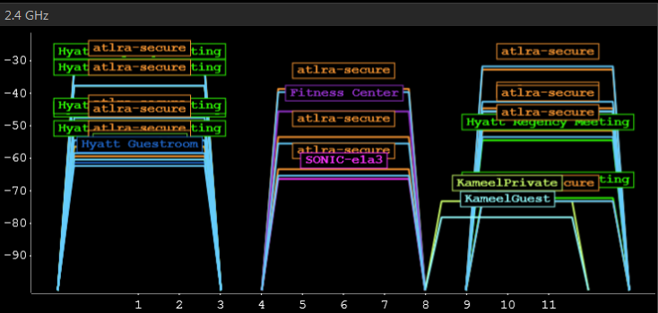
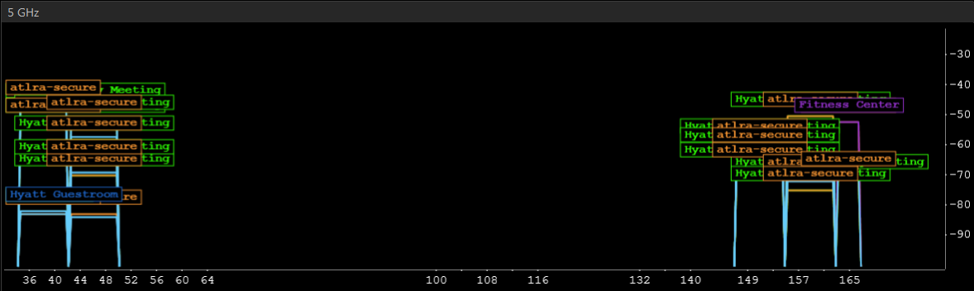
Atlanta Meeting Wi-Fi
SSID “Hyatt Regency Meeting”
2.4-GHz Channels
  1
  11
5-GHz Channels
  36+
  44+
  149+
  157+
  165

Slide 13
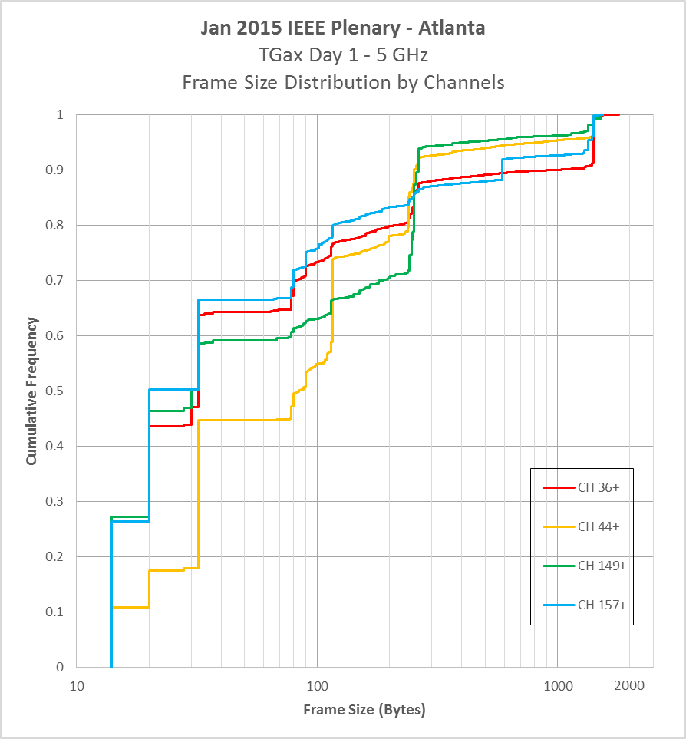
Frame Size Distribution by Channels
TGax Day 1 – 5 GHz
(frame size in logarithmic scale)

Slide 14
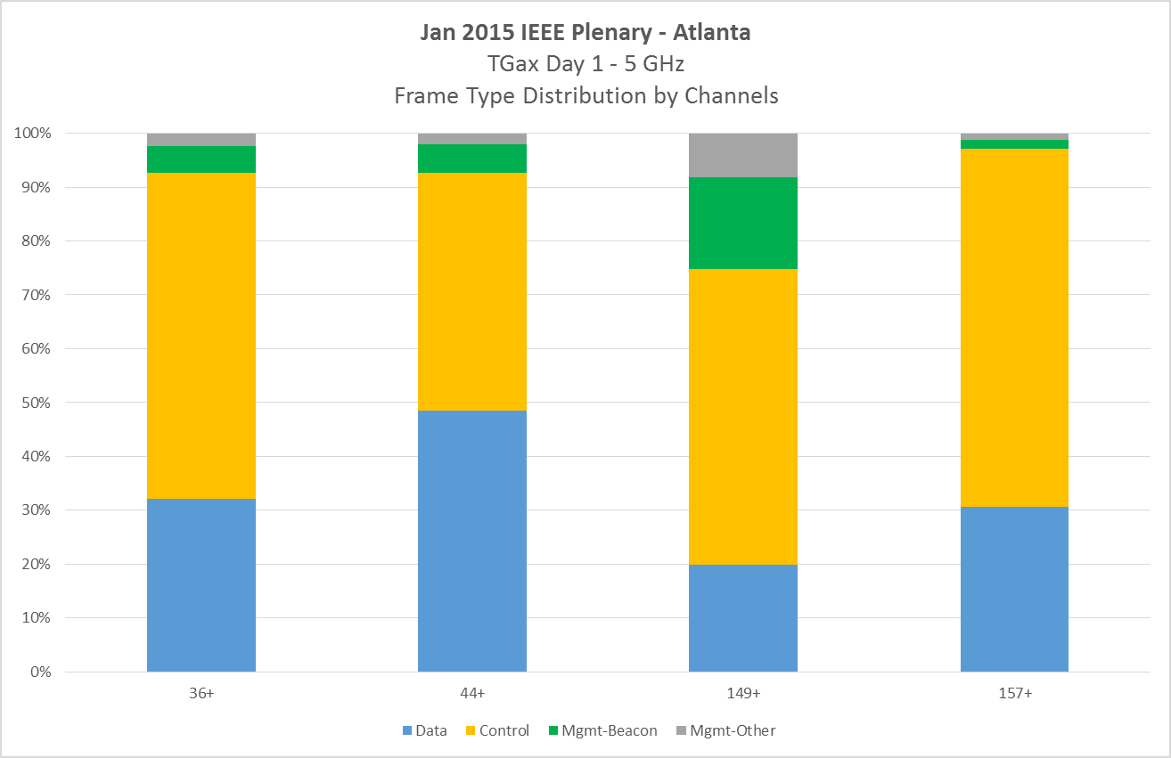
Frame Type Distribution by Channels
TGax Day 1 – 5 GHz

Slide 15
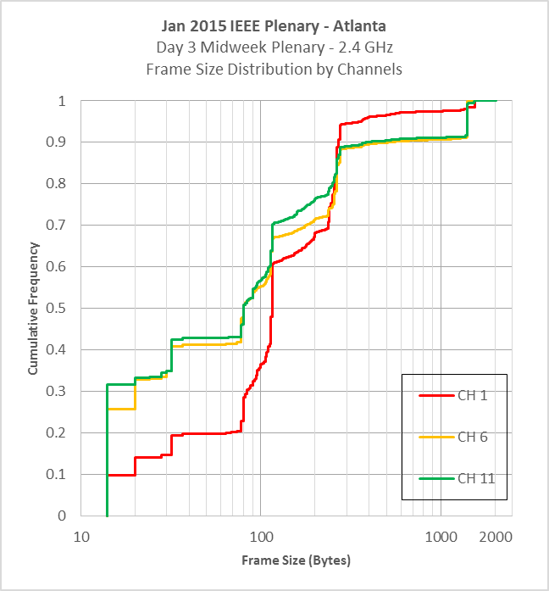
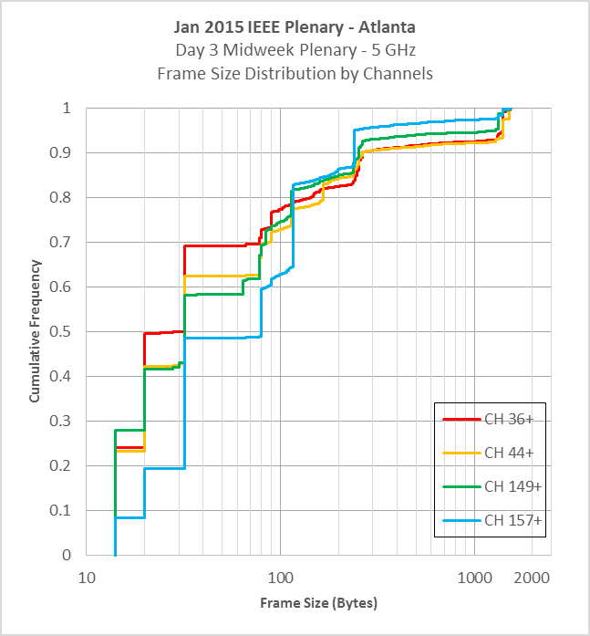
Frame Size Distribution by Channels
Day 3 Midweek Plenary – 2.4 GHz & 5 GHz
(frame size in logarithmic scale)

Slide 16
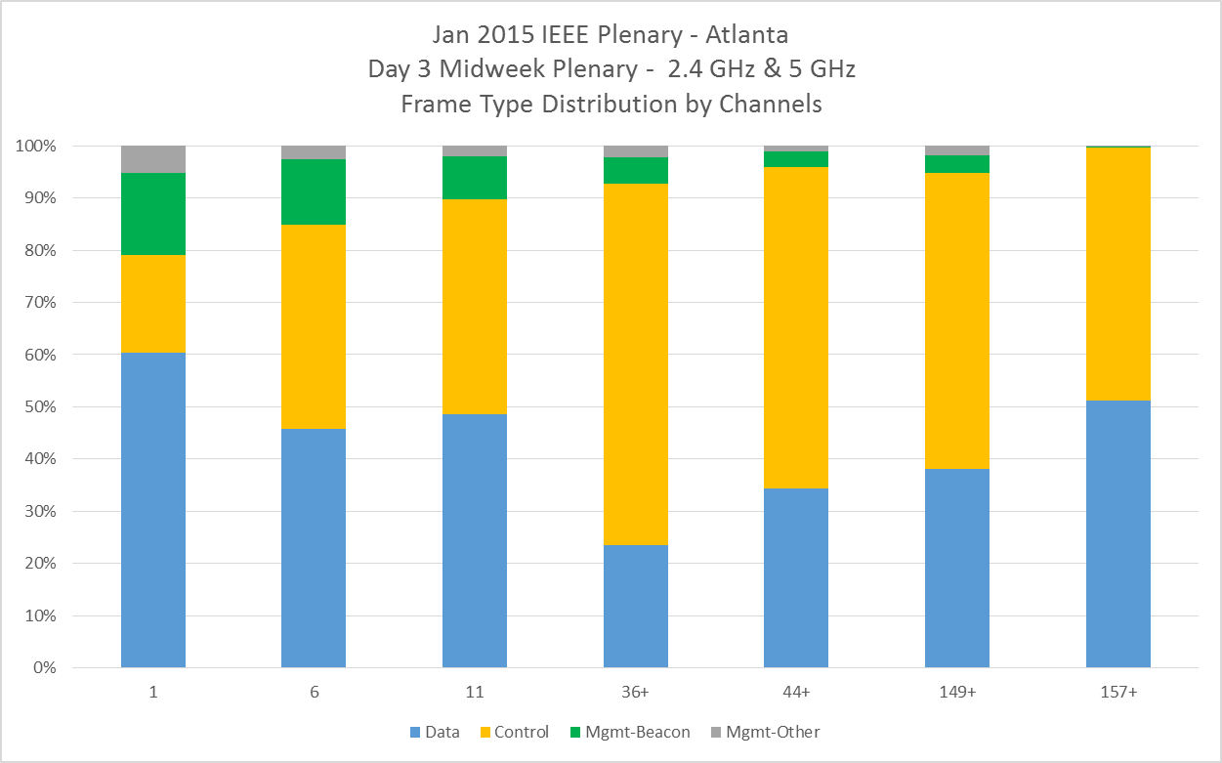
Frame Type Distribution by Channels
Day 3 Midweek Plenary – 2.4 GHz & 5 GHz

Slide 17
References
[1] 13/1438r0, “Traffic Observation and Study on Virtual Desktop Infrastructure”, L Yingpei, P Barber et al (Huawei), Nov 2013
[2] 14/1144r1, “Simplified Traffic Model Based On Aggregated Network Statistics”, W Carney, K Agardh et al (Sony, Ericsson), Sep 2013
[3] 14/1232r1 “On MU Aggreggation Mechanism for 11ax”, R Hedayat Y Kwon et all (Newracom), Sep 2014
[4] 14/546r1, “Packet Traffic Measurements Around Boulder, Colorado”, J Lansford (CSR), May 2014
[5] “Anatomy of WiFi Access Traffic of Smartphones and Implications for Energy Saving Techniques”, International Journal of Energy, Information and Communication (IJEIC), 3(1):1-16. February, 2012.
[6] “A First Look at Traffic on Smartphones”, IMC '10 Proceedings of the 10th ACM SIGCOMM conference on Internet measurement

