Slide 1
MAC Overhead Analysis of MU Transmissions
Date: 2015-03-09
Authors:

Slide 2
Abstract
This contribution presents an analysis of the potential efficiency gains to be had through the use of MU UL transmissions. This analysis provides insight to the systems trade-offs that can be made regarding MU UL overhead, MAC efficiency, number of MU users, and data payload size.

Slide 3
Table of Contents
Introduction
Analysis Methodology
Scenarios Being Considered
Assumptions
Analysis Results
Conclusions

Slide 4
Introduction
UL MU transmission schemes are included in the 11ax SFD.
Some control overhead is needed to allow for UL MU transmissions.
To optimize UL MU performance it is necessary to understand the relationship between the amount of the control overhead, MU transmission efficiency, number of MU users, and data payload size.
This contribution provides some analysis of how these parameters relate to each other.

Slide 5
Analysis Methodology
Determine the maximum allowed duration used for UL MU control frame(s) exchange, Tc, which would result in a throughput gain (G):
$G \left(Targeted Gain\right)=$ $\frac{Throughput_{MU}}{Throughput_{SU}}$
$$Throughput_{MU}=\frac{MU data payload}{MU TXOP duration}=F(\text{Tc})$$
$$Throughput_{SU}=\frac{SU data payload}{SU TXOP duration}$$

Slide 6
Analysis Methodology (Cont.)
UL MU transmissions
MU data payload: # of bits transmitted in $T_{d}^{MU}$ period
MU TXOP duration: $T_{MU}=T_{con}+T_{c}+T_{p}+T_{d}^{MU}+T_{ack}$
SU transmissions
SU data payload: # of bits carried in $T_{d}^{SU}$ period
SU TXOP duration: $T_{SU}=T_{con}+T_{p}+T_{d}^{SU}+T_{ack}$
$$T_{con}$$
$$T_{c}$$
$$T_{p}$$
$$T_{d}^{MU}$$
$$T_{ack}$$
MU UL Control Exchange
Preamble
MU Data
Ack
SIFS
SIFS
$$T_{con}$$
$$T_{p}$$
$$T_{d}^{SU}$$
$$T_{ack}$$
Preamble
SU Data
Ack
SIFS

Slide 7
Formulation of UL MU Control Exchange Duration
In order to achieve throughput gain higher than G, the maximum allowed time duration for UL MU control frame(s) exchange, T_{c}, should satisfy the following equation
If we set G=1, i.e., the throughput of MU is at least the same as SU, then
Notations:
T_{c}: UL MU control exchange duration + SIFS;
T_{con}: contention duration;
T_{p}: preamble duration;
T_{ack}: ACK frame +SIFS;
$T_{d}^{MU}$: MU data transmission time
N_{U}: number of users;
G = Throughput_MU/Throughput_SU
$$T_{c}<\frac{(T_{con}+T_{p}+T_{ack})\left(N_{U}−G\right)}{G}+\frac{(1−G)}{G}T_{d}^{MU}$$
$$T_{c}<(T_{con}+T_{p}+T_{ack})\left(N_{U}−1\right)$$
This is the upper bound of Tc, meaning, if Tc is larger than this, there is no throughput gain for MU over SU.

Slide 8
Scenarios Being Considered
4 STAs with small MPDUs sending UL data by:
SU: sequentially transmitting data MPDUs using 802.11 CSMA
UL MU: concurrently transmitting data MPDUs using OFDMA
8 STAs with small MPDUs sending UL data by:
SU: sequentially transmitting data MPDUs using 802.11 CSMA
UL MU: concurrently transmitting data MPDUs using OFDMA

Slide 9
Assumptions
Assumptions for UL MU transmissions:
OFDMA
All the users have the same data packet size
All the users use the same MCS
Assumptions for SU transmissions:
The data packet size is the same as the UL MU transmission.
The MCS is the same as used in the UL MU transmission.

Slide 10
Assumptions
Notation | Description | Value
T_{con} | Contention duration | 27 µs (3 time slots)
T_{p} | Preamble duration | 48 µs
T_{ack} | Acknowledgement duration | 96 µs (BA+SIFS)¹
N_{U} | # of users | 4 (case 1), 8 (case 2)
T_{sym} | OFDM symbol duration (including CP) | 16 µs
N_{d} | # of data sub carriers | 234
Preamble duration 48us [1]
L-STF | L-LTF | L-SIG | HE-SIG-A | HE-LTF
8µs | 8µs | 4µs | 12µs | 16µs
¹: BA contains 32 Bytes, and always transmitted on 20MHz channel

Slide 11
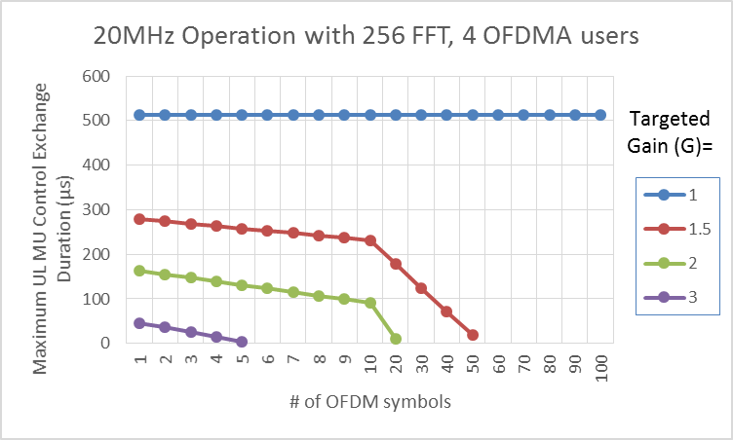
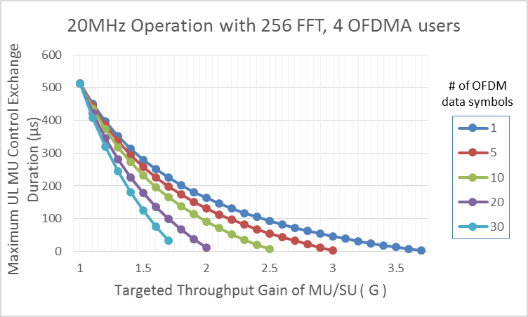
Results – 20MHz Operation with 4 Users
Tc=513 us
Observations:
The gain of UL MU decreases as the data size increases
For data carried by 20 OFDM symbols
To achieve 1.5x UL MU gain, maximum allowed control exchange overhead should be less than 178us

Slide 12
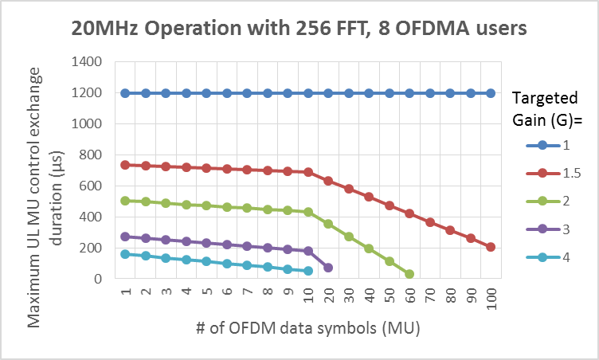
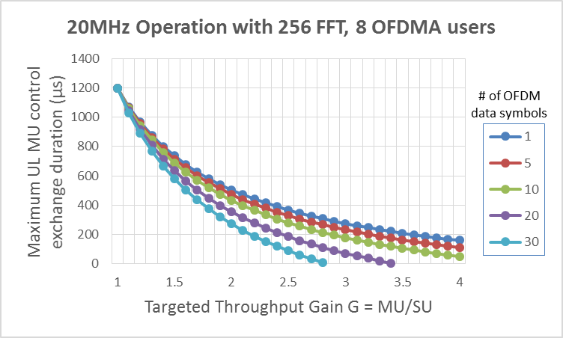
Results – 20MHz Operation with 8 Users
Tc=1197 us
Observations:
The gain of UL MU decreases as the data size increases
UL MU gains are higher compared to 4 user cases
For data carried by 20 OFDM symbols
To achieve 1.5x UL MU gain, maximum allowed control exchange overhead should be less than 633us
To achieve 2.5x UL MU gain, maximum allowed control exchange overhead should be less than 184us

Slide 13
Conclusions
An analysis is presented that provides insight to the systems trade-offs that can be made regarding MU UL overhead, MAC efficiency, number of MU users, and data payload size.
Some observation from analysis results:
The gain of UL MU decreases as the data size increases since overhead decreases iin UL SU transmissions
Significant gain can be achieved for small data packets by using UL OFDMA
This analysis can be used as guidance to the design and evaluation of UL MU transmissions

Slide 14
References
11-15/0099r4, Broadcom, Payload symbol size for 11ax

