Slide 1
OFDMA Numerology and Structure
Date: 2015-05-11
Authors:

Slide 2
Authors (continued)

Slide 3
Authors (continued)

Slide 4
Authors (continued)

Slide 5
Authors (continued)

Slide 6
Authors (continued)

Slide 7
Authors (continued)

Slide 8
Outline
Part-I
  Motivation and background
  Granularity of OFDMA resource units
  Methodology
  The proposed OFDMA resource units
Part-II
  Total usable tones
  The proposed OFDMA structure and units

Slide 9
Motivation and Background
Based on the target use cases for 802.11ax, methods to improve the PHY efficiency such as OFDMA techniques have been proposed [1-3].
  Time and space multiplexing have already been explored, with large number of users in dense network WLAN systems need to explore multiplexing in frequency dimension
  OFDMA can alleviate dense condition by maximizing user frequency selective multiplexing gain
    OFDMA can extract scheduling gains/selection diversity by scheduling users not in outage
    Scheduling is easily done at AP where channel state information is available for MU-MIMO
Contributions to 802.11ax have demonstrated that the existence of short data frames, at a low duty cycle in the network is a major factor for capping overall system throughput because such short packets can not be aggregated, and hence system suffers from MAC inefficiency and larger preamble overhead
  Benefits of use of OFDMA in such scenarios was shown in [4]
The 11ax specification framework has already defined UL and DL OFDMA as one of key 11ax MU features

Slide 10
Discussions on the Granularity of OFDMA
There is a tradeoff in obtaining OFDMA gain with complexity:
  On frequency selective fading channels, smaller resource unit size provides higher gain, but at the expense of larger feedback and signaling overhead
    The size of the smallest resource unit should be selected relative to the channel coherence BW, which is quite small especially for outdoor channels
    The larger the number of users participating in the OFDMA scheduling the higher the gain, but this requires larger scheduling/grouping complexity
It was agreed to use 4x OFDM symbol duration in 11ax [5,6] as follows
  11ax has duration 12.8 us (without CP) based on a 256 FFT in 20 MHz, 512 FFT in 40 MHz, 1024 FFT in 80 MHz/80+80 MHz and 2048 FFT in 160 MHz
  4x symbol duration allows better granularity for OFDMA
    There are more number of tones in a given OFDMA bandwidth

Slide 11
Selection of the Smallest OFDMA Resource Unit
Simulations are performed to evaluate the spectrum efficiency vs. selection of the smallest OFDMA resource unit
  Evaluation assumption is provided in the Appendix-A
It is observed that spectrum efficiency starts to go down from the point of 2.5MHz RU size => The size of the smallest OFDMA resource unit needs to be smaller than 2.5MHz
Indoor channel, 256 FFT
Outdoor channel, 256 FFT
Resource unit (RU) size
Resource unit (RU) size

Slide 12
Methodology (1/2)
Simple design
  Simple for implementation, testing, scheduling and sub-band feedback
  Ability to create a limited number of modes and/or user assignments
Reuse of existing design and hardware blocks of 802.11 alphabets
Consistency
  Consistent tone use for 2.4GHz and 5GHz bands
  Consistent tone use for 20/40BW: easy feedback
    And consistent with 80MHz BW
Good packing efficiency
  Minimize leftover tones as well as proper guard/DC tone setting depending on BWs
  Need to resolve following problems
    Very difficult to get 100% packing efficiency unless the resource unit is very small
    Also inefficient to use only one small unit because number of pilots grows linearly
Commonality between DL and UL resource unit
  Minimize implementation, enabling a soft AP acting by a non-AP STA
  Common design in terms of
    Resource granularity size
    Pilot location and portion within a resource unit
      Pilot tone locations agnostic to BW and specific tone assignments

Slide 13
Methodology (2/2)
Based on the criteria mentioned in the previous slide, the following block sizes are considered
  Reuse 26-tone block as defined in 11ah
    Mainly to support short/medium packets with many users
  Reuse 52-tone or 56-tone blocks from 11a/g or 11n/ac20MHz
  Define a 10MHz block that would be similar to the existing 11n/ac 40MHz
  Reuse 242- tone block as defined in 11ac
Packing efficiency and number of leftover tones are analyzed for variety of combinations of the considered resource units on 20/40 and 80MHz bandwidth
  The next slide proposes an OFDMA resource units that
    maximizes reuse of existing architecture while minimizes leftover tones
    can be extended to 40/80 and 160 MHz

Slide 14
The Proposed Resource Units in 20MHz BW
The proposed resource units have the following sizes
  26-tone with 2 pilots
  52-tone with 4 pilots
  106-tone with 4 pilots
  242-tone with 8 pilots

Slide 15
Discussions on Choice of Resource Units
The following lists the rationales behind the proposed resource units
  The two smallest units of 26-tone and 52-tone have 2 pilots and 4 pilots, respectively, as in current 11ah 1MHz and 11a/g 20MHz with 24 data and 48 data for uniformity
    Why picking 52-tone from 11a/g and not 56-tone from 11n/ac?
      52-tone allows 256 QAM rate 5/6 with BCC while as in 11ac, 256 QAM rate 5/6 cannot be used in 56-tone
      52-tone is a multiple of 26-tone that allows a nice alignment among OFDMA assignments
  The third unit has 102 data plus 4 pilots. It is similar to legacy 11ac 40MHz, with a small change of replacing Ncol=18 with Ncol=17
    Appendix-B shows the results of simulation studies performed to select number of pilots (2 to 6) for the 102-data tone unit
      It can be seen that using only 2 pilot tones can lead to significant SNR losses, the performance with 4-6 pilots is similar with some loss for 3 pilots in certain cases
  The fourth unit of 242-tone is as in 11ac 80MHz with 8 pilot tones
  There are reasonable number of pilots in each units

Slide 16
Outline
Part-I
  Motivation and background
  Granularity of OFDMA resource units
  Methodology
  The proposed OFDMA resource units
Part-II
  Total usable tones
  The proposed OFDMA structure and units

Slide 17
Number of Nulls at DC (1/2)
In 5GHz, 40ppm CFO spans ~3 tones on the left/right of DC
  Mainly 80/160MHz operation, as well as 40 and 20MHz operation
In 2.4GHz, 40ppm CFO spans 1 tone on the left/right of DC
  Mainly 20MHz operation
  To avoid DC, ideally we need at least 7 nulls in 5GHz, and at least 3 nulls in 2.4GHz
DL OFDMA
  Rx LO Leakage + CFO is the major concern
UL OFDMA
  In UL OFDMA, the assumption is that STAs are required to synchronize the carrier frequency to the AP
    If carrier frequency compensation is done in digital domain, then Tx carrier leakage (Tx DC) of each UL OFDMA transmission may not be at the center of the transmitted OFDMA waveform, potentially interfering with data tones.
  In Uplink, carrier leaks from the received signals cannot be calibrated out by the AP receiver
    Unknown frequencies, unknown magnitude
  Impact could be more severe than Rx DC in DL OFDMA, especially for narrow bandwidth OFDMA assignments near DC

Slide 18
Number of Nulls at DC (2/2)
  The impact of insufficient DC nulls depends on the bandwidth of resource units
    For wideband resource unit (like SU 20MHz), tone erasure of 1 or 2 tones cause negligible performance degradation (see Appendix-C)
    For small resource units like 26 tones, the degradation from insufficient DC nulls becomes significant (see Appendix-D)
For 20MHz and 80MHz OFDMA tone plan (discussed in the following slides)
  There is a straddling DC 26-tone allocation that is vulnerable to DC offset
  There are also some leftover tones which can be assigned around DC to provide better protection for the center 26-tone allocation
The proposed number of Nulls at DC
  For 20MHz, non-OFDMA has 3 DC nulls. OFDMA has 7 DC nulls to protect the central 26-tone allocation
  For 40MHz, 5 DC nulls
    There is no center 26-tone allocation
  For 80MHz, OFDMA has 7 DC nulls and non-OFDMA has 5 DC nulls
    There is a center 26-tone allocation in OFDMA tone plan

Slide 19
Number of Guard Tones
The payload design of 4x Symbol 20MHz is exactly 11ac 80 MHz down-clocked by 4, meaning (6,5) guard tones, 3 DC nulls, payload 234 data, 8 pilots (for the case where each user occupies the entire BW, DL/UL SU/MU-MIMO)
  Spectral mask is 11ac 80MHz mask down-clocked by 4
For 4x Symbol 40MHz bandwidth, the spectral mask is based on 11ac 80MHz mask down-clocked by 2, but with (12,11) guard tones
  Note that we replaced (6,5)x2 with (12,11) for better symmetry in tone assignment
For 4x Symbol 80MHz bandwidth, the spectral mask is based on 11ac 160MHz mask down-clocked by 2, but with (12,11) guard tones

Slide 20
Summary of NON-OFDMA Usable Tones
 | 2.4 GHz / 5GHz |  | 5GHz
 | 20MHz | 40 MHz | 80 MHz | 160 MHz/ 80MHz+80MHz
FFT size | 256 | 512 | 1024 | 2x1024
Edge | (6,5) | (12,11) | (12,11) | (12,11)
Usable tones | 242 | 484 | 996 | 2x996
DC Nulls
  For 20MHz, non-OFDMA has 3 DC nulls
  For 40MHz, 5 DC nulls
  For 80MHz, non-OFDMA has 5 DC nulls
80MHz non-OFDMA tone plan
  To maximize tone efficiency, non-OFDMA tone plan (SU and MU-MIMO) uses 996 with 5 DC tones
160MHz consists of two 80MHz tone plans

Slide 21
Summary of Total Number of OFDMA Usable Tones
 | 2.4 GHz / 5GHz |  | 5GHz
 | 20MHz | 40 MHz | 80 MHz | 160 MHz/ 80MHz+80MHz
FFT size | 256 | 512 | 1024 | 2x1024
Edge | (6,5) | (12,11) | (12,11) | (12,11)
Usable tones | Max 238 | 484 | 994 | max 2x996
DC Nulls
  For 20MHz, OFDMA has 7 DC nulls.
    Appendix-D shows simulation results for the need of 7 DC nulls
  For 40MHz, 5 DC nulls
  For 80MHz, OFDMA has 7 DC nulls.
160MHz OFDMA tone plan
  Two replicas of 80MHz tone plans
    996-tone (non-OFDMA tone plan in 80MHz) is used as a resource unit in 160MHz.
    Combinations of 996+994, 994+996, and 994+ 994 are valid for 160MHz.

Slide 22
Analysis on location of resource units (1/3)
We check if “moving location” for units can further improve Sub-band Selective Transmission (SST) gain by providing more available positions than “fixed position”
Note that to help with visualizing the analysis, we have illustrated 106-tone block as 4 units of 26-tone in the pictures below
Possible assignments (e.g.)
<Two 106-tone units assigned>
106
K (assignments) | 1x26 | 2x26 | 106 | Further improve SST gain by moving location
3 | 1 | 0 | 2 | Have improvement for the 1x26 unit (one position => multiple positions available) Not much improvement for 106 (max a 26 tone shift ) units
Fixed
26
26
26
26
26
26
26
26
26
Moving
26
26
26
26
26
26
26
26
26
26
26
26
26
26
26
26
26
26
* Leftover tones are not addressed here
<One 102+P unit assigned>
K | 1x26 | 2x26 | 106 | Further improve SST gain by moving location
4 | 1 | 2 | 1 | Have improvement for the 1x26 unit Not much improvement for other units
26
26
26
26
26
26
26
26
26
Fixed
26
26
26
26
26
26
26
26
26
Moving
26
26
26
26
26
26
26
26
26
* K = 5 with [1x26, 2x26, 106] = [3, 1, 1]
=> better than above for the 1x26 unit(3) in the fixed location
26
26
26
26
26
26
26
26
26

Slide 23
Analysis on location of resource units (2/3)
<No 106 unit assigned>
Possible assignments (e.g.)
K | 1x26 | 2x26 | 106 | Further improve SST gain by moving location
5 | 1 | 4 | 0 | Have improvement for the 1x26 unit Not much improvement for 2x26 (max a 26 tone shift for having four 2x26s) units
Fixed
26
26
26
26
26
26
26
26
26
Moving
26
26
26
26
26
26
26
26
26
K | 1x26 | 2x26 | 106 | Further improve SST gain by moving location
6 | 3 | 3 | 0 | Not much improvement because of being able to have enough number of units even with fixed location
26
26
26
26
26
26
26
26
26
Fixed
26
26
26
26
26
26
26
26
26
* Similar trend with
K = 6 with [1x26, 2x26, 106] = [5, 0, 1]
K = 7 with [1x26, 2x26, 106] = [5, 2, 0]
K = 8 with [1x26, 2x26, 106] = [7, 1, 0]
<Only 1x26 unit assigned>
K | 1x26 | 2x26 | 106 | Further improve SST gain by moving location
9 | 9 | 0 | 0 | No gain (already able to select any 26 unit in different positions)
Fixed
26
26
26
26
26
26
26
26
26

Slide 24
Analysis on location of resource units (3/3)
In previous slides on checking SST gain, following is shown
  As the number of assignments is small (requiring relatively large size of units) and a few small unit (like one 1x26) coexists with large size of units, it tends to have an opportunity to improve SST gain of the small unit by moving location while the SST gain for large unit (>26 tone) does not change much from fixed locations
  But, different location of units depending on assignment would cause increase of signaling (indicate multiple combinations of position per assignment case)
OFDMA is a technique to maximize user multiplexing gain
  Good to multiplex as many users as possible
  Good to multiplex traffic of similar sizes
    For efficiency of padding, decoding time, etc.
  The analysis showed that SST gain was limited for the case that only one 26-tone unit is assigned in the center
    Given that target 11ax use cases have many users to schedule, the case of scheduling only one 26-tone in the center is an unlikely event.
      SST gain also drops with multiple Tx and/or Rx antennas
    The assumption is that the scheduler would assign units smartly to maximize OFDMA gain, and hence fixing the position of resource units is preferred
      Reduced signaling overhead and complexity

Slide 25
The Proposed OFDMA Structure
OFDMA resource units are
  (1,2)x26-tone each with 2 pilots
  106-tone with 4 pilots
  (1,2)x242-tone each with 8 pilots
  996-tone with 16 pilots
The 20 MHz OFDMA structure uses the 26-tone, 52-tone and 106-tone at fixed positions, and the non-OFDMA 242-tone
The 40 MHz OFDMA structure is two replicas of 20MHz structure, and has the addition of non-OFDMA 2x242-tone
  Reuse of 11ac 160MHz
The 80MHz OFDMA structure is two replicas of 40MHz plus one central 26-tone, and has the addition of non-OFDMA 996-tone
The 160MHz OFDMA structure is two replicas of 80MHz
  996-tone is defined to be a resource unit for this bandwidth of operation

Slide 26
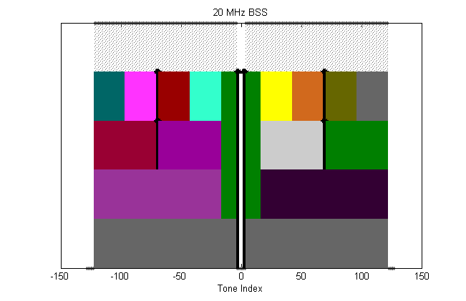
20 MHz BSS: Example 1
Leftover/null subcarriers are illustrated by black arrows:
  Exact location of leftover tones is open for discussions
Usable tones
26 tone RUs
52 tone RUs + one 26-tone
106 tone RUs+ one 26-tone
242 tone RU
(242 non-OFDMA)

Slide 27

20 MHz BSS: Example 2
Two null subcarriers are located at band edges:
  Exact location of leftover tones is open for discussions
Usable tones
26 tone RUs
52 tone RUs + one 26-tone
106 data RUs + one 26-tone
242 tone RU
(242 non-OFDMA)

Slide 28
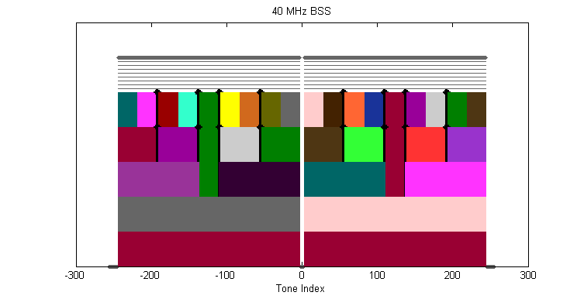
40 MHz BSS
Duplicated 20MHz assignment
In case of 52-tone and 106-tone resource units, there are additional 26-tone units that each is located in the middle
Usable tones
26 tone RUs
52 tone and 26-tone RUs
106 tone RUs + 26-tone RUs
242 tone RU
2x242 tone RU
(484 non-OFDMA)

Slide 29
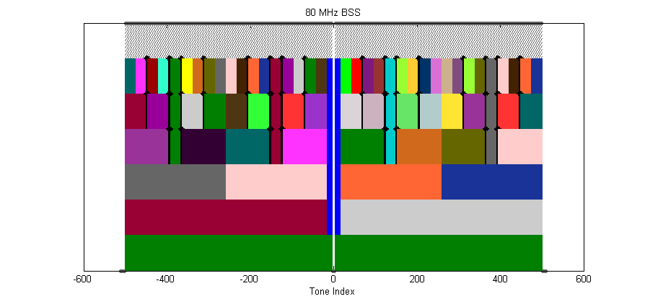
80 MHz BSS
Duplication of 40MHz + one 26 central
The OFDMA assignment of resource units to different users are completely aligned with 242-boundary
Usable tones
26 tone RUs
52 tone RUs and 26-tone
106 tone RUs + 52 tone RUs and 26-tone
242 tone RUs and 26-tone
2x242 tone RU and 26-tone
Non-OFDMA
996 tone

Slide 30
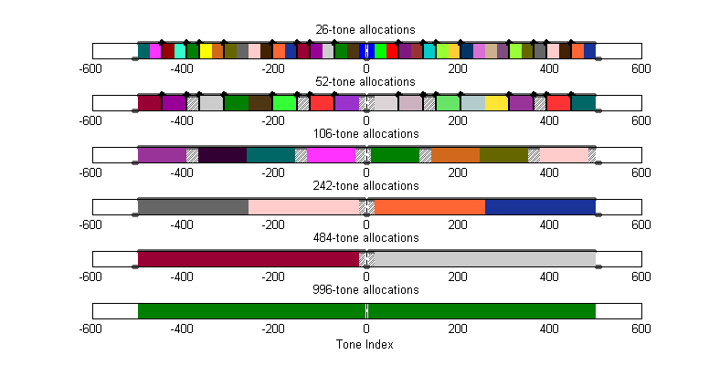
Fixed Position of Building Blocks
The proposed resource units are at fixed positions (as shown below)
  RUs are building blocks for the scheduler to assign them to different users

Slide 31
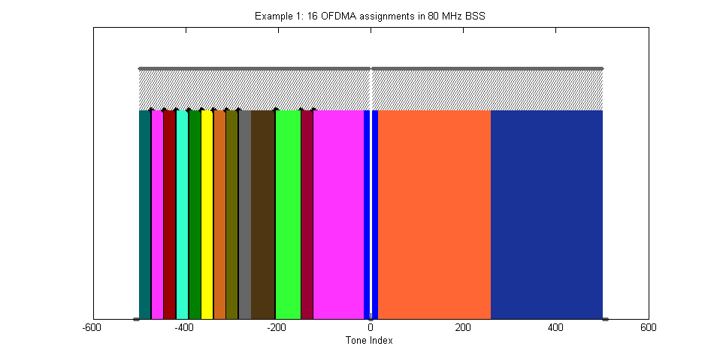
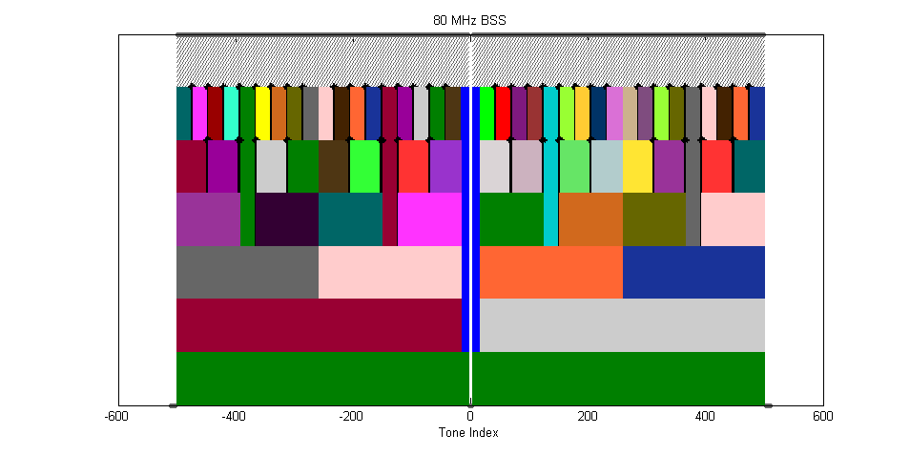
Example 1: 16 OFDMA assignments in 80MHz BSS
The proposed resource units at fixed positions are used as building blocks for the scheduler to assign them to different users

Slide 32
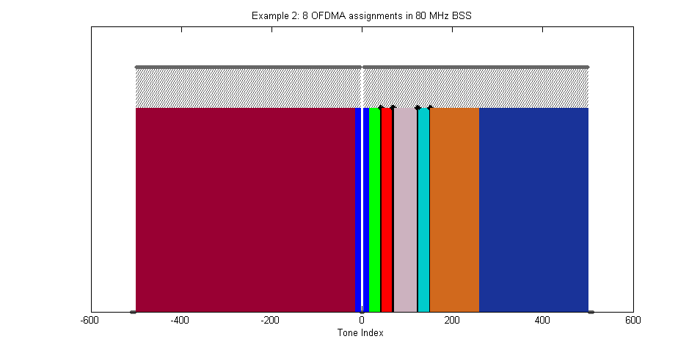
Example 2: 8 OFDMA assignments in 80MHz BSS
The proposed resource units at fixed positions are used as building blocks for the scheduler to assign them to different users

Slide 33
New Terminology
In previous slides, “non-OFDMA” was used to indicate a case where OFDMA is not used. This was meant to refer to a case where the entire bandwidth of operation is scheduled for a single access (SA) or multi-user MIMO. To be accurate, the following terminology are defined:
HE-MA-PPDU = OFDMA tone plan (or MA tone plan)
HE-SA-PPDU = non-OFDMA tone plan (or SA tone plan)
HE-MA-MU-PPDU = OFDMA + MU-MIMO
HE-SA-MU-PPDU = non-OFDMA tone plan + MU-MIMO
The term “OFDMA PPDU” means HE-MA-PPDU or HE-MA-MU-PPDU
  the “potential” case where MU-MIMO is being done on part of the PPDU BW

Slide 34
Straw Poll #1
Do you agree to add the following in 11ax SFD?
The tone structure of the Data field of the HE PPDU is as follows:
(6,5) guard tones and 3 DC tones for a 20MHz HE-SA-PPDU or HE-SA-MU-PPDU
(6,5) guard tones and 7 DC tones for 20MHz OFDMA PPDU
(12,11) guard tones and 5 DC tones for a 40MHz HE-SA-PPDU or HE-SA-MU-PPDU
(12,11) guard tones and 5 DC tones for a 40MHz OFDMA PPDU
(12,11) guard tones and 5 DC tones for an 80MHz HE-SA-PPDU or HE-SA-MU-PPDU
(12,11) guard tones and 7 DC tones for an 80MHz OFDMA PPDU
  This means a total of 994 = (484+26+484) usable tones for an 80 MHz OFDMA PPDU
Yes
No
Abstain

Slide 35
Straw Poll #2
Do you agree to define 20MHz, 40 MHz, 80MHz, and 160MHz OFDMA building blocks as follows
26-tone, 52-tone and 106-tone as defined in slide #25, and at fixed positions as shown in slides #26 (or 27), #28 and #29
  An OFDMA PPDU can carry a mix of different tone unit sizes within each 242 tone unit boundary
242-tone as defined in slide #25, and at fixed positions as shown in slides #28 and #29
484-tone as defined in slide #25, and at fixed positions as shown in slide #29
996-tone as defined in slide #25 for 160MHz OFDMA (note that 996-tone is defined for 80MHz HE-SA-PPDU or 80MHz HE-SA-MU-PPDU)
Note that 40MHz OFDMA is two replicas of 20MHz, 80MHz OFDMA is two replicas of 40MHz plus one central 26-tone, and 160MHz OFDMA is two replicas of 80MHz tone plan (OFDMA or non-OFDMA).
The following is TBD:
Exact location of extra four leftover tones within a 242 unit
Yes
No
Abstain

Slide 36
References
[1] 11-14-0858-01-00ax-analysis-on-frequency-sensitive-multiplexing-in-wlan-systems.pptx
[2] 11-14-1227-02-00ax-ofdma-performance-analysis.pptx
[3] 11-14-1452-00-00ax-frequency-selective-scheduling-in-ofdma.pptx
[4] 11-14-0855-00-00ax-techniques-for-short-downlink-frames.pptx
[5] 11-15-0099-03-00ax-payload-symbol-size-for-11ax.pptx
[6] 11-15-0132-02-00ax-spec-framework.docx

Slide 37
Appendix-A: Evaluation assumptions (1/2)
Evaluation setting
  Average spectrum efficiency(SE) is used
  100 STAs with same large scale fading (10dB SNR)
  256 subcarriers for 20MHz system BW
  Did not consider guard and pilot subcarrier for simplicity
  Resource Unit (RU) sizes of 1/2/4/8/16/32/64/128/256 subcarriers are compared
  DL Scheduler to maximize SE for each RU

Slide 38
Appendix-A: Evaluation assumptions (2/2)
Formulation on DL scheduler
  Calculate the post-detection SINR on each OFDM subcarrier (j) considering the receiver algorithm.
  Calculate the effective SINR ( ) , using the following equation (RBIR-based)
  Reference the AWGN link performance curves of different MCSs to obtain the mapping between effective SINR and PER
  Obtain each STA’s max rate
  Obtain each RU’s max rate
  Obtain SE for different RU

Slide 39
Appendix-B: Simulation studies for number of pilots for 102-data-tone unit (1/3)
Simulation setup
256 FFT in 20 MHz, 1000 bytes
Number of Pilots: 2,3,4,5,6
  6 pilots: Data tones = [16:122], pilots = [31,46,61,76,91,107]
  5 pilots: Data tones = [17:122], pilots = [34,51,69,87,104]
  4 pilots: Data tones = [18:122], pilots = [38,59,80,101]
  3 pilots: Data tones = [19:122], pilots = [44,70,96]
  2 pilots: Data tones = [20:122], pilots = [53,88]
Tone amplitude: assumes all 242 tones are loaded → each tone has amplitude = √256/242
Channels: 11nD, UMi-NLoS
SIG-A symbol and HE-LTF are considered: to ensure that payload performance curves are accurate (enough pilots + phase tracking)
Channel estimation, timing, CFO estimation, phase tracking: all real. Phase noise added
Channel estimation: smoothing done
Phase tracking: based on the pilots (and data aided tracking for MCS0)

Slide 40
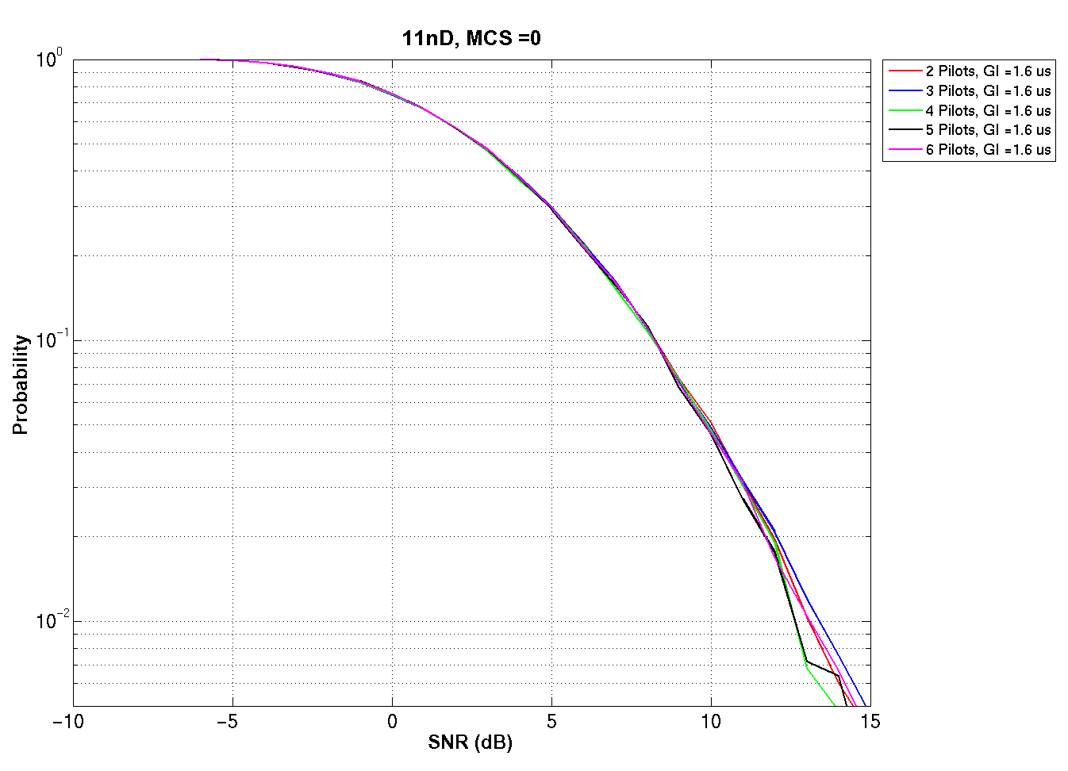
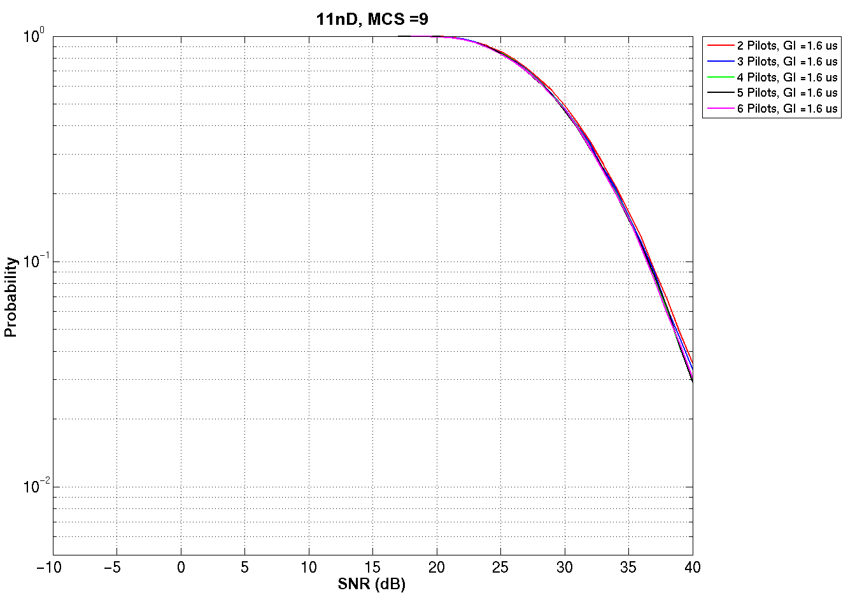
Appendix-B: OFDMA with 102 data tones (2/3)
Simulation results for 11nD Channel
MCS 0
MCS 9
Little difference in performance as we change #pilots from 2-6

Slide 41
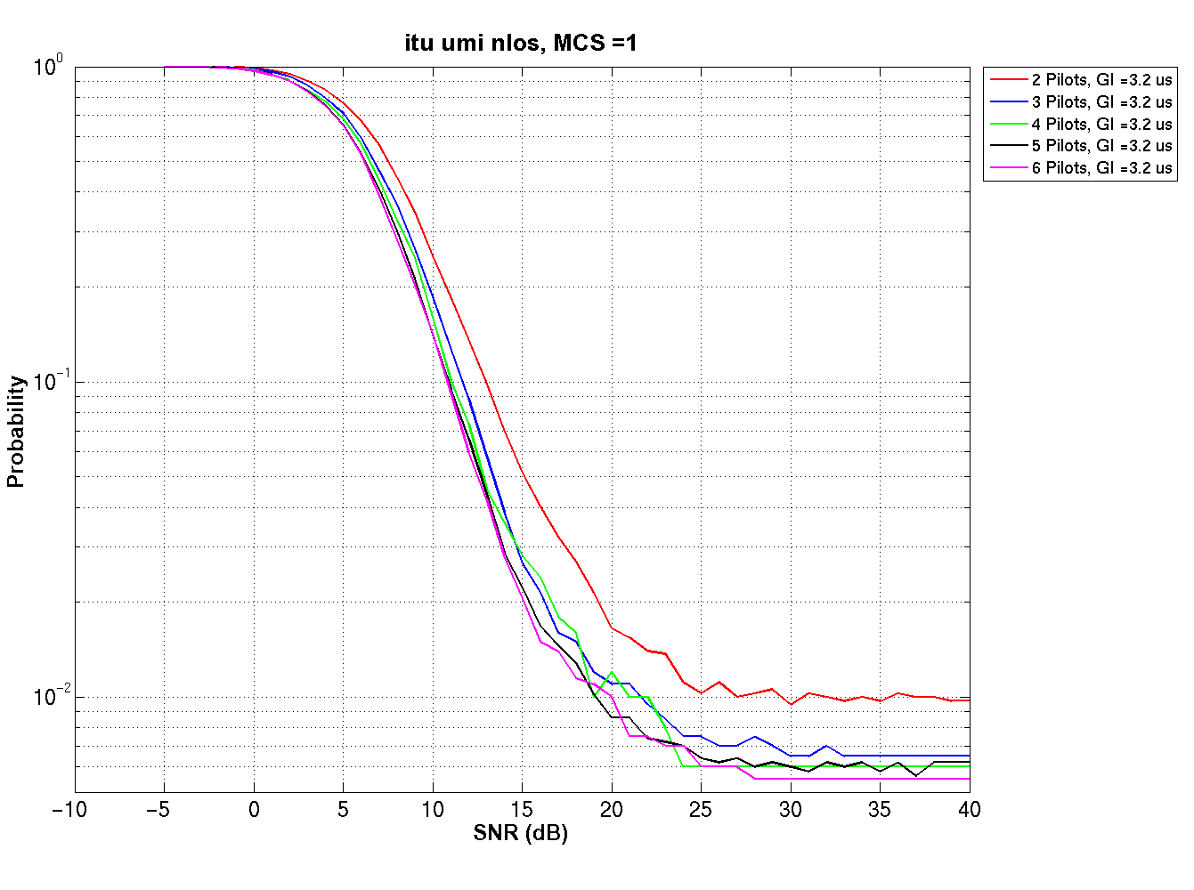
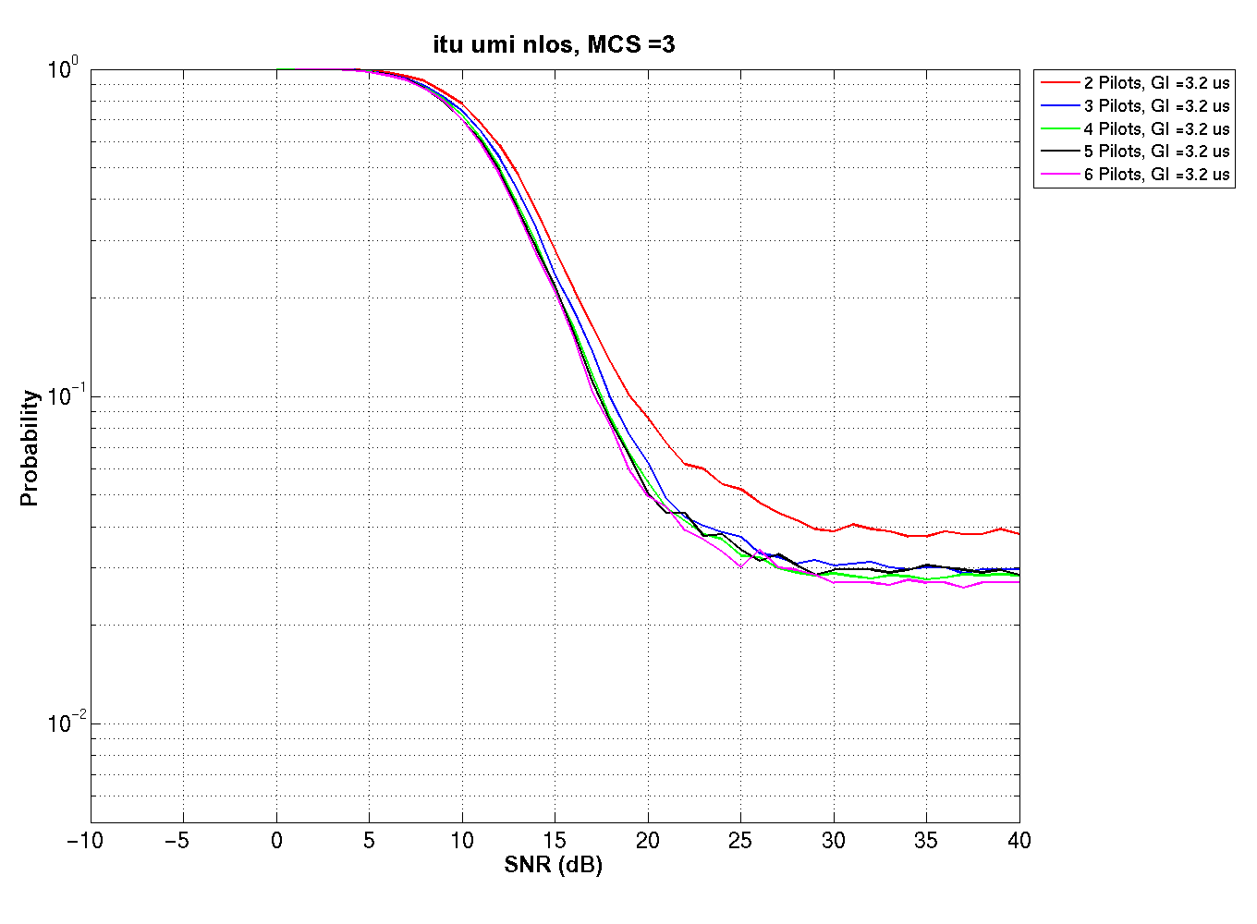
Appendix-B: OFDMA with 102 data tones (3/3)
Simulation results for UMi-NLoS
MCS 1
MCS 3
At 10% PER
2.15 dB loss with 2 pilots,
0.85 dB loss with 3 pilots
At 10% PER, loss with
2 pilots: 1.9 dB
3 pilots: 0.8 dB

Slide 42
Appendix-C: PER, Tone Erasure, AWGN
20MHz
80MHz

Slide 43
Appendix-C: PER, Tone Erasure, D-NLOS
20MHz
80MHz

Slide 44
Appendix-C: PER, Tone Erasure, UMi-NLOS
20MHz
80MHz

Slide 45
Appendix-D: Simulation Studies (1/3) for the Number of DC Nulls in 20MHz OFDMA
We performed simulations to study the impact of LO leakage in UL OFDMA on the performance of the 26 tone OFDMA unit straddling the DC
The study is performed as a function of the number of DC tones – 3,5 or 7 and the RF frequency 2.4GHz and 5GHz.
  20MHz, 256FFT, 25% GI, 40ppm max LO offset
  100 byte payload for the middle 26 tone unit under test
  Middle 26 tones
    3DC case: [-14:-2, 2:14] w/ pilots at [-8, 8]
    5DC case: [-15:-3, 3:15] w/ pilots at [-9, 9]
    7DC case: [-16:-4, 4:16] w/ pilots at [-10, 10]
  -32dB LO leakage for every user. It assumes the following 11ac requirement for 11ax STA participating in UL OFDMA
    When the RF LO is not at the center of the transmitted PPDU BW, power measured at the location of RF LO using resolution BW of 312.5KHz shall not exceed the maximum of -32dB relative to the total transmitted power and -20dBm, or equivalently max(P-32,-20), where P is the transmit power per antenna in dBm and N_{sT} defined in Table 22-5 (Timing Related Constants) – 11ac LO requirement
  4 RX Antenna
  Channel smoothing enabled w/ 4x LTF and with and without tone erasures for the 3DC and 5DC
  3/6/9 users are considered
  The LO of each user is assumed to undergo independent channel fading
  Frequency offset of each user is uniformly distributed over +/- 235KHz and +/-100KHz

Slide 46
Appendix-D: Simulation Studies (2/3) for the Number of DC Nulls in 20MHz OFDMA
2.4GHz Band
Compared to 7DC, penalty to use 3DC is about 5% in indoor and 10% in outdoor (9 user case)
Compared to 7DC, no penalty to use 5DC (9 user case)

Slide 47
Appendix-D: Simulation Studies (3/3) for the Number of DC Nulls in 20MHz OFDMA
5GHz Band
Compared to 7DC, penalty to use 3DC is about 40% in 9 user case
Compared to 7DC, penalty to use 5DC is about 25% in 9 user case

