Slide 1
Channel Sounding for NG60
Date: 2015-03-09
Authors:

Slide 2
Abstract
In this presentation, we show that polarimetric, high bandwidth, double directional measurements with a high dynamic range (dynamic > 70dB) are essential to develop channel models, which allow reliable system level simulations. By having high bandwidth, independent paths in delay, polarization and spatial domains can be identified, showing the dependency of the channel with the geometry of the environment and the interaction of different objects. We show that polarization measurements are essential for 60 GHz channel characterization.

Slide 3
Outline
Motivation
Measurement Scenarios and Requirements
Ultra-wideband dual-polarized indoor 3D measurement
Challenges for ultra-wideband dual-polarized 60 GHz indoor 3D measurement
Channel modeling Issues
Conclusion

Slide 4
Motivation
ISM-band at 60 GHz
  Free and wide bandwidth available
  WLAN/WiGig (.11ad) and WPAN (.15.3.c)
Advanced system concepts → define measurement and modelling requirements
  Massive MIMO/pencil beam-forming → large spatial bandwidth
  Adaptive or switched selection beam-forming to mitigate shadowing
  Channel bonding → large bandwidth
Propagation channel measurements
  Double directional measurements are needed to characterized the full channel
  Polarization is an important aspect
  High dynamic range are essential to measure the different propagation effects
Propagation channel characterization and modelling
  Stochastic vs. deterministic modelling
  Evolution of model parameters and shadowing/blockage influence
  Coupling of spatial, temporal and polarimetric parameters
  Contribution of dense multipath components

Slide 5

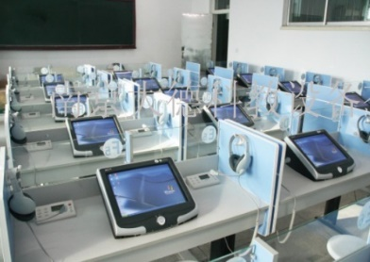
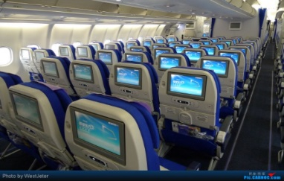
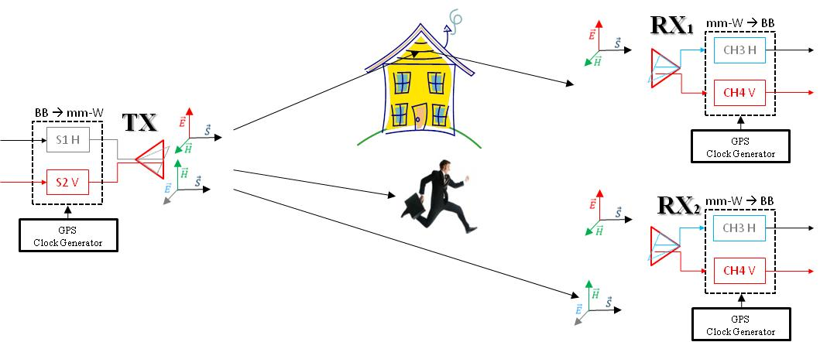
Measurement Scenarios and Requirements
Living room
  HD entertainment centers, video games, etc
Class room / office scenario
  Provide access to students / users with tablets, notebooks, electronic devices, etc.
  Wireless office
Public transportation
  Onboard entertainment systems, streaming on demand, etc.
  Access to public networks (4G,5G), access to internet
Requirements/Challenges
  Dual-polarized measurements
  Ultra-wideband measurements covering the possibility of channel bonding
  High double-directional resolution to provide accurate model parameters
  High temporal resolution (high speed measurement) to detect shadowing effects and Doppler shift
  Multi–link channel analysis
Notes:
5G systems at mm-wave require SNR optimisation → and this will be only done with dual polarisation

Slide 6
Ultra-wideband dual-polarized
60 GHz indoor 3D measurement

Slide 7
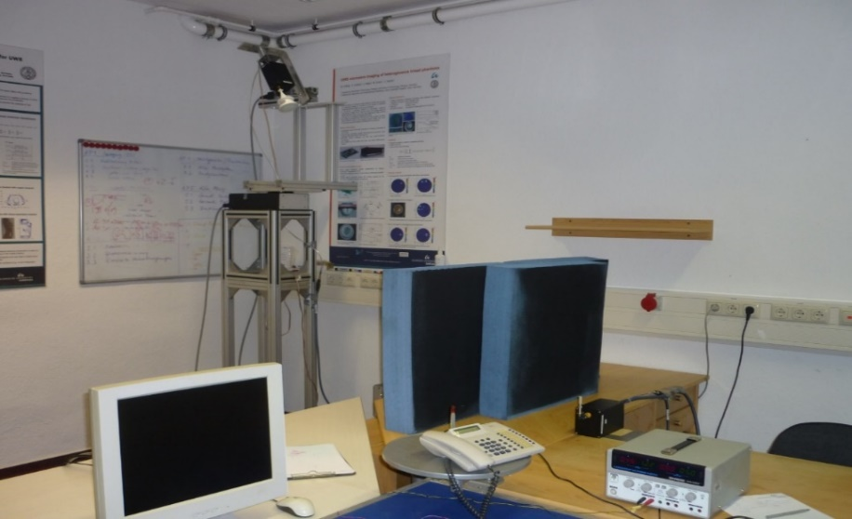

Measurement Scenario and Setup: Small Office
Directional resolution: high gain (35 dBi) antenna rotated in azimuth and elevation at TX
Dipole antenna (2dBi) at RX position
Polarization: H/V at TX and H/V at RX
3 GHz bandwidth → Resolution in DoD, time and polarization
$$\text{Pol} \text{H}$$
Pol V
TX
30°Elevation
90°Azimut
0°Azimut
-60°Elevation
Vertical
RX
Horizontal
Notes:
5G systems at mm-wave require SNR optimisation → and this will be only done with dual polarisation

Slide 8
Results: DoD, Delay and Polarization
TxH - RxH
TxH - RxV
TxV - RxV
TxV - RxH
Cluster C shows high cross polarization coupling
Cluster G shows high cross-polarization discrimination
Notes:
Hier wurden nur multipath aus den dominanten berücksichtigt

Slide 9
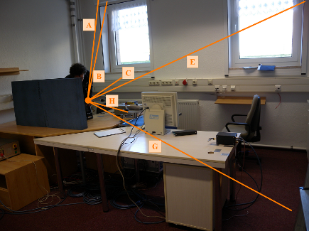
Geometrical Interpretation of Polarimetric DoA / DoD Estimates
Cluster | Description
A | Double-bounce reflection from ceiling and upper wall
B and C | Diffraction/reflection from the upper/lower part of a metal frame of the left window
D | Reflection on the floor under a desk and multiple bounces
E and F | Double-bounce reflection from the upper-right corner of the room
G | Scattering from a bookshelf and a metal ladder in the lower-right corner
H | Scattering from objects
I | Scattering from lamps in the ceiling
TxH - RxH
TxV - RxH
Ray-tracing assisted interpretation
Antenna beam-width

Slide 10
Issues of the ultra-wideband dual-
polarized 60 GHz indoor 3D measurement

Slide 11
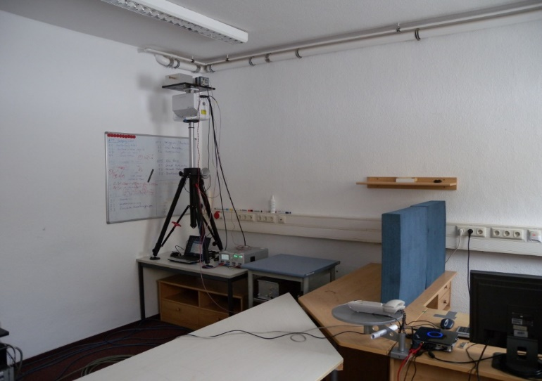
Scenario and Measurement Set-up
70 GHz measurements at the small office as examples: Show the DMC (Dense Multipath Component) characteristic for NLOS scenario → DMC is generated by the many metallic refection's
DMC still important for the mm-wave channel modelling
First measurements was only single directional measured
Current CS dynamic of 35 dB is too less to see all mmWave propagations effects

Slide 12
Noval Dual Polarimetric Ultra-Wideband Channel Sounder (DP-UMCS) (1)
TX Module
PA min. 27 dBm
RX Module
Step
Attenuator
LNA
Gain : 40 dB
H Pol.
CH 1
UWB Sounder TX
0 – 3.5 GHz
3.5 GHz - 10.5 GHz
H Pol.
Switch
UWB Sounder RX
0 – 3.5 GHz
3.5 GHz - 10.5 GHz
56 - 66 GHz
56 - 66 GHz
V Pol.
Step
Attenuator
CH 2
LNA
Gain : 40 dB
V Pol.
PA min.
27 dBm
Multiplier
X8
Multiplier
X8
Optical link
7 GHz
Oscillator
Optical link
7 GHz BW up to 10 GHz measurable bandwidth
Maximum excess delay of 585 ns (175m) in CS version 1 and 4.7 µs (1410m) CS version 2
Doppler shift of 100 Hz Version 1+ 2 and 5000 Hz for Version 3
Continuous recording of min. 200 CIR/s per RX channel up to 10000CIR/s per RX
Distributed clock synchronisation
Dual polarization measurement capability

Slide 13
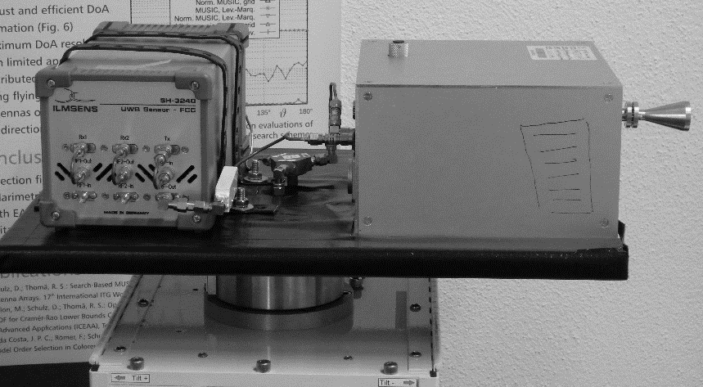
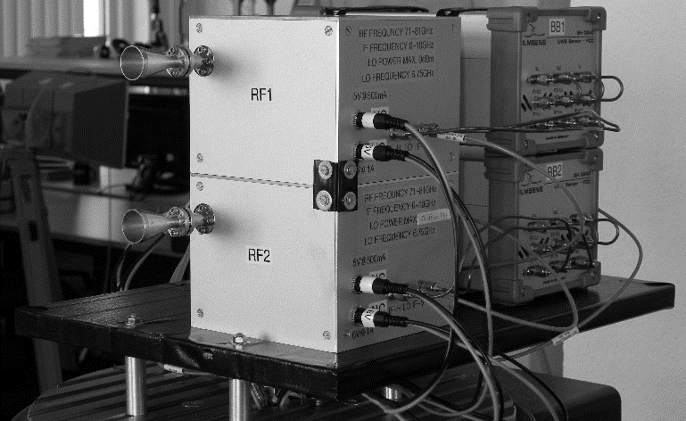
Dual Polarimetric Ultra-Wideband Channel Sounder (DP-UMCS) (2)
Current 70 GHz Channel Sounder as Example
Advantages of DP-UMCS
Compact Size → the complete system can be attached to the positioner
  No movement of the IF- cables → constant phase and amplitude
High instantaneous dynamic range: up to 75 dB in baseband and RF part
Multi-Link and Massive MIMO capabilities
Double directional measurements (with 1 TX and 2 RX) feasible
Only power and clock connection are necessary

Slide 14
Channel Modeling Issues

Slide 15
Extension of the WINNER II/+ model for mm-Wave
Why to implement a new model from scratch when we could use a widely used and accepted channel model?
Extension of the WINNER II/+ model to the (Q – D) approach
  Deterministic clusters, Polarization aspects, …
Deterministic LOS component
Deterministic component (component from reflections)
Stochastic component
PDP
PDP
RX Horizontal
RX Vertical
τ
τ
Overall DMC
Path specific DMC
Overall DMC
Path specific DMC
Notes:
5G systems at mm-wave require SNR optimisation → and this will be only done with dual polarisation

Slide 16
Overlaid deterministic - stochastic process with DMC components
 | WINNER
Full 3D and full polarimetric | Covers elevation and azimuth as well as polarization
Double directional model | Spatial resolution at TX and RX
Antenna independent | Any antenna pattern can be implemented on simulations
Generic model approach | One core model approach for many scenarios by parameter tables
Large Scale Parameter (LSPs) | So called LSPs control the behavior of the model aka scenarios
Deterministic paths | Only LOS ray is deterministic
Stochastic paths == clusters | Scatters introduce sub-paths that summed up introduce fast fading
Cluster based model | The position of the clusters is stochstic and controlled by LSPs
Well accepted approach | Within 3GPP and also for 5G.
 | Extension or new Models
Deterministic clusters with clear polarization | One-ray clusters as in LOS but simulating reflections, no difuse polarization
Dense multipath components | At some scenarios contribute with 20-40% of total power (see next slide)
Time evolution | High spatial resolution might introduce significant changes when the user moves – to allow to evaluation beam tracking or similar approaches
Notes:
5G systems at mm-wave require SNR optimisation → and this will be only done with dual polarisation

Slide 17
DMC Components in Measurements
Diffuse multipath components are observed in measurements as a background scattering process along the PDP and can‘t be neglected
Depends on the scenario
(a)
(b)
Figure: (a) LOS and (b) NLOS measurements at 70 GHz in an entrance hall. Maximum excess delay (MED) and delay spread (DS) with 20 dB dynamic range
Notes:
5G systems at mm-wave require SNR optimisation → and this will be only done with dual polarisation

Slide 18
Conclusions
Ultra-wide bandwidth of measurement enables high resolution identification of independent paths in delay domain, polarization domain, and spatial domain
  High resolution of specular paths (DoD, DoA, time delay) give rise to more deterministic channel modeling paradigm
  Important for channel characterization
Polarization is a very important aspect
  Not only for diversity but also for SNR maximization and interference suppression
  Specular paths tend to arrive from different directions at different time delays with well defined polarization orientation
  Polarimetric measurements are essential for mm-wave channel characterisation
  Additional degree of freedom → beam-forming, multiplexing
Channel sounder requirements
  Polarimetric, double-directional, broadband, fast
Modeling issues
  Contribution of dense multipath component
  Polarization for stochastic and deterministic multipath
Notes:
5G systems at mm-wave require SNR optimisation → and this will be only done with dual polarisation

