Slide 1
GCR-BA Performance with Measurement Report in OBSS
Date: 2015/03/09
Authors:

Slide 2
Abstract
Previous submission[1] showed that if the BAR(Block Ack Request) Destination is selected appropriately by throughput characteristics, the multicast performance improves.
It also suggested that the number of BAR Destinations should be optimized.
This submission shows that the use of existing frames to identify the optimal BAR Destinations will degrade the overall performance due to significant overhead.
This submission concludes that a more efficient mechanism is necessary to ensure the reliability for multicast applications.

Slide 3
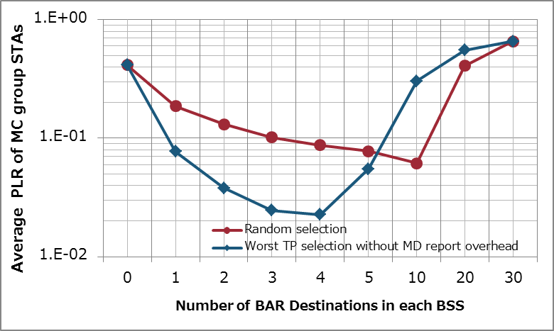
Recap [1]
Worst TP selection outperforms Random selection when appropriate number of BAR Destinations are selected.
AP needs a mechanism to identify underperforming STAs to determine BAR Destinations.
Performance improves
due to proper retransmission
Random selection
Worst TP selection
Performance degrades
due to too much retransmission
Target PLR for
video applications

Slide 4
Determination of BAR Destination by an existing method
802.11v (now merged into [2]) has introduced a mechanism to collect STAs' throughput information by a frame called Multicast Diagnostic Report (MD Report).
AP can identify underperforming STAs to determine BAR Destinations through collection of this MD Reports from all STAs.
Fig1. Measurement Report field format for a Multicast Diagnostics Report

Slide 5
Frequency of Reporting
For optimal BAR Destination (re-)selection, MD report is preferable to be sent no more than BAR interval.
When multicast traffic is transmitted at 3 Mbps, BAR would be transmitted at least every 250 msec in this scenario.
(1500 [byte/packet] * 8 [bit/byte]) * 64 [packet] / 3 [Mbit /sec]
= 256 [msec]
BAR should be sent at least once out of 64packets.
→System performance using MD Report to identify BAR Destination is simulated.

Slide 6
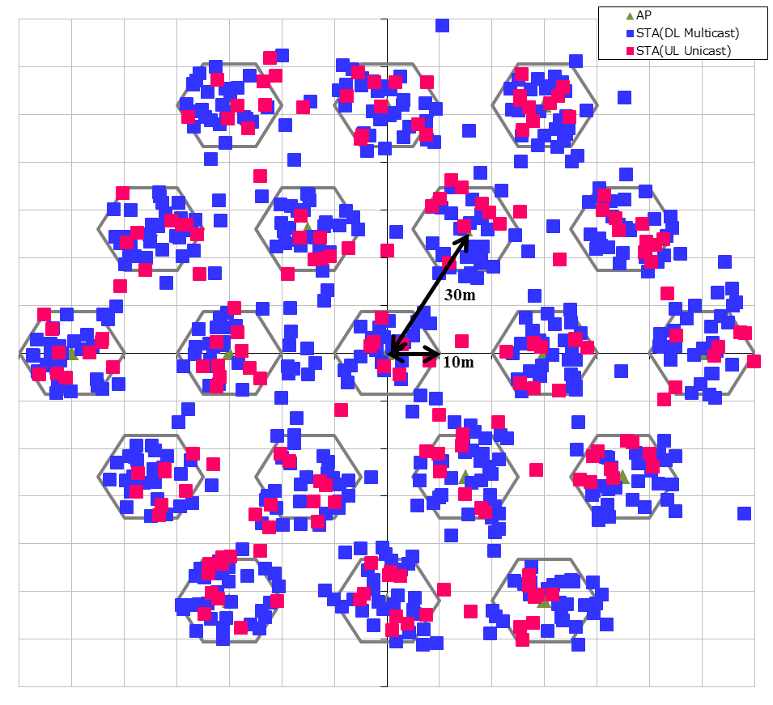
Simulation Conditions
Scenario-3
19-cell model with wrap-around (Reuse=3)
Traffic model
Multicast downlink UDP Flow (3Mbps)/BSS
All APs broadcast same contents
30 STAs/BSS are receiving multicast
10 uplink UDP Flows(300kbps)/BSS
# of BAR Destinations /BSS
0, 1, 2, 3, 4, 5, 10, 20, 30 (all STAs receives BAR)
Selection of BAR Destinations
In order of bad throughput
Overhead
With MD report overhead per 250 msec from All STAs
Without MD report overhead, but optimal selection
PHY rate
Data frames = 585Mbps (MCS = 7, 80MHz, 2SS)
BAR/BA/MD report = 6Mbps (MCS = 0, with legacy format)
More details are shown in appendix.

Slide 7
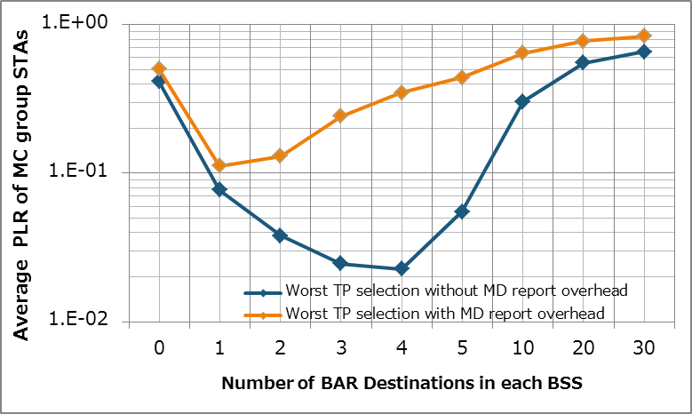
Simulation Results in SS3 (PLR)
The performance degrades due to MD report overhead as compared to the performance without overhead.
The performance can be improved if the overhead can be reduced.
Degradation due to
MD report overhead
With MD report overhead
Without overhead
Target PLR for
video applications

Slide 8
Conclusions
This submission showed GCR-BA performance with throughput selection by MD report from all STAs.
The overhead of the MD report is not negligible, therefore the entire performance degrades as compared to the performance without such overhead.
To improve the performance of GCR BA, an effective mechanism is needed to reduce the overhead in selection of proper STAs.

Slide 9
References
Eisuke Sakai, Sony, 11-15-0046-00 11aa GCR-BA Performance in OBSS
IEEE Std. 802.11-2012
Simone Merlin, Qualcomm, 11-14-0980-06 TGax Simulation Scenarios
IEEE Std. 802.11aa

Slide 10
Backup

Slide 11
Simulation Setup details
Node | (AP x 1, STA x 40) x 19
Num of Drops [times] | 1
Traffic Model & Load | Downlink CBR UDP 3 Mbps (from all AP) Uplink CBR UDP 300 kbps (from 10 of 40 STAs, not multicast receiving STAs)
Traffic Duration [sec] | 39
Access Category | AC_BE CWmin=15, CWmax=1023, AIFSN=3, TXOP limit=0
Tx Power [dBm] | AP:+23dBm (2 antennas), STA:+15dBm (Single antenna)
MCS Selection | Fixed (Legacy 6Mbps for BAR/BA/MD Report, MCS7, with HT80 and 2SS, for data frames)
Packet Length [byte] | (MPDU, MSDU, APP)=(1530, 1500, 1464) Fixed
L2 Retry | 10
Ack Rate | Legacy 6.0Mbps
RTS/CTS | OFF
Max Aggregation Size | A-MPDU, A-MSDU)=(64KB, NA)
NF [dB] | 7
Channel | TGn Channel D (pathloss, shadowing, fading)
Channel Setting [MHz] | (CenterFreq, BW)=(5180, 80)
Det. Cancel on PLCP err | Enable (Error performance is shown in next slide)
Antenna settings(Gain [dBi, Height [m] | (0, 3) for AP, (-2, 1.5) for STA
Tx buffer size [kB] | 375
TTL [sec] | 1
BAR receiving STAs selction | Worst TP
Multicast Diagnostic Report Overhead | (None, transmitted every 250msec from each STA)
Wraparound | Enabled
Sensitivity level [dBm] | (CCA-SD, CCA-ED) = (-82, -62) [NOTE] The term “CCA-ED” represents “20 dB above the minimum modulation and coding rate sensitivity” in this material.

Slide 12
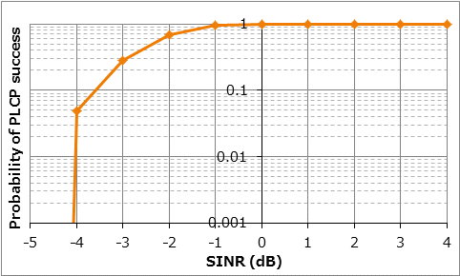
Prob. of PLCP Success

Slide 13
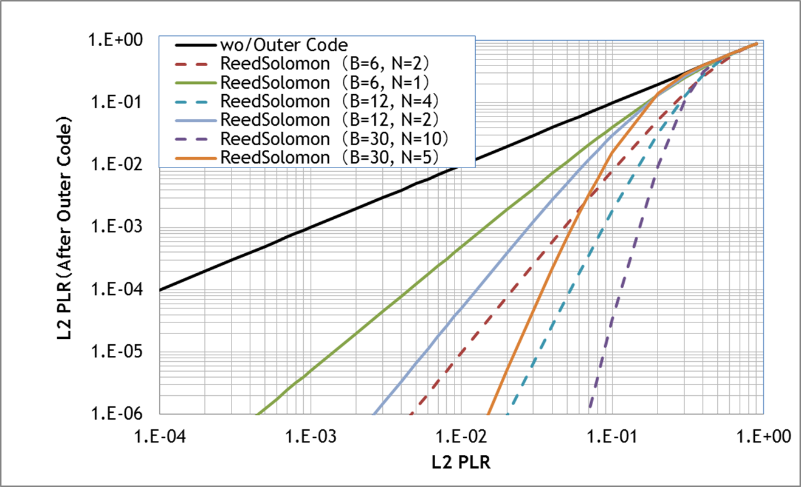
Target PLR on Wireless System for Multicast = 2E -2
When utilizing (B, N) = (30, 5), Target PLR = 2E-2
B :Block length, N: Parity length Code rate = (B-N)/B
Required PLR on application
Solid line : Code Rate = 5/6
Dashed line : Code Rate = 2/3

