Slide 1
Long range indoor channel measurements for the 60 GHz band
Date: 2015-03-08
Authors:

Slide 2
Abstract
New channel models are needed to support the wide range of use cases envisioned for NG60.
Channel measurements are important to help with channel modeling efforts.
This contribution presents some results from a channel measurement campaign carried out within the METIS project [1].
Long range indoor office signal strength measurements in the 60 GHz band for both line-of-sight and non-line-of-sight are given.
Measurements of loss due to blockages are shown.

Slide 3
Outline
Motivation/Related Work
Office corridor long range measurements
Blockage due to door, window, wall
Human blockage measurements
Summary and Conclusions

Slide 4
Motivation/Related work
Many new use cases are envisioned for NG60, covering short, medium, and long range communications [2].
New channel models that complement 802.11ad channel models [3] are needed to support these use cases.
Channel measurements are important to help with channel modeling efforts.
Outdoor channel measurements were presented and a channel modeling approach was proposed in [4].

Slide 5
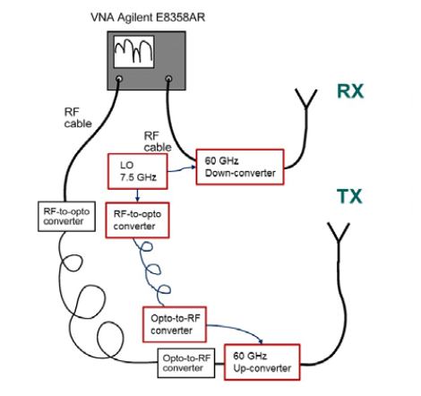
Office corridor long range measurements
Measurements carried out in an indoor office environment in Stockholm, Sweden by Ericsson.
Frequency range | 57.68 – 59.68 GHz
Tx height | 1 m
Rx height | 1 m
Tx/Rx antenna gain | 10 dBi
Tx/Rx antenna beamwidth | 60°in elevation plane 30°in azimuth plane
Tx/Rx velocity | Stationary
Measurement setup

Slide 6
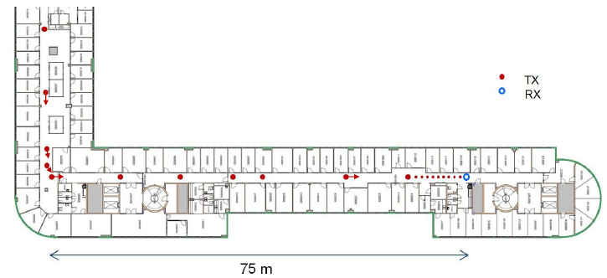
Measurement layout
20 Tx locations, 1 Rx location.

Slide 7
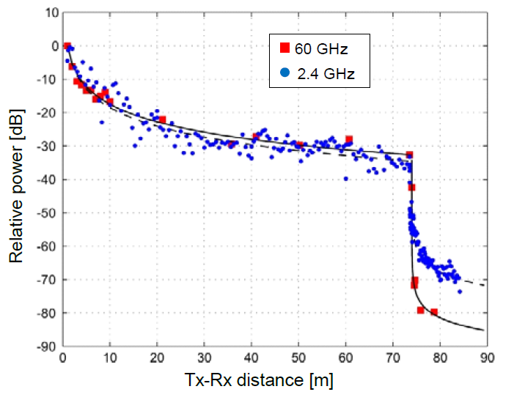
Measurement results
Sharp drop after corner.
Clear frequency dependency in NLOS path loss: 15 dB larger at 60 GHz compared to 2.4 GHz.
Path loss modeled according to recursive Berg model [5]:
Semi-empirical model
Proposed for modeling signal strength in urban environment
Street corner modeled as a source
Diffraction loss at corners calculated as a function of the angle and empirical parameters.
Measurements show good agreement with the model.
model

Slide 8
Recursive Berg model
Model details:
Path loss modeled according to recursive Berg model [5]:
Semi-empirical model
Proposed for modeling signal strength in urban environment
Street corner modeled as a source
Diffraction loss at corners calculated as a function of the angle and empirical parameters.
Tx
node 0
s₀
node 1
θ₁
Rx
s₁
node 2
Loss at node j is given by the free space path loss equation:
$$20log10{(4πd_{j}/λ)}$$
d_{j} is the “distance” adjusted for diffraction and is calculated recursively:
$d_{j}= k_{j} s_{j−1} + d_{j−1}$ ,
where s_{j} is the real distance and
$k_{j}=k_{j−1}+d_{j−1}q_{j−1}$.
Effect of diffraction is introduced through q, which is angle dependent:
$q_{j}=q_{90}{\left(\frac{θ_{j}}{90°}\right)}^{ν}$
Parameters q₉₀ and ν extracted from measurements.

Slide 9
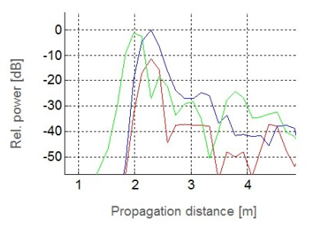
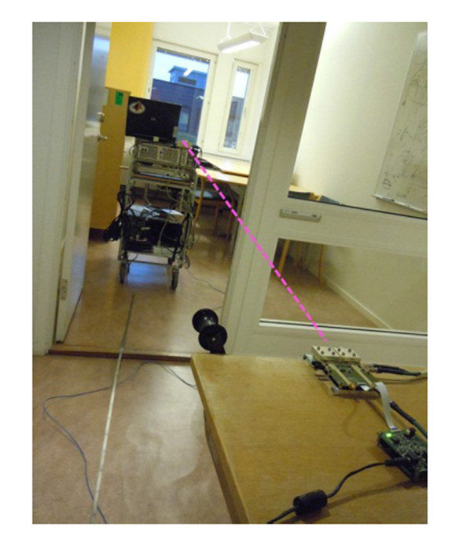
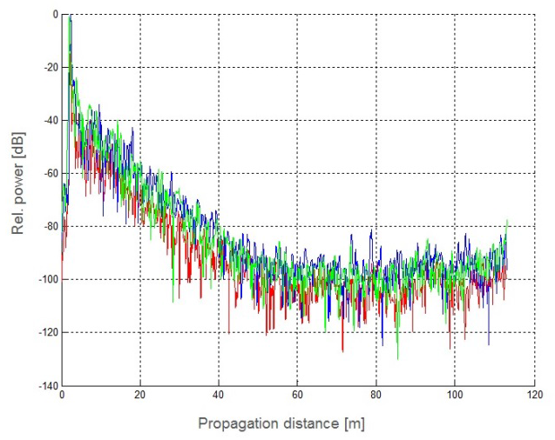
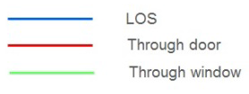
Loss due to obstacles
Loss due to
window = 1.0 dB
door = 11.5 dB
wall = 7.5 dB

Slide 10
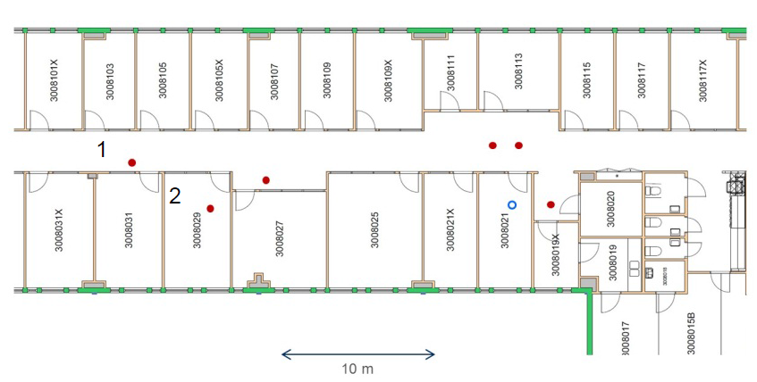
Medium range indoor office
Tx location 1 (corridor-to-room): 29 dB loss observed in excess of free space loss
Tx location 2 (room-to-room): 48 dB loss observed in excess of free space loss

Slide 11
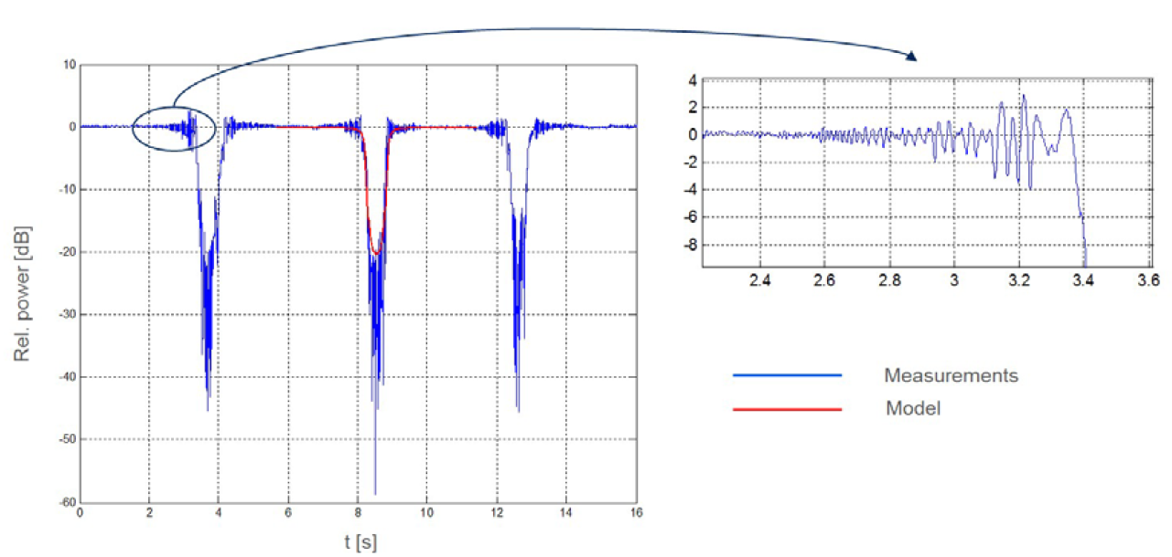
Human body shadowing
Line-of-sight link of 3.7 m.
One person walking back and forth in between.
Model: Diffraction around four edges of a rectangular screen with 30 cm width.

Slide 12
Summary and Conclusions
Long range indoor office signal strength measurements are provided for the 60 GHz band.
Loss due to blockages such as wall, door, window, human body are measured and shown to be significantly frequency dependent.
Sharp drop observed in signal strength once nodes are in none-line-of-sight (NLOS). NLOS measurements show good agreement with the recursive Berg model [5]. This shows that diffraction can be dominant in NLOS 60 GHz links.

Slide 13
References
“METIS Channel Models,” METIS Deliverable D1.4, February 2015. https://www.metis2020.com/
11-14/1386r1, “NG60 Usage Models Update”
11-09/0334r8, “Channel Models for 60 GHz WLAN Systems”
11-14/1486r0, “Channel Models in NG60”
J. E. Berg, “A recursive method for street microcell path loss calculations,” Personal, Indoor and Mobile Radio Communications, September, 1995.

