Slide 1
Indoor Wall Propagation Loss Measurements
Date: 2015-01-14
Authors:

Slide 2
Abstract
It has been observed that the current Simulation Scenarios significantly understate propagation loss across walls. [1]
  SS#1 assumes 5dB per wall
  SS#2 assumes 7dB per wall
  SS#4a references SS#1 (Outside in penetration)
This contribution presents field RF measurements from site surveys using professional grade software tools
Recommend uniform loss value of 9 dB / wall in SS #1 and #2

Slide 3

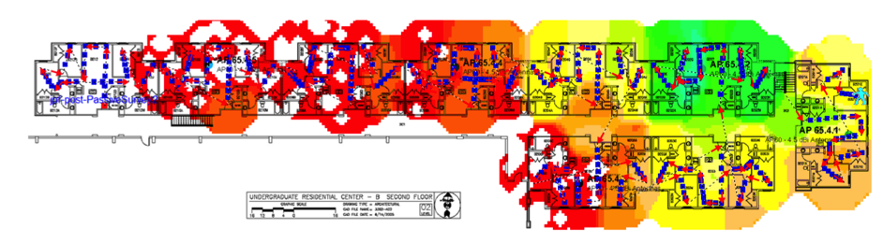
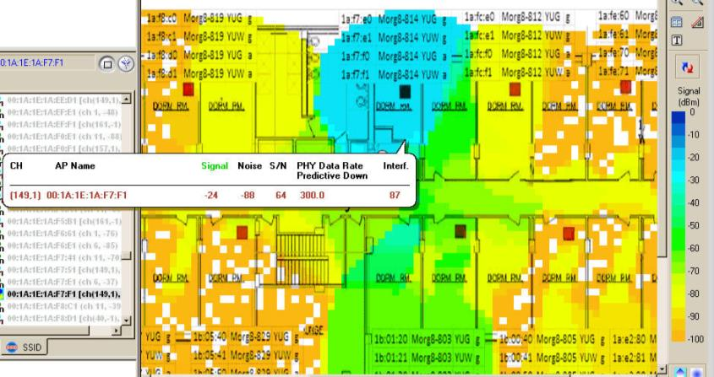
Framed vs. Concrete/Block Construction
Stud and
Wallboard
Construction
(~10dB/wall)
Concrete Wall
Construction
(25-30dB/wall)

Slide 4
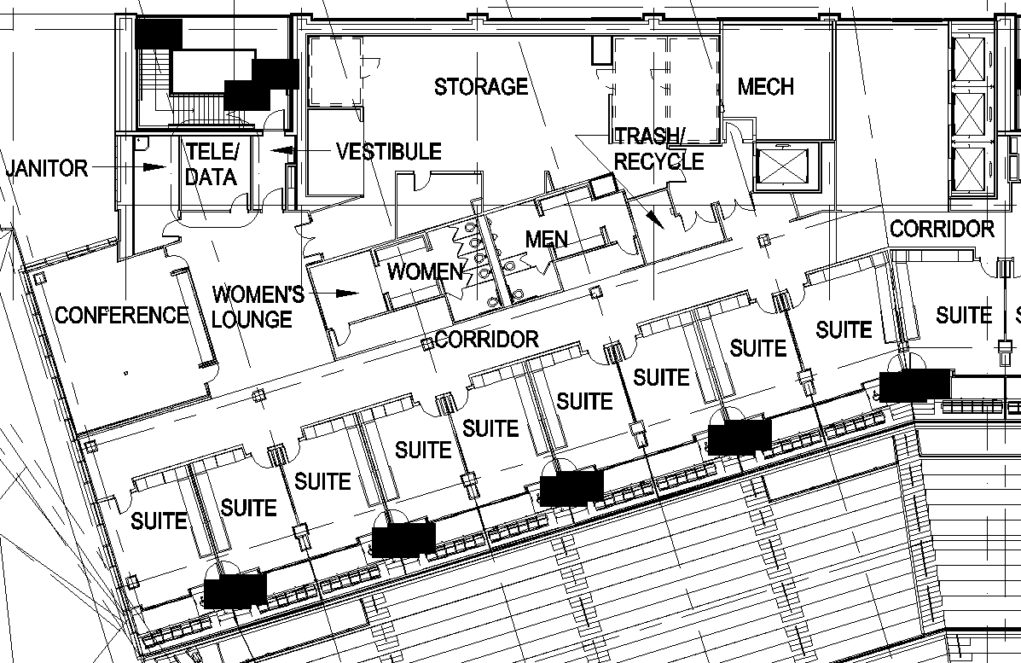
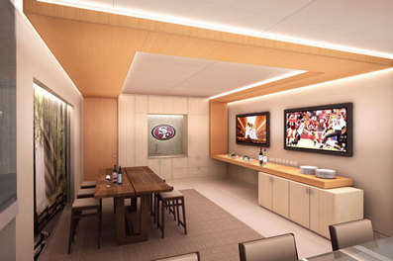
70,000 Seat Stadium Skyboxes
Aluminum stud + wallboard (3.3m /11ft wide)

Slide 5
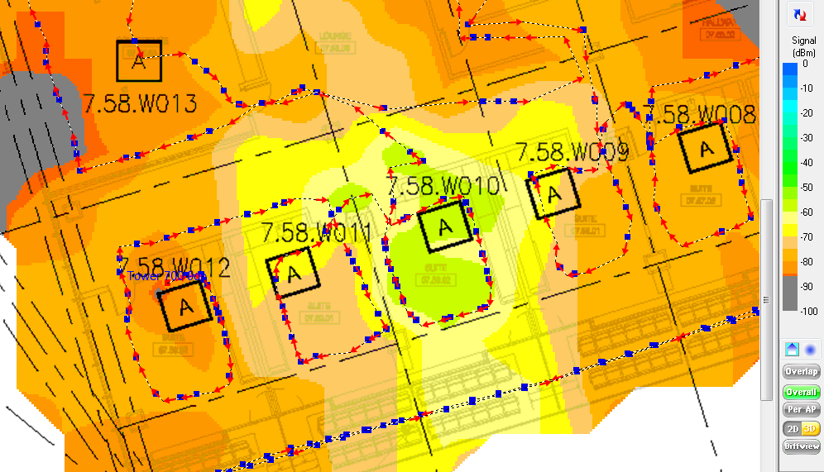
70,000 Seat Stadium Skyboxes (5GHz)
Aluminum stud + wallboard (3.3m /11ft wide)
-57dBm
-66dBm
-58dBm
-67dBm
-62dBm
-69dBm
-70dBm
-60dBm

Slide 6
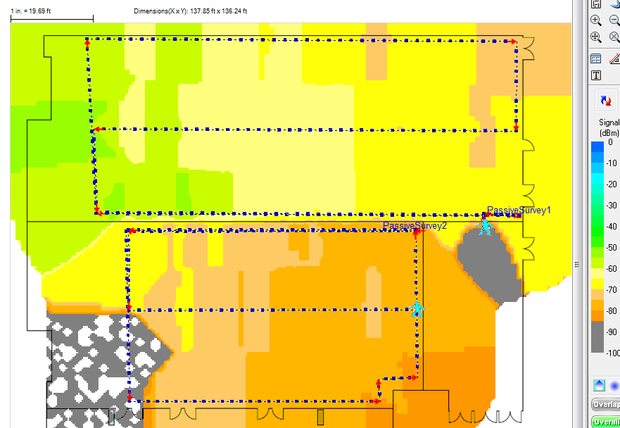
Jan 2015 Hyatt Regency Ballroom (5 GHz)
Retracting partition wall
AP in front of room
47:e0:cc
Ch 165
-56dBm
-67dBm
-70dBm
-77dBm

Slide 7
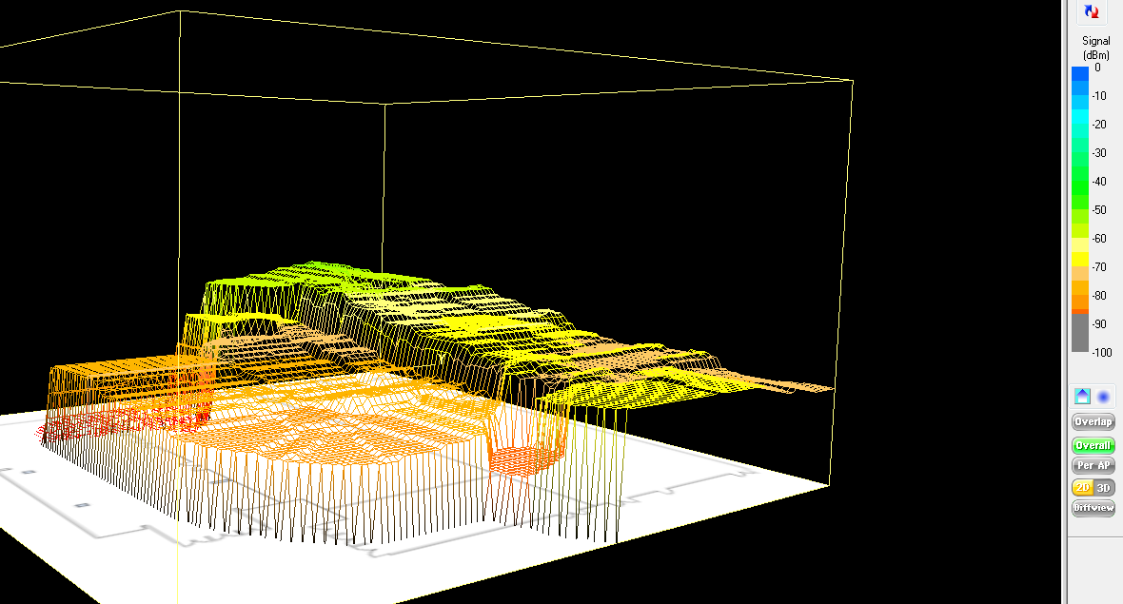
Jan 2015 Hyatt Regency Ballroom (5 GHz)

Slide 8
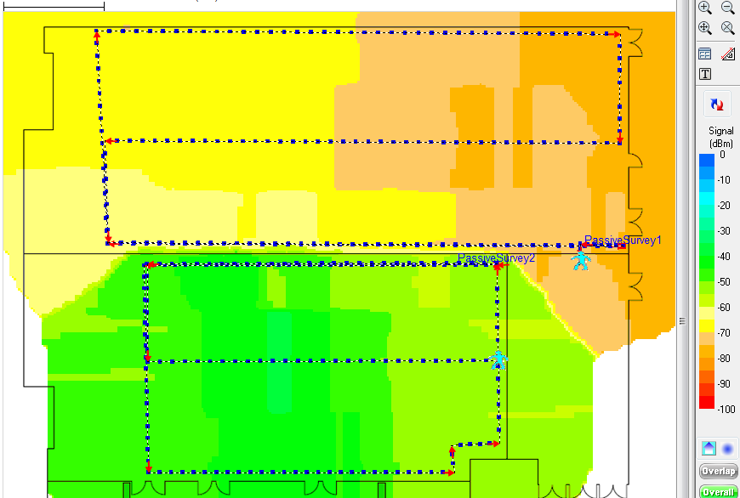
Jan 2015 Hyatt Regency Ballroom (5 GHz)
Retracting partition wall
-62dBm
-69dBm
AP in next room
4f:df:ac
Ch 36
-50dBm
-56dBm

Slide 9
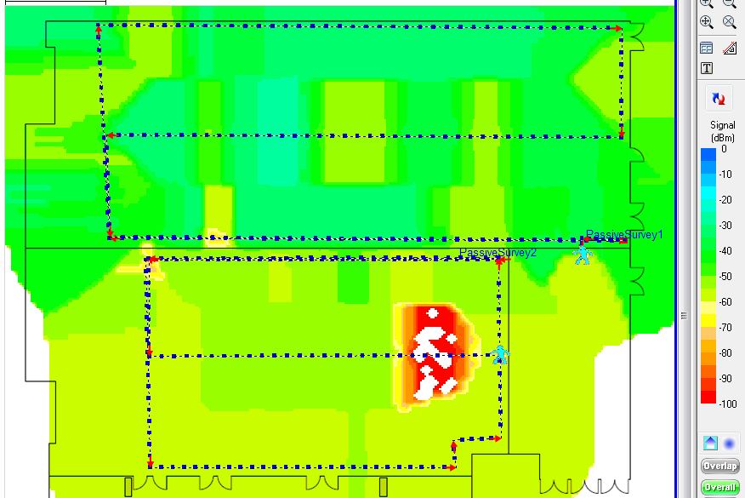
Jan 2015 Hyatt Regency Ballroom (2.4 GHz)
Retracting partition wall
AP in front of room
ce:41:58
Ch 1
-35dBm
-42dBm
-51dBm
-52dBm

Slide 10

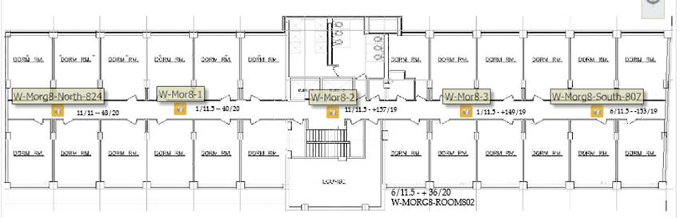
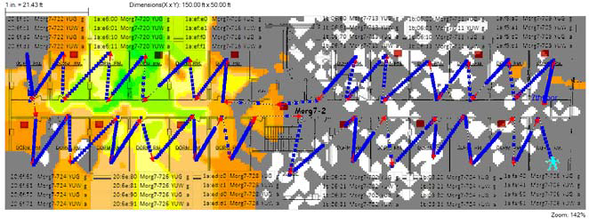
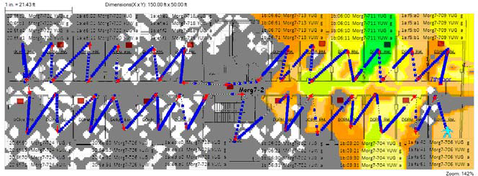
Private NY Area University Dorm
Concrete block walls – each dorm room is 3.1m /10ft wide

Slide 11
Recommendation
Based on data presented, 9 dB is a more conservative value for soundproofed interior walls separating tenants.
  This assumes wood-frame or aluminum-frame construction with wallboard and standard insulating materials.
  “Mass walls” made from concrete block, plaster-over-brick, and poured concrete walls have much higher values (at least 25dB)
There is no structural reason to use a different value for residential & enterprise scenario. Insulated bearing walls will have similar loss. If anything, residential case will have slightly higher average loss than enterprise.
Exterior walls in SS#4a should be modeled using a higher value than 9 dB

Slide 12
Counterpoint
5dB is an appropriate value for interior, non-insulated walls that subdivide an office, house or apartment (when framed walls are used)
  However, no SS currently uses interior subdividing walls
Want to keep pressure on the simulators. Increasing wall loss will effectively reduce the number of interfering OBSS nodes.
  We could knowingly accept a lower path loss value in order to increase OBSS interference effect, thereby making SS result more conservative.

Slide 13
Straw Poll
Do you agree that the penetration loss values in both SS#1 and SS#2 should be increased to 9 dB?
  Yes/No/Abstain

Slide 14
References
14/1590r0 - Zhao, et al, “Multi-wall penetration loss model for HEW system level simulation” – Jan 2014

