Slide 1
Approach to NG60 Peak Rate
Authors:
Name | Affiliation | Address | Phone | Email
Hong Li | Huawei | No.2222, Xin Jinqiao Rd., Shanghai, China |  | Macro.lihong@huawei.com
Yi Wang |  |  |  | Yi.wang@huawei.com

Slide 2
Abstract
In this presentation we study what are the potential technologies to meet the peak data rate requirements defined in NG-60 PAR.

Slide 3
NG60 PAR
“This amendment defines standardized modifications to both the IEEE 802.11 physical layers (PHY) and the IEEE 802.11 medium access control layer (MAC) that enables at least one mode of operation capable of supporting a maximum throughput of at least 20 gigabits per second (measured at the MAC data service access point), while maintaining or improving the power efficiency per station.”

Slide 4
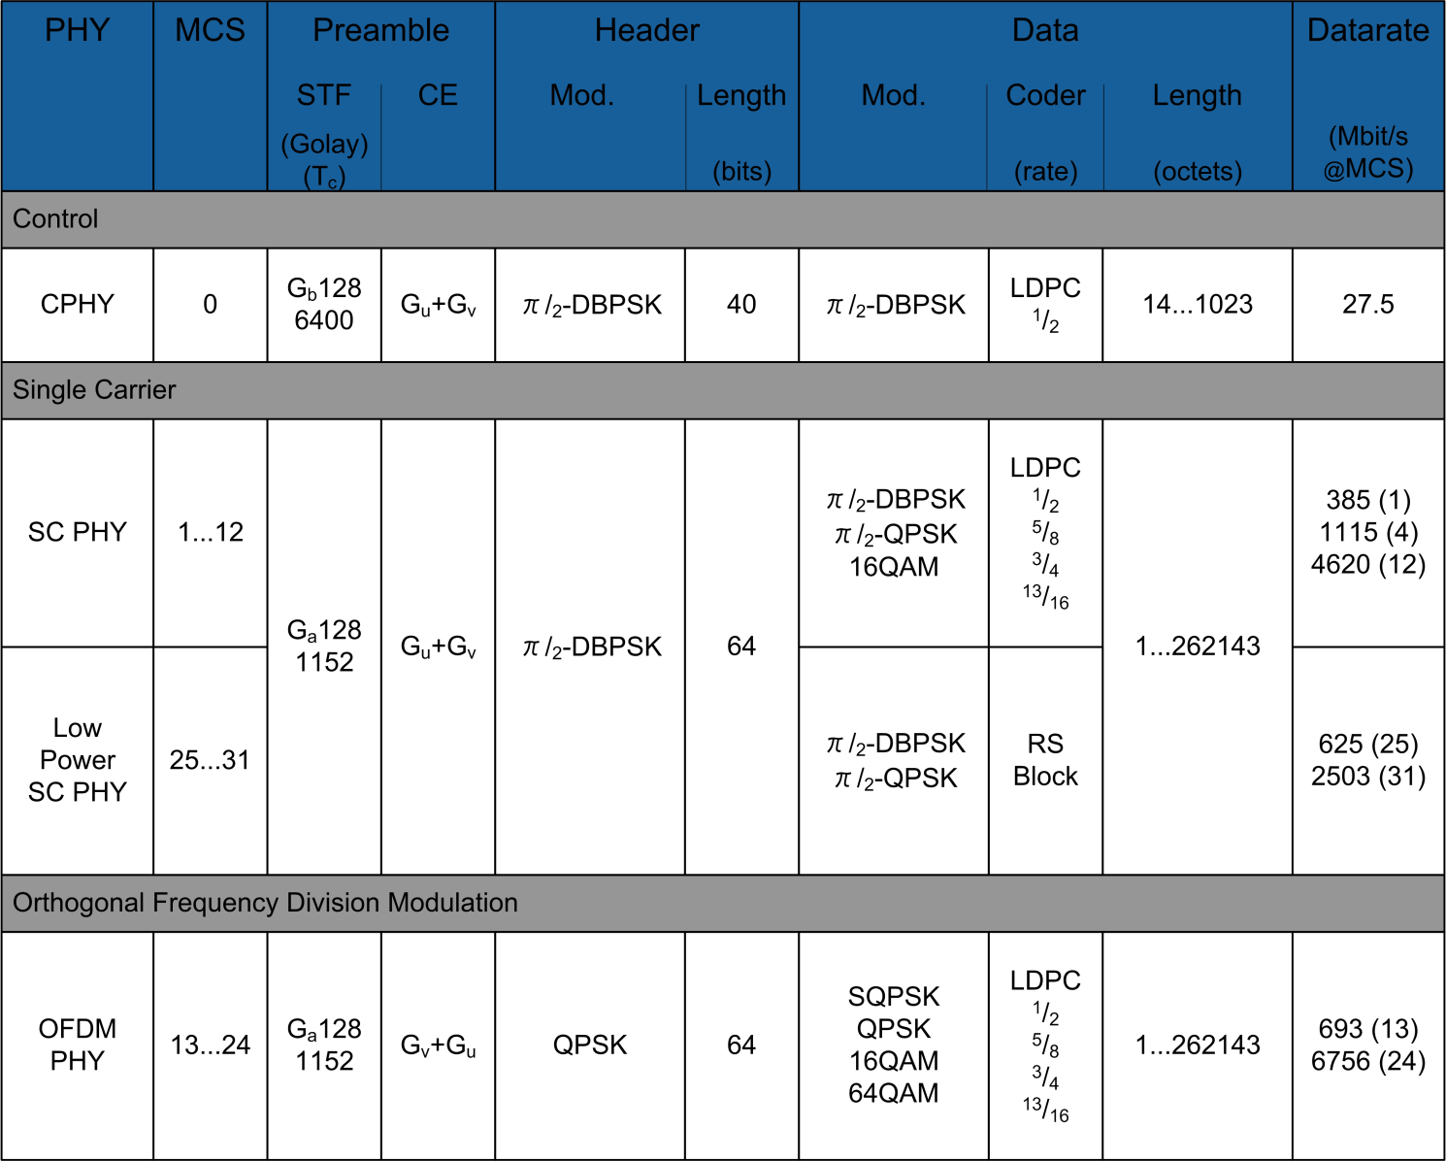
IEEE802.11 ad Parameters
IEEE802.11 ad standard defined a point-to-point link that could reach peak data rate of 6.7Gbps (OFDM) by means of one single band with bandwidth of 2.16GHz.

Slide 5
How to reach NG-60 data rate target
Channel bonding:
  Aggregate more 11ad channels. [*]
  Suppose NG-60 uses other parameters as same as IEEE802.11ad.
PHY Peak Data Rate (Gbps) | 802.11ad | NG60
 | Peak Rate | 2 channels | 3 channels | 4 channels
SC PHY | 4.62 (12) [**] | 9.24 | 13.86 | 18.48
Low Power SC PHY | 2.5 (31) | 5 | 7.5 | 10
OFDM PHY | 6.76( 24) | 13.52 | 20.28 | 27.04
** MCS Scheme, SC PHY: LDPC, pi/2-16-QAM + ¾code rate; Low Power SC PHY: LDPC, pi/2-QPSK 5/8 code rate; OFDM PHY: LDPC, 64-QAM, 13/16 code rate;
NG-60 Peak rate = BW * SE per beam
* Report ITU-R M.2227, “Multiple Gigabit Wireless Systems in frequencies around 60 GHz”, 2011
The nominal channel bandwidth of 11ad is 2.16 GHz. Four channels are defined for this band, but they are not universally available. The available band around 60 GHz(57 GHz to 66 GHz) is regulated differently in various regions of the world.

Slide 6
How to reach NG-60 data rate target
Considering the MAC overhead, the data rate of MAC will be smaller than that of PHY, suppose that the MAC efficiency of NG60 can reach 70% [*], thus the MAC data rate of different channel combinations are:
MAC Peak Data Rate (Gbps) | NG60
 | 2 channels | 3 channels | 4 channels
SC MAC | 6.47 | 9.7 | 12.94
Low Power SC MAC | 3.5 | 5.25 | 7
OFDM MAC | 9.46 | 14.2 | 18.93
thus the largest achievable Peak data rate of MAC is, 27.04*0.7 = 18.93Gbps, which is still lower than the target, 20Gbps.
* 2014-TECH-Panasonic-0001-00-NG60 USR usage models.pptx

Slide 7
How to reach NG-60 data rate target
Multi-stream
  Increase stream up to 8 streams.
  Suppose NG-60 uses other parameters as same as IEEE802.11ad
PHY Peak Data Rate (Gbps) | 802.11ad | NG60
 | Peak Rate | 2 streams | 4 streams | 8 streams
SC PHY | 4.62 (12) | 9.24 | 18.48 | 36.96
Low Power SC PHY | 2.5 (31) | 5 | 10 | 20
OFDM PHY | 6.76( 24) | 13.52 | 27.04 | 54.08
Similarly, suppose that the MAC efficiency of NG60 can reach 70%,
the largest achievable MAC Peak data rate of 4 streams is, 27.04*0.7 = 18.93Gbps<20Gbps.
When increasing the stream number up to 8, 20Gbps can be easily achieved. But the implementation of 8 streams is challenging because of the hardware complexity.
MAC Peak Data Rate (Gbps) | NG60
 | 2 streams | 4 streams | 8 streams
SC MAC | 6.47 | 12.94 | 25.87
Low Power SC MAC | 3.5 | 7 | 14
OFDM MAC | 9.46 | 18.93 | 37.86

Slide 8
How to reach NG-60 data rate target
Channel bonding + Multi-stream
PHY Peak Data Rate (Gbps) | 802.11ad | NG60
 | Peak Rate | 2 streams |  | 4 streams
 |  | 2 channels | 3 channels | 2 channels
SC PHY | 4.62 (12) | 18.48 | 27.72 | 36.96
Low Power SC PHY | 2.5 (31) | 10 | 15 | 20
OFDM PHY | 6.76( 24) | 27.04 | 40.56 | 54.08
Suppose that the MAC efficiency of NG60 can reach 70%, the 20Gbps MAC data rate can be achieved by:
2 streams with aggregation of 3 channels or even more.
4 streams with aggregation of 2 channels or even more.
MAC Peak Data Rate (Gbps) | NG60
 | 2 streams |  | 4 streams
 | 2 channels | 3 channels | 2 channels
SC MAC | 12.94 | 19.4 | 25.87
Low Power SC MAC | 7 | 10.5 | 14
OFDM MAC | 18.93 | 28.39 | 37.86

Slide 9
Summary
Suppose that the MAC efficiency of NG60 can reach 70%:
The target data rate of NG60, 20Gbps, can NOT be achieved by means of simply extending bandwidth based on 11ad (at most 4 channels).
The target data rate of NG60, 20Gbps, could be achieved by means of simply increasing streams based on 11ad up to 8 streams. But the implementation of 8 streams is challenging.
The target data rate of NG60, 20Gbps, could be achieved by combining Channel bonding and MIMO.
  2 streams with 3 channels or even more bandwidth
  4 streams with 2 channels or even more bandwidth

