Slide 1
Non-Uniform Constellations for Higher Order QAMs
Date: 2015/01/12
Authors:

Slide 2
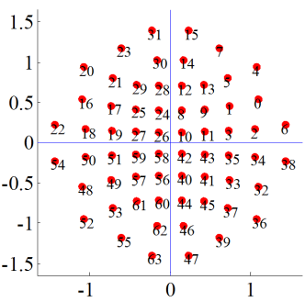
Motivation (1/2)
Higher order QAMs discussed in e.g. [1]-[2] as potential technology for next-generation 60GHz
  OFDM: 128-QAM, 256-QAM (up to 64-QAM in ad)
  SC: 64-QAM (up to 16-QAM in ad)
Non-uniform constellations (NUCs) provide increased performance compared to uniform constellations (UCs)
  Optimum location of constellation points
  Robust and weak bits carry
  optimum amount of information

Slide 3
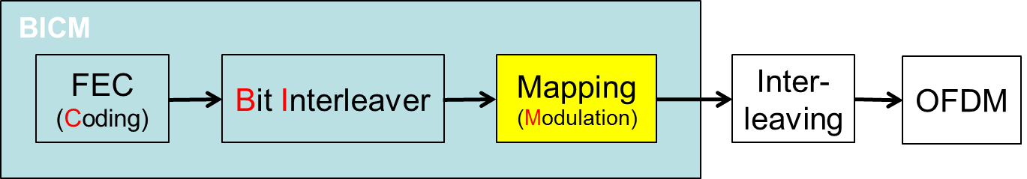
Motivation (2/2)
Introduced lately in several broadcast standards
  DVB-NGH [3], DVB/S2x [4]
  Theoretical shaping gain up to 1.5dB
Moderate complexity increase
  Change of QAM (de)mapper

Slide 4
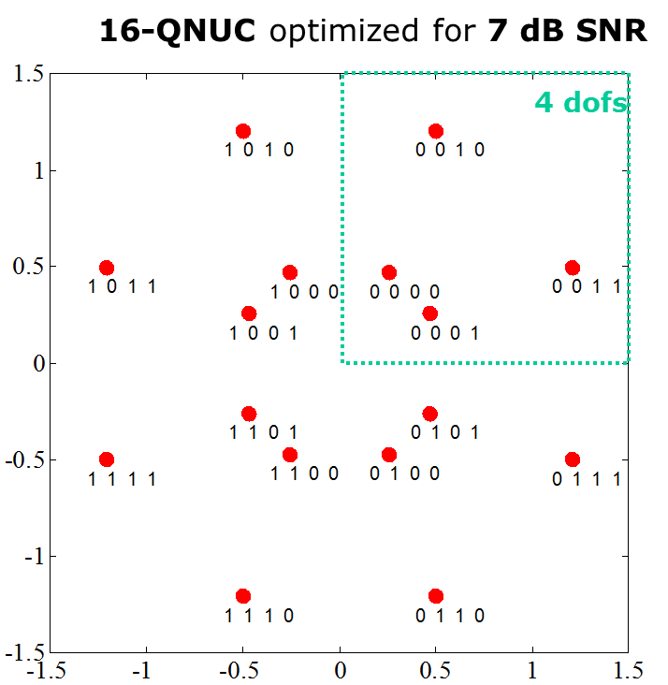
NUC: 1-D vs 2D
1-D NUC: 16-QAM
1-D NUC
  I/Q symmetry
  1-D demapping as for uniform
  constellations (UC), i.e. same
  demapping complexity as for regular QAMs
2-D NUC
  Symmetric quadrants
  Higher gain compared to 1-D NUC
  2-D demapping required
2-D NUC: 16-QAM

Slide 5
NUC Example for different SNR Conditions
8NUC for low SNR
8PSK reference
2 over-lapping points
robust
bits
robust
bits
110
010
100
000
weak bits
weak bits
111
011
101
001
0.1282+0.3973+0.3973 = 0.9229
0.0000+0.4859+0.4859= 0.9719
Interpretation: weak bits carry no information, 2 most robust bits with maximum distance
8NUC for high SNR
8PAM reference
robust
bits
robust
bits
110
001
weak bits
000
100
011
weak bits
101
010
111
0.9393+0.9697+0.9697 =2.8787
0.9749+0.9749+0.9779 =2.9276
Interpretation: hexagonal lattice = „dense packing“ , maximize minimum Euclidean distance

Slide 6
Initial Simulations: Parameters
Replacement of original uniform constellations by NUC
OFDM, MCSs: 18-24
Additionally: 128- and 256-QAM
Message Length: 1000bytes
Channel AWGN
  AWGN (channel is very close
  to AWGN in the LOS case)
Gain evaluated compared to UC
at FER=10⁻²
1D and 2D NUC
MCS index | modulation | bit/symbol | coderate
18 | 16-QAM | 4 | 1/2
19 | 16-QAM | 4 | 5/8
20 | 16-QAM | 4 | 3/4
21 | 16-QAM | 4 | 13/16
22 | 64-QAM | 6 | 5/8
23 | 64-QAM | 6 | 3/4
24 | 64-QAM | 6 | 13/16
 | 128-QAM | 7 | 1/2
 | 128-QAM | 7 | 5/8
 | 128-QAM | 7 | 3/4
 | 128-QAM | 7 | 13/16
 | 256-QAM | 8 | 1/2
 | 256-QAM | 8 | 5/8
 | 256-QAM | 8 | 3/4
 | 256-QAM | 8 | 13/16

Slide 7
Initial Simulations: Results
Channel: AWGN
Up to 0.8dB gain of NUC compared to regular QAM
128-QAM*
256-QAM
802.11ad
64-QAM
16-QAM
* Only 2D-NUC
simulated

Slide 8
Conclusions
Significant gain of NUC compared to UC
  Gain up to 0.8dB for 128-QAM and 0.7dB for 256-QAM
Moderate complexity increase
  Isolated change of QAM mapper and demapper
  Same demapper complexity as for uniform constellations for 1-D NUCs
  2-D demapping required for 2-D NUCs

Slide 9
References
Alecsander Eitan, Qualcomm, 11-14-1378-00-ng60 PHY rate for NG60
Alecsander Eitan, Qualcomm et al, 11-14-0652-00-0wng-wng Next Generation 802.11ad
Next Generation broadcasting system to Handheld, physical layer specification (DVB-NGH), DVB BlueBook A160, 2012
DVB-S2X BlueBook A83-2 / EN302307-2

Slide 10
Backup

