Slide 1
Considerations on
11ax OFDMA Frequency Granularity
Date: 2015-01-13
Authors:

Slide 2
Background
For 802.11ax, DL/UL OFDMA is one of key techniques for supporting MU transmission[1].
  Based on the analysis on the multi-user & frequency diversity gain, there has been proposed that 4 or 8 subbands for 20MHz as a potential resource granularity [2].
New OFDM numerology with 4 times FFT size for 20MHz is also proposed for 802.11ax
  256 FFT size with normal 0.8us CP length in 20MHz BW can provide about 17% throughput improvement over that of 64 FFT size by CP overhead reduction [3-5].
In this contribution, we consider further details on frequency granularity for OFDMA with 256 FFT.

Slide 3
Parameters for 11ax PHY Structure
Basic Parameter Set of 20 MHz for 11ax PHY [1-5]
Need to determine the subcarrier allocation parameters
  The number of subcarriers for guard band in 256 FFT for 20 MHz BW
  The total number of used subcarriers for data and pilots
  The number of subcarriers per subband
Parameters | Values
Bandwidth | 20 MHz (Other BWs need to be extended)
Subcarrier frequency spacing | 78.125 kHz (256 FFT), 312.5 kHz (64 FFT)
IDFT/DFT period | 12.8 us (256 FFT), 3.2 us (64 FFT)
Guard interval duration | 0.8us, Other CPs to be considered
Number of frequency segments/subbands | 4 or 8 (256 FFT), 1 (64 FFT)

Slide 4
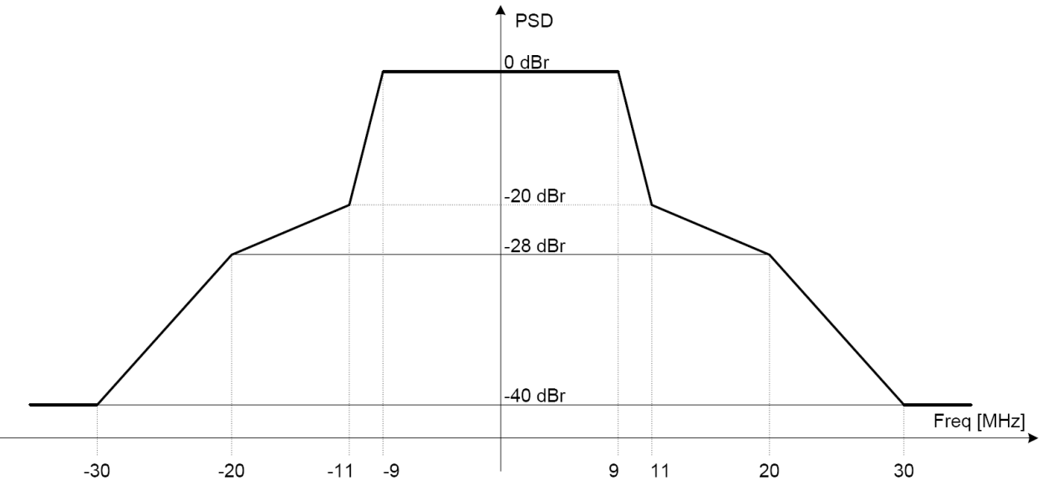
Subcarrier Allocation for 256 FFT
– Guard Band Spacing
Spectral mask for 11ac was proposed in [6]
  For 20MHz, +/-9 for 0dBr, +/-11 for -20dBr, +/-20 for 28dBr, and +/-30 for -40dBr
The used subcarriers are allocated in flat region. In the ac case for 20MHz band, there are 56 used subcarriers. At least, 224 subcarriers can be considered in ax for 256FFT.
For ac, considering a subcarrier for DC, 7 subcarriers are allocated for guard band (about 2MHz). For ax, at most 12~16 subcarriers (937.5KHz~1.25MHz) can be considered for guard band.

Slide 5
Subcarrier Allocation for 256 FFT
– The number of sub-bands
In [2] and [7], OFDMA based on 2.5MHz or 5MHz (8 and 4, respectively) subband is considered according to channel models in order to obtain high throughput gain improvement over OFDM exploiting multi-user and frequency selective diversity.
In the next step, the number of subcarriers per sub-band needs to be determined commonly for 2.5MHz and 5MHz subband to reflect flexibility of resource allocation according to channel models.

Slide 6
Subcarrier Allocation for 256 FFT
– The number of used subcarriers per subband
The number of used subcarriers per subband is designed to be equally allocated to each subband for user fairness.
56, 57, and 58 subcarriers for 5 MHz subband
  Let n= # of used subcarriers per subband
  {256-(16+15+1)}/4 = 56 ≤ n ≤ 58={256-(11+10+3)}/4
For flexible resource allocation between 2.5 and 5 MHz subbands, even number can be considered, i.e., 57 is excluded.
  56 and 58 are candidates for the 4 subband case.
DC
GB

Slide 7
Subcarrier Allocation for 256FFT
– The number of pilot subcarriers per subband
Coherence BW according to channel modes [8]
  Supporting outdoor channels, more pilots seem to be needed but comparable pilot overhead with legacy system is also necessary.
Since pilot overhead of 11n/ac for 20MHz BW is 0.071, at most 4 pilots per 5MHz subband can be considered. (4/58=0.071, 4/56=0.069)
Parameters | Scenario | DS (ns) | 0.5-Coherence BW (MHz) | # of subcarriers
UMi | LOS | 65 | 3.08 | 39
 | NLOS | 129 | 1.55 | 19
 | O-to-I | 240 | 0.83 | 10
UMa | LOS | 93 | 2.15 | 27
 | NLOS | 363 | 0.55 | 7

Slide 8
Subcarrier Allocation for 256 FFT: Summary
Parameters for 20 MHz | 11 a/g | 11n/ac | Option1 for ax | Option 2 for ax
# of complex data numbers per frequency segment (subband) | 48 | 52 | 52 or more | 54 or more
# of pilot values per frequency segment (subband) | 4 | 4 | 4 or less | 4 or less
Total # of subcarriers per frequency segment (subband) | 52 | 56 | 56 | 58
# of frequency segment (subband) | 1 | 1 | 4 or 8 | 4 or 8
Subcarrier frequency spacing | 312.5 KHz | 312.5 KHz | 78.125 KHz | 78.125 KHz
IDFT/DFT period | 3.2 us | 3.2 us | 12.8 us | 12.8 us
# of subcarriers for guard band (left/right) | 4(1.25MHz) /3(937.5KHz) | 4(1.25MHz) /3(937.5KHz) | 15(1.17MHz) /14(1.09MHz) or 16(1.25MHz) /15(1.17MHz) | 11(859.4KHz) /10(781.3KHz) or 12(937.5KHz) /11(859.4KHz)
Pilot overhead | 4/52=0.077 | 4/56=0.071 | 4/56=0.071 | 4/58=0.069

Slide 9
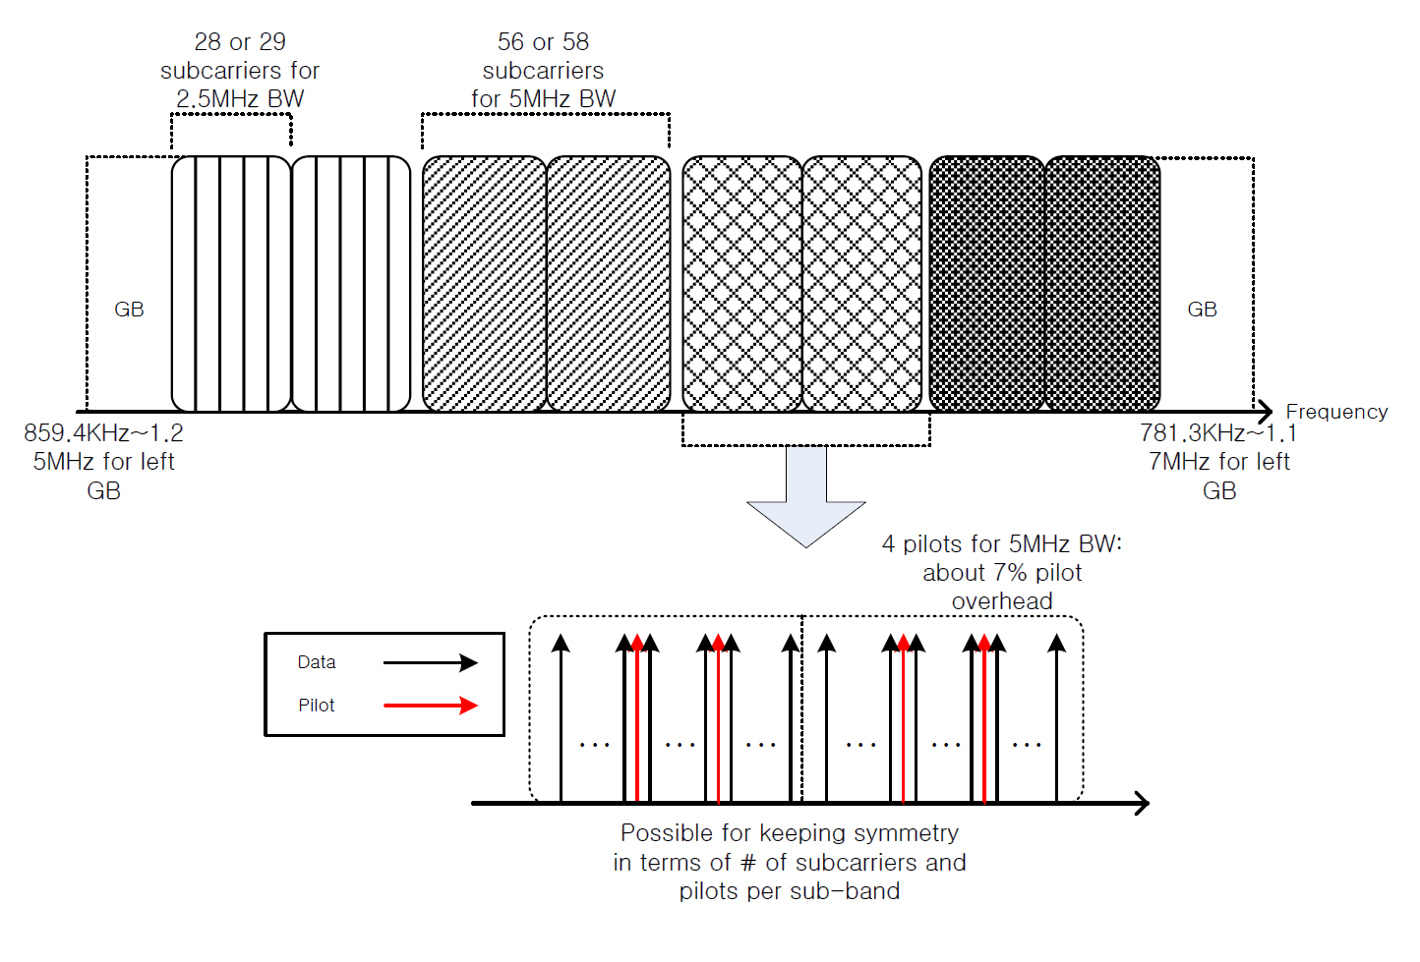
Subcarrier Allocation for 256 FFT: Summary
The example for 256 FFT with 20MHz BW

Slide 10
Conclusions
Considering OFDMA with 256FFT for 20MHz bandwidth, the candidate parameters for frequency granularity can be as follows:
  Sub-band partitioning: 4 or 8
  # of subcarriers for guard band: at most 12~16
  # of used subcarriers per frequency segment: 56 or 58
  # of pilot subcarriers based on pilot overhead: less than 4

Slide 11
References
[1] 11-14/1453r2, Spec Framework Proposal
[2] 11-14/1227r3, OFDMA Performance Analysis
[3] 11-14/0804r1, Envisioning 11ax PHY Structure - Part I
[4] 11-14/0801r0, Envisioning 11ax PHY Structure - Part II
[5] 11-14/1228r2, Issues on 256-FFT per 20MHz
[6] 11-10/1109r1, Spectral Mask and Flatness
[7] 11-14/1452r0, Frequency Selective Scheduling in OFDMA
[8] 11-14/0882r4, IEEE 802.11ax Channel Model Document

