Slide 1
OFDM Numerology for 11ax
Date: 2015-01-12
Authors:

Slide 2
Background
Motivation for new OFDM numerology
312.5kHz subcarrier spacing was design for 11a in the late 1990s
Some improvements, such as 4 more data subcarriers in 11n (HT), and support of 40/80/160MHz, have been made.
Reconsideration of CP length to support of outdoor environments that potentially has large channel delay spreads. [1] [2]
Reconsideration of subcarrier spacing, to enable longer OFDM symbols for higher efficiency. [1] [2]
However, ANY changes to numerology should be reviewed carefully and benefits should be clearly identified, as it has significant impact to transceiver implementation.
Some discussion on issues with new OFDM numerology has been discussed in [3]

Slide 3
Discussion Topics
How many usable tones with larger FFT size in 20MHz?
How to expand the numerology from 20MHz to 40/80/160MHz?
What is the expected potential gains?

Slide 4
Some Candidates
Current numerology
312.5 kHz subcarrier spacing, 64 FFT per 20MHz
56 tones + 1 DC tone used
Potential new numerology
78.125 kHz subcarrier spacing, 256 FFT per 20MHz
How many tones?
Number of tones used for 256 FFT per 20MHz, should be based such that power spectral mask can be met with reasonable implementation complexity
Please note that the 78.126kHz is just an example for discussions. Similar spectrum mask analysis would need to performed for other potential numerologies.

Slide 5
Compared OFDM Numerology
20 MHz System
64 FFT
56 data/pilot tones
Existing 11ac numerology
256 FFT
242 data/pilot tones
Using 80 MHz 11ac numerology
256 FFT
224 data/pilot tones
4 times the 64 FFT numerology, occupies +-8.75 MHz
256 FFT
230 data/pilot tones
Maximal number of tones within +- 9MHz, occupies +-8.9844 MHz

Slide 6
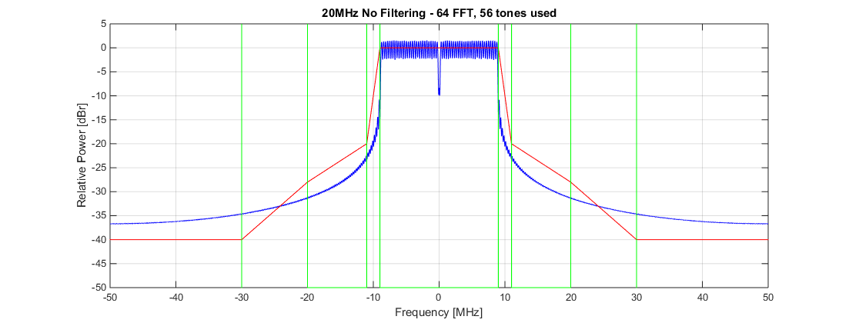
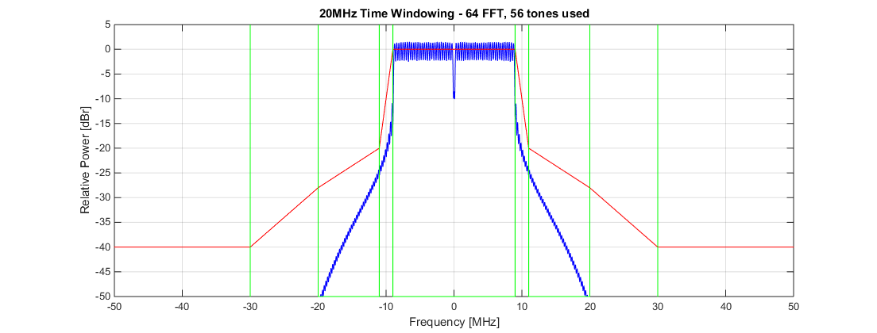
Option 1)

Slide 7
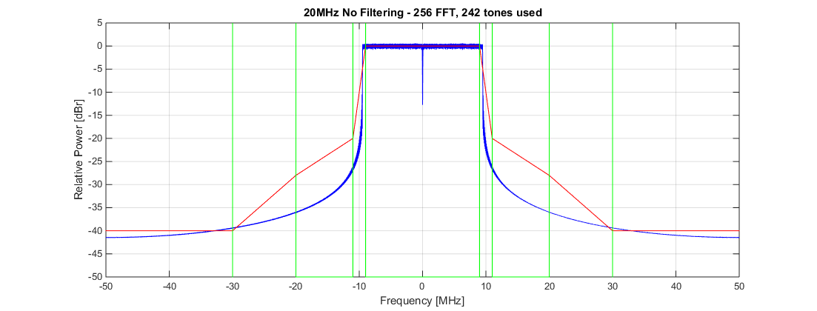
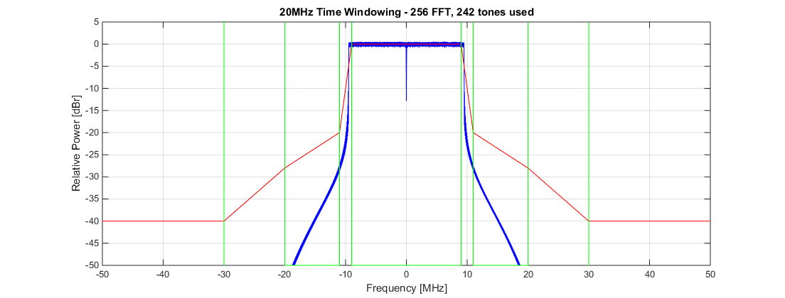
Option 2)
Unable to met the power spectrum mask
without significantly sacrificing EVM

Slide 8
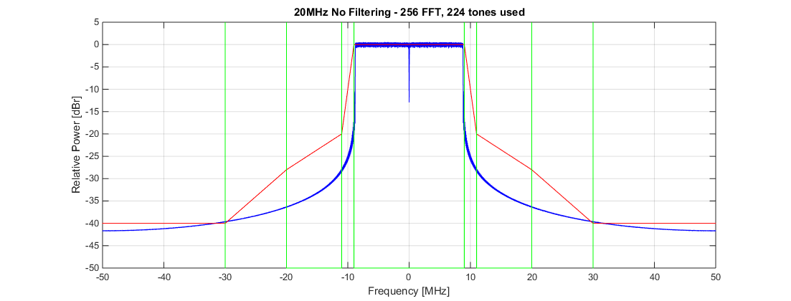
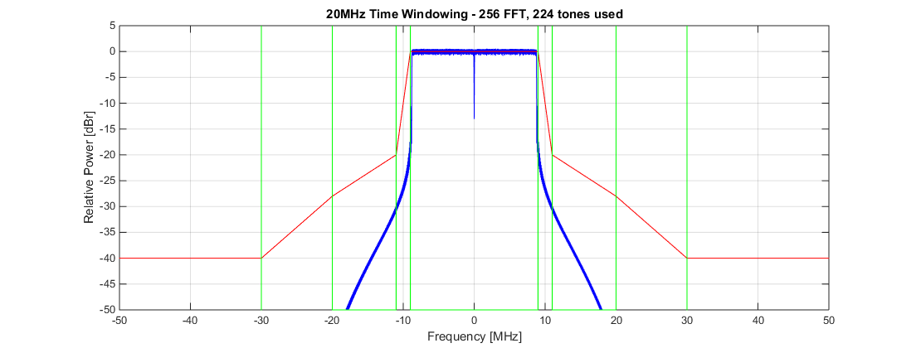
Option 3)

Slide 9
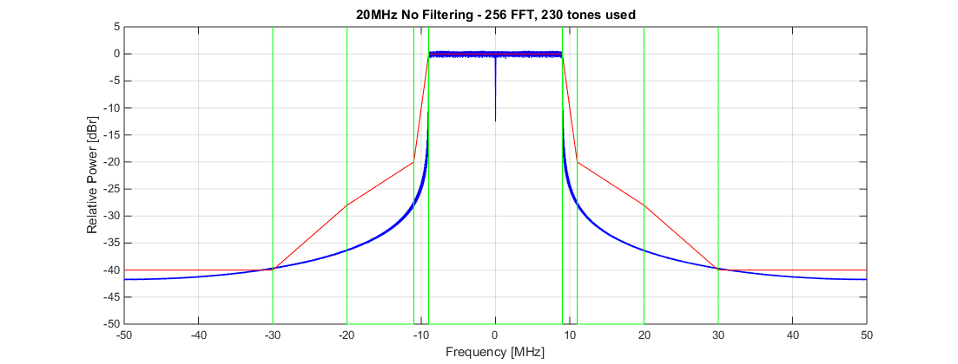
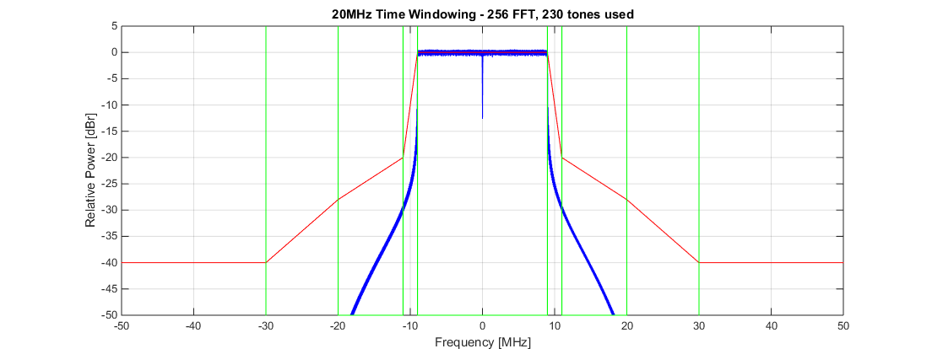
Option 4)

Slide 10
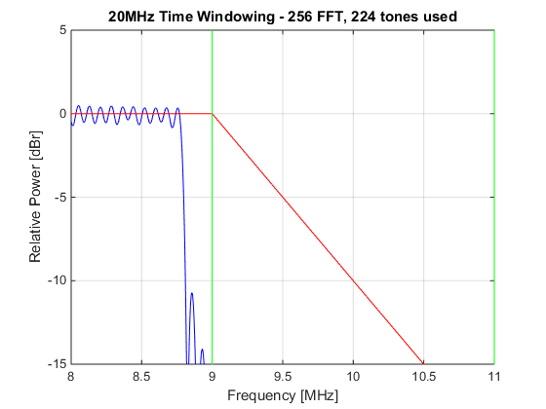
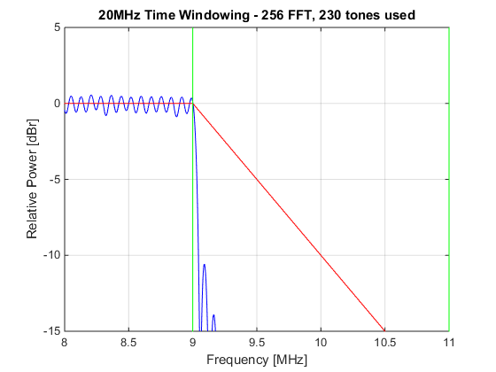
Comparison between option 3 and 4
230 data/pilot tone is the maximum number of tones available without exceeding the power spectrum mask requirements

Slide 11
Observations
Option 2, using 11ac 80 MHz numerology as base, is not feasible with existing spectral mask definitions
This method was ok in 11af, because the bandwith was for 6 MHz, while the numerology was for 5 MHz. This gave extra 1 MHz guard frequency to filter out adjacent channel leakages.
In case new spectral mask can be considered, option 2 might be feasible. Wider spectral mask may be considered for 11ax if it does not issues to legacy systems and maintain the same ACI rejection level.
With 78.125 kHz subcarrier spacing, Up to 230 tones in 20MHz may be usable based on current 20 MHz spectral mask.
The actual number should be chosen such that potential technologies for 11ax, such as OFDMA, can be implemented with ease.

Slide 12
Expansion to 40/80/160 MHz
Alternative 1
Direct multiplication of 20 MHz
No further optimization to use the guard subcarriers between bands
Ease to scale sub-channel definitions for OFDMA
Alternative 2
Optimized to use all available spectrum
sub-channel definitions for OFDMA becomes complicated
Unused
40 MHz
Guard Band Gap:
Approximately 2 MHz of spectrum
5.6% of potential capacity for 40 MHz
8.3% of potential capacity for 80 MHz
20 MHz
20 MHz
40 MHz

Slide 13
Discussions
The guard band gap between 20 MHz channels is 28 subcarriers with 78.125 kHz subcarrier spacing
Depending how resource allocation for OFDMA is defined, the extra 28 subcarriers may pose some challenges to definition of sub-channels.
However, the 28 subcarriers represents approximately 5 ~ 8% extra resources.
Therefore, some further discussion will be needed on design and support of OFDMA before conclusions are made.
28 subcarriers (may include some DC tones)
40 MHz
20 MHz
20 MHz

Slide 14
Maximum Spectral Efficiency Gain with 0.4 us CP
0.4 us
3.2 us
Subcarrier Spacing 312.5 kHz
(64 FFT in 20 MHz)
Subcarrier Spacing 78.125 kHz
(256 FFT in 20 MHz)
0.4 us
12.8 us
Single [78.125 kHz] OFDM symbol (13.2 us) = 3.67 [312.5kHz] OFDM Symbol
[estimated] 226 – 214 data tones
52 x 3.67 = 190.67 Data tones
18.53 % ~ 12.24 % spectral efficiency gain compared to 64 FFT per 20MHz

Slide 15
Maximum Spectral Efficiency Gain with 0.8 us CP
0.8 us
3.2 us
Subcarrier Spacing 312.5 kHz
(64 FFT in 20 MHz)
Subcarrier Spacing 78.125 kHz
(256 FFT in 20 MHz)
0.8 us
12.8 us
Single [78.125 kHz] OFDM symbol (13.6 us) = 3.4 [312.5kHz] OFDM Symbol
[estimated] 226 – 214 data tones
52 x 3.4 = 176.8 Data tones
27.8 % ~ 21.04 % spectral efficiency gain compared to 64 FFT per 20MHz

Slide 16
Maximum Spectral Efficiency Gain with 1.6 us CP
1.6 us
3.2 us
Subcarrier Spacing 312.5 kHz
(64 FFT in 20 MHz)
Subcarrier Spacing 78.125 kHz
(256 FFT in 20 MHz)
1.6 us
12.8 us
Single [78.125 kHz] OFDM symbol (14.4 us) = 3 [312.5kHz] OFDM Symbol
[estimated] 226 – 214 data tones
52 x 3 = 156 Data tones
44.87 % ~ 37.18 % spectral efficiency gain compared to 64 FFT per 20MHz

Slide 17
Discussions on potential efficiency gains
For traditional deployment environments (e.g. Indoor) that has small channel delay spread, use of smaller subcarrier spacing results in modest maximum spectral efficiency gains, approximately 10% ~ 20%.
For deployments with large channel delay spread, use of small subcarrier spacing definitely improves overall efficiency.
Therefore, TGax group needs to discuss the supported deployment type (and supported channel delay spreads) for 11ax, before determination and adoption of larger FFT sizes.

Slide 18
Reference
Jinsoo Choi, et al., “Envisioning 11ax PHY Structure - Part I,” doc. num. 11-14/0804r1, July 2014.
Dongguk Lim, et al., “Envisioning 11ax PHY Structure - Part II,” doc. num. 11-14/0801r0, July 2014.
Heejung Yu, et al., “Issues on 256-FFT per 20MHz” doc. num. 11-14/1228r1, November 2014

Slide 19
Annex: Time Windowing
τ = 100ns (T_{TR}), time window roll-off period
T : OFDM Symbol duration + CP duration
Other time windowing is possible. This is the example from 802.11a specification.

