Slide 1
Support of Outdoor Environments
Date: 2015-01-12
Authors:

Slide 2
Backgrounds
TGax includes outdoor environment as one of possible operation scenarios.
  In PAR [1]:
    ... Improvements will be made to support environments such as wireless corporate office, outdoor hotspot, dense residential apartments, and stadiums.
As current IEEE 802.11 protocol is optimized for indoor environments, supporting outdoor operation may require quite a lot of modification from current protocol.
  It is needed to consider the extent of modification that is beneficial and reasonable.

Slide 3
Outdoor environments
Channel statistics of outdoor environments are severer than indoor environments, and several solutions were discussed to resolve these issues:
  Large delay spread [2][3]
    Longer Guard Interval to cope with most of channel delay spread.
    Longer OFDM symbol duration by using larger FFT size to compensate for additional overhead of using longer GI value.
  Faster channel variation in time [4]
    Traveling or scattered pilot design to obtain up to date channel status information while decoding a packet
However, these are several more issues to be considered, especially to support backward compatibility.

Slide 4
Preamble structure
Even if longer GI and longer symbol duration is used for 802.11ax frame, due to support of backward compatibility, it is highly likely that new preamble format will start from Legacy fields, similar to 802.11n/ac.
Therefore, we need to check if Legacy fields work well in outdoor environment.
  If decoding of L-SIG field fails, regardless of GI duration of new PHY format, it is highly likely that receiver may not decode the received frame successfully.
If L-SIG decoding performance is degraded a lot in outdoor environment, we may need to consider preamble structure that can overcome L-SIG decoding failure such as
  Can detect and decode HE-SIG field even if L-SIG decoding fails.
  Not relying on information on L-SIG field

Slide 5
Control frame transmission
Due to backward compatibility and more robust protection, non-HT (duplicated) frame format is widely used for some of control frame transmission.
  RTS/CTS frame
  ACK/BA frame
Therefore, even though longer GI and longer symbol duration is used for 802.11ax frame, there’s still chances that outdoor performance will be limited by these control frame transmission.
If reception performance of legacy control frames is degraded a lot in outdoor environment, we may need to consider additional protection mechanisms such as
  Additional use of RTS/CTS frame exchange in HE frame format
  CTS-to-Self in non-HT frame format followed by RTS/CTS frame exchange in HE frame format

Slide 6
Management frame transmission
As it is possible that legacy STAs may be associated with an outdoor 802.11ax AP, management frames may be transmitted in non-HT frame format, unless the AP doesn’t allow legacy STA’s association.
  Beacon frame
Therefore, even though longer GI and longer symbol duration is used for 802.11ax frame, there’s still chances that outdoor STAs may miss critical management frames, or the coverage of an BSS may be limited by that of non-HT frame transmission.
If reception performance of management frames in legacy format is degraded a lot in outdoor environment, we may need to consider to limit the usage cases such as
  Sending management frames in HE format only, which implies that legacy STAs will not be associated to the outdoor BSS.
  Sending management frames in both legacy and HE format, which may increase additional signaling overhead.

Slide 7
Simulation Setup
Parameters | Values
System Bandwidth | 20 MHz
Channel Models | - ITU UMi NLOS - 3GPP EPA - 3GPP ETU
Channel Estimation | Real channel estimation Based on L-LTF for L-SIG, SIG-A, legacy Data Based on VHT-LTF for VHT Data
Cyclic prefix length | 0.8 us (for all OFDM symbols)
Residual Frequency offset | None
Symbol Timing estimation | Ideal (perfectly known)
Phase Noise | None

Slide 8
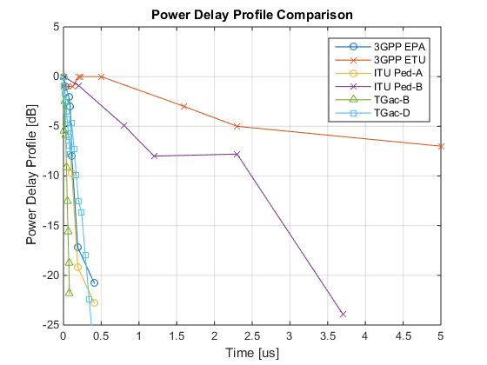
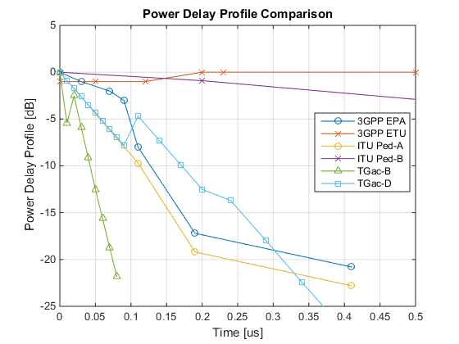
Power delay profile for outdoor channels
Fixed power delay profiles
Close-up of the figure on the left
 | 3GPP EPA | 3GPP ETU | ITU Ped-A | ITU Ped-B | TGac B | TGac D
RMS Delay Spread | 43.13 ns | 990.94 ns | 45.99 ns | 633.42 ns | 15.65 ns | 49.95 ns
Max Delay Spread | 410 ns | 5000 ns | 410 ns | 3700 ns | 80 ns | 390 ns

Slide 9
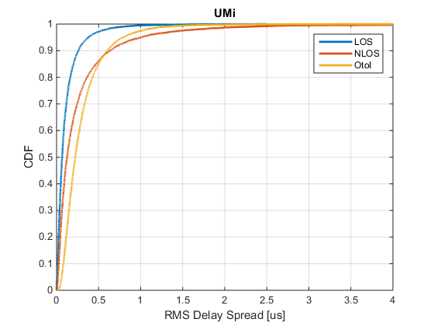
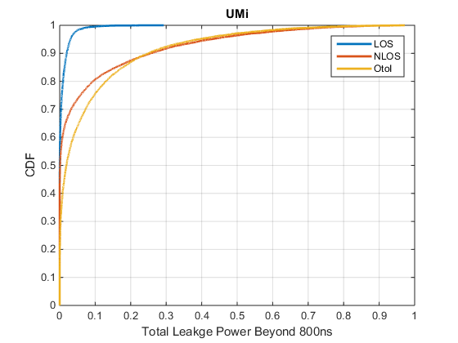
Random Power Delay Profile (ITU UMi)
Total leakage power of excess delay beyond 800ns and maximum delay spread is shown above.
Statistically,
  13% of the NLOS/OtoI users have total leakage power of more than 20% in the excess delay (>0.8us)
  6% of the NLOS/OtoI users have total leakage power of more than 40% in the excess delay (>0.8us)
  3% of the NLOS/OtoI users have total leakage power of more than 60% in the excess delay (>0.8us)
  0.5% of the NLOS/OtoI users have total leakage power of more than 80% in the excess delay (>0.8us)
  than 800 ns.

Slide 10
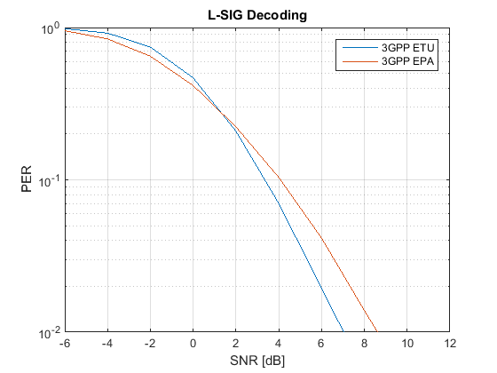
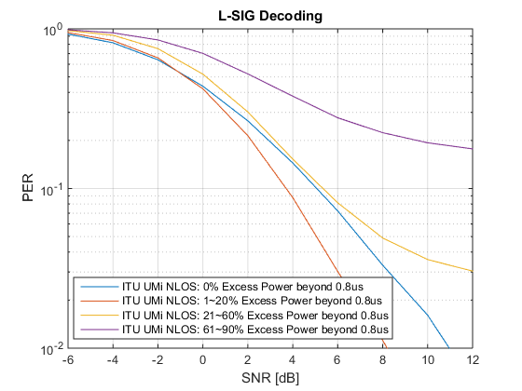
L-SIG decoding performance
L-SIG uses L-LTF for channel estimation
L-LTF has Double GI (1.6us cyclic prefix), which is twice as large as L-SIG GI
There are some gains from higher channel frequency selectivity (i.e. frequency diversity gain)
For 97% of NLOS STAs (ITU UMi), there’s only negligible performance degradation in L-SIG decoding due to excess delay spread.

Slide 11
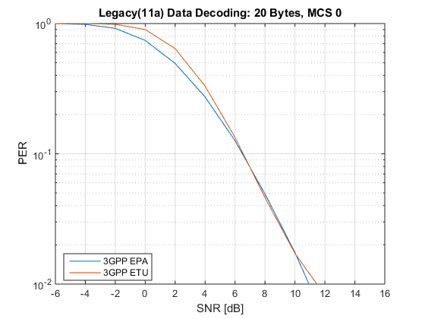
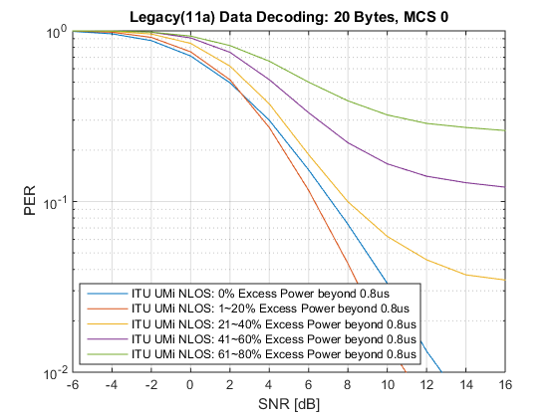
Legacy(11a) Data 20 Bytes, MCS 0
For 97% of NLOS STAs (ITU UMi), there’s only up to 1dB performance degradation in decoding non-HT short control frames due to excess delay spread.

Slide 12
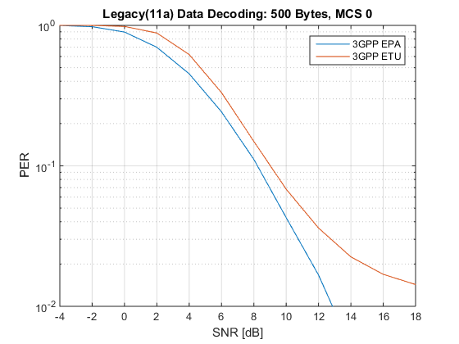
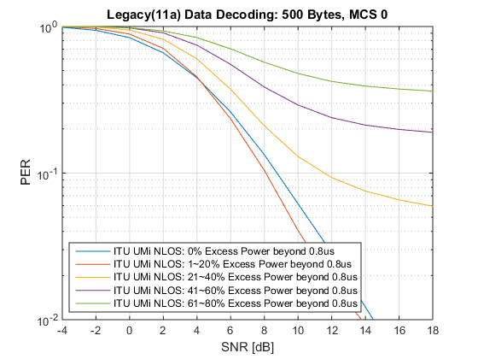
Legacy(11a) Data 500 Bytes, MCS 0
For 13% of NLOS STAs (ITU UMi) STAs experience over 3dB performance degradation in decoding non-HT management frames due to excess delay spread.
More than 3% of NLOS STAs (ITU UMi) STAs cannot meet 10% PER in decoding non-HT management frames due to excess delay spread.

Slide 13
Conclusions
Several issues in supporting outdoor environment were considered, and their impact was analyzed.
  Legacy fields at the PHY header
    Negligible performance degradation is observed.
  Short control frames in non-HT frame format
    Slight performance degradation (less than 1dB for most STAs) was observed.
    Even though protection coverage of control frames may be slightly reduced, it may not have any critical performance degradation.
  Management frames in non-HT frame format
    For 13% of NLOS STAs (ITU UMi) STAs experience over 3dB performance degradation, and 3% of STAs may not receive management frames under 10% PER target.
    Overall BSS coverage may be limited by Beacon frame transmission performance.

Slide 14
References
[1] 11-14/0165r1, “802.11 HEW SG Proposed PAR”.
[2] 11-14/1439r0, “Preamble Considerations in Large Channel Delay Spread Scenarios”
[3] IEEE 802.11-14/0882r3, “IEEE 802.11ax Channel Model Document”
[4] 11-13/0843r0, “Further evaluation on outdoor Wi-Fi”

Slide 15
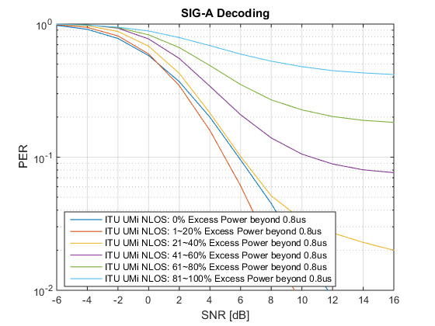
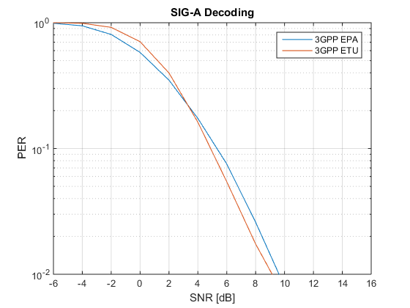
Appendix: SIG-A decoding performance
Similar observations as L-SIG

Slide 16
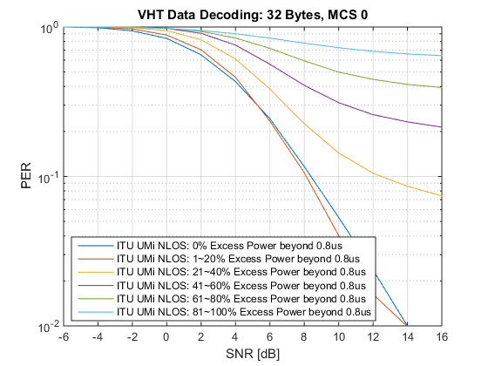
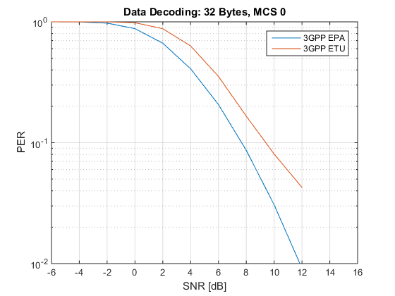
Appendix: VHT Data: 32 Bytes, MCS 0
Data uses VHT-LTF for channel estimation
VHT-LTF is more susceptible to ISI compared to L-LTF
The channel estimation error from ISI negates all gains from frequency diversity
Approx. 1.5dB loss for 32 Byte data at MCS 0

Slide 17
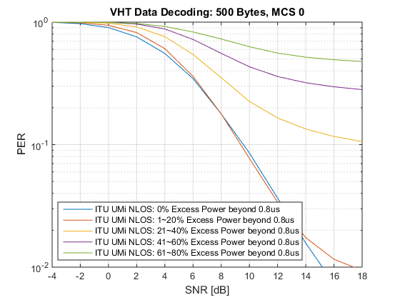
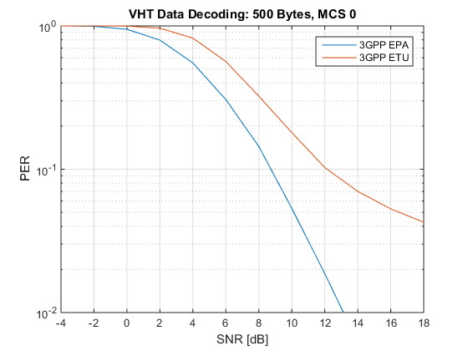
VHT Data: 500 Bytes, MCS 0

Slide 18
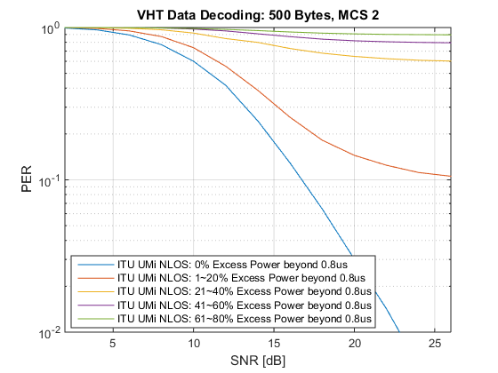
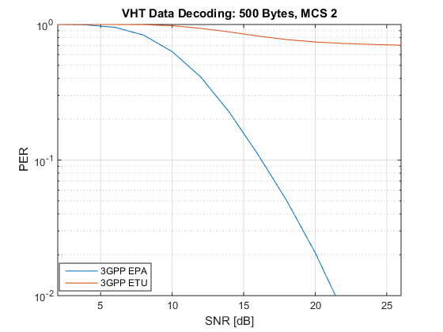
Appendix: VHT Data: 500 Bytes, MCS 2

Slide 19
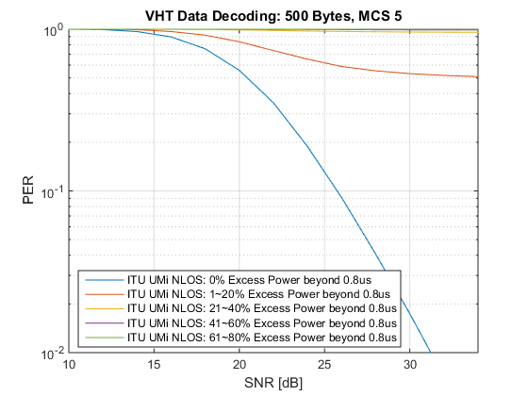
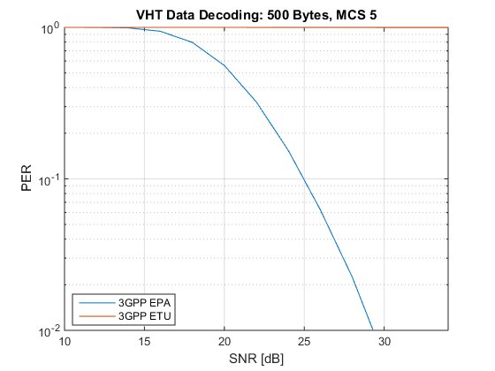
Appendix: VHT Data: 500 Bytes, MCS 5

Slide 20
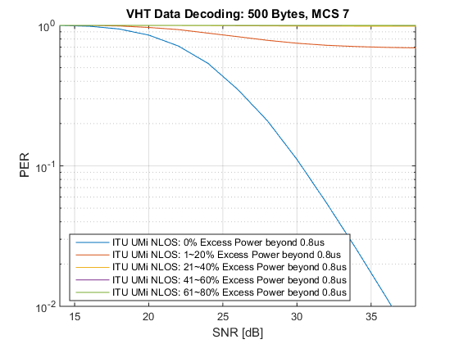

Appendix: VHT Data: 500 Bytes, MCS 7

