Slide 1
Downlink OFDMA Protocol Design
Date: 2015-01-11
Authors:

Slide 2
OFDMA Support in High Efficiency (HE) BSS
TGax Specification Framework [1]
4. Multi-user (MU) features This section describes MU related features. MU features include UL and DL OFDMA and UL and DL MU-MIMO.
But, in order to sustain a gain of OFDMA, the frequency selective scheduling is very important [5]
This document discusses the Downlink OFDMA protocol design to enable the frequency selective scheduling

Slide 3
Downlink OFDMA General Procedure
First step is that HE AP obtains the frequency selectivity information of the recipient STAs
Second step is that HE AP determines the sub-channel assignment structure based on the frequency selectivity information
HE AP transmits the Downlink OFDMA PPDU wherein the sub-channel assignment structure is contained in the PHY header

Slide 4
Frequency Selectivity Information
The frequency selectivity information of recipient STAs can be obtained in an explicit or implicit manner
The recipient STA may report its frequency selectivity information to HE AP in a solicited or unsolicited manner
For example, the recipient STA may include its frequency selectivity information in the ACK frame, similarly to the Link Adaptation mechanism of 11ac
Also, HE AP can estimate the frequency selectivity information of recipient STAs from any received frames
Assume the channel reciprocity between HE AP and recipient STA

Slide 5
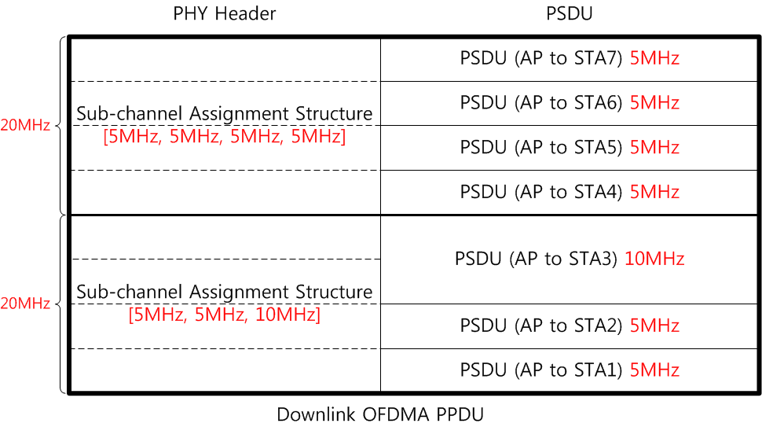
Sub-channel Assignment Structure
HE AP determines the sub-channel assignment structure for segmenting the Channel Bandwidth into a set of sub-channels
The sub-channel assignment structure is included in PHY Header
All sub-channels in the sub-channel assignment structure are assigned to recipient STAs

Slide 6
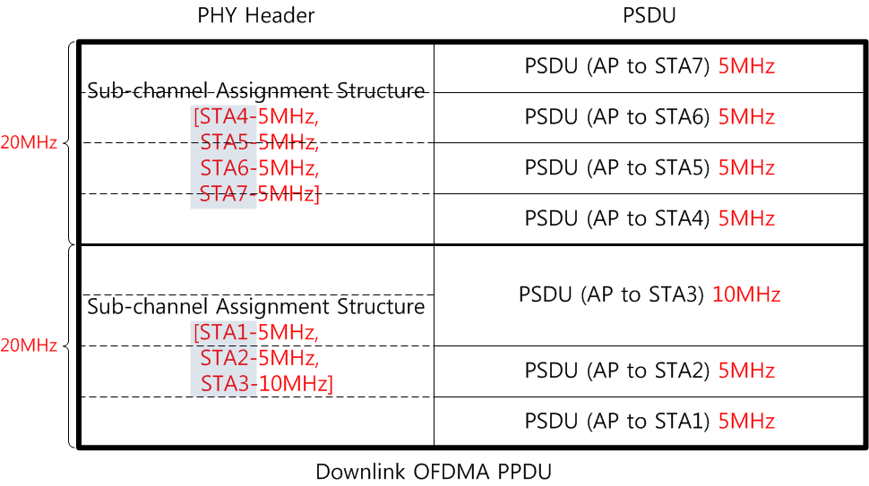
Sub-channel Assignment Structure
The recipient information of the Downlink OFDMA PPDU should be also signaled in the PHY Header
Each recipient receives the addressed PSDU on its assigned sub-channel identified by the Sub-channel Assignment Structure field

Slide 7
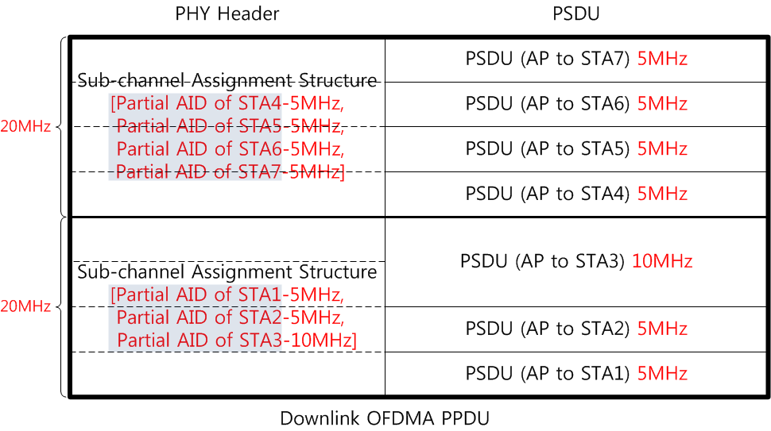
Sub-channel Assignment Structure
The recipient information of the Downlink OFDMA PPDU can be signaled by the Association ID (13 bits), Partial AID (9 bits) or Group ID (6 bits)
Since the available bits of PHY Header is very limited, Partial AID or Group ID has a benefit for reducing the signaling overhead

Slide 8
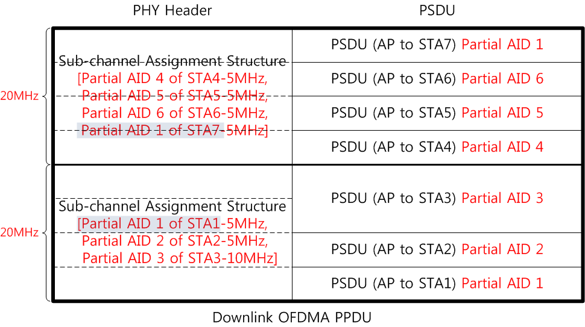
Sub-channel Assignment Structure
When Partial AID is used to indicate the recipient information of the Downlink OFDMA PPDU, HE AP have to carefully schedule recipient STAs to avoid the ambiguity of the sub-channel determination
If the partial AIDs of the recipient STAs in the Downlink OFDMA PPDU is same, the corresponding recipient STAs can not identify their assigned sub-channel

Slide 9
Sub-channel Assignment Structure
When Group ID is used to indicate the recipient information of the Downlink OFDMA PPDU, HE AP have to carefully schedule recipient STAs to avoid the ambiguity of the sub-channel determination
If a recipient STA has memberships of a plurality of Group IDs, the corresponding recipient STA can not identify its assigned sub-channel
In the below figure, even though AP does not transmit any space time stream with the Group ID 2, 3 and 4 to STA1, STA1 does not know its sub-channel. This situation should be avoided.

Slide 10
Conclusion
This document presents the Downlink OFDMA protocol design considerations
the frequency selectivity information of the recipient STA
the sub-channel assignment structure to the recipient STA
Also, this document proposes the PHY Header design consideration of the Downlink OFDMA PPDU
Because TGax Specification Framework decided to support the Uplink OFDMA and Uplink MU-MIMO, the final PHY Header design should be harmonized with all other features

Slide 11
References
[1] https://mentor.ieee.org/802.11/dcn/14/11-14-1453-02-00ax-spec-framework-proposal.docx
[2] https://mentor.ieee.org/802.11/dcn/14/11-14-1210-01-00ax-hew-ppdu-format-for-supporting-mimo-ofdma.pptx
[3] https://mentor.ieee.org/802.11/dcn/14/11-14-1211-00-00ax-ack-procedure-for-ofdma.pptx
[4] https://mentor.ieee.org/802.11/dcn/14/11-14-1417-00-00ax-hew-ppdu-transmission-discussion.pptx
[5] https://mentor.ieee.org/802.11/dcn/14/11-14-1452-00-00ax-frequency-selective-scheduling-in-ofdma.pptx

