Slide 1
Consideration on UL-MU overheads
Date: 2015-01-12
Authors:

Slide 2
Abstract
This presentation considers impact of UL-MU overheads.

Slide 3
UL-MU
UL-MU is more difficult than DL-MU because STAs have to synchronize their transmissions.
The easiest way to achieve synchronization is by an AP’s support.
But the AP doesn’t really know which STA has data to transmit.
To find out STAs’ transmission demands, asking one by one is the steadiest way, but that will be a large overhead.
On the other hand, if we can do UL MU transmission for data, then response frames can also be in MU transmission.

Slide 4
UL-MU
Assume to divide into 3 phases for UL-MU transmission.
Initial phase
UL data transmission phase
DL response phase

Slide 5
Initial phase
Both exchanges in legacy rate (24 Mbps)
Assume two approaches
AP asks STAs one by one if they have Tx demands
ref. doc.11-14/0598
method 1
method 2
AP
Inquiry
Inquiry
…
Inquiry
Poll
Poll
≒RTS
≒QoS CF-Poll
≒CTS
STA 1
Resp.
TxReq
≒CTS
≒RTS
to N_m
STAs
STA 2
Resp.
…
…
STA N_m
Resp.
N_m: number of STAs multiplexed (4)
Note: above conventional frames were used as substitutes for throughput calculation (may be too convenient)

Slide 6
DL response phase
Assume two approaches
BA to all N_m STAs by DL-MU
All exchange in legacy rate (24 Mbps)
method A
method B
AP
BA
BA
BA
BA
STA 1
BAR
STA 2
BAR
…
…
…
STA N_m
BAR
N_m: number of STAs multiplexed (4)

Slide 7
Comparison cases
Initial phase
UL data transmission phase
DL response phase
Throughput comparison on DL response phase methods (method 1-A and 1-B)
method 1
method A
method 2
method B
Throughput comparison on initial phase methods (method 1-B and method 2-B)

Slide 8
Throughput calculation
N_m: number of STAs multiplexed (and also inquired for method 1) (4)
assumed OFDMA using short GI for MU transmission
TXOP limit = 0
20 MHz bandwidth, 1SS, MCS 8
  assumed 24 us for HE preamble part (+4 us to VHT preamble)
full buffer, error free

Slide 9
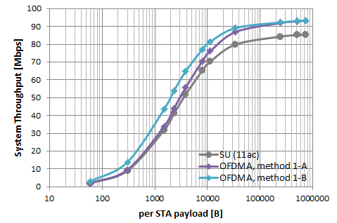
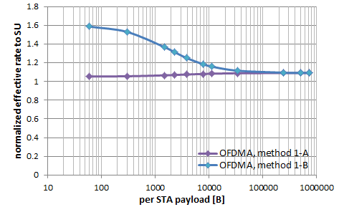
Throughput comparison on
DL response phase methods
Initial phase: method 1
DL response phase: method A vs. method B

Slide 10
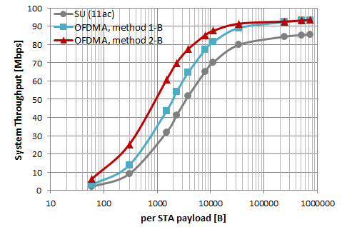
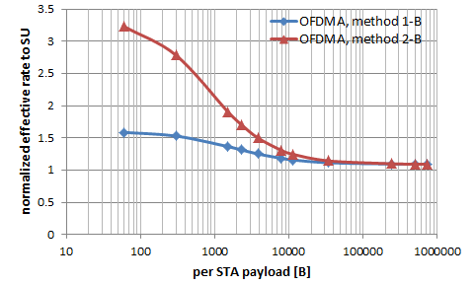
Throughput comparison on initial phase methods
Initial phase: method 1 vs. method 2
DL response phase: method B

Slide 11
From the results…
DL BA responses after UL-MU transmission should be multiplexed (in some way, such as transmit in DL MU or extend BA frame format to carry multiple STAs’ responses).
Initial phase prior to UL-MU transmission should be simple. Need to find a more rough way to grasp or estimate TX demands.

Slide 12
Straw Poll
The amendment shall include a mechanism by which DL BA/ACK responses are multiplexed
  eg. DL MU-MIMO, DL-OFDMA, single PSDU
  Yes:
  No:
  Abstain:

