Slide 1
MU Beamformee capabilities indication in VHT
Date: 2015-01-05
Authors:

Slide 2
Introduction
A VHT non-AP STA indicates the following MU-related capabilities in the VHT Capabilities element:
  Beamformee capable:
    Whether it can receive frames in MU format
  “Beamformee STS capability”
    One value indicating:
        Maximum number of streams it can receive in an NDP, AND
        Maximum number of rows in Compressed feedback, AND
        Maximum value of N_sts_total it can receive in a VHT MU PPDU
With the current signaling, 1, 2 and 3 are forced to the same value

Slide 3
What’s the problem?
1 and 2 relate to sounding capabilities
  Limited by SVD implementation
  Capability indication allows implementers to dimension complexity of this block
3 relates to reception of data frames
  No SVD required
  No processing of all N_sts_total streams required
    Channel estimation and equalization can be limited to streams intended for the user
It is not natural to force these capabilities to be the same
  Different operations and complexity at play
  Max sounding capability ≠ Max N_sts_total in received data frame

Slide 4
What’s the problem? (2)
For example:
  STA may be limited to sending 3SS feedback, but may have no problem processing an MU frame with N_sts_total = 4 as long as N_sts ≤ 3
    In fact, in both cases, VHT-LTF has 4 symbols
    With the current signaling, Beamformee STS capability has to be set to 3
Forming of MU groups is constrained by STAs with the lowest value of Beamformee STS capability
  N_STS_total needlessly limited

Slide 5
Proposal
Decouple the signaling of both capabilities
  One value for sounding capabilities
    Max number of streams in NDP
    Max number of rows (per tone) in compressed feedback
  One value for MU PPDU max N_sts_total capability
This maintains maximum flexibility in operation, without forcing STAs to implement either extended sounding capabilities or PPDU processing capabilities
  E.g. STA can process N_sts_total of 4, but does only want to implement 3x3 SVD complexity

Slide 6
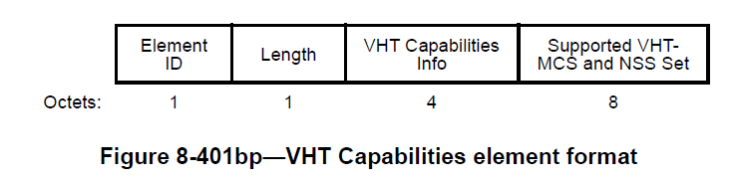
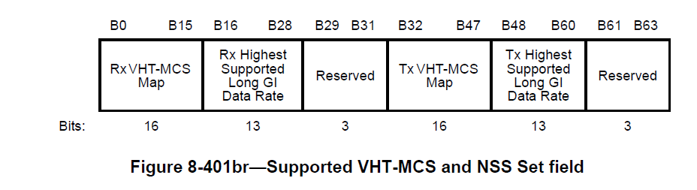
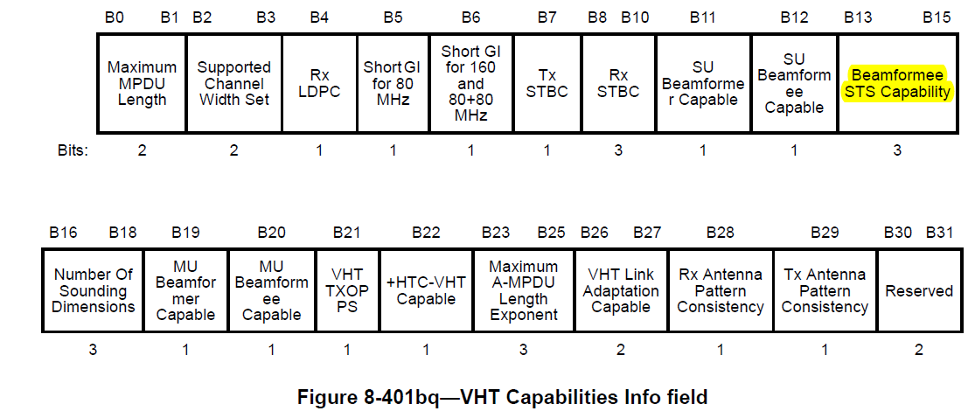
Current signaling: VHT Capabilities element

Slide 7
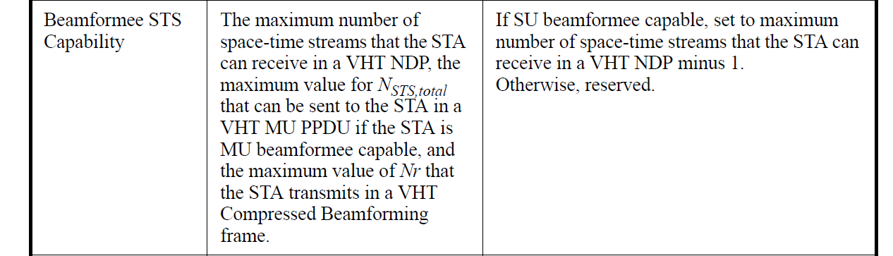
Current Signaling (2)
Current signaling:
  3 bits in VHT Capabilities Info Field (in VHT Capabilities element)

Slide 8
Proposed signaling (1)
Ground rules:
  Any change should be transparent to devices that are compliant with published 802.11ac-2013
  No additional requirements should be imposed or implied because of the change
Reminder:
  Reserved fields and subfields are set to 0 upon transmission and are ignored upon reception (See 8.2.2 in 802.11-2012)

Slide 9
Proposed signaling (2)
Supported VHT-MCS and NSS Set field has 6 reserved bits
  This field is a natural fit for signaling the max. value of N_sts_total in MU PPDU reception
  All content is related to Rx and Tx MCS/N_STS support

Slide 10
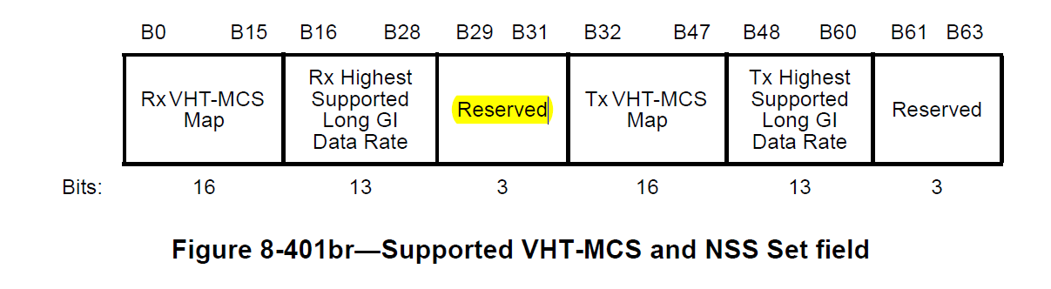
Proposed signaling (3)
Use reserved bits B29-B31 in Supported VHT-MCS and NSS Set field
Modify the interpretation of B29-B31 as follows:
  Value 1-7
    the value is N_sts_total-1
    The existing “Beamformee NSTS Capability field” contains the max sounding capability
  Value 0
    N_sts_total is signaled in “Beamformee NSTS Capability field”
Note: we only need 7 values for N_sts_total, since a maximum supported N_sts_total of 1 is not MU

Slide 11
Backwards compatibility
A compliant 802.11ac-2013 non-AP STA indicating its Beamformee capabilities will:
  Set B29-B31 to zero (reserved)
  Signal both max. N_sts_total and max Sounding in “Beamformee NSTS Capability field”
  Both 802.11ac-2013 and “11mc” APs will correctly interpret this
100 % compatible with MU-capable STAs

Slide 12
Backwards compatibility (2)
A compliant 802.11ac-2013 AP receiving a VHT Capabilities element will:
  Ignore B29-B31
  Always assume that the STAs N_sts_total and max Sounding are identical and equal to the value given in “Beamformee NSTS Capability field”
  AP may underestimate the “real” N_sts_total Capability of an “11mc” STA, but the assumed capability would be on par with that of current 802.11ac-2013 devices
  Compatible with current devices, even if current APs can’t exploit full capability of the “new” devices
NOTE: it’s natural to assume that N_sts_total will always be the larger of the two values

Slide 13
Summary
MU Beamformee Sounding capability should be decoupled from MU PPDU reception capability
  Without burdening current or future devices with extra complexity
Proposed signaling scheme achieves this
  Natural fit within “Supported VHT-MCS and NSS Set field”
  Totally transparent to 802.11ac-2013 compliant devices
Detailed text changes are documented in separate Word document

