Slide 1
Non-Uniform Constellations for Higher Order QAMs
Date: 2015/01/12
Authors:

Slide 2
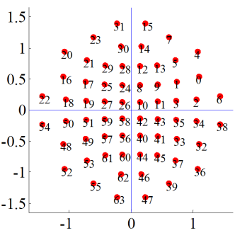
Motivation (1/2)
1024-QAM discussed as potential technology for ax to increase peak data rate (indoor and in-room), e.g. [1]
  25% increased spectral efficiency compared to 256-QAM
  1Gbit/s with 1 spatial stream (160MHz, code rate 5/6, short GI)
Non-uniform constellations (NUCs) provide increased performance compared to uniform constellations (UCs)
  Optimum location of constellation points
  Robust and weak bits carry
  optimum amount of information

Slide 3
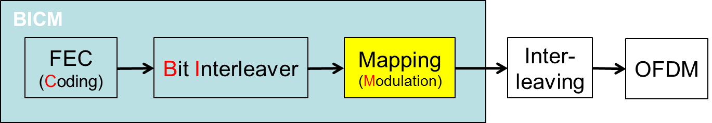
Motivation (2/2)
Introduced lately in several broadcast standards
  DVB-NGH [2], DVB/S2x [3]
  Theoretical shaping gain up to 1.5dB
Moderate complexity increase
  Change of QAM (de)mapper

Slide 4
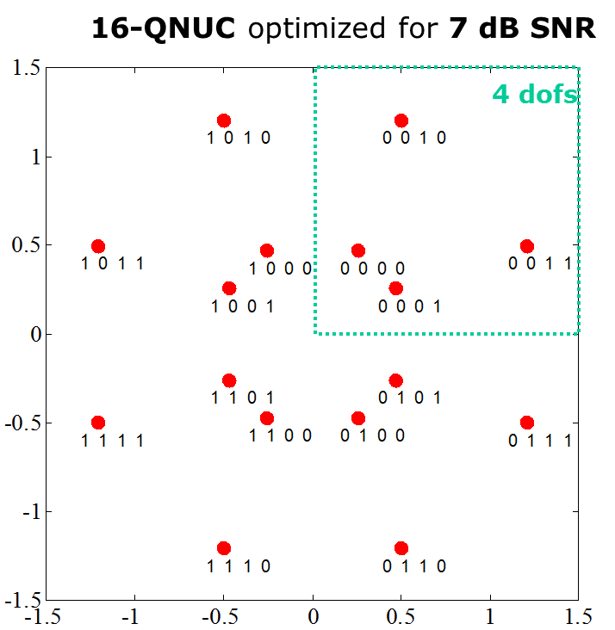
NUC: 1-D vs 2D
1-D NUC: 16-QAM
1-D NUC
  I/Q symmetry
  1-D demapping as for uniform
  constellations (UC), i.e. same order
  of demapping complexity
2-D NUC
  Symmetric quadrants
  Higher gain compared to 1-D NUC
  2-D demapping required
2-D NUC: 16-QAM

Slide 5
Simulations: Parameters
Replacement of original uniform constellations by NUC
Basic MCSs: 0-9
Additionally: 1024-QAM
FEC: LDPC
Message Length: 1000bytes
Channel
  AWGN
  Channel model B
Gain evaluated compared to UC at FER=10⁻²
1D and 2D NUC
MCS index | modulation | bit/symbol | coderate
0 | BPSK | 1 | 1/2
1 | QPSK | 2 | 1/2
2 | QPSK | 2 | 3/4
3 | 16-QAM | 4 | 1/2
4 | 16-QAM | 4 | 3/4
5 | 64-QAM | 6 | 2/3
6 | 64-QAM | 6 | 3/4
7 | 64-QAM | 6 | 5/6
8 | 256-QAM | 8 | 3/4
9 | 256-QAM | 8 | 5/6
 | 1024-QAM | 10 | 2/3
 | 1024-QAM | 10 | 3/4
 | 1024-QAM | 10 | 5/6

Slide 6
Simulations: Results
Channel: AWGN
Gain up to 0.95dB (2D NUC) and 0.75dB (1D NUC) for 1024-QAM
1024-QAM
higher gain for
higher constellations
256-QAM
64-QAM
16-QAM

Slide 7
Simulations: Results
Channel: channel model B
~0.1dB smaller gain compared to AWGN results
1024-QAM
256-QAM
64-QAM
16-QAM

Slide 8
Conclusions
Significant gain of NUC compared to UC
  Gain up to 0.6dB for 256-QAM
  Gain up to 0.9dB for 1024-QAM
Moderate complexity increase
  Isolated change of QAM mapper and demapper
  Same demapper complexity as for uniform constellations for 1-D NUCs
  2-D demapping required for 2-D NUCs

Slide 9
References
Eunsung Park, LG, 11-14-0624-00-00ax Investigation on 1024 QAM feasibility in 11ax
Next Generation broadcasting system to Handheld, physical layer specification (DVB-NGH), DVB BlueBook A160, 2012
DVB-S2X BlueBook A83-2 / EN302307-2

Slide 10
Backup

Slide 11


NUC Example for different SNR Conditions
8NUC for low SNR
8PSK reference
2 over-lapping points
robust
bits
robust
bits
110
010
100
000
weak bits
weak bits
111
011
101
001
0.1282+0.3973+0.3973 = 0.9229
0.0000+0.4859+0.4859= 0.9719
Interpretation: weak bits carry no information, 2 most robust bits with maximum distance
8NUC for high SNR
8PAM reference
robust
bits
robust
bits
110
001
000
100
weak bits
011
weak bits
101
010
111
0.9393+0.9697+0.9697 =2.8787
0.9749+0.9749+0.9779 =2.9276
Interpretation: hexagonal lattice = „dense packing“ , maximize minimum Euclidean distance

