Slide 1
Discussion on Integrated UL/DL MU-MIMO MAC
January 2015
Date: 2015-01-09
Authors:
TaeYoon KIM, Korea University

Slide 2
Abstract
January 2015
This contribution discusses on the integrated structure of uplink (UL) and downlink (DL) MU-MIMO MAC and how to reduce overheads incurred by UL/DL MU-MIMO MAC
TaeYoon KIM, Korea University

Slide 3
Background
January 2015
UL MU-MIMO is decided to be an option for 802.11ax in [1]
A new UL MU-MIMO MAC needs to be devised, which should be well-integrated with DL MU-MIMO MAC
In addition, significant overhead incurred by control messages in the integrated UL/DL MU-MIMO MAC should be mitigated to improve the overall performance
TaeYoon KIM, Korea University

Slide 4
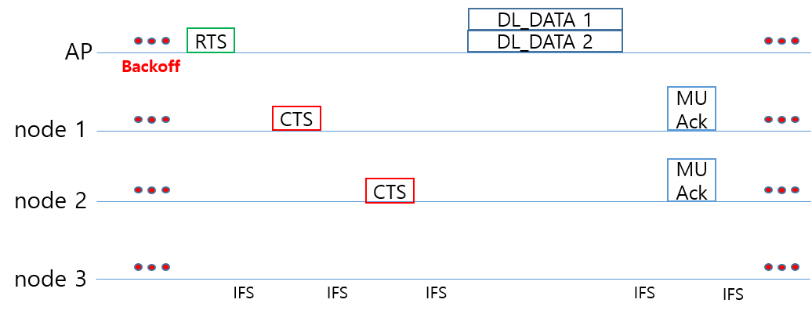
Integrated UL/DL MU-MIMO MAC (1/2)
January 2015
Unified MAC structure
No separation of uplink and downlink phases (i.e., legacy IEEE 802.11 MAC style)
If AP wins the contention, a downlink phase starts
If stations win the contention, an uplink phase starts
Uplink phase
Downlink phase
TaeYoon KIM, Korea University

Slide 5
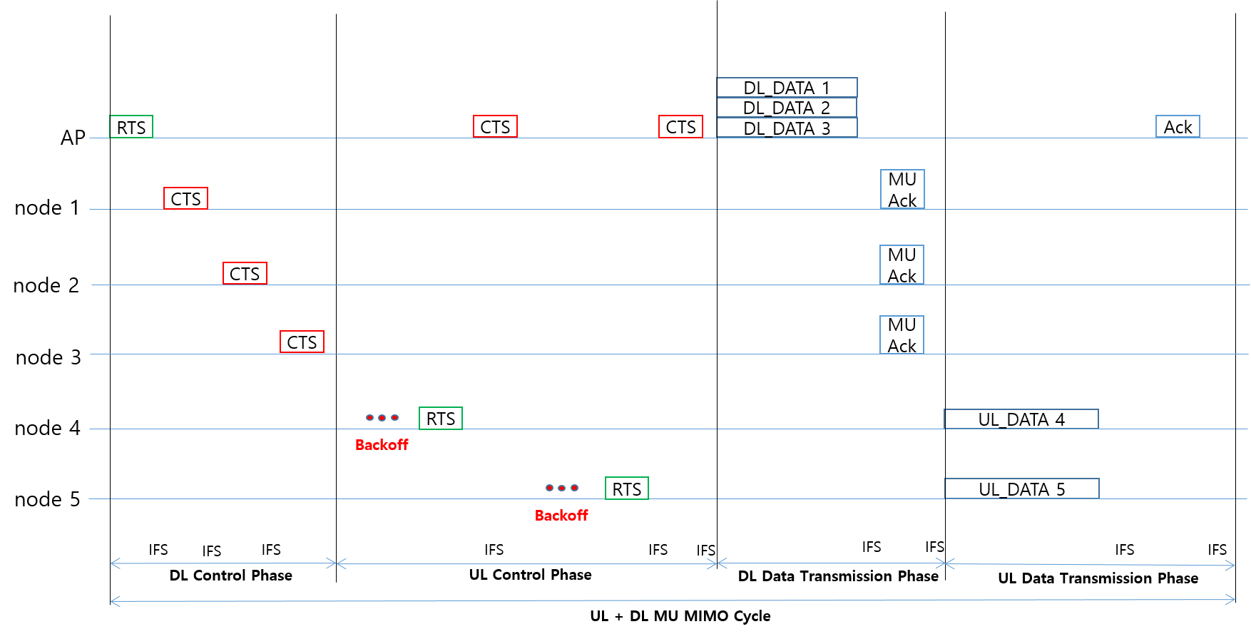
Integrated UL/DL MU-MIMO MAC (2/2)
January 2015
Divided MAC structure
Separation of DL and UL phases
Transmission from and to station can be scheduled in turn, i.e., DL phase + UL phase
TaeYoon KIM, Korea University

Slide 6
Issues in Integrated UL/DL MU-MIMO MAC
January 2015
In unified MAC structure
Backoff priorities for AP and stations should be considered to solve fairness issues in uplink and downlink transmissions
In both unified and divided MAC structures
Significant overhead owing to frequent control messages (RTS/CTS) and IFSs [2]
TaeYoon KIM, Korea University

Slide 7
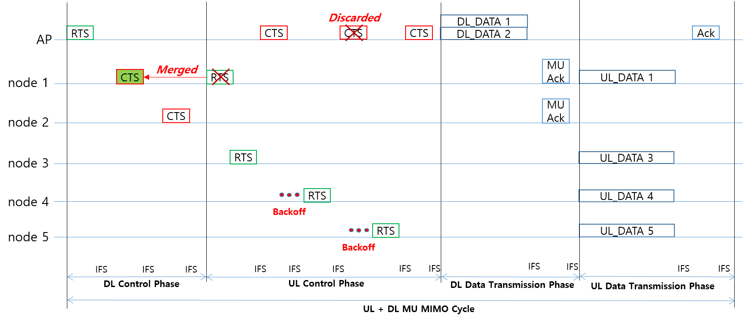
Issues in Integrated UL/DL MU-MIMO MAC
January 2015
How to reduce control overheads
Remove unnecessary CTS frames
e.g., repeated CTS frames from AP at UL control phase
Remove unnecessary RTS frames (for divided MAC structure)
Merge RTS and CTS functionalities for stations with uplink data (e.g., node 1’s CSI can be fed back to AP without RTS frame using CTS of DL control phase)
TaeYoon KIM, Korea University

Slide 8
Conclusion
January 2015
We considered two structures for integrated UL / DL MU-MIMO MAC
Unified MAC structure
Divided MAC structure
We also identified control overhead in integrated UL / DL MU-MIMO MAC
More studies are needed to mitigated the control overhead
TaeYoon KIM, Korea University

Slide 9
References
January 2015
[1] 11-14/1453, “ax-spec-framework-proposal”
[2] 11-14/1431r1, “issues on ul-ofdma”
TaeYoon KIM, Korea University

