Slide 1
Empirical open-air VHT client scaling results for use in validating MAC simulators
Date: 2014-11-05
Authors:

Slide 2
Abstract
Numerous MAC simulation results have been presented based on the Simulation Scenarios (SS). Vendors are cross-checking results.
SS2, SS3 and SS4 involve large numbers of co-located STAs, albeit with induced path loss due to walls, etc.
Aruba has a Very High Density (VHD) lab taking empirical data with late-model clients in open air
This contribution presents actual lab TCP data taken in open air with 50 STAs each of 1SS, 2SS and 3SS. Data is presented for VHT20, VHT40 and VHT80.
Our goal is to help vendors further validate the accuracy of their MAC & PHY simulators by sharing our data set.

Slide 3
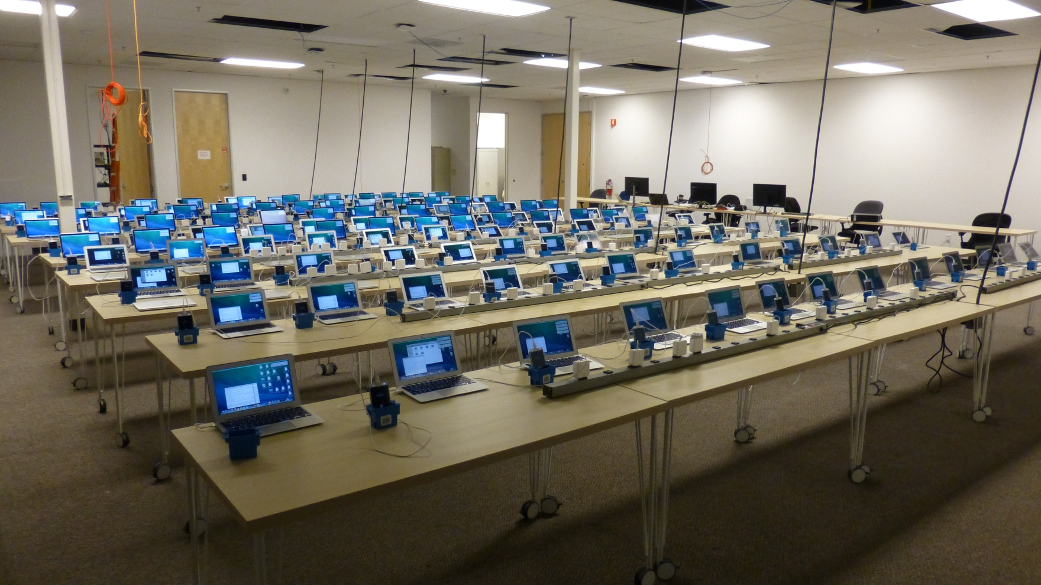
Our Box 5 Emulator

Slide 4
Testbed Configuration
Clients:
Smartphone, 11ac, 1SS, 100 stations
Laptop, 11ac, 2SS, 100 stations
Laptop, 11ac, 3SS, 100 stations
Controller & AP:
7220-US controller running 6.4.0.3-HDMS public code.
Aruba AP225 (11ac 3SS)
LAN:
Jumbo frames enabled
Test Automation:
IxChariot 8.1EA. Separate, dedicated machines for console and wired endpoint.
RF configuration:
Channels - 100E (VHT80), 100+ (VHT40), 100 (VHT20).
Exclusive use of 5490 - 5570MHz / swept daily.

Slide 5
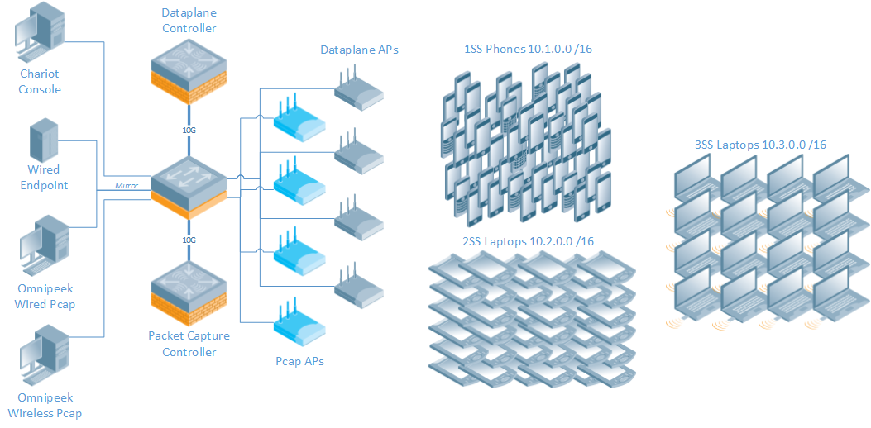
Aruba VHD Testbed Topology

Slide 6
SSID Configuration
wlan ssid-profile "hdtest100-ssid"
essid "HDTest-5"
a-basic-rates 24
a-tx-rates 18 24 36 48 54
g-basic-rates 18
g-tx-rates 18 24 36 48 54
max-clients 255
wmm
wmm-vo-dscp "56"
wmm-vi-dscp "40"
g-beacon-rate 24
a-beacon-rate 24
!
wlan ht-ssid-profile "HDtest-htssid-profile"
max-tx-a-msdu-count-be 3
!
rf dot11a-radio-profile "hdtest100-11a-pf"
channel 100E
disable-arm-wids-functions Dynamic
!

Slide 7
Known Issues
VHT80 - 3SS Laptop TCP Downstream
VHT80 – 1SS Phone TCP Bidirectional
VHT20 – 3SS Laptop TCP Upstream

Slide 8
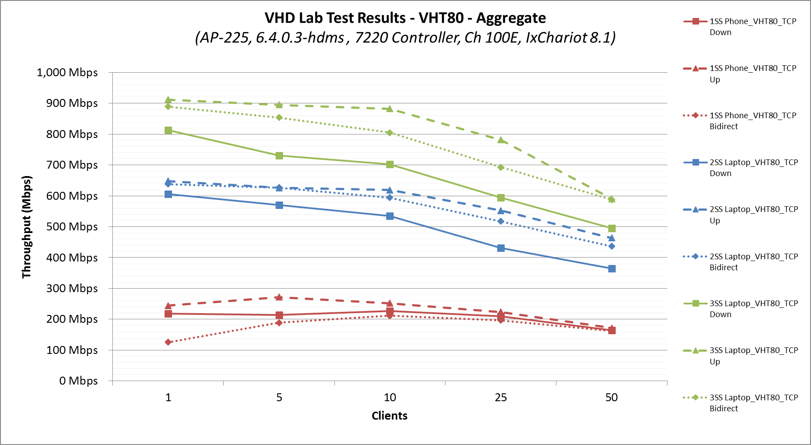
VHT80 - 1SS, 2SS & 3SS (Aggregate - Mbps)

Slide 9
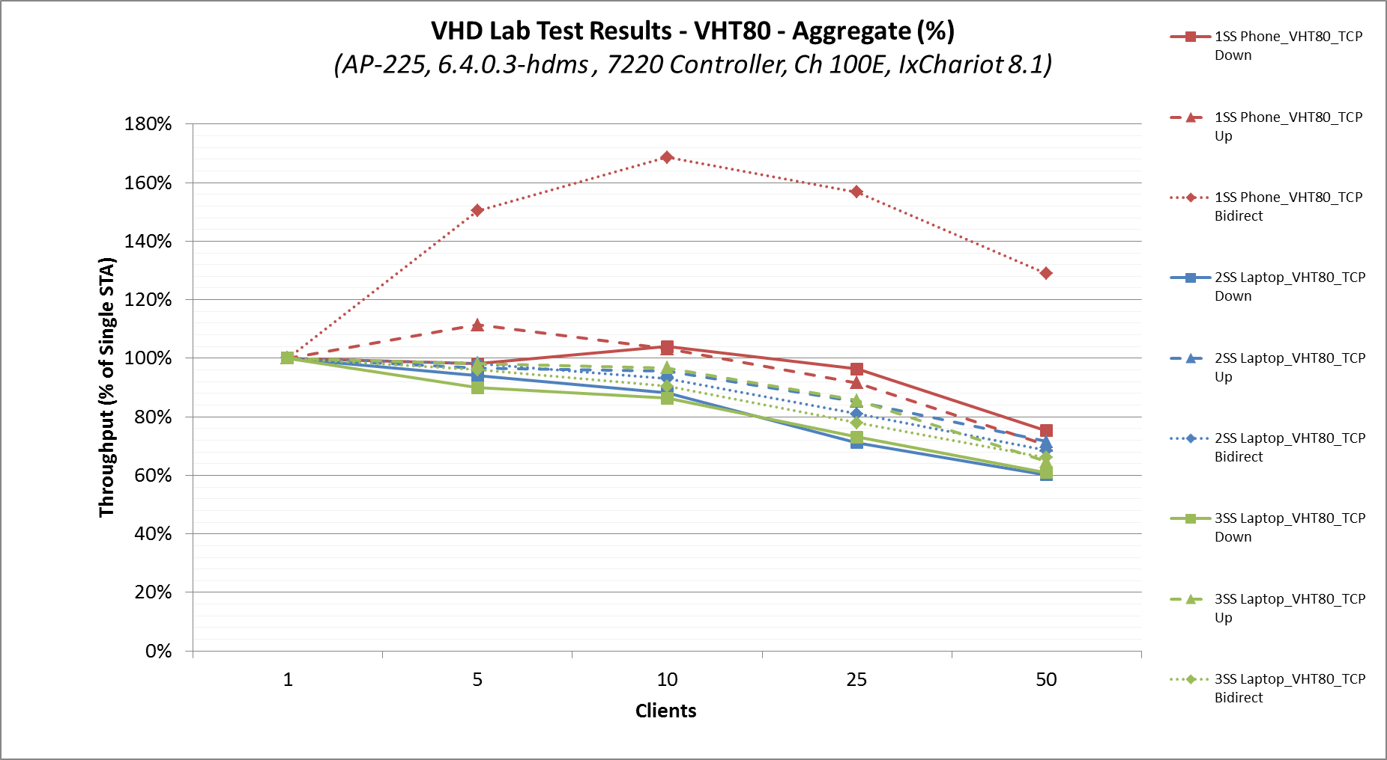
VHT80 - 1SS, 2SS & 3SS (Aggregate - %)
25% - 40% contention premium

Slide 10
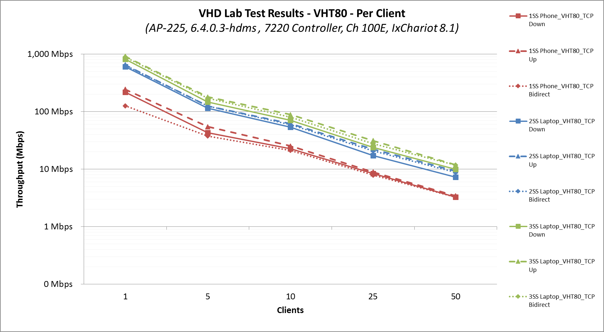
VHT80 - 1SS, 2SS & 3SS (Per-Client Avg)

Slide 11
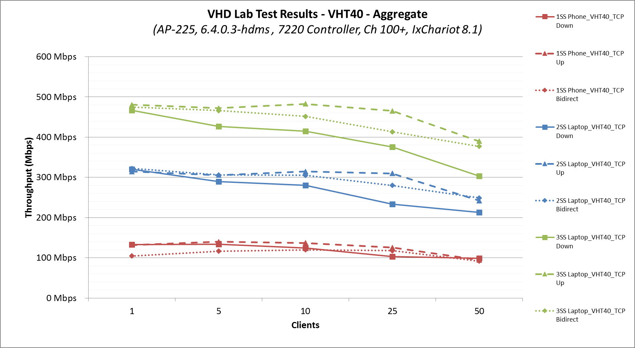
VHT40 - 1SS, 2SS & 3SS (Aggregate - Mbps)

Slide 12
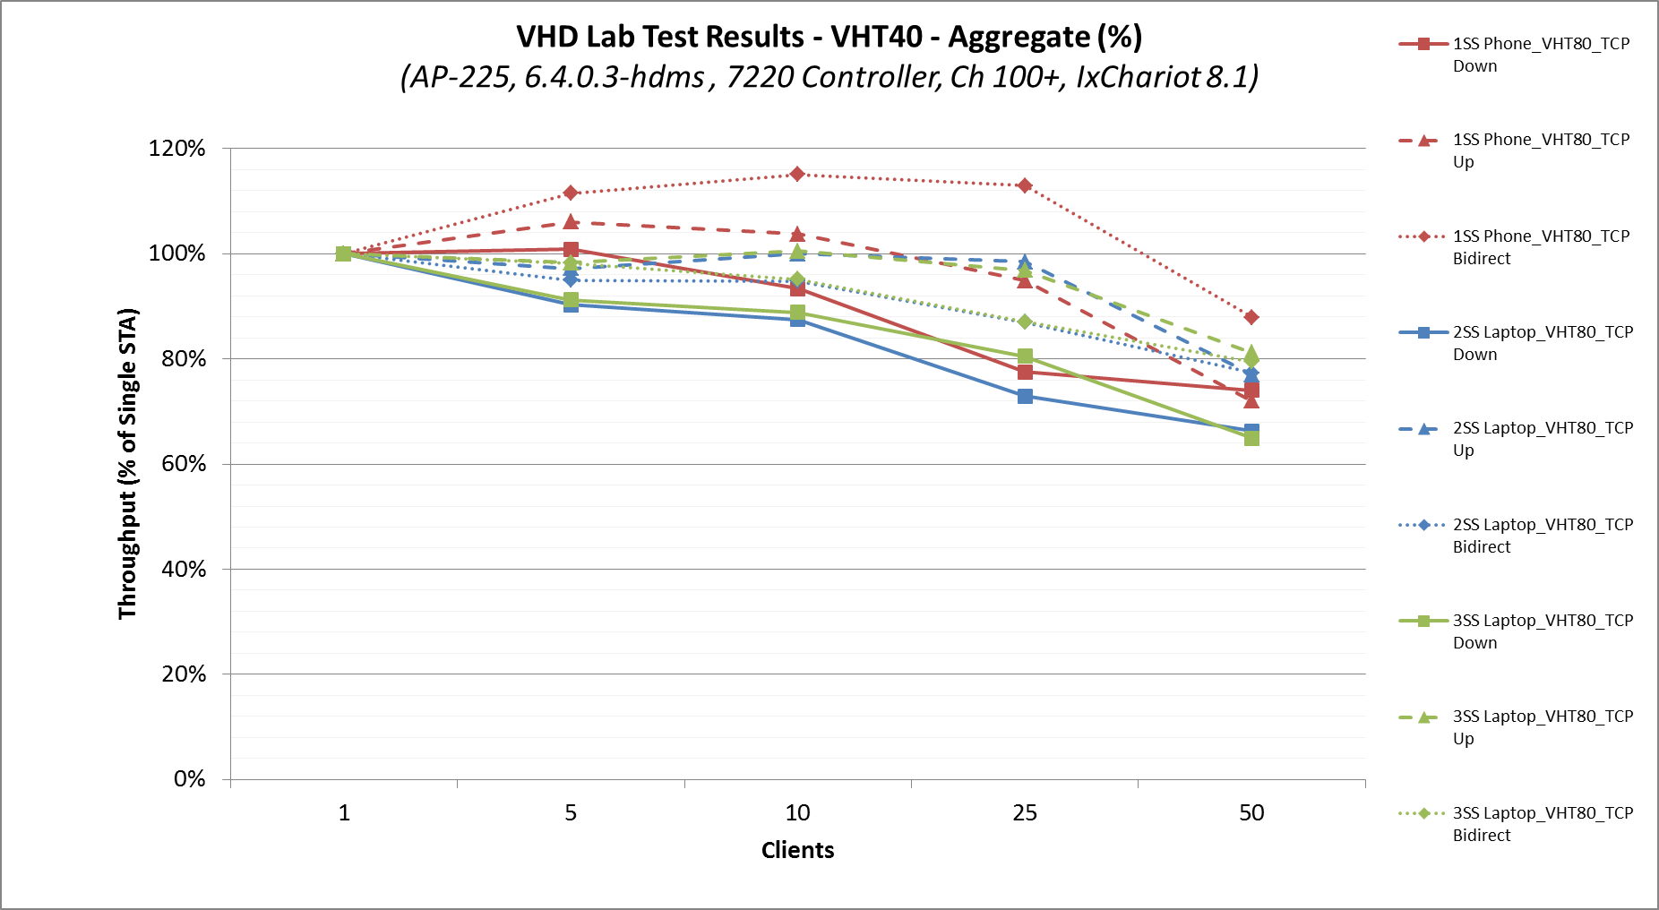
VHT40 - 1SS, 2SS & 3SS (Aggregate - %)
11% - 37% contention premium

Slide 13
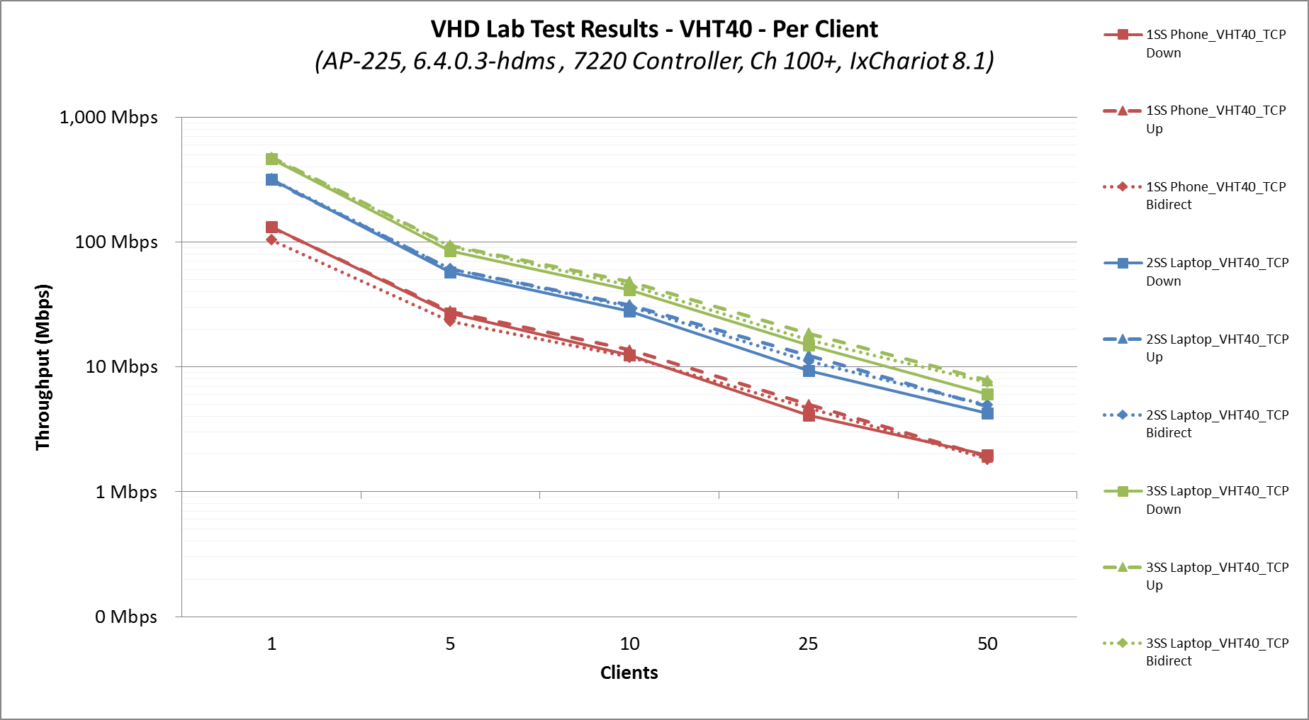
VHT40 - 1SS, 2SS & 3SS (Per-Client Avg)

Slide 14
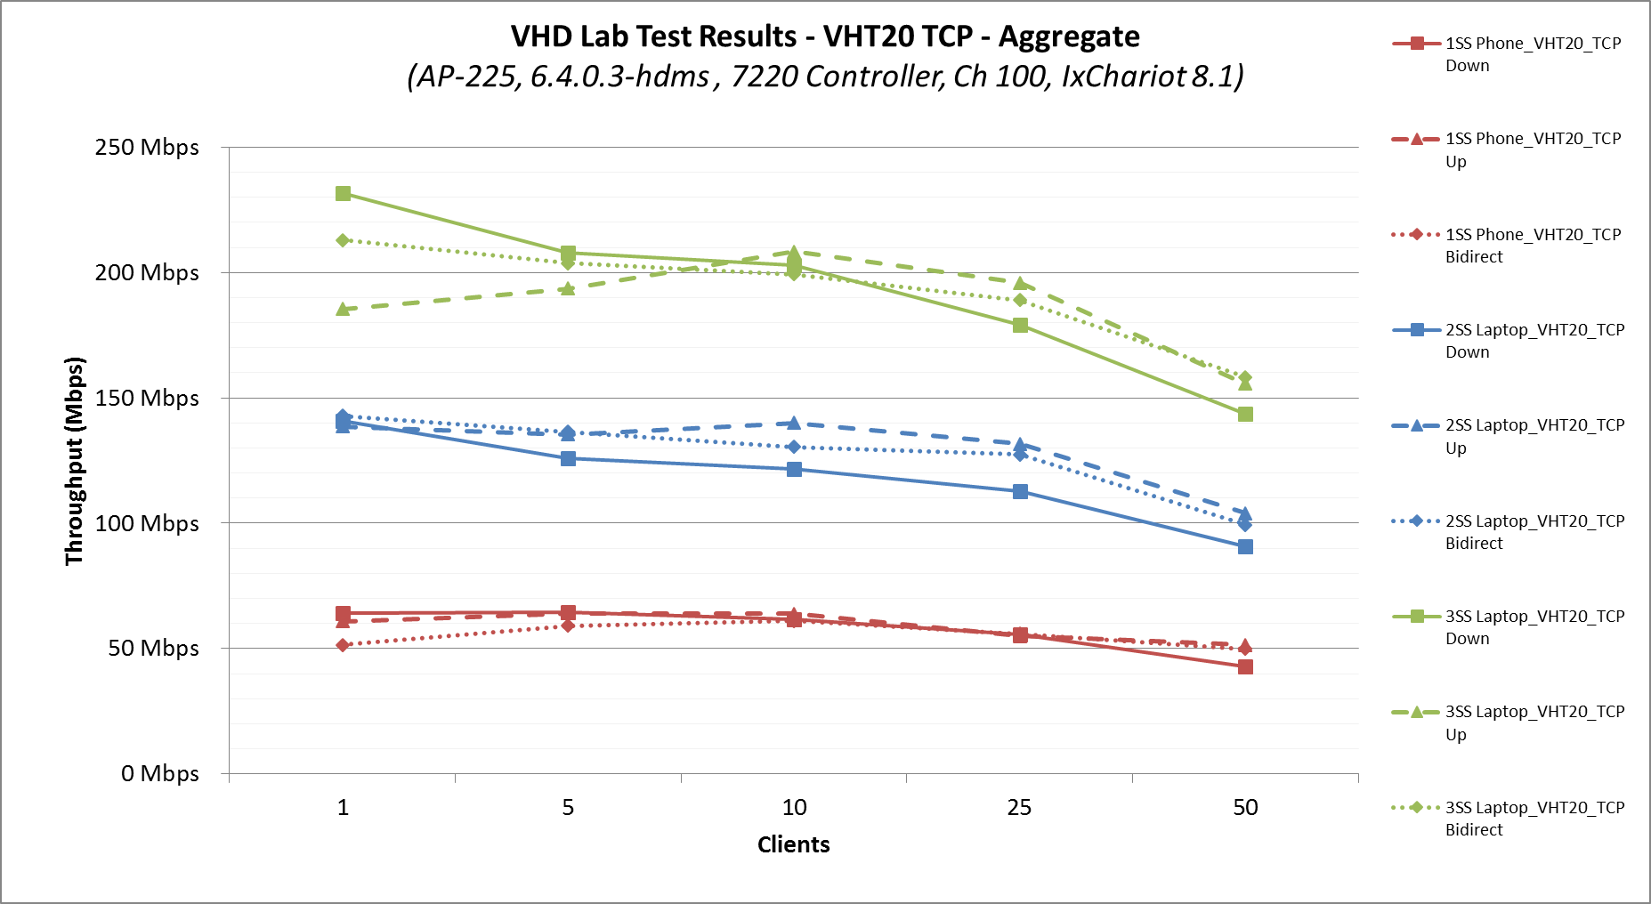
VHT20 - 1SS, 2SS & 3SS (Aggregate - Mbps)

Slide 15
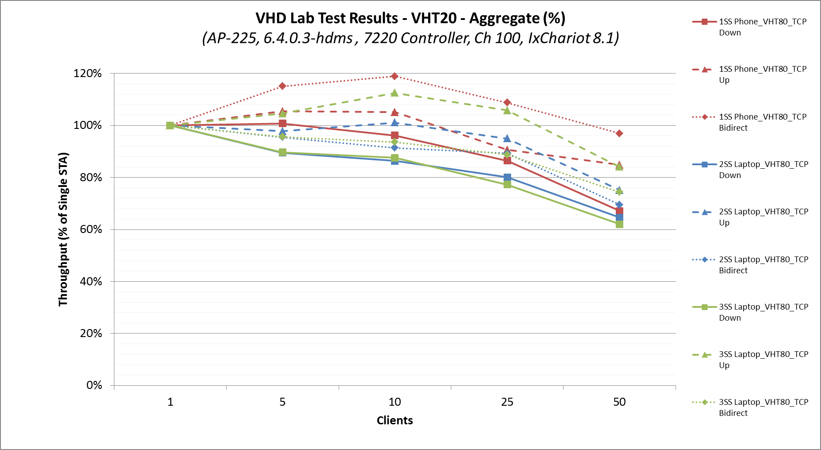
VHT20 - 1SS, 2SS & 3SS (Aggregate - %)
3% - 38% contention premium

Slide 16
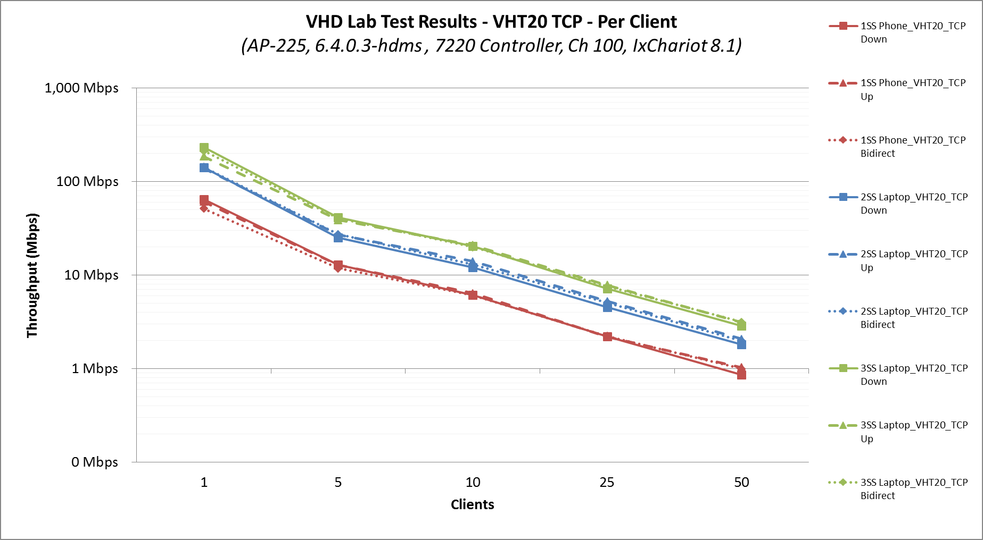
VHT20 - 1SS, 2SS & 3SS (Per Client Avg)

Slide 17
Raw #s – VHT20 Aggregate
 | 1 | Clients |  | 5 | Clients |  | 10 | Clients |  | 25 | Clients |  | 50 | Clients
1SS Phone_VHT20_TCP | Down | Up | Bidirect | Down | Up | Bidirect | Down | Up | Bidirect | Down | Up | Bidirect | Down | Up | Bidirect
Run 1 | 65.90 | 60.40 | 52.90 | 64.67 | 63.74 | 56.98 | 59.06 | 63.71 | 62.57 | 56.93 | 57.74 | 56.81 | 43.23 | 49.51 | 50.80
Run 2 | 65.65 | 58.81 | 52.97 | 65.14 | 64.08 | 60.30 | 63.98 | 63.84 | 60.53 | 55.74 | 55.40 | 55.76 | 41.25 | 53.26 | 52.97
Run 3 | 61.04 | 63.15 | 48.56 | 64.12 | 64.27 | 60.07 | 61.90 | 63.98 | 60.24 | 53.82 | 51.83 | 55.15 | 44.45 | 51.73 | 45.99
Average Throughput | 64.20 | 60.79 | 51.47 | 64.64 | 64.03 | 59.12 | 61.65 | 63.85 | 61.11 | 55.50 | 54.99 | 55.91 | 42.98 | 51.50 | 49.92
Total Pairs (Chariot) | 2 | 4 | 4 | 5 | 20 | 5 | 10 | 40 | 10 | 25 | 50 | 25 | 50 | 100 | 50
 | 1 | Clients |  | 5 | Clients |  | 10 | Clients |  | 25 | Clients |  | 50 | Clients
2SS Laptop_VHT20_TCP | Down | Up | Bidirect | Down | Up | Bidirect | Down | Up | Bidirect | Down | Up | Bidirect | Down | Up | Bidirect
Run 1 | 138.43 | 137.36 | 142.46 | 125.58 | 136.06 | 136.94 | 120.14 | 138.42 | 132.07 | 111.47 | 132.80 | 127.12 | 96.99 | 109.79 | 98.73
Run 2 | 141.98 | 140.21 | 142.75 | 128.63 | 133.03 | 136.30 | 124.11 | 142.46 | 130.18 | 113.61 | 133.40 | 127.37 | 87.79 | 101.50 | 101.97
Run 3 | 142.03 | 138.05 | 143.26 | 123.99 | 137.28 | 136.00 | 120.62 | 139.29 | 129.23 | 113.07 | 128.63 | 128.00 | 87.66 | 100.77 | 97.22
Average Throughput | 140.81 | 138.54 | 142.82 | 126.07 | 135.45 | 136.41 | 121.62 | 140.06 | 130.49 | 112.72 | 131.61 | 127.50 | 90.81 | 104.02 | 99.31
Total Pairs (Chariot) | 10 | 20 | 10 | 20 | 40 | 20 | 80 | 160 | 80 | 100 | 200 | 100 | 100 | 200 | 100
 | 1 | Clients |  | 5 | Clients |  | 10 | Clients |  | 25 | Clients |  | 50 | Clients
3SS Laptop_VHT20_TCP | Down | Up | Bidirect | Down | Up | Bidirect | Down | Up | Bidirect | Down | Up | Bidirect | Down | Up | Bidirect
Run 1 | 232.01 | 179.03 | 217.47 | 208.52 | 194.58 | 208.39 | 202.83 | 212.15 | 199.96 | 178.76 | 199.04 | 189.59 | 144.47 | 158.17 | 160.30
Run 2 | 228.86 | 186.08 | 214.18 | 208.22 | 196.20 | 200.60 | 202.61 | 210.80 | 195.15 | 177.59 | 198.26 | 188.82 | 150.10 | 156.84 | 155.82
Run 3 | 234.29 | 191.01 | 207.43 | 206.45 | 190.16 | 202.10 | 202.96 | 201.83 | 202.67 | 180.93 | 190.21 | 188.50 | 136.46 | 151.94 | 158.69
Average Throughput | 231.72 | 185.37 | 213.03 | 207.73 | 193.65 | 203.70 | 202.80 | 208.26 | 199.26 | 179.09 | 195.84 | 188.97 | 143.68 | 155.65 | 158.27
Total Pairs (Chariot) | 20 | 20 | 20 | 40 | 40 | 40 | 160 | 320 | 160 | 200 | 300 | 200 | 200 | 300 | 200

Slide 18
Raw #s – VHT20 Per Client
 | 1 | Clients |  | 5 | Clients |  | 10 | Clients |  | 25 | Clients |  | 50 | Clients
1SS Phone_VHT20_TCP | Down | Up | Bidirect | Down | Up | Bidirect | Down | Up | Bidirect | Down | Up | Bidirect | Down | Up | Bidirect
Run 1 | 65.90 | 60.40 | 52.90 | 12.93 | 12.75 | 11.40 | 5.91 | 6.37 | 6.26 | 2.28 | 2.31 | 2.27 | 0.86 | 0.99 | 1.02
Run 2 | 65.65 | 58.81 | 52.97 | 13.03 | 12.82 | 12.06 | 6.40 | 6.38 | 6.05 | 2.23 | 2.22 | 2.23 | 0.82 | 1.07 | 1.06
Run 3 | 61.04 | 63.15 | 48.56 | 12.82 | 12.85 | 12.01 | 6.19 | 6.40 | 6.02 | 2.15 | 2.07 | 2.21 | 0.89 | 1.03 | 0.92
Per Client Throughput | 64.20 | 60.79 | 51.47 | 12.93 | 12.81 | 11.82 | 6.16 | 6.38 | 6.11 | 2.22 | 2.20 | 2.24 | 0.86 | 1.03 | 1.00
Total Pairs (Chariot) | 2 | 4 | 4 | 5 | 20 | 5 | 10 | 40 | 10 | 25 | 50 | 25 | 50 | 100 | 50
 | 1 | Clients |  | 5 | Clients |  | 10 | Clients |  | 25 | Clients |  | 50 | Clients
2SS Laptop_VHT20_TCP | Down | Up | Bidirect | Down | Up | Bidirect | Down | Up | Bidirect | Down | Up | Bidirect | Down | Up | Bidirect
Run 1 | 138.43 | 137.36 | 142.46 | 25.12 | 27.21 | 27.39 | 12.01 | 13.84 | 13.21 | 4.46 | 5.31 | 5.08 | 1.94 | 2.20 | 1.97
Run 2 | 141.98 | 140.21 | 142.75 | 25.73 | 26.61 | 27.26 | 12.41 | 14.25 | 13.02 | 4.54 | 5.34 | 5.09 | 1.76 | 2.03 | 2.04
Run 3 | 142.03 | 138.05 | 143.26 | 24.80 | 27.46 | 27.20 | 12.06 | 13.93 | 12.92 | 4.52 | 5.15 | 5.12 | 1.75 | 2.02 | 1.94
Per Client Throughput | 140.81 | 138.54 | 142.82 | 25.21 | 27.09 | 27.28 | 12.16 | 14.01 | 13.05 | 4.51 | 5.26 | 5.10 | 1.82 | 2.08 | 1.99
Total Pairs (Chariot) | 10 | 20 | 10 | 20 | 40 | 20 | 80 | 160 | 80 | 100 | 200 | 100 | 100 | 200 | 100
 | 1 | Clients |  | 5 | Clients |  | 10 | Clients |  | 25 | Clients |  | 50 | Clients
3SS Laptop_VHT20_TCP | Down | Up | Bidirect | Down | Up | Bidirect | Down | Up | Bidirect | Down | Up | Bidirect | Down | Up | Bidirect
Run 1 | 232.01 | 179.03 | 217.47 | 41.70 | 38.92 | 41.68 | 20.28 | 21.22 | 20.00 | 7.15 | 7.96 | 7.58 | 2.89 | 3.16 | 3.21
Run 2 | 228.86 | 186.08 | 214.18 | 41.64 | 39.24 | 40.12 | 20.26 | 21.08 | 19.51 | 7.10 | 7.93 | 7.55 | 3.00 | 3.14 | 3.12
Run 3 | 234.29 | 191.01 | 207.43 | 41.29 | 38.03 | 40.42 | 20.30 | 20.18 | 20.27 | 7.24 | 7.61 | 7.54 | 2.73 | 3.04 | 3.17
Per Client Throughput | 231.72 | 185.37 | 213.03 | 41.55 | 38.73 | 40.74 | 20.28 | 20.83 | 19.93 | 7.16 | 7.83 | 7.56 | 2.87 | 3.11 | 3.17
Total Pairs (Chariot) | 20 | 20 | 20 | 40 | 40 | 40 | 160 | 320 | 160 | 200 | 300 | 200 | 200 | 300 | 200

Slide 19
Raw #s – VHT40 Aggregate
 | 1 | Clients |  | 5 | Up |  | 10 | Up |  | 25 | Up |  | 50 | Up
1SS Phone_VHT40_TCP | Down | Up | Bidirect | Down | Up | Bidirect | Down | Up | Bidirect | Down | Up | Bidirect | Down | Up | Bidirect
Run 1 | 132.94 | 129.35 | 107.51 | 134.52 | 140.37 | 118.17 | 125.15 | 138.05 | 116.06 | 105.12 | 120.03 | 117.77 | 102.12 | 99.75 | 92.35
Run 2 | 131.40 | 133.16 | 102.60 | 133.68 | 139.98 | 114.98 | 122.19 | 135.25 | 120.93 | 104.52 | 127.81 | 117.61 | 91.65 | 92.97 | 91.22
Run 3 | 134.63 | 133.37 | 102.97 | 134.06 | 139.30 | 115.75 | 125.21 | 137.27 | 123.07 | 99.47 | 127.83 | 117.98 | 101.56 | 91.90 | 91.49
Average Throughput | 132.99 | 131.96 | 104.36 | 134.09 | 139.88 | 116.30 | 124.19 | 136.85 | 120.02 | 103.04 | 125.22 | 117.79 | 98.45 | 94.88 | 91.69
Total Pairs (Chariot) | 2 | 4 | 1 | 5 | 20 | 5 | 10 | 40 | 10 | 25 | 100 | 25 | 50 | 100 | 50
 | 1 | Clients |  | 5 | Clients |  | 10 | Clients |  | 25 | Clients |  | 50 | Clients
2SS Laptop_VHT40_TCP | Down | Up | Bidirect | Down | Up | Bidirect | Down | Up | Bidirect | Down | Up | Bidirect | Down | Up | Bidirect
Run 1 | 319.91 | 312.85 | 324.36 | 288.98 | 307.41 | 309.28 | 274.80 | 317.48 | 305.25 | 236.98 | 303.12 | 279.50 | 207.98 | 245.66 | 247.47
Run 2 | 320.97 | 313.33 | 322.23 | 289.47 | 304.95 | 301.76 | 281.19 | 312.43 | 303.41 | 232.62 | 311.34 | 280.50 | 219.38 | 240.89 | 248.30
Run 3 | 320.75 | 317.77 | 319.79 | 289.47 | 304.80 | 306.99 | 285.37 | 313.72 | 307.36 | 231.44 | 314.87 | 280.50 | 210.21 | 239.95 | 251.29
Average Throughput | 320.54 | 314.65 | 322.13 | 289.31 | 305.72 | 306.01 | 280.45 | 314.54 | 305.34 | 233.68 | 309.78 | 280.17 | 212.53 | 242.17 | 249.02
Total Pairs (Chariot) | 10 | 20 | 10 | 40 | 40 | 20 | 80 | 160 | 80 | 100 | 300 | 200 | 200 | 300 | 200
 | 1 | Clients |  | 5 | Clients |  | 10 | Clients |  | 25 | Clients |  | 50 | Clients
3SS Laptop_VHT40_TCP | Down | Up | Bidirect | Down | Up | Bidirect | Down | Up | Bidirect | Down | Up | Bidirect | Down | Up | Bidirect
Run 1 | 467.26 | 480.71 | 481.21 | 426.20 | 470.29 | 465.58 | 413.80 | 485.90 | 449.88 | 373.68 | 469.74 | 410.38 | 294.86 | 387.55 | 375.61
Run 2 | 467.07 | 482.29 | 472.51 | 426.52 | 477.59 | 466.17 | 414.06 | 483.76 | 452.36 | 377.72 | 461.75 | 415.26 | 306.52 | 388.64 | 375.65
Run 3 | 467.17 | 478.34 | 470.72 | 426.24 | 468.50 | 466.54 | 417.00 | 478.91 | 452.96 | 376.63 | 464.69 | 414.42 | 307.66 | 393.39 | 380.34
Average Throughput | 467.17 | 480.45 | 474.81 | 426.32 | 472.12 | 466.09 | 414.95 | 482.86 | 451.73 | 376.01 | 465.39 | 413.35 | 303.01 | 389.86 | 377.20
Total Pairs (Chariot) | 20 | 20 | 10 | 40 | 80 | 40 | 160 | 320 | 160 | 200 | 500 | 200 | 300 | 500 | 200

Slide 20
Raw #s – VHT40 Per Client
 | 1 | Clients |  | 5 | Clients |  | 10 | Clients |  | 25 | Clients |  | 50 | Clients
1SS Phone_VHT40_TCP | Down | Up | Bidirect | Down | Up | Bidirect | Down | Up | Bidirect | Down | Up | Bidirect | Down | Up | Bidirect
Run 1 | 132.94 | 129.35 | 107.51 | 26.90 | 28.07 | 23.63 | 12.52 | 13.80 | 11.61 | 4.20 | 4.80 | 4.71 | 2.04 | 2.00 | 1.85
Run 2 | 131.40 | 133.16 | 102.60 | 26.74 | 28.00 | 23.00 | 12.22 | 13.52 | 12.09 | 4.18 | 5.11 | 4.70 | 1.83 | 1.86 | 1.82
Run 3 | 134.63 | 133.37 | 102.97 | 26.81 | 27.86 | 23.15 | 12.52 | 13.73 | 12.31 | 3.98 | 5.11 | 4.72 | 2.03 | 1.84 | 1.83
Per Client Throughput | 132.99 | 131.96 | 104.36 | 26.82 | 27.98 | 23.26 | 12.42 | 13.69 | 12.00 | 4.12 | 5.01 | 4.71 | 1.97 | 1.90 | 1.83
Total Pairs (Chariot) | 2 | 4 | 1 | 5 | 20 | 5 | 10 | 40 | 10 | 25 | 100 | 25 | 50 | 100 | 50
 | 1 | Clients |  | 5 | Clients |  | 10 | Clients |  | 25 | Clients |  | 50 | Clients
2SS Laptop_VHT40_TCP | Down | Up | Bidirect | Down | Up | Bidirect | Down | Up | Bidirect | Down | Up | Bidirect | Down | Up | Bidirect
Run 1 | 319.91 | 312.85 | 324.36 | 57.80 | 61.48 | 61.86 | 27.48 | 31.75 | 30.52 | 9.48 | 12.12 | 11.18 | 4.16 | 4.91 | 4.95
Run 2 | 320.97 | 313.33 | 322.23 | 57.89 | 60.99 | 60.35 | 28.12 | 31.24 | 30.34 | 9.30 | 12.45 | 11.22 | 4.39 | 4.82 | 4.97
Run 3 | 320.75 | 317.77 | 319.79 | 57.89 | 60.96 | 61.40 | 28.54 | 31.37 | 30.74 | 9.26 | 12.59 | 11.22 | 4.20 | 4.80 | 5.03
Per Client Throughput | 320.54 | 314.65 | 322.13 | 57.86 | 61.14 | 61.20 | 28.05 | 31.45 | 30.53 | 9.35 | 12.39 | 11.21 | 4.25 | 4.84 | 4.98
Total Pairs (Chariot) | 10 | 20 | 10 | 40 | 40 | 20 | 80 | 160 | 80 | 100 | 300 | 200 | 200 | 300 | 200
 | 1 | Clients |  | 5 | Clients |  | 10 | Clients |  | 25 | Clients |  | 50 | Clients
3SS Laptop_VHT40_TCP | Down | Up | Bidirect | Down | Up | Bidirect | Down | Up | Bidirect | Down | Up | Bidirect | Down | Up | Bidirect
Run 1 | 467.26 | 480.71 | 481.21 | 85.24 | 94.06 | 93.12 | 41.38 | 48.59 | 44.99 | 14.95 | 18.79 | 16.42 | 5.90 | 7.75 | 7.51
Run 2 | 467.07 | 482.29 | 472.51 | 85.30 | 95.52 | 93.23 | 41.41 | 48.38 | 45.24 | 15.11 | 18.47 | 16.61 | 6.13 | 7.77 | 7.51
Run 3 | 467.17 | 478.34 | 470.72 | 85.25 | 93.70 | 93.31 | 41.70 | 47.89 | 45.30 | 15.07 | 18.59 | 16.58 | 6.15 | 7.87 | 7.61
Per Client Throughput | 467.17 | 480.45 | 474.81 | 85.26 | 94.42 | 93.22 | 41.50 | 48.29 | 45.17 | 15.04 | 18.62 | 16.53 | 6.06 | 7.80 | 7.54
Total Pairs (Chariot) | 20 | 20 | 10 | 40 | 80 | 40 | 160 | 320 | 160 | 200 | 500 | 200 | 300 | 500 | 200

Slide 21
Raw #s – VHT80 Aggregate
 | 1 | Clients |  | 5 | Clients |  | 10 | Clients |  | 25 | Clients |  | 50 | Clients
1SS Phone_VHT80_TCP | Down | Up | Bidirect | Down | Up | Bidirect | Down | Up | Bidirect | Down | Up | Bidirect | Down | Up | Bidirect
Run 1 | 220.46 | 246.25 | 126.73 | 213.07 | 275.54 | 185.95 | 227.21 | 258.34 | 204.76 | 212.84 | 222.47 | 196.85 | 162.52 | 173.25 | 167.56
Run 2 | 216.36 | 241.43 | 134.03 | 213.39 | 270.75 | 183.26 | 227.08 | 245.50 | 210.13 | 207.86 | 223.16 | 197.37 | 161.81 | 163.91 | 172.42
Run 3 | 217.06 | 245.64 | 116.96 | 215.38 | 270.27 | 196.29 | 225.88 | 253.17 | 219.53 | 208.97 | 225.67 | 196.30 | 168.00 | 177.94 | 147.40
Average Throughput | 217.96 | 244.44 | 125.90 | 213.95 | 272.19 | 188.50 | 226.72 | 252.34 | 211.47 | 209.89 | 223.77 | 196.84 | 164.11 | 171.70 | 162.46
Total Pairs (Chariot) | 2 | 4 | 2 | 5 | 20 | 5 | 10 | 40 | 10 | 25 | 100 | 25 | 50 | 200 | 50
 | 1 | Clients |  | 5 | Clients |  | 10 | Clients |  | 25 | Clients |  | 50 | Clients
2SS Laptop_VHT80_TCP | Down | Up | Bidirect | Down | Up | Bidirect | Down | Up | Bidirect | Down | Up | Bidirect | Down | Up | Bidirect
Run 1 | 603.43 | 645.31 | 638.99 | 571.41 | 625.50 | 629.20 | 534.85 | 620.51 | 597.08 | 430.53 | 551.49 | 515.60 | 362.78 | 462.09 | 436.90
Run 2 | 609.79 | 651.10 | 637.93 | 569.64 | 625.59 | 623.25 | 533.58 | 617.22 | 589.33 | 432.61 | 555.53 | 516.43 | 366.83 | 465.84 | 435.75
Run 3 | 605.97 | 647.66 | 638.31 | 568.74 | 626.44 | 628.82 | 535.48 | 618.95 | 596.11 | 431.29 | 550.55 | 519.93 | 364.56 | 463.24 | 437.95
Average Throughput | 606.40 | 648.02 | 638.41 | 569.93 | 625.84 | 627.09 | 534.64 | 618.89 | 594.17 | 431.48 | 552.52 | 517.32 | 364.72 | 463.72 | 436.87
Total Pairs (Chariot) | 10 | 20 | 10 | 40 | 40 | 20 | 120 | 160 | 80 | 200 | 300 | 200 | 300 | 300 | 200
 | 1 | Clients |  | 5 | Clients |  | 10 | Clients |  | 25 | Clients |  | 50 | Clients
3SS Laptop_VHT80_TCP | Down | Up | Bidirect | Down | Up | Bidirect | Down | Up | Bidirect | Down | Up | Bidirect | Down | Up | Bidirect
Run 1 | 810.73 | 908.15 | 884.17 | 739.54 | 895.69 | 850.20 | 700.06 | 887.33 | 808.69 | 589.02 | 787.17 | 690.54 | 489.60 | 591.34 | 587.74
Run 2 | 809.78 | 912.09 | 891.06 | 738.70 | 899.57 | 853.93 | 705.84 | 881.02 | 801.76 | 599.64 | 779.39 | 695.41 | 507.39 | 594.88 | 591.53
Run 3 | 817.96 | 916.03 | 892.52 | 714.49 | 890.43 | 857.77 | 701.10 | 879.42 | 803.87 | 594.44 | 777.23 | 692.84 | 489.57 | 584.44 | 584.04
Average Throughput | 812.83 | 912.09 | 889.25 | 730.91 | 895.23 | 853.96 | 702.33 | 882.59 | 804.78 | 594.37 | 781.26 | 692.93 | 495.52 | 590.22 | 587.77
Total Pairs (Chariot) | 20 | 20 | 10 | 80 | 80 | 40 | 240 | 320 | 160 | 400 | 500 | 200 | 300 | 500 | 400

Slide 22
Raw #s – VHT80 Per Client
 | 1 | Clients |  | 5 | Clients |  | 10 | Clients |  | 25 | Clients |  | 50 | Clients
1SS Phone_VHT80_TCP | Down | Up | Bidirect | Down | Up | Bidirect | Down | Up | Bidirect | Down | Up | Bidirect | Down | Up | Bidirect
Run 1 | 220.46 | 246.25 | 126.73 | 42.61 | 55.11 | 37.19 | 22.72 | 25.83 | 20.48 | 8.51 | 8.90 | 7.87 | 3.25 | 3.47 | 3.35
Run 2 | 216.36 | 241.43 | 134.03 | 42.68 | 54.15 | 36.65 | 22.71 | 24.55 | 21.01 | 8.31 | 8.93 | 7.89 | 3.24 | 3.28 | 3.45
Run 3 | 217.06 | 245.64 | 116.96 | 43.08 | 54.05 | 39.26 | 22.59 | 25.32 | 21.95 | 8.36 | 9.03 | 7.85 | 3.36 | 3.56 | 2.95
Per Client Throughput | 217.96 | 244.44 | 125.90 | 42.79 | 54.44 | 37.70 | 22.67 | 25.23 | 21.15 | 8.40 | 8.95 | 7.87 | 3.28 | 3.43 | 3.25
Total Pairs (Chariot) | 2 | 4 | 2 | 5 | 20 | 5 | 10 | 40 | 10 | 25 | 100 | 25 | 50 | 200 | 50
 | 1 | Clients |  | 5 | Clients |  | 10 | Clients |  | 25 | Clients |  | 50 | Clients
2SS Laptop_VHT80_TCP | Down | Up | Bidirect | Down | Up | Bidirect | Down | Up | Bidirect | Down | Up | Bidirect | Down | Up | Bidirect
Run 1 | 603.43 | 645.31 | 638.99 | 114.28 | 125.10 | 125.84 | 53.49 | 62.05 | 59.71 | 17.22 | 22.06 | 20.62 | 7.26 | 9.24 | 8.74
Run 2 | 609.79 | 651.10 | 637.93 | 113.93 | 125.12 | 124.65 | 53.36 | 61.72 | 58.93 | 17.30 | 22.22 | 20.66 | 7.34 | 9.32 | 8.72
Run 3 | 605.97 | 647.66 | 638.31 | 113.75 | 125.29 | 125.76 | 53.55 | 61.89 | 59.61 | 17.25 | 22.02 | 20.80 | 7.29 | 9.26 | 8.76
Per Client Throughput | 606.40 | 648.02 | 638.41 | 113.99 | 125.17 | 125.42 | 53.46 | 61.89 | 59.42 | 17.26 | 22.10 | 20.69 | 7.29 | 9.27 | 8.74
Total Pairs (Chariot) | 10 | 20 | 10 | 40 | 40 | 20 | 120 | 160 | 80 | 200 | 300 | 200 | 300 | 300 | 200
 | 1 | Clients |  | 5 | Clients |  | 10 | Clients |  | 25 | Clients |  | 50 | Clients
3SS Laptop_VHT80_TCP | Down | Up | Bidirect | Down | Up | Bidirect | Down | Up | Bidirect | Down | Up | Bidirect | Down | Up | Bidirect
Run 1 | 810.73 | 908.15 | 884.17 | 147.91 | 179.14 | 170.04 | 70.01 | 88.73 | 80.87 | 23.56 | 31.49 | 27.62 | 9.79 | 11.83 | 11.75
Run 2 | 809.78 | 912.09 | 891.06 | 147.74 | 179.91 | 170.79 | 70.58 | 88.10 | 80.18 | 23.99 | 31.18 | 27.82 | 10.15 | 11.90 | 11.83
Run 3 | 817.96 | 916.03 | 892.52 | 142.90 | 178.09 | 171.55 | 70.11 | 87.94 | 80.39 | 23.78 | 31.09 | 27.71 | 9.79 | 11.69 | 11.68
Per Client Throughput | 812.83 | 912.09 | 889.25 | 146.18 | 179.05 | 170.79 | 70.23 | 88.26 | 80.48 | 23.77 | 31.25 | 27.72 | 9.91 | 11.80 | 11.76
Total Pairs (Chariot) | 20 | 20 | 10 | 80 | 80 | 40 | 240 | 320 | 160 | 400 | 500 | 200 | 300 | 500 | 400

Slide 23
Call to Action
Adapt Box 3 simulators to create a special case of SS#2 that reflects our VHD lab setup and test sequence
Compare simulation results against empirical data
Results should be no worse than these numbers
Significantly higher numbers should be investigated
We are interested in your assessment of the mechanics of the contention premium.

