Slide 1
Energy Efficiency Evaluation and Simulation Model
Date: 2014-10-01
Authors:

Slide 3
Abstract
This presentation describes energy efficiency evaluation and simulation model based on the concepts presented in DCN: 11-14/571r5, 11-14/827r3, 11-14/980r4 and 11-14/1162r1.
Introduce enhancements to power model.
  Ideal Power and Energy Source Model to evaluate power saving mechanisms for generic power supply and battery operating devices.
  Device Energy Model for average energy per bit calculation.
  Define TX, RX, and LISTEN power states and transitions.

Slide 4
Background
  According to the PAR, TGax should also consider the requirement “Maintain or reduce energy per successful information bit, i.e. energy efficiency rating of at least one or less”.
  Base on previous contribution 11-14/827r3, 11-14/967r1 and 11-14/1162r2 proposed Energy Efficiency Ratio, Average Energy Per Bit calculation is required for the metric.

Slide 5
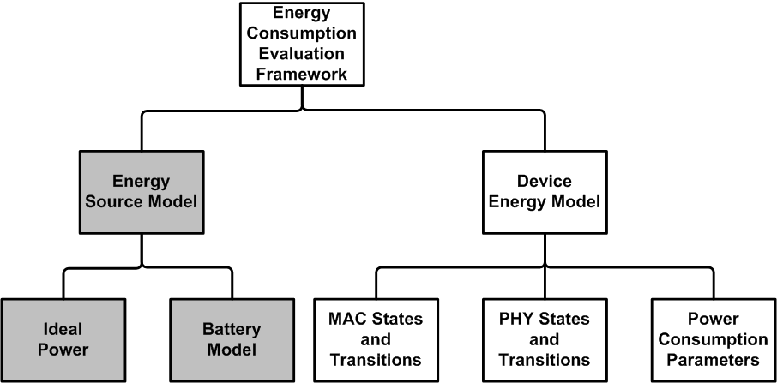
Energy Consumption Evaluation Framework
Energy Source Model:
  Power source attaches to each simulation device node.
  Notify Device Energy Model when its capacity drains below a threshold.
Ideal Power Source:
  Constant voltage remains overtime.
  Provides unlimited current (A, Ampere) drain for the load.
  Simulate generic power supply source, e.g. Home.
Battery Model:
  Battery capacity (Ah, Ampere-hour) depletion rate is a non-linear function of time and the remaining amount of energy in the battery.

Slide 6
Why Battery Model required?
Battery-Driven System Design becomes more and more important, e.g. mobile device system design usually address to determine a balanced design between battery usage and required performance.
Due to the specific physical nature of batteries, the current extraction pattern of a Power-Saving protocol may also dominate the battery life-time.
  Rate capacity effect: the effective capacity decreases quickly under a heavier load - the current draw is higher than the rated value of the battery.
    e.g. A PS protocol significantly drains higher current in a period of time (consecutive rapid TX/LISTEN/RX state transitions within a short period of time) than another one, this protocol may impact negatively to battery life-time even it has similar EER and consumed power (Watt).
  Recovery effect: battery voltage can be partially recovered during idle periods.
    e.g. A PS protocol which has longer sleep time may have longer battery life-time, even it has similar EER and consumed power (Watt) to another one.
Battery Model Function: TBD.

Slide 7
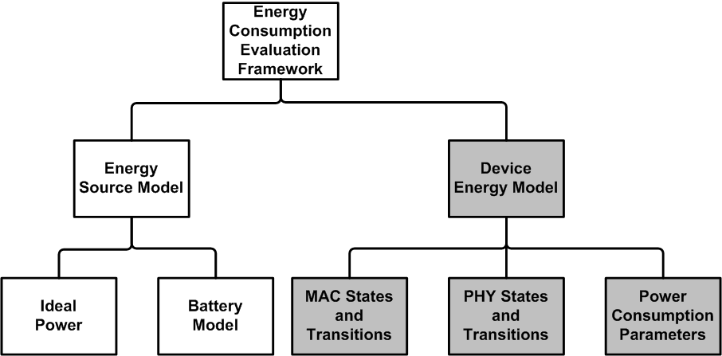
Energy Consumption Evaluation Framework Con’t
Device Energy Model:
  Calculate average energy per bit for each device node.
MAC / PHY States and Transitions:
  Notify Device Energy Model for the duration of the TX, RX, LISTEN and SLEEP power states.
Power Consumption Parameters:
  Voltage (V) and Current (mA) parameters for different MAC and PHY power states.

Slide 8
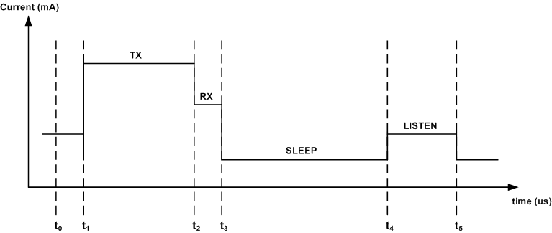
Device Energy Model
Total energy: the E_{i+1} value during the period (t₀ , t_{i+1}) as follows:
Average Energy Per Bit:

Slide 9
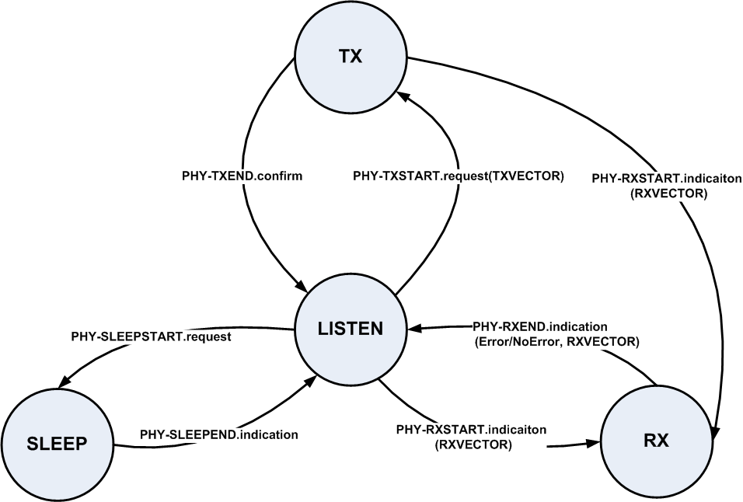
PHY Transition Definition
Transition definitions are based on IEEE 802.11REVmcD3.0 Clause 7 PHY service specification.

Slide 10
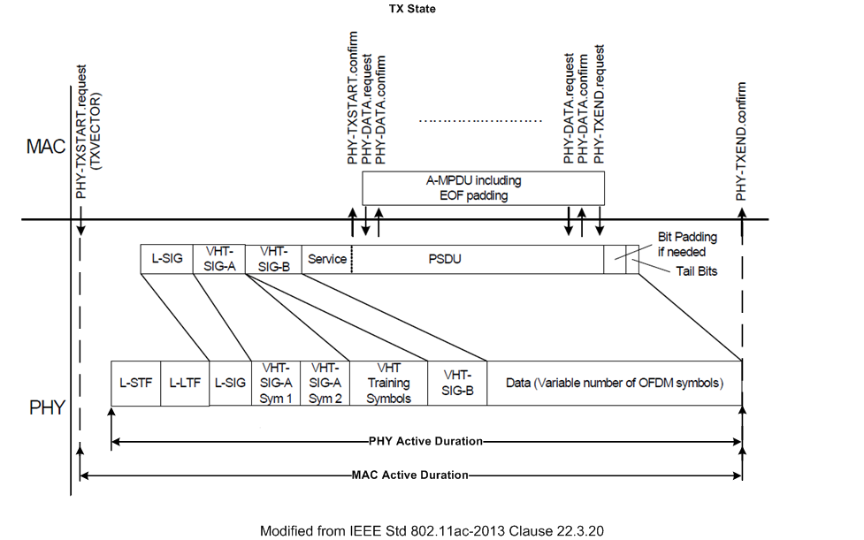
TX Power State and Duration

Slide 11
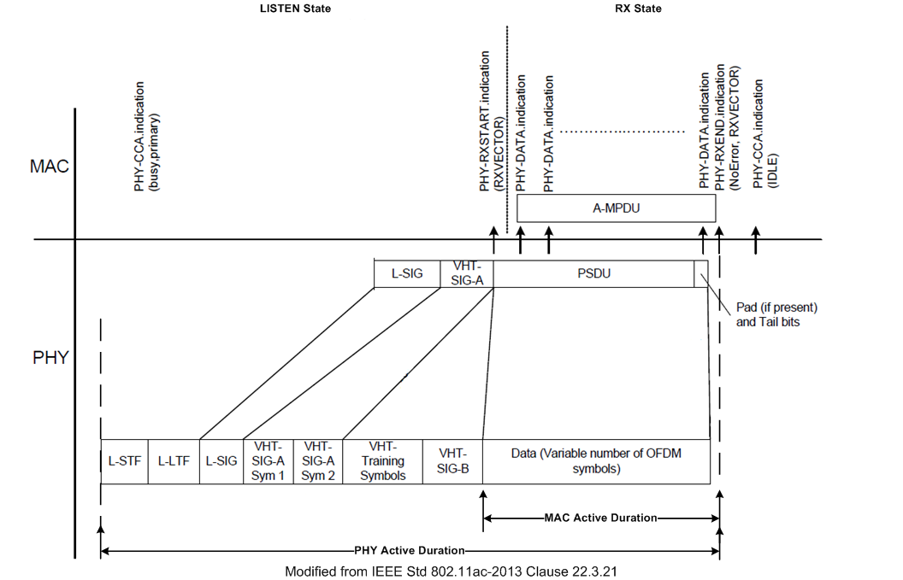
LISTEN / RX Power State and Duration

Slide 12
MAC PHY Power Consumption Simulation Parameters
Example Simulation Parameters.
Power State parameters
Power State | Average Power Consumption (mW) Average Current Consumption (mA), Voltage = 1.1 V, Bandwidth = { 20/40/80 MHz }, Band = { 2.4 GHz, 5 GHz }, NSS = { 1 }, Number of TX/RX antennas = { 1 }, TX power per antenna = { 15 dBm }
Bandwidth [MHz] | 20 | 40 | 80
PHY Transmit [mA] | 280 | 285 | 290
PHY Receive [mA] | 100 | 110 | 130
Listen [mA] | 50 | 55 | 60
Sleep [mA] | 0.003 | 0.003 | 0.003
MAC Transmit [mA] | 40 | 60 | 80
MAC Receive [mA] | 40 | 60 | 80

Slide 13
Conclusions
Introduce Ideal Power and Battery Source Model to evaluate power efficiency for generic power supply and battery-operated devices.
Propose Average Energy Per Bit calculation method.
  Device Energy Model definition in slide 8.
Introduce two MAC power states (TX / RX) for power efficiency evaluation.
  Define operating duration for MAC and PHY TX / RX / LISTEN power states.
  MAC/PHY Power Consumption Simulation Parameters in slide 12.

Slide 14
References
E. Wong, “Energy Efficiency Evaluation Methodology”, IEEE 11-14/827r3.
E. Wong, “Energy Efficiency Evaluation Methodology
Follow Up”, IEEE 11-14/1162r1.
R. Porat et al, “Evaluation Methodology,” IEEE 11-14/571r5.
S. Merlin et al, “Simulation Scenarios,” IEEE 11-14/980r4.
M. R. Jongerden and B. R. Haverkort, “Battery Modeling”, TR-CTIT-08-01, Centre for Telematics and Information Technology, University of Twente, Enschede.
IEEE 802.11REVmc-D3.0.
IEEE Std 802.11ac-2013.

