Slide 1
Energy Efficiency Evaluation and Simulation Model
Date: 2014-10-01
Authors:

Slide 3
Abstract
This presentation describes energy efficiency evaluation and simulation model based on the concepts presented in DCN: 11-14/571r5, 11-14/827r3, 11-14/980r4 and 11-14/1162r1.

Slide 4
Background
According to the PAR, TGax should also consider the requirement “Maintain or reduce energy per successful information bit, i.e. energy efficiency rating of at least one or less”.
Base on previous contribution 11-14/827r3, 11-14/967r1 and 11-14/1162r2 proposed Energy Efficiency Ratio, Average Energy Per Bit calculation is required for the metric.

Slide 5
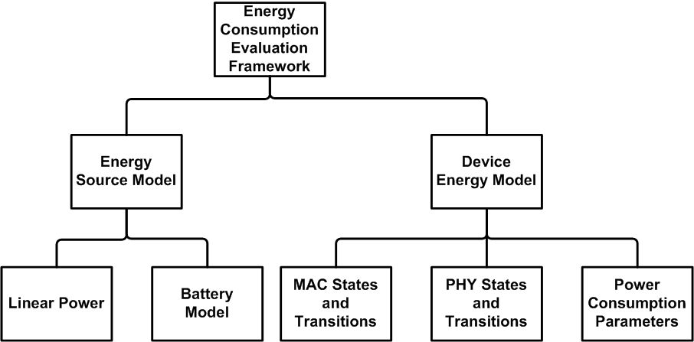
Energy Consumption Evaluation Framework
Energy Source Model:
Power source attaches to each simulation device node.
Energy Source Model notifies Device Energy Model when its capacity drains below threshold.
Linear Power:
Constant voltage remains overtime.
Provides unlimited current (A, Ampere) drain for the load.
Battery Model:
Battery capacity (Ah, Ampere-hour) depletion rate in non-linear in time and depends on the remaining amount of energy in the battery.

Slide 6
Energy Consumption Evaluation Framework Con’t
Device Energy Model:
Calculates the Energy consumed by simulation device nodes.
MAC States and Transitions:
Defines duration of MAC TX, RX and SLEEP.
PHY States and Transitions:
Defines duration of PHY TX, RX, LISTEN and SLEEP.
Power Consumption Parameters:
Defines Voltage and Ampere for different MAC and PHY states.

Slide 7
Why Battery Model required?
Battery-Driven System Design becomes more and more important, e.g. mobile devices system design usually address to determine a balanced design between battery usage and required performance.
Due to the specific physical nature of batteries, the current extraction pattern of a Power-Saving protocol may also dominate the battery life-time.
Rate capacity effect: the effective capacity becomes lower more quickly under a higher load - the current draw is higher than the rated value of the battery.
e.g. A PS protocol significantly drains higher current in a period of time (delta time of states) than another one, this protocol may impact negatively to battery life-time even it has similar EER and Watt.
Recovery effect: battery can regain some of its “consumed” capacity during idle periods.
e.g. A PS protocol which has longer sleep time may have longer battery life-time, even it has similar EER and Watt to another one.

Slide 8
Battery Model

Slide 9
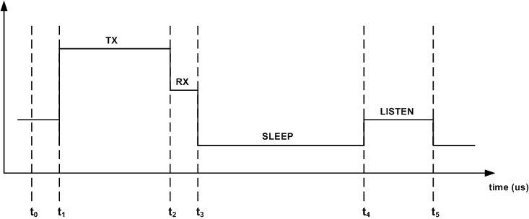
Device Energy Model
Device Energy Model calculates the new E_{i+1} value during the period (t_{i} , t_{i+1}) as follows:

Slide 10
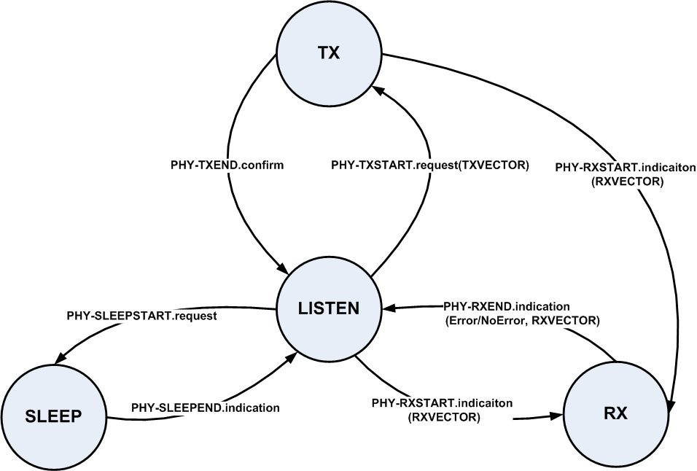
Transition Definition
Transitions definitions are base on IEEE 802.11REVmcD3.0 Clause 7 PHY service specification.

Slide 11
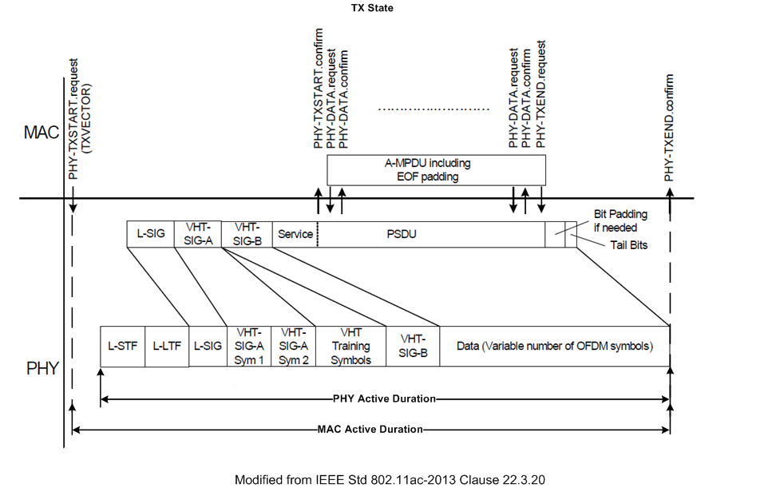
TX State

Slide 12
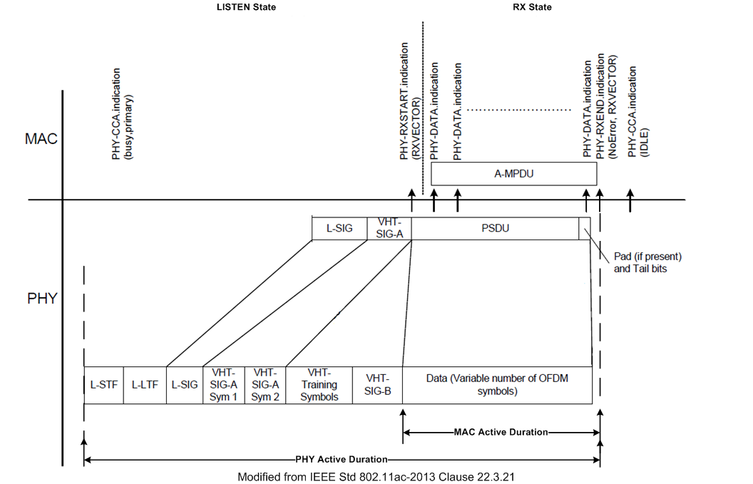
LISTEN and RX States

Slide 13
Power Consumption Simulation Parameters
Example Simulation Parameters.
 | 20MHz | 40MHz | 80MHz
Voltage (V) | 1.1 | 1.1 | 1.1
PHY TX (mA@15dBm) | 280 | 285 | 290
PHY RX (mA) | 100 | 110 | 130
LISTEN (mA) | 50 | 50 | 50
SLEEP (mA) | 0.003 | 0.003 | 0.003
MAC TX (mA) | 40 | 60 | 80
MAC RX (mA) | 40 | 60 | 80

Slide 14
Conclusions
This presentation proposes a system simulation approach to evaluate energy efficiency for TGax.
Change to the simulation scenario document [3] and evaluation methodology document [4]:
Add Device Energy Model definition in slide 9.
Add TX/RX/LISTEN Duration definition in slide 10 – 12.
Add MAC/PHY Power Consumption Simulation Parameters in slide 13.

Slide 15
References
E.Wong, “Energy Efficiency Evaluation Methodology” IEEE 11-14/827r3.
E. Wong, “Energy Efficiency Evaluation Methodology Follow Up”, IEEE 11-14/1162r1.
R. Porat et al, “Evaluation Methodology,” IEEE 11-14/571r5.
S. Merlin et al, “Simulation Scenarios,” IEEE 11-14/980r4.
M. R. Jongerden and B. R. Haverkort, “Battery Modeling”, TR-CTIT-08-01, Centre for Telematics and Information Technology, University of Twente, Enschede.
IEEE 802.11REVmc-D3.0.
IEEE std 802.11ac-2013.

