Slide 1
Preamble Considerations in Large Channel Delay Spread Scenarios
Date: 2014-11-02
Authors:

Slide 2
Large Channel Delay Spread Scenarios
802.11ax is required to take further study on support of robust transmissions in outdoor environments.
Naturally, large channel delay spread scenarios in which 802.11ax systems should operate brings challenges to the TGax group.
This presentation provides some initial study of the affect of large channel delay spread to the existing preamble structures.

Slide 3
UMa and UMi Channel Delay Spread (1/2)
The channel delay spreads for agreed 11ax channel models, UMa and UMi, may result in considerably large channel delay spreads.
Table above shows the delay spread for UMi and UMa channel model from the 11ax channel model document [1].
However, the above table does not correct depict the typical UMi and UMa channel delay spreads. The values do not even correspond to the average RMS of the delay spread.
Table 1. Brief Summary of delay spreads for UMi and UMa channel models [1]
Channel Model | Scenario | DS (ns)
UMi | LOS | 65
 | NLOS | 129
 | O-to-I | 240
UMa | LOS | 93
 | NLOS | 363

Slide 4
UMa and UMi Channel Delay Spread (2/2)
UMi and UMa cluster delay is computed by
r_{τ} : delay scaling parameter
Table 1 only seemed to consider the mean of the delay spread parameter without regards to the delay scaling parameter in ITU M.2135-1 [2]
 |  | UMi |  |  | UMa
 |  | LOS | NLOS | O-to-I | LOS | NLOS
Delay Spread, log(σ_{τ}) | Mean | -7.19 | -6.89 | -6.62 | -7.03 | -6.44
 | Var | 0.40 | 0.54 | 0.32 | 0.66 | 0.39
Delay scaling parameter, r_{τ} |  | 3.2 | 3 | 2.2 | 2.5 | 2.3

Slide 5
Indoor Channel Delay Profile
Model | Maximum Excess Delay | RMS Excess Delay
A | 0 ns | 0 ns
B | 80 ns | 15 ns
C | 200 ns | 30 ns
D | 390 ns | 50 ns
E | 730 ns | 100 ns
F | 1050 ns | 150 ns
Indoor channel delay models A~E do not have excess delay larger than 800ns.
Model F has maximum excess delay of 1050ns, however, the RMS delay is only 150ns.
Generally, no significant ISI issues are expected from the indoor models.

Slide 6
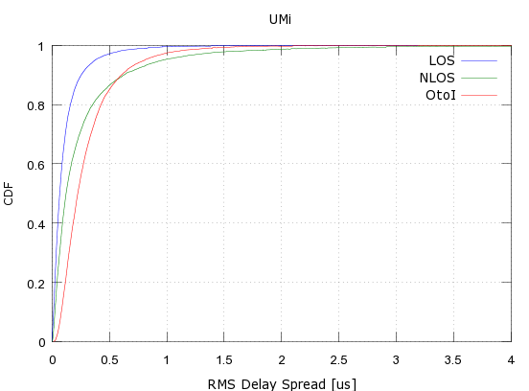
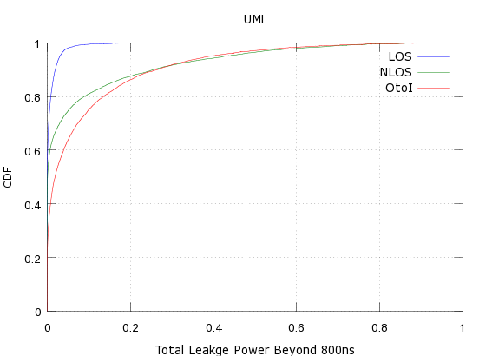
UMi NLOS Channel Delay Profile
Total leakage power of excess delay beyond 800ns and maximum delay spread is shown above.
Statistically,
13% of the NLOS/OtoI users have total leakage power of more than 20% in the excess delay of more than 800 ns.
3% of the NLOS/OtoI users have total leakage power of more than 50% in the excess delay of more than 800 ns.

Slide 7
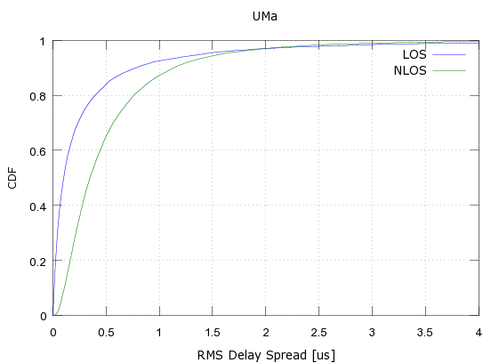
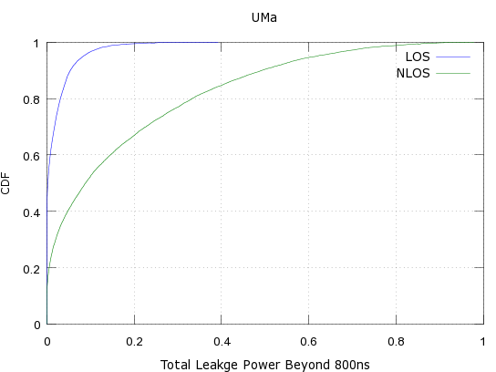
UMa NLOS Channel Delay Profile
Total leakage power of excess delay beyond 800ns and maximum delay spread is shown above.
Statistically, 8% of the NLOS users have total leakage power of more than 50% in the excess delay of more than 800 ns.

Slide 8
Excess Delay Spread
Excess delay spread larger than 800ns exist in outdoor scenarios.
Why is 800ns important? Legacy preamble portion functions based on 800ns GI.
The leakage power in the excess delay spread can be significant for some small population of users.
We will need further study on impact of large delay spread, exceeding 800ns, to the preamble design for 11ax.
This presentation focus on some simple analysis of large delay spread to legacy PPDU formats.

Slide 9
Impact of Large Delay Spread to Preamble (1/2)
ISI not an big issue, as used for AGC, FO compensation
1.6 us
0.8 us
L-STF
L-STF
L-STF
L-STF
L-STF
L-STF
L-STF
L-STF
L-STF
L-STF
D-GI
L-LTF
L-LTF
GI
L-SIG
GI
SIG-A1
GI
SIG-A2
…
4 us
4 us
8 us
4 us
4 us
4 us
Symbol dispersion of previous OFDM symbol from delay spread
time
Inter-Symbol Interference
Inter-Symbol Interference (ISI) can distort the signals, and cannot be resolved using a single tap equalization.
In deployment environments with large delay spread, decoding performance of L-SIG, SIG-A1, SIG-A2 is compromised.
Channel estimation from L-LTF can be done as, it effectively has a large cyclic prefix already.

Slide 10
Impact of Large Delay Spread to Preamble (2/2)
It has been shown that decoding performance of SIGs (e.g. L-SIG) is significantly degraded in UMa channel models [3] [4].
In fact, [3] and [4] shows that SNR required to achieve 1% PER for SIGs is degraded by more than 10dB.
As SIGs contain critical information to allow decoding of the data in the PPDU, SIG decoding performance becomes the coverage bottleneck in outdoor scenarios.
ISI in the data portion results in increase in data packet PER
ISI in the SIG portion results in increase error in SIG which results in packet decoding failure automatically.

Slide 11
Summary
Control information decoding in the preamble can be problematic when the channel delay spread is larger than 800ns, especially for existing PPDU formats.
Support of large channel delay scenarios not only should support reliable reception of data packets but also control information (e.g. information in the preamble) as well.
Further study is needed on the affect of ISI to decoding performance of control information such as L-SIG.

Slide 12
References
[1] IEEE 802.11-14/0882r3, “IEEE 802.11ax Channel Model Document”
[2] Report ITU-R M.2135-1, (12/2009), Guidelines for evaluation of radio interface technologies for IMT-Advanced
[3] IEEE 802.11-13/0536r0, “HEW SG PHY Considerations For Outdoor Environment,” LG Electronics.
[4] IEEE 802.11-13/0843r0 “Further evaluation on outdoor Wi-Fi,” LG Electronics.

