Slide 1
Issues on UL-OFDMA Transmission
Date: 2014-11-03
Authors:

Slide 2
Backgrounds
OFDMA has been proposed in TGax as a prominent feature that can improve spectral efficiency [1].
  Simultaneous transmission to/from multiple stations can reduce back-off time that otherwise has to exist between each transmission.
  If larger FFT is used, especially for outdoor scenarios that requires longer Guard Interval, smaller resource allocation unit enables better frequency domain scheduling efficiency by utilizing channel selectivity.
Especially for UL-OFDMA, there are several issues that DL-OFDMA doesn’t have [2].
  Frequency and time synchronization among participating stations
In this contribution, we discuss further on some additional issues on UL-OFDMA, especially on
  Protection for UL MU transmission
  Needs for UL request frame

Slide 3
Protection for UL-OFDMA Transmission
Overview
  Even though multiple clients send data frames simultaneously and an AP is a receiver, to maintain synchronization among multiple stations, the AP is supposed to send a trigger frame and to control the UL transmission.
  Therefore, it is expected that the AP initiates protection mechanism for UL transmission by e.g., RTS/CTS exchange and/or CTS-to-Self.
As there are multiple transmission points in UL-OFDMA, it is hard to protect the transmission duration before actual transmission happens.
  Current protection mechanisms are mainly for i) point-to-point transmission, or ii) protection from the transmission point only.

Slide 4
Protection Solutions Discussed
Multiple RTS/CTS exchange
  AP initiates RTS/CTS procedure for each STA sequentially.
  Issues
    RTS/CTS overhead increases as the number of participating STAs increases.
TXOP duration
AP1
RTS
RTS
Trigger
ACK*
ACK
STA1
CTS
UL DATA
STA2
CTS
UL DATA
* There can be multiple different ways of sending acknowledgement frames and these are out of scope of this contribution.

Slide 5
Protection Solutions Discussed
Multiple CTS response for single RTS frame
  AP sends RTS frame to a group of STAs.
  Each STA within the group sends back CTS frame sequentially.
  Issues
    As AP1 does not send any frame right after receiving the first CTS frame, 3rd party STA may initiate frame transmission at this time.
    CTS overhead increases as the number of participating STAs increases.
TXOP duration
AP1
RTS
Trigger
ACK
ACK
STA1
CTS
UL DATA
STA2
CTS
UL DATA

Slide 6
Protection Solutions Discussed
Use of single RTS/CTS procedure only
  AP initiates RTS/CTS exchange with single STA within the group only.
  Issues
    If different STAs are located far apart, it may not protect areas of STAs that RTS/CTS exchange is not made.
TXOP duration
AP1
RTS
Trigger
ACK
ACK
STA1
CTS
UL DATA
STA2
UL DATA

Slide 7
Protection Solutions Discussed
Simultaneous CTS transmission with identical waveform
  AP sends RTS frame to a group of STAs.
  All STAs within the group send back CTS frame with identical waveform.
  CTS frame will be RF-combined at the receiver side.
  Issues
    AP cannot identify who sent CTS frame and who didn’t send CTS frame.
TXOP duration
AP1
RTS
Trigger
ACK
ACK
STA1
CTS
UL DATA
STA2
CTS
UL DATA

Slide 8
Protection for UL-OFDMA Transmission
Issues
  Different from DL MU-MIMO in TGac, which is mainly targeting for high SINR stations that are located in the inner cell area, operation scenario for UL-OFDMA in TGax is more vulnerable to hidden nodes mainly due to
    There are more number of OBSS stations
    More cell edge stations to participate
  However, none of currently discussed mechanism works properly for UL-OFDMA operation.
  Therefore, for UL-OFDMA to work properly, protection mechanism for UL-OFDMA shall be provided.

Slide 9
Need for UL Request Frame
Overview
  Different from DL transmission, UL transmission has to be pre-scheduled and synchronized.
  For this reason, an AP has to know UL buffered BU status and related information to properly schedule multiple STAs.
  Therefore, unless continuation of ongoing UL transmission (using piggy-backing mechanism such as More Data bit indication), each STA needs to send UL data request, which requires additional overhead for UL MU transmission.
  Moreover, each STA may prefer sending UL data frames directly to sending UL data requestframe, unless there’s any benefit of doing this.

Slide 10
Need for UL Request Frame
UL-OFDMA with UL request
  As the major gain of UL-OFDMA comes from the fact that it can reduce multiple back-off and signaling overhead, if additional back-off and signaling is required for UL request, the gain of UL-OFDMA may not be as good as what we expected.
  We have a simple analysis on the overall channel occupancy time of multiple UL transmission schemes.

Slide 11
Need for UL Request Frame
Case 1: Conventional UL transmission
  Each STA initiates UL transmission independently.
  Each UL transmission needs independent Backoff time.
  No RTS/CTS protection assumed.
AP
SIFS
ACK
SIFS
ACK
STA1
Backoff
UL DATA
STA2
Backoff
UL DATA

Slide 12
Need for UL Request Frame
Case 2: UL-OFDMA w/o Request frame
  AP initiates UL-OFDMA transmission by sending a Trigger frame, which includes UL resource allocation and scheduling information.
  Every participating STA sends UL data frame in SIFS time after receiving Trigger frame.
  AP is assumed to send ACK to multiple stations simultaneously.
    How to send acknowledge frame is out of scope of this contribution.
  AP is assumed to know UL buffer status (ideal condition).
  No RTS/CTS protection assumed.
Backoff
SIFS
ACK
AP
Trigger
ACK
STA1
SIFS
UL DATA
STA2
SIFS
UL DATA

Slide 13
Need for UL Request Frame
Case 3: UL-OFDMA w/ Request frame
  Each STA sends UL request frame independently to indicate its buffer status to AP.
  After AP receiving UL request frames from multiple STAs, AP initiates UL-OFDMA transmission by sending Trigger frame.
  No RTS/CTS protection assumed.
SIFS
SIFS
Backoff
SIFS
ACK
AP
ACK
ACK
Trigger
ACK
STA1
Backoff
Request
SIFS
UL DATA
STA2
Backoff
Request
SIFS
UL DATA

Slide 14
Numerical Analysis
Performance measure: Total occupied time for UL MU transmission, which includes back-off and related data/control frame transmission time.
Assumptions on the analysis
  FFT size per 20MHz: 64 or 256
  Channel bandwidth: 20MHz or 80MHz
  # STAs considered: 2, 4, 8, and 16
  Guard Interval: 0.8usec for 64 FFT and 1.6usec for 256FFT
  CW = 15 and assumed half of CW for random backoff (68usec)
  Data frame
    Payload size: 100, 1K, and 10KByte
    MCS level for each STA: 5 (64QAM with 2/3 rate)
    PLCP header:
      11ac format for 64FFT
      Legacy + HEW-SIG1 followed by STF/LTF/SIG2 each with one OFDM symbol for 256FFT
  Request frame
    Assumed QoS null data frame
  AP’s Acknowledgement frame
    Assumed single BA including multiple STA’s info.
    12 Byte BA information field is assumed for each STA.
  Trigger frame
    Assumed 3 Byte resource allocation information per participating STA.

Slide 15
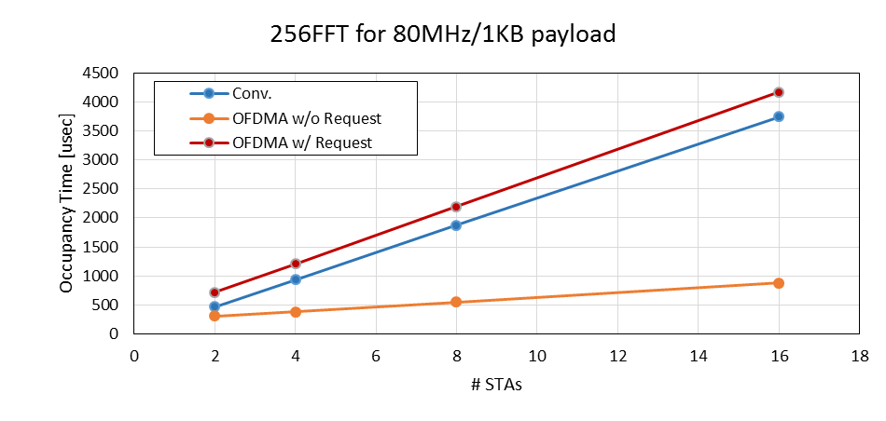
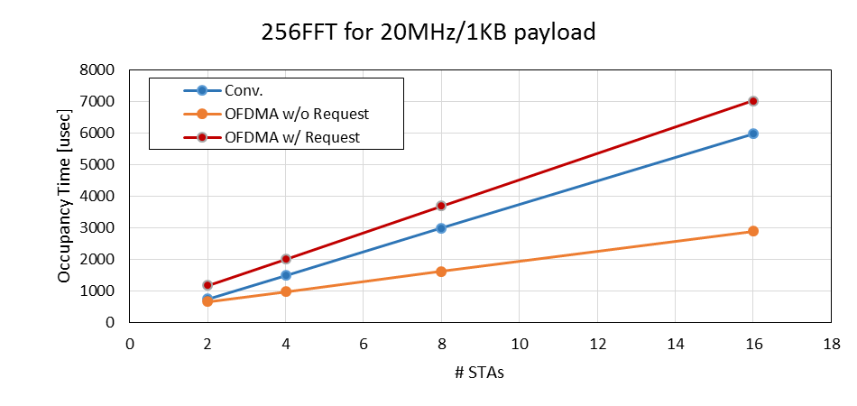
Numerical Analysis
As a function of #STAs
  Without UL Request frame, OFDMA shows quite gain over conventional transmission scheme.
  With UL Request frame OFDMA even performs worse than conventional transmission scheme.

Slide 16
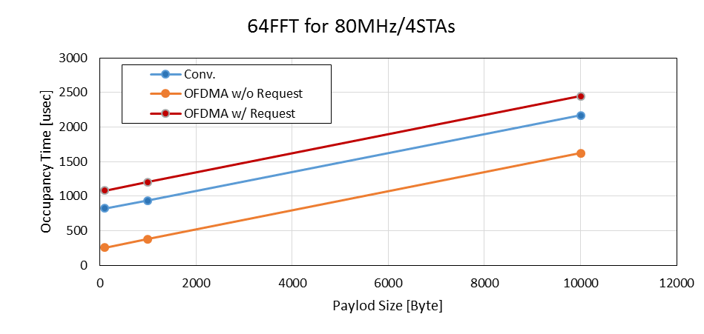
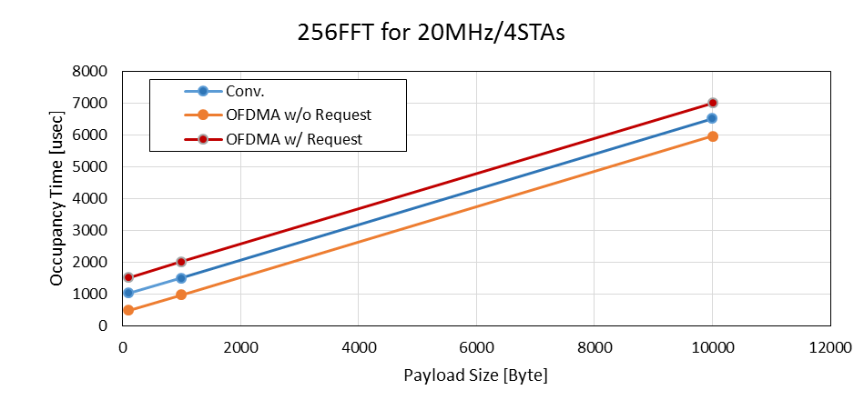
Numerical Analysis
As a function of payload size
  Similar trend with previous graphs.

Slide 17
Need for UL Request Frame
Issues
  If we consider simple UL request frame exchange for AP to identify UL buffer status, the gain of UL-OFDMA diminishes, and even worse performance compared to conventional UL transmission.
  For UL-OFDMA to be feasible, simple and meaningful mechanism for AP to identify UL buffer status shall be required.

Slide 18
Conclusions
We considered two issues for UL-OFDMA transmission:
  Protection mechanism for UL-OFDMA
  Need for UL request frame
And, our observation is that
  None of current protection mechanism works for UL-OFDMA, and thus, proper protection mechanism for UL-OFDMA shall be provided.
  For UL-OFDMA to be feasible, simple and meaningful mechanism for AP to identify UL buffer status shall be required.

Slide 19
References
[1] 11-13/1382, “Discussion on OFDMA in HEW”
[2] 11-14/0802, “Consideration on UL MU transmission”

