Slide 1
SLS Box5 Calibration Results and Discussions
Date: 2014-11-02
Authors:
Name | Affiliations | Address | Phone | email
Yakun Sun | Marvell Semiconductor | 5488 Marvell Ln, Santa Clara, CA 95054 | 1-408-222-3847 | yakunsun@marvell.com
Jinjing Jiang

Slide 2
Basic settings
Using 11ac Scenario 6 – OBSS Enterprise suggested by [1]
Parameters are set according to the parameters[1] except
  Fixed buffer size at AP and STA, both 2000 packets
  Independent channel fading per A-MPDU subframe/control frame
  Do not include UL and DL combined traffic yet
  RTS/CTS is turned off
  No managerment frame exchange
Throughput charts: the average of 100 drops, each drop runs 1 second
The STAs that do not have traffic are not shown in the chart. The order of STAs in the plot is the same as [1] from BSS to BSS.

Slide 3
11ac Scenario 6 – OBSS Enterprise [1]
Fixed Location and Association
STA1 | (5,-9.5)
STA2 | (3.5,7.5)
STA4 | (-4.5,0.5)
STA5 | (-1.5,6)
STA7 | (-9,-5)
STA8 | (-8.5,8.5)
STA10 | (-3,0.5)
STA11 | (-0.5,8)
STA13 | (-4,-4)
STA14 | (7.5,-1)
STA16 | (8,-6)
STA17 | (0,-7.5)
STA19 | (-2.5,-4.5)
STA20 | (0.5,-2)
STA22 | (0,-4.5)
STA23 | (-1.5,7)
STA25 | (3.5,-5)
STA26 | (9,9.5)
STA28 | (-8,-5.5)
STA29 | (1.5,3.5)
AP A | (0,0)
AP B | (40,20)
AP C | (-40,-20)
STA3 | (7.5+xb, ‑9.5+yb)
STA9 | (7+xb, -7.5+yb)
STA15 | (3+xb, -0.5+yb)
STA21 | (-6.5+xb, -3+yb)
STA27 | (‑6+xb, 2.5+yb)
STA6 | (-5.5+xc,4.5+yc)
STA12 | (7+xc,7+yc)
STA18 | (10+xc,0.5+yc)
STA24 | (3+xc,2.5+yc)
STA30 | (9.5+xc,3.5+yc)

Slide 4
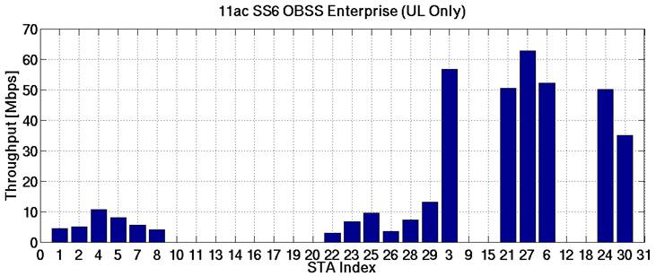
Scenario 6: UL only
[1]
Marvell
Notes:
In total, the area throughput is ~317 Mbps (maximum 292.5 Mbps per link)

Slide 5
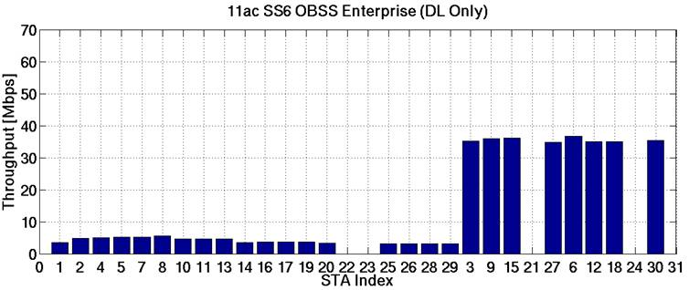
Scenario 6: DL only
[1]
Marvell
Notes:
In total, the area throughput is 232 Mbps (maximum is 292.5 Mbps per link). It makes sense since 3 AP actually sharing the channel, not much spatial reuse in this case

Slide 6
Observations
The throughput results are quite different from drop to drop
  Suggest to turn off shadowing to further trim down the sources of randomness
It seems that we have the same trend on the BSS throughput with [1] but the numbers have difference.
  Suggest to compare one BSS case first, e.g., the up-right corner BSS in Scenario 6

Slide 7
Selecting One BSS For Calibration
Only simulate upper-right corner BSS (AP-B) for step-1 calibration
STA1 | (5,-9.5)
STA2 | (3.5,7.5)
STA4 | (-4.5,0.5)
STA5 | (-1.5,6)
STA7 | (-9,-5)
STA8 | (-8.5,8.5)
STA10 | (-3,0.5)
STA11 | (-0.5,8)
STA13 | (-4,-4)
STA14 | (7.5,-1)
STA16 | (8,-6)
STA17 | (0,-7.5)
STA19 | (-2.5,-4.5)
STA20 | (0.5,-2)
STA22 | (0,-4.5)
STA23 | (-1.5,7)
STA25 | (3.5,-5)
STA26 | (9,9.5)
STA28 | (-8,-5.5)
STA29 | (1.5,3.5)
AP A | (0,0)
AP B | (40,20)
AP C | (-40,-20)
STA3 | (7.5+xb, ‑9.5+yb)
STA9 | (7+xb, -7.5+yb)
STA15 | (3+xb, -0.5+yb)
STA21 | (-6.5+xb, -3+yb)
STA27 | (‑6+xb, 2.5+yb)
STA6 | (-5.5+xc,4.5+yc)
STA12 | (7+xc,7+yc)
STA18 | (10+xc,0.5+yc)
STA24 | (3+xc,2.5+yc)
STA30 | (9.5+xc,3.5+yc)

Slide 8
UP-Right Corner BSS Alone: UL Only
In total, the BSS total throughput is 234 Mbps (maximum is 292.5 Mbps per link).
Each STAs throughput is relative reasonable comparing its distance to AP.
Notes:
In total, the BSS total throughput is 234 Mbps (maximum is 292.5 Mbps per link). Each STAs throughput is relative reasonable comparing its distance to AP.

Slide 9
UP-Right Corner BSS Alone: DL Only
In total, the BSS throughput is 263 Mbps (maximum is 292.5 Mbps per link)
If a uniform 1ms application start time is used, all 5 STAs will have similar throughput around 52 Mbps
Notes:
In total, the BSS throughput is 263 Mbps (maximum is 292.5 Mbps per link)

Slide 10
Problem of Preamble Model and Packet Collision
We have observed non-negligible packet collision in UL.
Need an aligned (and accurate) modeling on the preamble detection.
For example, if assuming preamble is always correctly decoded.
  The closer-to-AP STA always has the advantage of grabbing the channel successfully.
  On the contrary, the faraway STA wastes its medium access on BAR transmission and such retransmission will hurt the overall throughput.

Slide 11
Discussions on Preamble Detection
There have been contributions starting to study the modeling.
Different fields in preamble play a different role and have different impact → should be model individually.

Slide 12
Modeling Individual Fields in Preamble
STF
  Timing and AGC setting may be corrupted and lead to packet loss, if a later-arrival packet’s power is strong enough.
  Modeling: Receiver will be locked in receiving the earlier-arrival packet if no packet of received power within [x]dB comes in STF; otherwise both packets are lost and receiver remains in CCA busy.
LTF
  Only used for channel estimation
  Modeling: Channel estimation error will be counted as additional in SINR calculation, and contribute to the SIG/data subframe decoding error [2].
  No need to model if LTF “passes” or not.
SIG
  Modeling: use PHY abstraction for MCS0/24bit/BCC to determine decoding error. All subsequent subframes will be lost if SIG fails.

Slide 13
Preamble Modeling Illustration
STF
LTF
SIG
STA 1/TX
STA 2/TX
AP/RX
PER(MCS0) → SIG decoding pass/fail.
CCA busy
P_{RX}(STA2) < P_{RX}(STA1) – xdB → receive STA1;
Otherwise, both packets are lost
Calculate additional AWGN for SIG/Data PHY abstraction

Slide 14
Alternative Preamble Model
Typically STF is more robust than SIG, then STF model can be skipped.
  SIG decoding error is the bottleneck of preamble reception.
In such a case, the preamble can be modeled as a whole with two impact:
  Decoding SIG to determine if preamble is failed and the subsequent subframes are lost (but remain CCA busy).
  Determine additional AWGN to PHY abstraction

Slide 15
Alternative Model Illustration
STF
LTF
SIG
STA 1/TX
STA 2/TX
AP/RX
PER(MCS0) → SIG decoding pass/fail.
CCA busy
Calculate additional AWGN for SIG/Data PHY abstraction

Slide 16
Conclusions
Box5 calibration results have been collected using 11ac scenario 6 as proposed in [1].
Further simulated one BSS results and suggest to use as the first step box5 calibration.
Motivated by the observation of frequent packet collision and offline discussions, proposed a preamble model for collision.

Slide 17
References
[1] 11-14-1177-02-00ax-box5-calibration-discussion
[2] 11-14-0810-00-00ax-RBIR-based-phy-abstraction-with-channel-estimation-error

