Slide 1
Observed protocol violations caused by DSC with roaming STAs
Date: 2014-11-02
Authors:

Slide 2
Abstract
All of the many DSC presentations [1] [2] [3] [4] [5] [6] and simulation results [7] [8] [9] [10] assume fixed STAs. Roaming has not been considered by TGax to date.
While tuning video roaming in a large stadium, we observed unexpected, adverse client behavior with DSC enabled on the AP side.
We replicated this in the lab, characterizing behavior of 3 different major client OS in a simple 2 AP roam test.
Drivers that are not aware of DSC behavior on both AP and STA respond badly to peer protocol violations caused by DSC.
The adverse behavior is independent of OS and silicon vendor.
DSC proposals must be modified to including a signaling method for APs and STAs to indicate when they are reaching the edge of the cell margin to avoid significant loss of airtime and battery to DSC roaming transitions. Pre-emptive AP steering may be necessary.

Slide 3
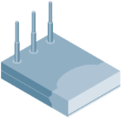

Testbed Configuration
(2) 802.11ac 3SS APs @ 20m separation
  EIRP = 15dBm, DSC margin = 35dB, Noise Floor = -97dBm
  Effective DSC cell edge = -62dBm
(2) 1SS 11ac Smartphones, (1) Laptop with 3SS 11n NIC on cart
  Streaming HLS live stream from live.twit.tv
(1) Omnipeek multichannel capture laptop on cart
AP-1
AP-2
20m
Cart
30m
Capture

Slide 4
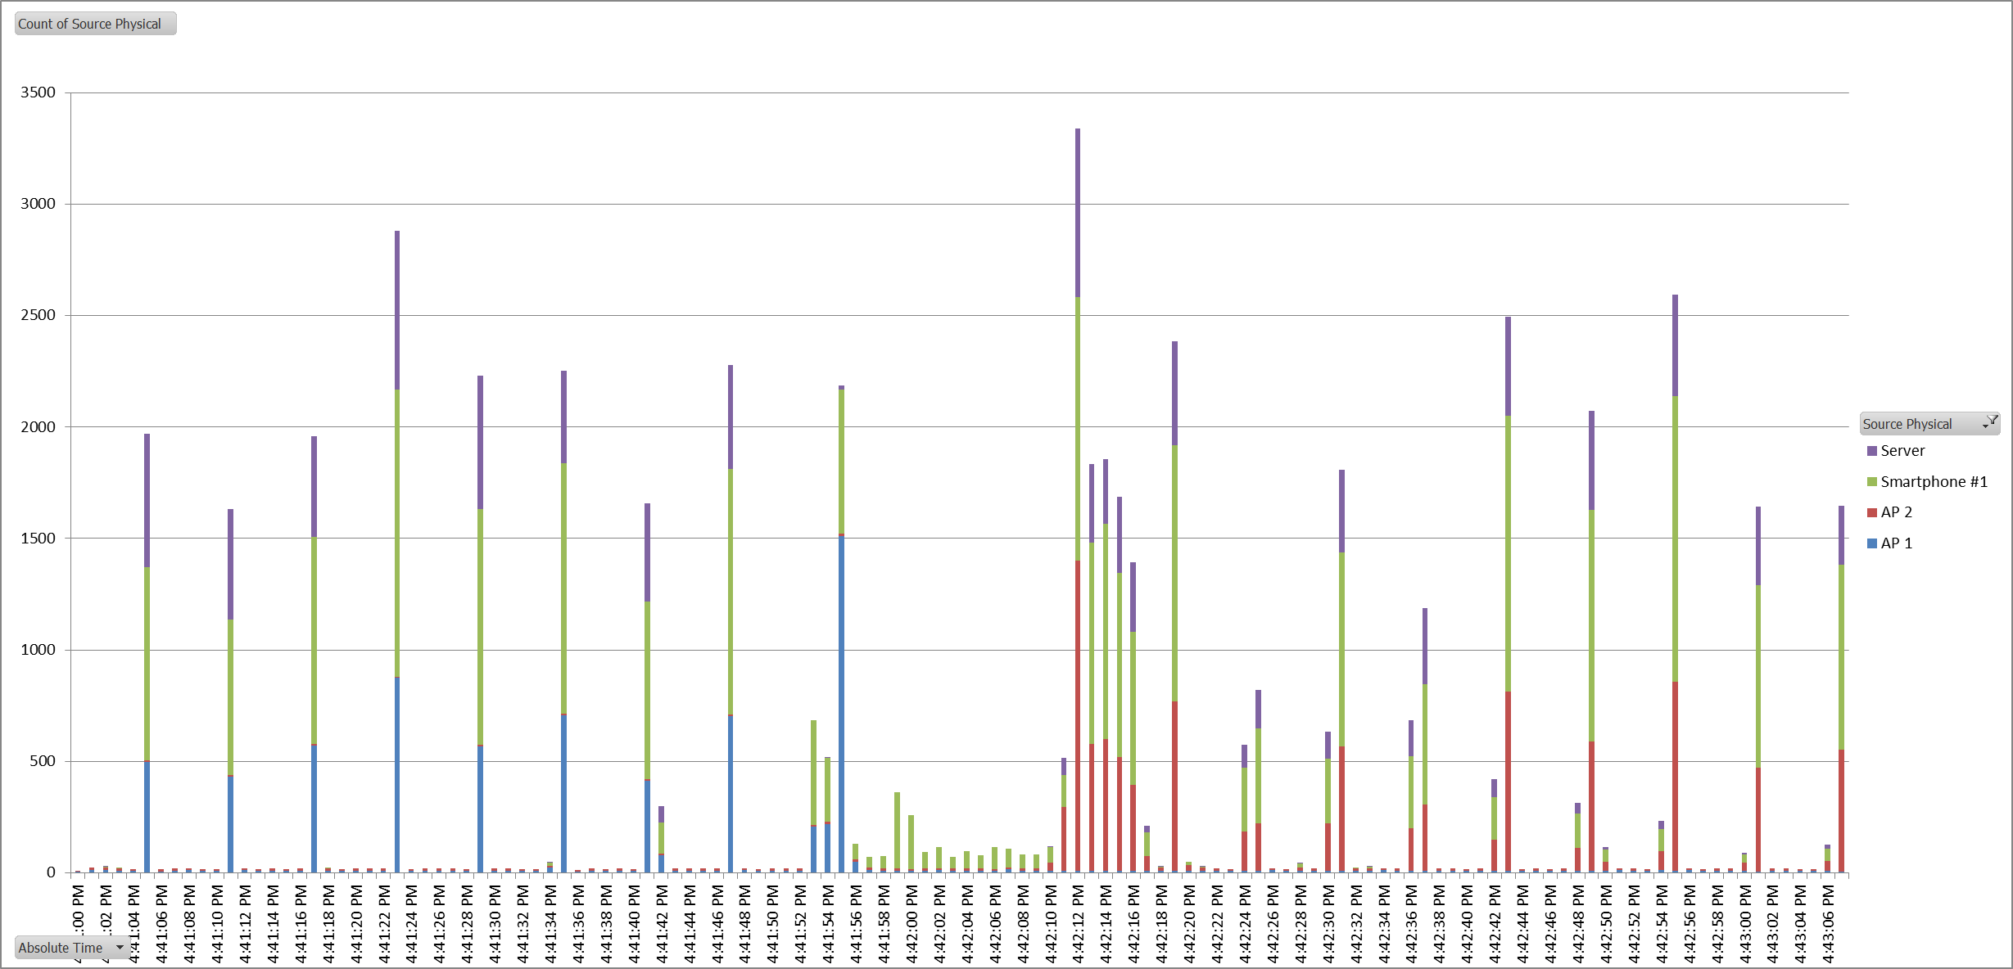
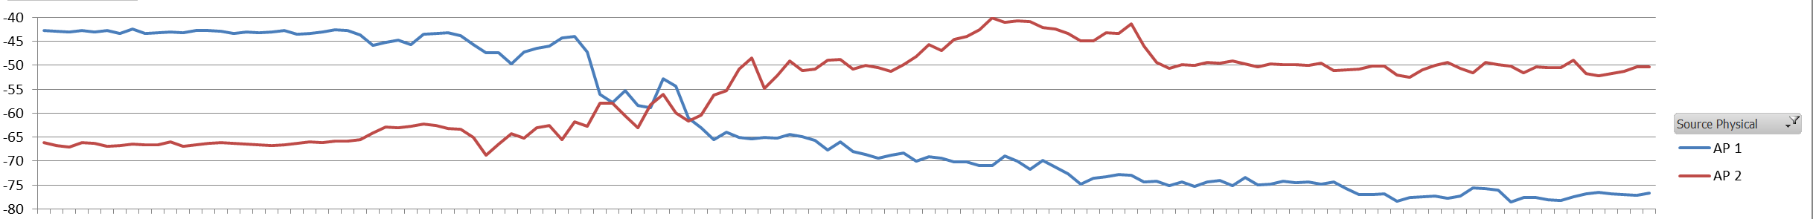
Smartphone #1 Roam (AP1 → AP2)
HLS Catchup
Normal HLS Traffic
Normal HLS Traffic
Roam
Protocol Failure Zone
Frames
RSSI
DSC Edge
Roam Threshold

Slide 5
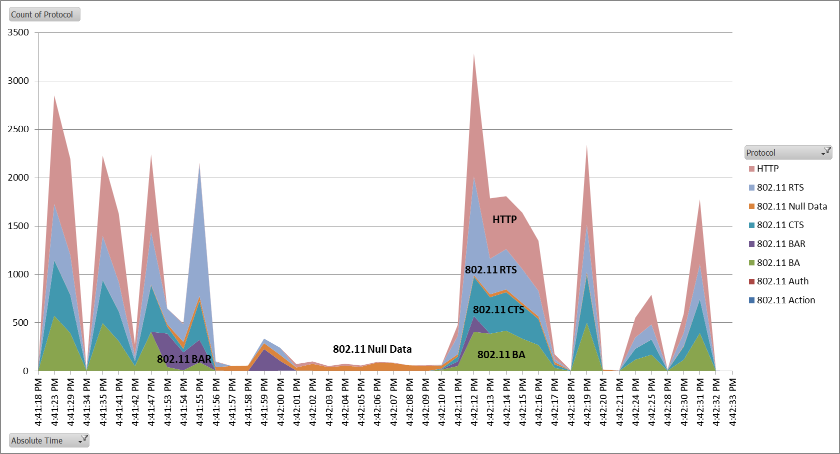
Smartphone #1 Roam (A -> B)
Protocol Failure Zone
5,000+ frames, 24 sec

Slide 6
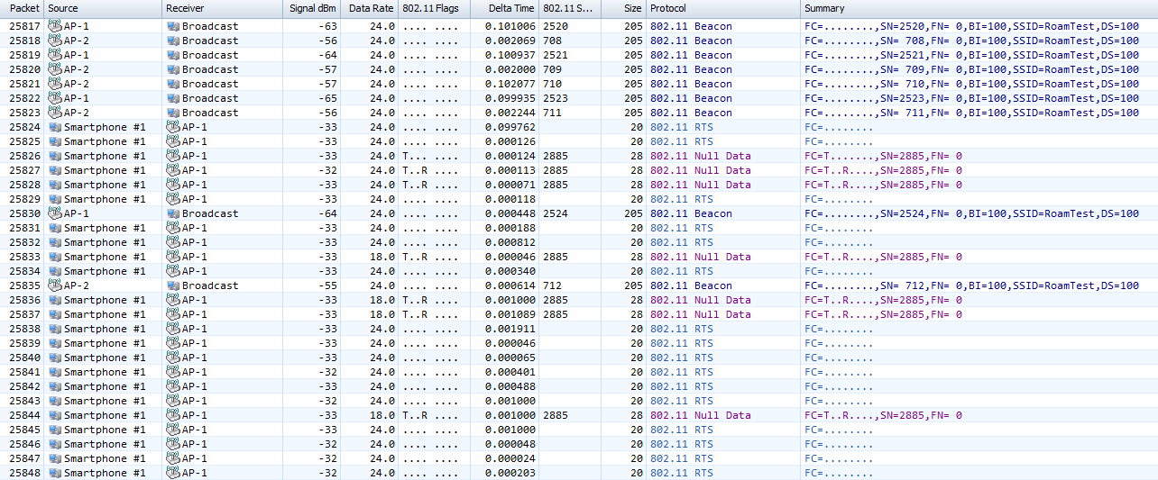
Smartphone #1 – AP stops responding to RTS & PS (54 frames)
Phone attempts to wake AP by setting PS=0; AP does not ack so multiple retries
Unacknowledged RTS, but AP @ -65dBm!

Slide 7
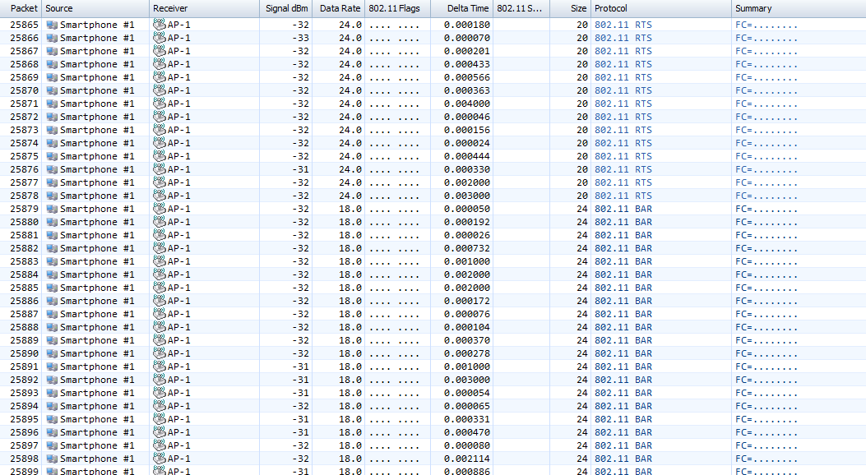
Smartphone #1 – Phone initiates BAR storm
(170 frames)
Unacknowledged BARs.
5-6 packet sequences with increasing delays up to 5ms

Slide 8
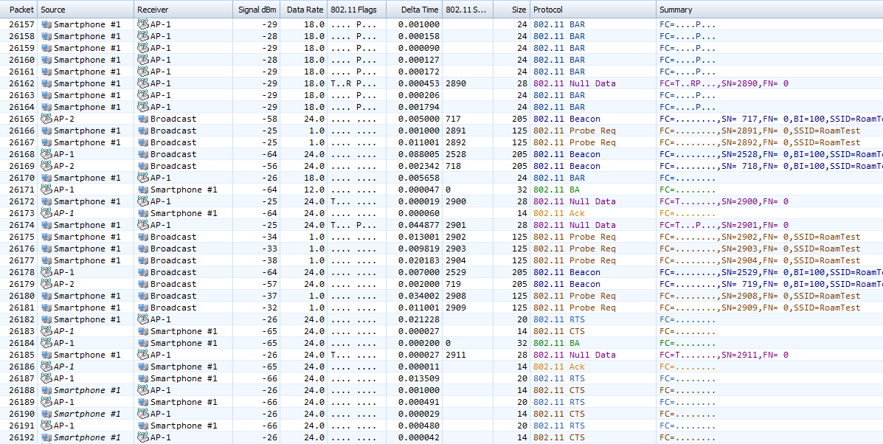
Smartphone #1 – Off-channel probing starts; two TXes complete; AP ignores its own RTS
Probes on 1, 6 & 11
2 get through!
AP ignores CTS in response to own RTS

Slide 9
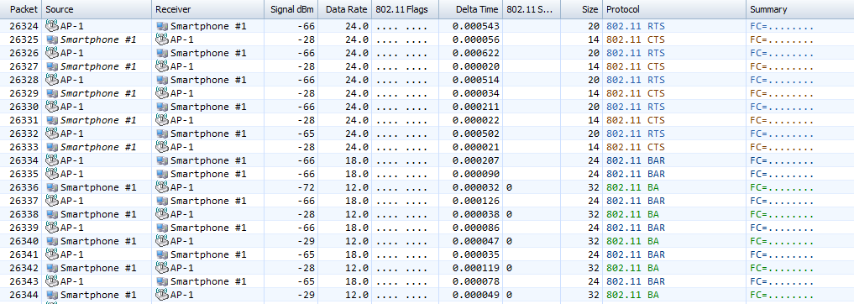
Smartphone #1 – AP ignores response to own BARs
140 RTS/CTS frames
150x BAR/BA frames
AP still @ -65dBm!!

Slide 10
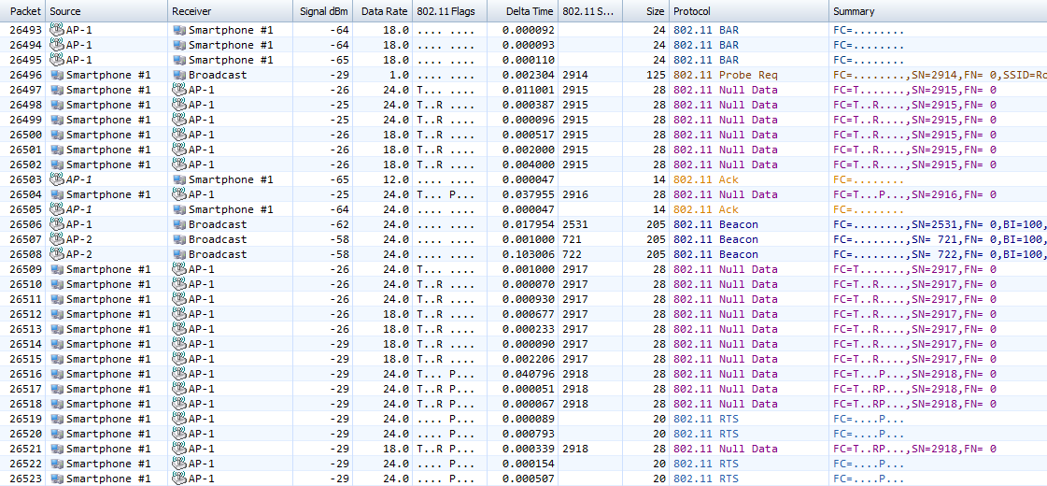
Smartphone #1 – AP loses track of STA PS state
Multiple retries to wake
2 get through!
PS state cycles
AP misses both PS states

Slide 11
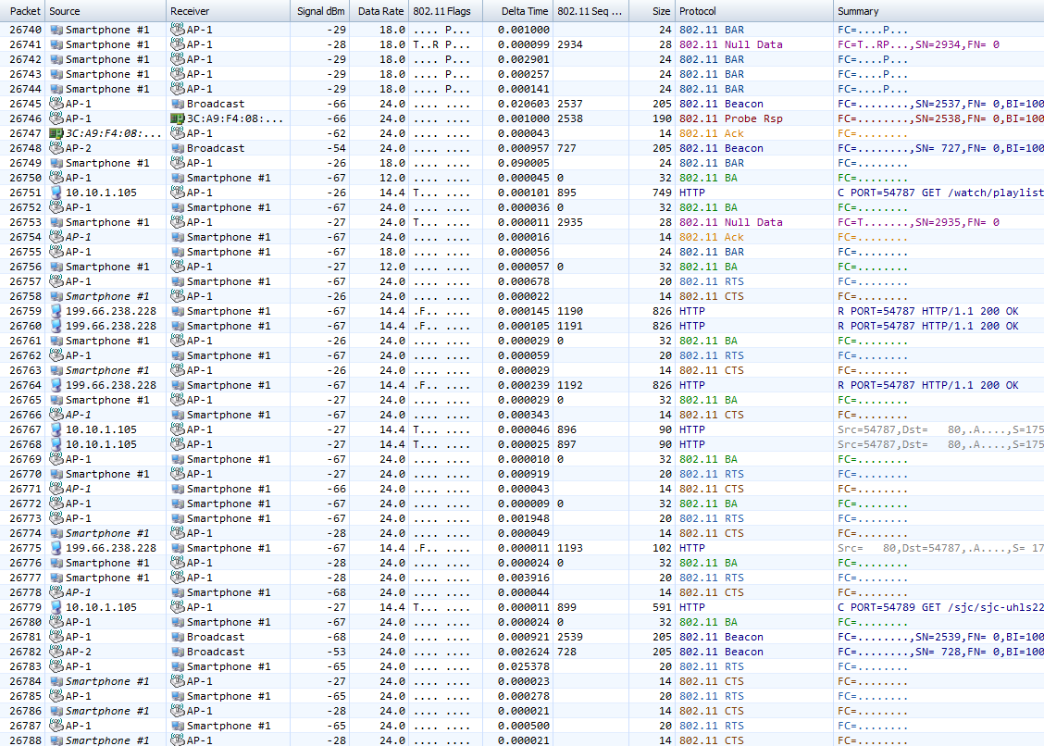
Smartphone #1 – Link temporarily restored
220 more junk frames
Channel improves; 7 TXOPs complete
Demonstrates importance of 2-way signalling method on edge of DSC margin
Channel fails; Back to 1-way RTS

Slide 12
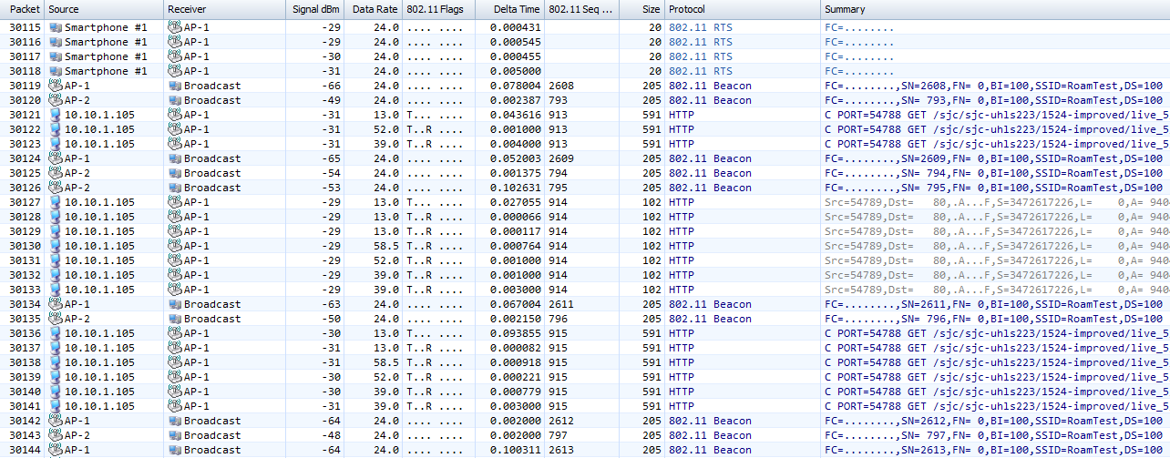
Smartphone #1 – Fall back to legacy Ack with rate probing (after 3500+ more wasted frames)
Multiple retries; Note rate probing

Slide 13
Smartphone #1 Roam – Final Notes
After another 700 frames, AP-1 beacons drop below -70dBm and device roam threshold kicks in. Phone roams to AP-2 immediately (frame 31,007).
Total damage to channel of DSC:
  Over 5,000 frames @ lowest TX rate (25,824 – 31,007)
  17 seconds (4:41:52 – 4:42:09)

Slide 14
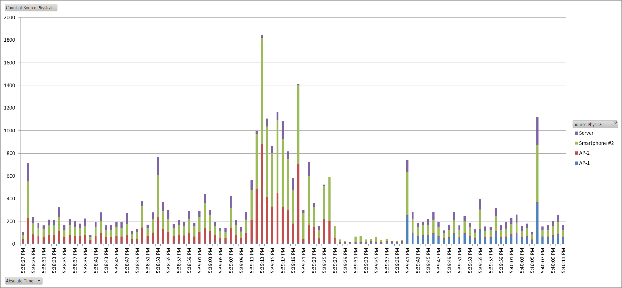
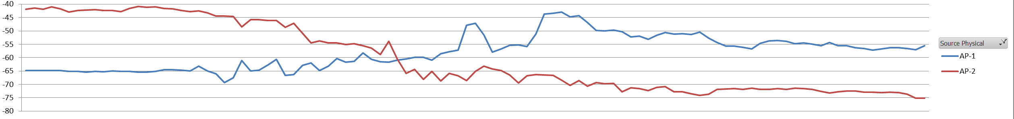
Smartphone #2 Roam (AP2 → AP1)
Protocol Failure Zone
HLS Catchup
Frames
Normal
HLS
Normal HLS Traffic
Roam
RSSI
DSC Edge
Roam Threshold

Slide 15
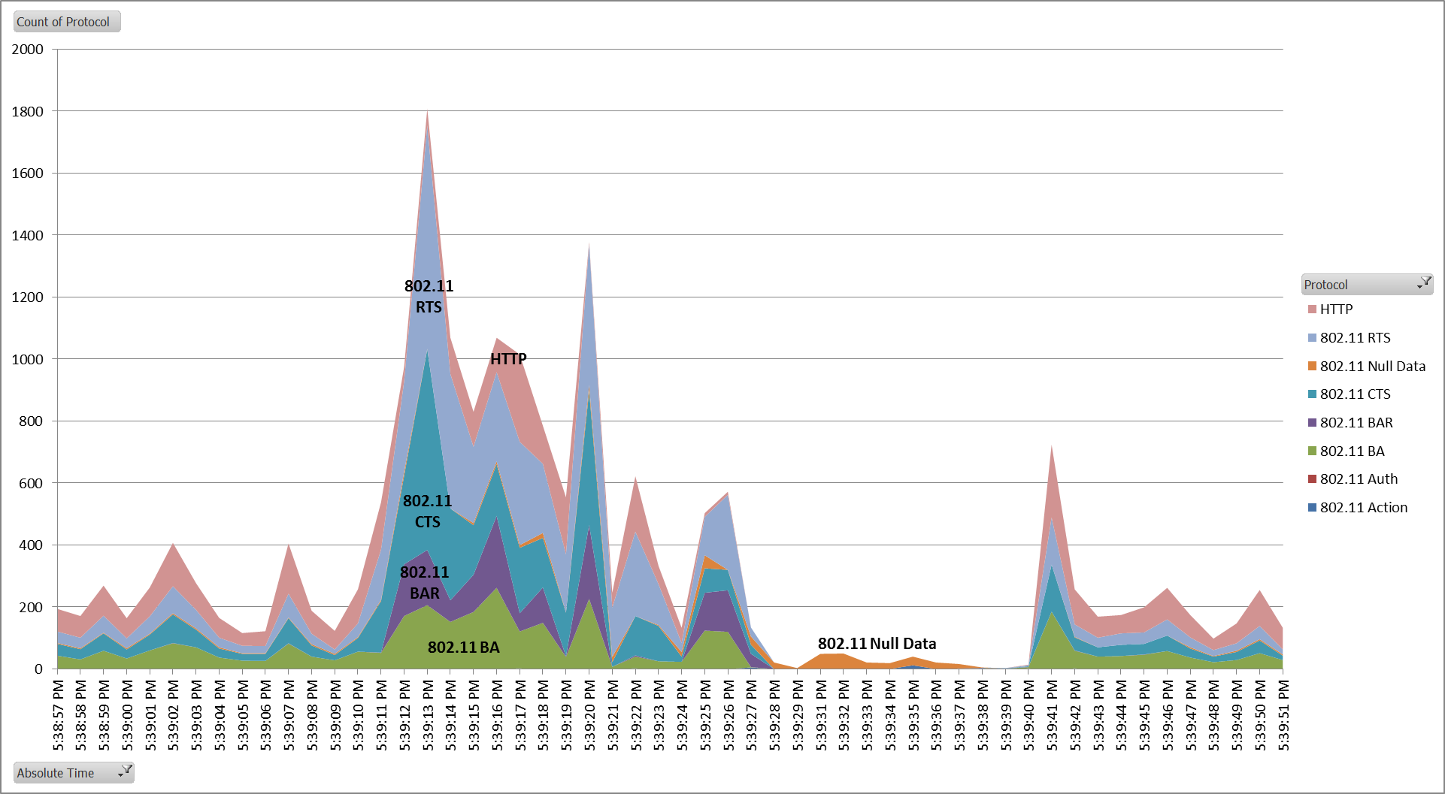
Smartphone #2 Roam (AP2 → AP1)
Protocol Failure Zone
10,000+ frames, 29 sec

Slide 16
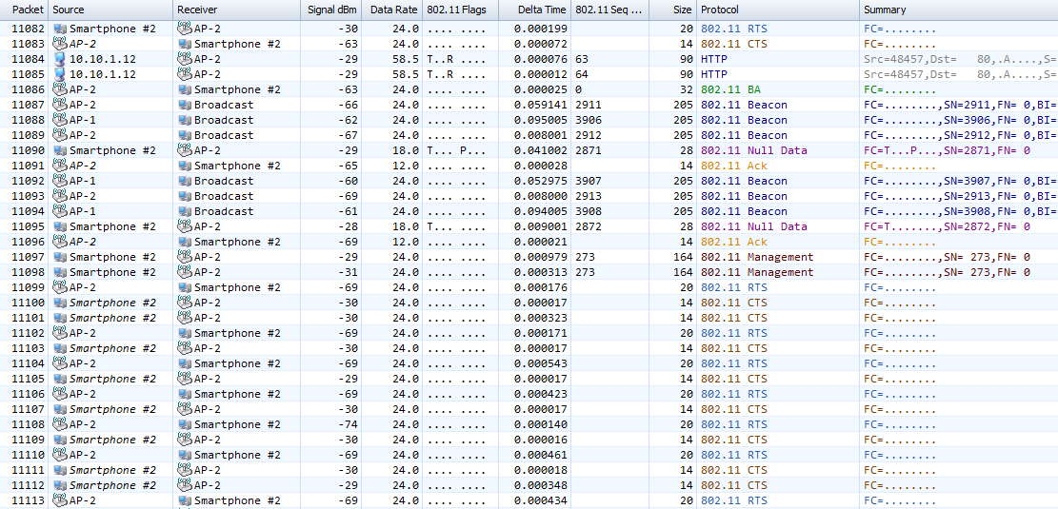
Smartphone #2 Pcap – AP stops responding to RTS
Last clean TXOP and PS state change
RSSI drops suddenly to -69, AP stops responding to Phone

Slide 17
Smartphone #2 Roam – Final Notes
Does not roam until 14 beacons seen < -70dBm
Total damage to channel of DSC:
  Over 10,000 frames @ lowest TX rate (11,099, – 24,598)
  25 seconds (5:39:11 – 5:39:36)

Slide 18
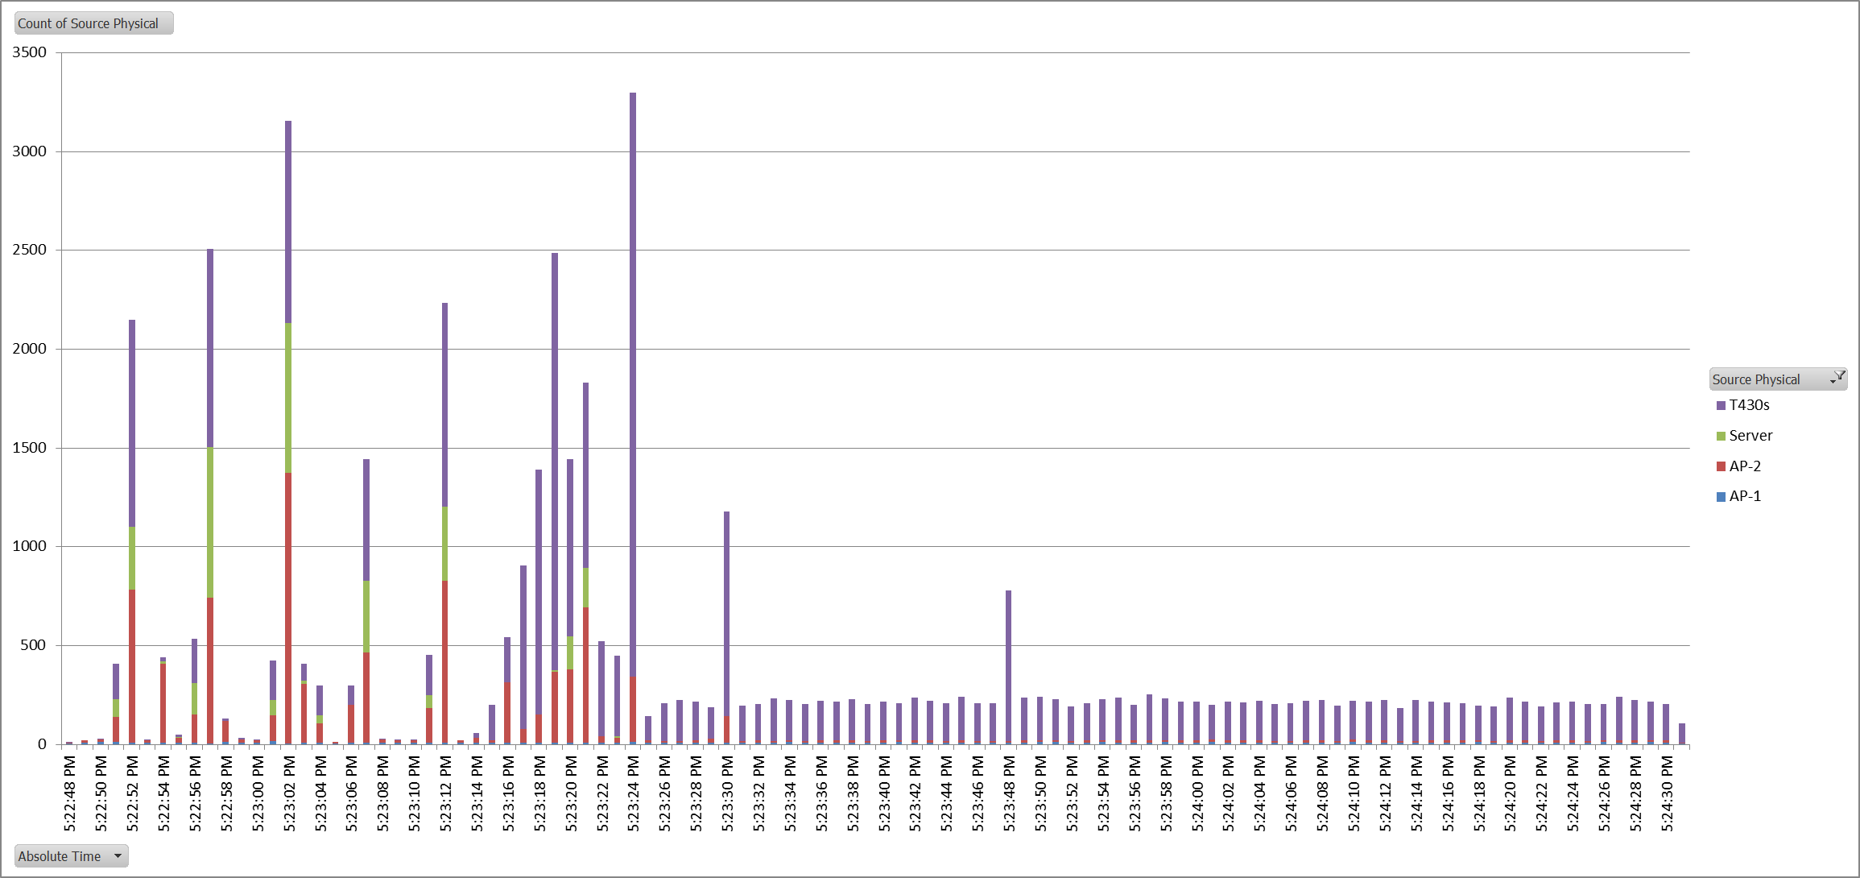
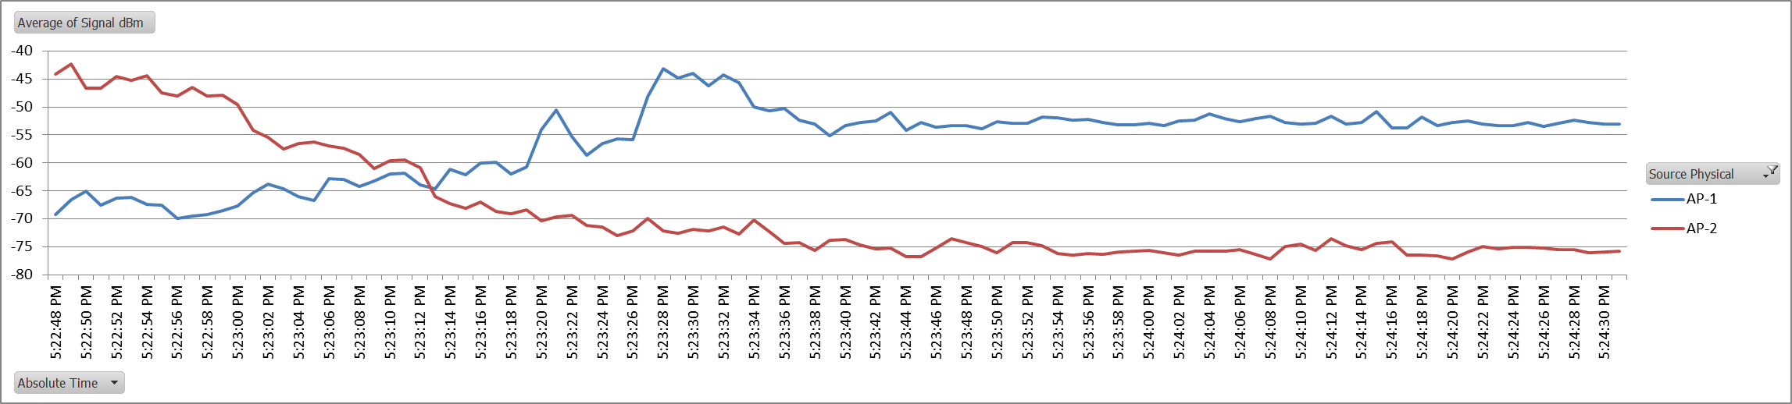
11n Laptop Roam (B → A)
Normal HLS Traffic
Protocol Failure Zone
20K+ frames, client never recovers or roams
Frames
RSSI
DSC Edge

Slide 19
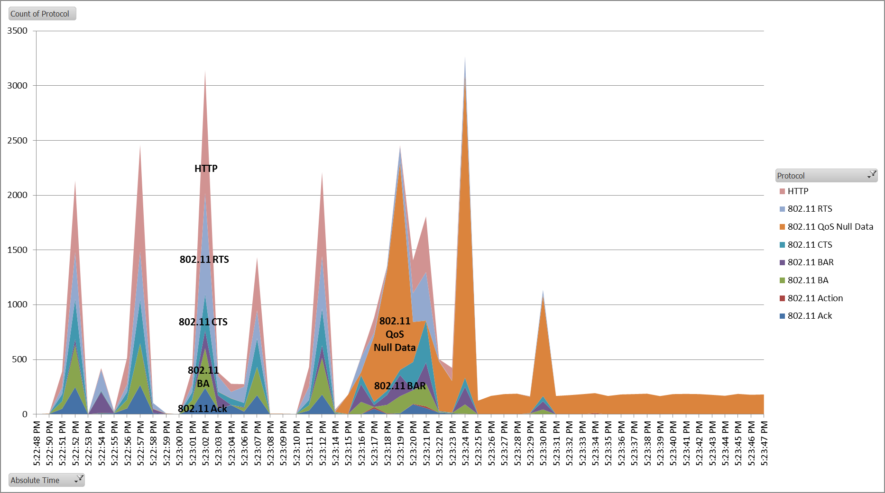
11n Laptop Roam (B → A)
Protocol Failure Zone

Slide 20
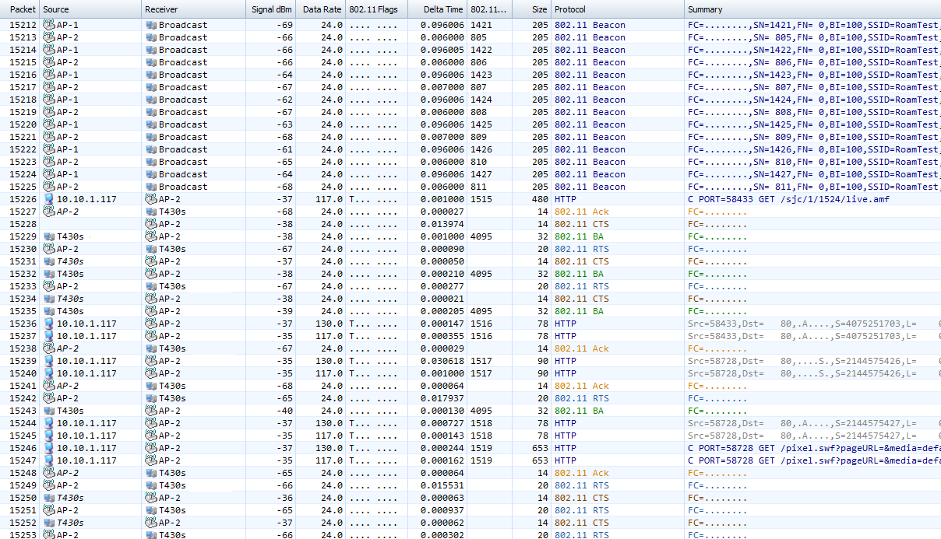
11n Laptop Pcap #1 – AP stops responding to RTS
RSSI drops suddenly to -68, AP stops responding to laptop RTS; client sends BA for frames already acked

Slide 21
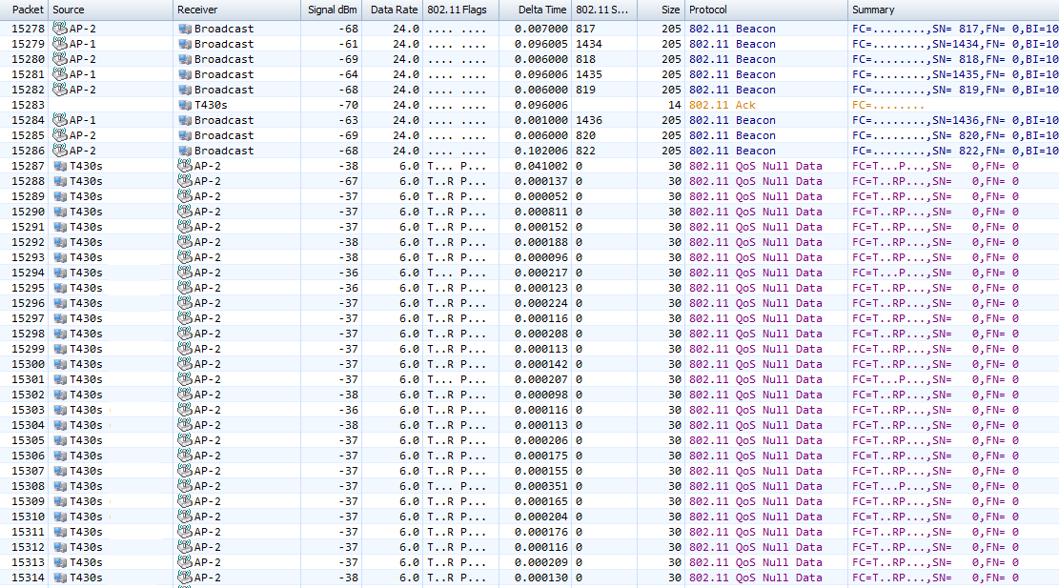
11n Laptop Pcap #2 – PS Failure Loop
AP ignores PS notification, client locks up – 175 frames

Slide 22
11n Laptop Roam – Final notes
After 200-250 Null Data PS bits, then goes into RTS/CTS, then BAR/BA, then BA
  Then loops back through sequence over and over for 10 seconds
After 10 second wakeup period, STA gives up all communication except PS notifications (18 retries each)
Total damage to channel of DSC:
  Over 9,300 frames @ low rate during initial 10 second wakeup attempt (15,139 – 24,489)
  220 frames/second average (30,819 – 33,004)
  Never roams
  Never resets connection

Slide 23
Summary of Protocol Violations
Hard Violations
  Initiating any TX to STA that is known to be outside DSC margin
  Initiating TX to STA that has informed AP it is in PS
  Failing to disassociate a STA which is effectively no longer in the BSS
“Soft” Violations
  AP ignoring repeated BAR or RTS from STA outside the margin
  AP ignoring repeated non-aggregated data frames from STA
  STA continuing to attempt TX to AP that has not responded in X frames and has SNR > RoamThreshold

Slide 24
Why not just fix by matching margin to roam thresold?
Every device has different roaming thresholds.
  For example, IOS and Android have huge variation.
  Within same OS, roaming thresholds change by release
Many vendors do not publish their roaming thresholds
Margin for a given OS varies with radio chain count
Setting for least common denominator (e.g. Android) nullifies potential DSC gain

Slide 25
Conclusions
Roaming case is a key aspect of Scenarios 2, 3 and 4
  Do we have a gap in Sim Scenarios – roaming is not required?
It is probably impossible to choose a single margin value that works for all clients
Margin should probably never be set higher than:
SNR[min cell TX rate] – 3dB
Any DSC implementation in TGax needs to be roam-aware
SNR fluctuations and MIMO effects create non-deterministic TX openings after crossing DSC edge
Is increasing DSC complexity worth the benefit?

Slide 26
Critical DSC Proposal Modifications
Fixed margins are problematic.
  DSC-enabled APs and STAs must keep track of the realtime delta between the peer SNR and the cell margin value
Retry algorithms should be aware of DSC state for peer
Neither AP nor STA should initiate a protocol session to a peer that is currently outside the DSC margin
  If we have already decided to stop RXing for a peer, we should not attempt to TX to it
Both AP and STA need a method to signal the peer that (i) it is about to withhold TX due to cell exit so the peer can take appropriate action; or (ii) it has re-entered the margin area and TX will resume.
  Cannot notify peer ex-post facto if it attempts to TX outside of range, since we will not receive ACK
Algorithms must be robust in face of edge flapping

Slide 27
Straw Poll
Should any DSC specification adopted by TGax include mechanism(s) to ensure graceful roaming and eliminate unnecessary transmissions?
Yes / No / Abstain

Slide 28
Straw Poll
Should 14/0980 TGax Simulation Scenarios 2, 3 and 4 be revised to include roaming STAs?
Yes / No / Abstain

Slide 29
References
14/0779r2 - “Dynamic Sensitivity Control - Practical Usage,” Smith, Jul 2014
14/0872r0 - “A Protocol Framework for Dynamic CCA”, Coffey Hart Hiertz et al, July 2014
14/1224r0 – “Link Aware CCA,” Hart, Cisco, Sep 2014
0854r0 – “DSC and Legacy Coexistence,” Carney et al, Sony, Jul 2014
14/1207r1 – “OBSS reuse mechanism which preserves fairness”, Jamil, Orange, Sep 2014
14/1233r2 – “Adaptive CCA for 11ax,” Hedayat et al, NEWRACOM, Sep 2014
14/1171r1, “DSC Simulation Results for Scenario 3,” Itagaki, Sony, Sep 2014
14/1199r1 – “Effect of CCA in residential scenario part 2”, Barriac et al, Qualcomm, Sep 2014
14/0868r0, “UL & DL DSC and TPC MAC simulations,” Soder, Ericsson, Jul 2014
14/0523r0, “MAC simulation results for Dynamic sensitivity control (DSC - CCA adaptation) and transmit power control (TPC),” Jamil, Orange, Apr 2014

