Slide 1
Ethernet Next Generation Enterprise Access BASE-T PHY in support of 802.11ac – 802.3 CFI Summary
Date: 2014-10-31
Authors:

Slide 2
Abstract
This presentation is a short summary of IEEE 802.3 Call For Interest (CFI), to be presented on November 4th, 2014, 6:00 ~ 7:30 pm.
A successful outcome of this CFI will form a Study Group in 802.3 to explore new Ethernet speed(s) between 1 Gb/s and 10 Gb/s over 100 meters of installed base of Cat 5e or better, in support of data rates needed for Enterprise Access Points using 802.11ac, and other higher speed devices on the horizontal structured wiring.

Slide 3
CFI request for
Next Generation Enterprise BASE-T Access
This is a call for interest to initiate a Study Group to explore the need for one or more new Ethernet speed(s) between 1 Gb/s and 10 Gb/s over balanced twisted pair cabling. We believe there is a market need, driven by IEEE Std 802.11ac wireless access points, to support higher than 1 Gb/s Ethernet rates at a 100m reach using the installed base of Cat 5e (or better) structured cabling. Higher performance end devices like desktop and laptop PCs, as well as other enterprise applications for Ethernet, will also benefit from the new data rates provided by this work.

Slide 4
802.3 CFI Agenda
Overview
Market Drivers
Technical Feasibility
Why Now?

Slide 5
Overview: Next Generation Enterprise BASE-T Access
Provide cost optimized connections in Enterprise Ethernet Access networks at rates between 1 Gb/s and 10 Gb/s using structured UTP wiring.
Provide new MAC rate(s) and PHY(s) that:
  Leverage 10GBASE-T PHY technology.
  Optimize data rates on installed structured wiring. i.e. 100 meters over Cat 5e (or better).
Provide a speed upgrade for Enterprise Access using the installed base of structured cabling.
  1000BASE‐T has been massively successful.
  End devices are increasing in number and capacity faster than cabling is being upgraded.
  Many client devices (e.g. laptops, smartphones, tablets, etc.) are shifting to 802.11 for network access.
  The bandwidth backhaul needs of 802.11ac Wave 2 Access Points (MU-MIMO) are a key driver.

Slide 6
Overview: Next Generation Enterprise BASE-T Access (cont.)
Support needs of 802.11ac (aka Gigabit Wi-Fi) APs
  IEEE 802.11ac-2013 was approved December 13. Many products shipped pre-standard. Wi-Fi Alliance launched the “Wi-Fi CERTIFIED ac” program in June 13.
  The first round of devices (aka “Wave 1”) with 80MHz channels/single-user MIMO (SU-MIMO) is deploying today in enterprise markets.
  The 2nd round (aka “Wave 2”) is in the pipe. It adds features like four spatial streams, 160 MHz channels and multi-user MIMO (MU-MIMO)
  The Ethernet bandwidth needs of 802.11ac Wave 2 APs approach 2Gb/s within 12 months, and 4Gb/s in 24-36 months
  The rule of thumb is that the AP Ethernet speed should be at least 75% of maximum radio speed to avoid the Ethernet link being the system bottleneck.

Slide 7
Market Drivers

Slide 8
Enterprise Network Structure today
Enterprise campus networks are typically built using a three tier design shown at the right
This design (very different to DC spine/leaf) has proven stable and durable over a number of technology evolutions.
The links between the Enterprise Access switches and the APs are the key focus of this presentation
Enterprise
Core
Enterprise
Distribution
Enterprise
Access
AP
AP
AP
AP
APs and
End Devices
Notes:
PJ 10/6/14 PM – rewords and moves.

Slide 9
Enterprise Access links today
Enterprise access links (aka Horizontal Links ) are dominated by 1000BASE‐T over Cat 5e/Cat 6
  Source: Cable and Install Mag Feb14
  Survey participants were asked to identify all major cable types in their Horizontal Links
  The chart shows the proportions of cable types for BASE-T links
Enterprise Access port types are dominated by 1000BASE-T
  Source Dell’Oro July 14
Notes:
PJ 10/6/14 PM – rewords and moves.

Slide 10



802.3 Ethernet and 802.11 Wireless LAN
1000BASE-T
Power over Ethernet
Ethernet Access Switch
Dominated by 1000BASE‐T ports
Acts as Power over Ethernet Power Sourcing Equipment (PoE PSE), supports 15W, 30W, 4PPoE
Cabling
100m Cat 5e/6/6A installed base.
New installs moving to Cat 6A for 10+yr life.
Wireless Access Point
Mainly connects 802.11 to 802.3
Normally PoE powered
Footprint sensitive (e.g. power, cost, heat, etc.)
Increasing 802.11 radio capability (11ac Wave 1 to Wave 2 ) drives Ethernet backhaul traffic beyond 1 Gb/s.
Link Aggregation (Nx1000BASE-T) or 10GBASE-T only options today
Notes:
PJ 10/14 –
Clarify power provided from switch – add 802.3 standard refs.
Says that New Cabling 6A, 10years + expectancy

Slide 11
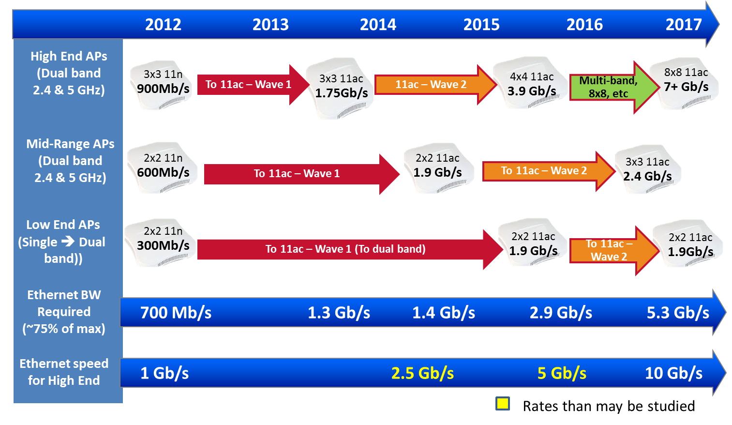
802.11ac Enterprise AP Radio Bandwidth Trends
Notes:
Removing AD
[YK] Speaker Notes:
The managed AP market is segmented into High-end high-performance, and Low-end hot-spot-oriented and some mid-range.
Here we are showing Ethernet edge switch port speeds, relative to AP bandwidth needs for the three segments.
802.11n is the LAST radio on 2.4 GHz band. 802.11ac does not work in 2.4 GHz band.
High-end and Mid-Range APs support simultaneous 2.4 GHz and 5 GHz bands,
so 802.11ac transition assumes 802.11n support @ 2.4 GHz band and .11ac transition @ 5 GHz band.
Low End typically does not. Low-end supports legacy 2.4 GHz b/g/n uses.
But with proliferation of 802.3ac wireless clients, low-end transitions to support dual band.
[YK] Background info:
802.11 n radio rates are multiples of 72.2 Mb/s (20 MHz) or 150 Mb/s (40 MHz) per [MIMO] antenna.
802.11ac radio rates are multiple of 867 Mb/s (80 MHz) per [MIMO] antenna.

Slide 12
Enterprise AP Radio Bandwidth
Period Standard
1997-1998 802.11
1999-2001 802.11b
2002-2006 802.11a/g
2007-2011 802.11n
2013-2015 802.11ac
2015-2017 802.11ac W2
Max
(Mb/s)
2
11
54
600
3470
6930
802.11 is clearly outgrowing 1000BASE-T as an Enterprise access media.
APs upgrade cycle is faster than switches or cabling (in the order of 3Y/7Y/15Y)
802.11ax High Efficiency WLAN (HEW) became a TG May14, target date 1H/2019.
  Its PAR states “enable at least one mode of operation capable of supporting at least four times improvement in the average throughput per station.”
The rule of thumb is that the AP Ethernet bandwidth should be at least 75% of radio bandwidth to avoid the Ethernet link being the system bottleneck.
Notes:
Would like predictions for next 5-10 years, showing APs will need rates above 5Gb/s . TEF FY13 discussed rates in panel, Bruce Kramer? PJ to get comment back from 802.11.
Refs
http://www.wi-fi.org/beacon/clint-w-brown/80211ac-wi-fi-next-generation-wireless-connectivity
http://www.cisco.com/c/en/us/products/collateral/wireless/aironet-3600-series/white_paper_c11-713103.html

Slide 13
Enterprise 802.11 Market Forecast
Enterprise 802.11ac AP adoption rate is growing faster than 802.11n did
  21% in 5th quarter of shipments
802.11ac Wave 2 APs will offer significant performance improvements for campus deployments
BYOD devices (e.g., the latest smart phone, the newest tablet) are driving technology adoption in the enterprise
  Within 5 years >95% of shipping 802.11 devices will support 802.11ac.
  Lots of devices drives multi-user MIMO adoption
Source: Dell’Oro June 2014
Notes:
PJ: need to check numbers

Slide 14
Other Broad Market Uses
This work offers a speed upgrade over 1G Ethernet using existing installed structured wiring.
  100BASE-TX to 1000BASE-T over existing cabling reduced the barrier to adoption.
  We have a chance to do the same for the current 1000BASE-T user base.
Speed upgrades are often made when an existing link becomes congested.
  Any application that requires more bandwidth than 1000BASE-T could use this work without expensive cable rip/replace.
When does mass adoption of increased Ethernet link speeds happen?
  When the marginal cost of deployment is small compared to the increase in bandwidth.
Notes:
PJ 10/14/14 PM – rewords and moves.

Slide 15
Technical Feasibility

Slide 16
Wealth of Prior Experience
Industry already has experience in this space with MACs & PHYs at intermediate rates between 1G and 10G
The MAC is feasible in existing technology, and designs can leverage a Gigabit Ethernet MAC and run it faster, or run a 10G Ethernet MAC slower.
The PCS is feasible in existing technology, a sensible PCS choice is:
  Re-use the 10GbE PCS, 64B/66B, but run slower.
10GBASE-T proves much of the PHY functionality:
  Significant base of knowledge of channel and component characteristics
  Can run on some Cat 5e at reduced distances.
  Supports Cat 6 at 55m (and some to 100m), and Cat 6A to 100m
  Supporting data rates between 1G and 10G are enabled with symbol rate trade offs allowing longer reaches on Cat 5e/Cat 6
Energy efficient Ethernet approaches are well known for 1G and 10G
Notes:
PJ 10/6/14 PM – rewords and moves.

Slide 17
Between 1G and 10G, There’s Lots of Room for BASE-T PHYs
Cat 5e Spec
Cat 6A Spec
(100 MHz)
(250 MHz)
(500 MHz)
Cat 6 Spec
6.25
5 Gbps
(example)
2.5 Gbps
(example)
10G BASE-T
Encoding: bits/sec/Hz (per pair)
4
1000 BASE-T
62.5
100
200
400
Nyquist Frequency (MHz) for Ethernet Data Rates
Notes:
PJ 10/27/14 PM – talking points from GZ
Ethernet twisted pair signalling “BASE-T’s” all use baseband signalling, beginning near DC – hence, their capacity is sensitive to the product of the highest frequency they use and the spectral efficiency they use it with – how many bits per second they pack into each Hz of bandwidth.
In 1999 when 1000BASE-T came out, it used a relatively simply coded system, and minimal transmit filtering to fit within the bandwidth to which Category 5/5e cabling is specified, 100 MHz
(build) – In 2006, 10GBASE-T used improved coding techniques and improvements in cabling technology to provide 10Gbps over category 6, 6a or better cabling, both using more bandwidth and packing more bits into each Hz of bandwidth. 10GBASE-T defined the characteristics of a link segment out to 500 MHz to support this. In concert with the development of 10GBASE-T in IEEE 802.3, Cabling standards bodies developed specifications for Category 6a, also known as Class Ea, as well as technical standards bulletins relating to the use of Category 6 cabling beyond its specified frequency range of 250 MHz, and to maintain the required noise characteristics.
(build) – One way one might conceive a technically feasible solution for 2.5 Gbps over the existing installed cabling would be to more fully utilize the characterized bandwidth of Category 5e cabling, and use the entire defined 100 Mhz with the encoding approaches used in 10GBASE-T to get 6.25 bits/sec /Hz (per twisted pair), or 2.5 Gbps over 4 pair Category 5e Cabling.
(build) – Similarly, one might make a 5 Gbps transmission running over existing installed Category 6 cabling by utilizing 200 Mhz of the 250 Mhz defined bandwidth at the same spectral efficiency as 10GBASE-T. As IEEE 802.3 did for 10GBASE-T on category 6 cabling, IEEE could define the link segment characteristics consistent with using Category 5e over the wider frequency band.
Thus, we can see a family of baseband transmission schemes are possible, not just 1Gbps on Category 5e using DC to 62.5 Mhz, and 10Gbps on Category 6, 6a and above from DC to 400 Mhz, but filling in the needs of the enterprise with potentially 2.5 Gbps from DC to 100 Mhz and 5 Gbps from DC to 200 MHz.
On the subject of alien crosstalk, If asked, but not during the main presentation – because the insertion loss of 100 meters of cabling at 100 or 200 Mhz is so much less than it is at 400 Mhz, the example systems described do not need the extreme noise / “alien crosstalk” performance specified for 10GBASE-T. However, if needed, cabling standards bodies have already written standards bulletins on measuring and mitigating alien crosstalk noise. A study group would likely investigate whether the levels likely to be required would need such work, and make recommendations regarding applicable broad market potential and technical feasibility of such an approach.

Slide 18
Why Now?

Slide 19
Why Now?
The application is imminent!
  Enterprise Access Points transitioning to 802.11ac ~2 Gb/s speed in the next 12 months, and near ~4Gb/s speed for high end Wave 2 APs.
  Cost and power sensitive for nearer-term deployment
Industry has recognized the need & possible solutions
  Switching & PHY silicon under development
  The market needs an interoperable, open standard to avoid fragmentation and poor user experience.
  Launch of Consortiums targeting this market highlights the need.
The Ethernet Ecosystem has been very successful
  Open and common specifications
  Ensured Interoperability
  Security of development investment
Notes:
PJ: wordsmithing, “2.5GbE Consortium” is not the only game in town, more than one solution.

Slide 20
Q&A
IEEE 802.3 CFI announcement and its material is available here:
http://ieee802.org/3/cfi/request_1114_1.html
And this presentation is a shorter summary of that material.

