Slide 1
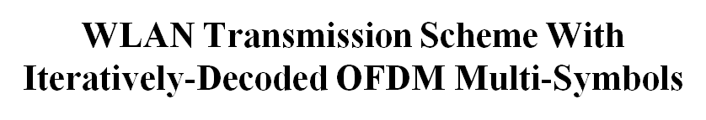
Date: 2014-11-04
Authors:
Notes:
September 2012

Slide 2
Outline
A glance at Bit-interleaved Coded Modulation with Iterative Decoding (BICM-ID)
OFDM multi-symbol in WLANs
Proposed transmission scheme
Simulation results
Summary

Slide 3


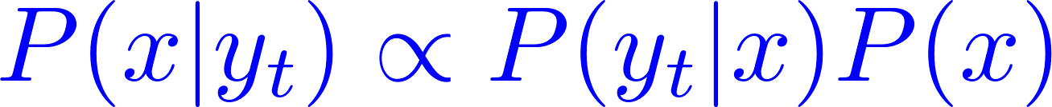
BICM
Data input
Conv.
encoder
Interleaver
Mapper
Fading channel
Data sink
SISO
conv.
decoder
Demapper
Deinterleaver

Slide 4

BICM-ID
Data input
Conv.
encoder
Interleaver
Mapper
Fading channel
Data sink
SISO
conv.
decoder
Demapper
Deinterleaver
Interleaver
Requirements:
  appropriate labeling map
  short-constraint-length convolutional encoder
  pseudo-random interleaver (of a sufficient depth)
  high computational power
High receiver latency!

Slide 5
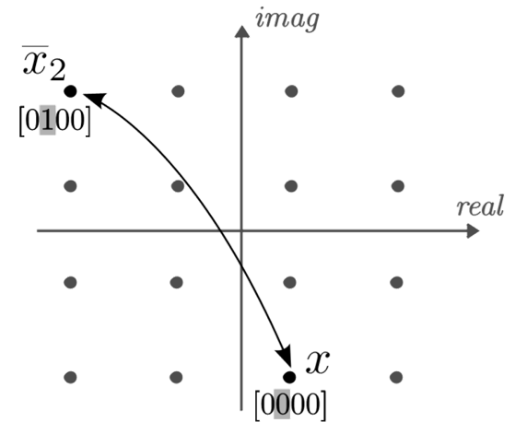
BICM-ID – labelings designed for iteratively decoded systems
maximize avg. Euclidean distance between constellation points, whose labels differ in exactly one bit

Slide 6
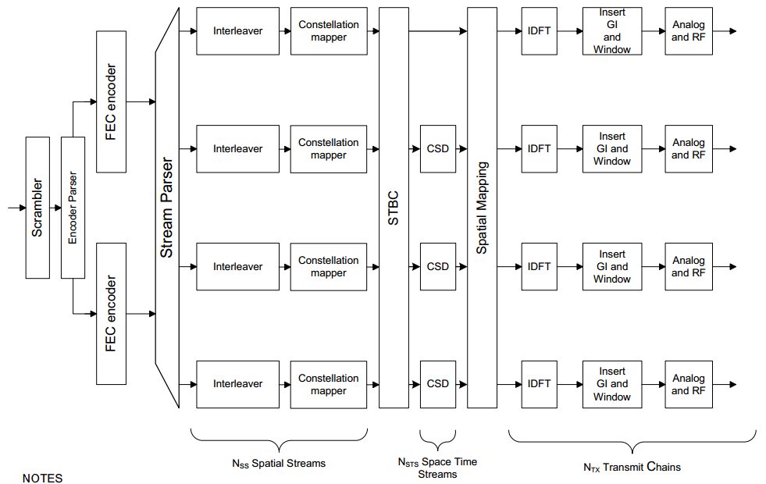
OFDM multi-symbol
802.11n transmitter
OFDM multi-symbol

Slide 7
Proposed transmission scheme
OFDM
data symbols
space
stream
PHY
header
OFDM multi-symbol
time
Coding and interleaving applied individually
for every OFDM multi-symbol
RESULTS:
every OFDM multi-symbol can be decoded separately
parallel processing of individual multi-symbols possible

Slide 8
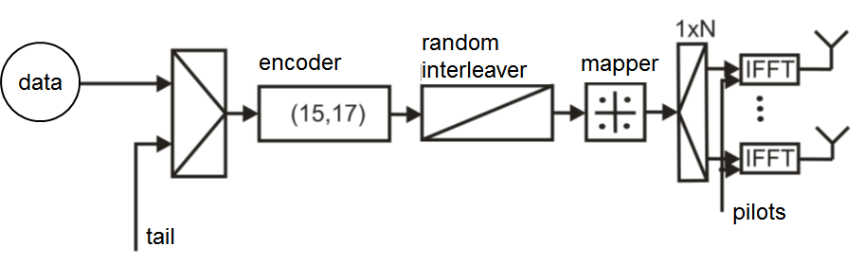
Transmitter (1)
3 tail bits appended for every multi-symbol
  (<1% of data payload (416 bits), in the case of 4 space streams,
  16-QAM modulation and 20 MHz channel)

Slide 9
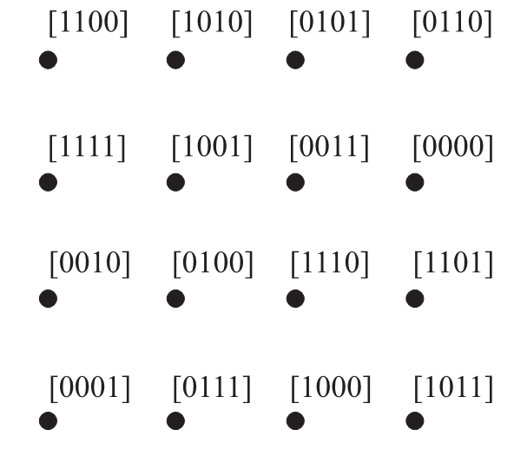
Transmitter (2)
„Optimal” 16-QAM
labeling map applied
in the mapper

Slide 10
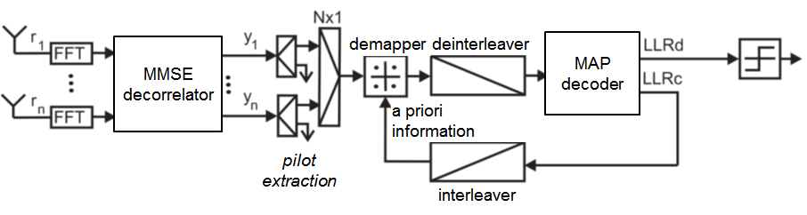
Receiver

Slide 11
Simulation results (1)
4x4 MIMO, 20 MHz uncorrelated Rayleigh fading channel
Iterative receiver, [15 17] code
Iteration #1
Conventional receiver
[171 133] code
Iteration #15

Slide 12
Simulation results (2)
4x4 MIMO, 20 MHz
WLAN B channel (2 clusters, max. delay spread of 15 ns)
Iterative receiver, [15 17] code
Iteration #1
Conventional receiver
[171 133] code
Iteration #15

Slide 13
Simulation results (3)
4x4 MIMO, 20 MHz
WLAN D channel (3 clusters, max. delay spread of 50 ns)
Iterative receiver, [15 17] code
Iteration #1
Conventional receiver
[171 133] code
Iteration #15

Slide 14
Simulation results (4)
4x4 MIMO, 20 MHz
WLAN E channel (4 clusters, max. delay spread of 100 ns)
Iterative receiver, [15 17] code
Iteration #1
Conventional receiver
[171 133] code
Iteration #15

Slide 15
Summary
System performance improved by iterative decoding
Receiver latency reduced thanks to individual coding and interleaving of every OFDM multi-symbol
  no need to wait for the reception of the original (possibly large) data frame before the iterative decoding starts
Applicable for WLANs exploiting space multiplexing
  a need for both reasonably high interleaver depth and low correlation between sub-channels
Transmission over 40, 80, or 160 MHz channels should be considered in the future
  improved frequency diversity effect expected

Slide 16
Straw Poll
Do you think the next generation WLANs should be designed for iterative decoding?
Do you find the proposed technique applicable for future WLANs?

