Slide 1
The Multi-Carrier Training Fields for OFDM transmission in 802.11aj(45GHz)
Date: 2014-11-15
Presenter: Shiwen HE
Authors/contributors:
Shiwen He, Haiming Wang

Slide 2
Introduction
Multi-Carrier Training Fields (MCTF) is applied for channel estimation in IEEE 802.11aj OFDM transmission.
This presentation focuses on the OFDM-MCTF in OFDM transmission.
Slide 2
Shiwen He, Haiming Wang
Notes:
2

Slide 3
MCTF
Considering the situation of IEEE 802.11aj, there are two objectives for the design of MCTF.
    Low PAPR of the OFDM signals
    Binary sequence for MCTF
Slide 3
Shiwen He, Haiming Wang
Notes:
3

Slide 4
MCTF
All the points of the MCTF are set to the same amplitude with different phase. The MCTF can be represented by
where is the index of the subcarriers, and indicates the subcarrier’s
value.
As each frequency point obtains the same power, the selection of phase will not affect the performance of channel estimation.
A sequence with low PAPR is proposed to design.
Slide 4
Shiwen He, Haiming Wang
Notes:
4

Slide 5
PAPR
In the OFDM system with N subcarriers , the PAPR of the transmitted signal is defined as
where denotes the excepted value operation， is the time domain signal of .
The MCTF is designed by using cross entropy algorithm.
The cross entropy method iteratively optimizes the parameters of the probability distribution to produce a random variable solution in the neighborhood of the global optimal solution by minimizing cross entropy between the associated distribution and the optimal importance sampling distribution.
where denotes the excepted value operation， denotes the IFFT transform.
Slide 5
Shiwen He, Haiming Wang
Notes:
5

Slide 6
MCTF based on cross entropy
The figure shows the lowest PAPR of random sequences for 256 length and training sequences for 256 length in one hundred training iterations. The value of the PAPR for 256-MCTF converged at 70 times.
Slide 6
Shiwen He, Haiming Wang
Notes:
6

Slide 7
MCTF based on cross entropy
The 256-MCTF including DC carriers & Null carriers

Slide 8
MCTF based on CE
The figure shows the lowest PAPR of random sequences for 512 length and training sequences for 512 length in one hundred training iterations. The value of the PAPR for 512-MCTF converged at 80 times.
Slide 8
Shiwen He, Haiming Wang
Notes:
8

Slide 9
MCTF based on CE
The 512-MCTF including DC carriers & Null carriers

Slide 10
MCTF based on CE
The comparison of PAPR between 11aj MCTF and 11ac VHT-VTF
Training Field | PAPR
 | Length of 64 | Length of 128 | Length of 256 | Length of 512
11ac VHT-LTF | 3.5 dB | 5.7 dB | 8.6 dB | 11.6 dB
11aj MCTF | - | - | 3.2 dB | 3.6 dB
The MCTF of 512 length obtains PAPR for 3.5 dB the same as the VHT-LTF of 64 length.
NOTE: The sequences calculated including DC carriers and null carriers.

Slide 11
Conclusion
MCTF achieves 3.2 dB PAPR for the DFT length of 256 and 3.5 dB PAPR for the DFT length of 512.
MCTF sequence is a binary sequence.
Slide 11
Shiwen He, Haiming Wang
Notes:
11

Slide 12
Thanks for your attention
Slide 12
Shiwen He, Haiming Wang
Notes:
12

Slide 13
Simulation Setup
Channel model: IEEE 802.11aj
Number of distinguishable paths : 18
Packet length: 4096 bytes
LDPC codeword length: 672bits
Number of channel realizations: 2000
Simulation antennas: 4x4 for 1,2,3,4ss, 2x2 for 1,2ss, 1x1 respectively
Modulation and code rate: {QPSK ½}
Channel estimation: LS with DFT correction
Spatial Extension Matrix:
Slide 13
Shiwen He, Haiming Wang
Notes:
13

Slide 14
Appendix
Simulation antennas:4x4
Modulation : QPSK
Streams: 4 Estimation: LS estimation with correction
PER performance of ideal channel and estimated channel
Slide 14
Shiwen He, Haiming Wang
Notes:
14

Slide 15
Appendix
Simulation antennas:4x4
Modulation : QPSK
Streams: 3 Estimation: LS estimation with correction
PER performance of ideal channel and estimated channel
Slide 15
Shiwen He, Haiming Wang
Notes:
15

Slide 16
Appendix
Simulation antennas:4x4
Modulation : QPSK
Streams: 2 Estimation: LS estimation with correction
PER performance of ideal channel and estimated channel
Slide 16
Shiwen He, Haiming Wang
Notes:
16

Slide 17
Appendix
Simulation antennas:4x4
Modulation : QPSK
Streams: 1 Estimation: LS estimation with correction
PER performance of ideal channel and estimated channel
Slide 17
Shiwen He, Haiming Wang
Notes:
17

Slide 18
Appendix
Simulation antennas:2x2
Modulation : QPSK
Streams: 2 Estimation: LS estimation with correction
PER performance of ideal channel and estimated channel
Slide 18
Shiwen He, Haiming Wang
Notes:
18

Slide 19
Appendix
Simulation antennas:1x1
Modulation : QPSK
Streams: 1 Estimation: LS estimation with correction
PER performance of ideal channel and estimated channel
Slide 19
Shiwen He, Haiming Wang
Notes:
19

Slide 20
Appendix
Simulation antennas:1x1
Modulation : QPSK
Streams: 1 Estimation: LS estimation with correction
MSE performance of ideal channel and estimated channel
Slide 20
Shiwen He, Haiming Wang
Notes:
20

Slide 21
Appendix
Simulation antennas:1x1
Modulation : QAM
Streams: 1 Estimation: LS estimation with correction
MSE performance of ideal channel and estimated channel
Slide 21
Shiwen He, Haiming Wang
Notes:
21

Slide 22
Questions & Replies
The gap of the PER curve of ideal and estimated channel is actual?
  The gap is similar in some other simulations.
  The next two figure contrast the PER gap of ideal and estimated channel between IEEE 802.11n and IEEE 802.11aj with MCTF.
Slide 22
Shiwen He, Haiming Wang
Notes:
22

Slide 23
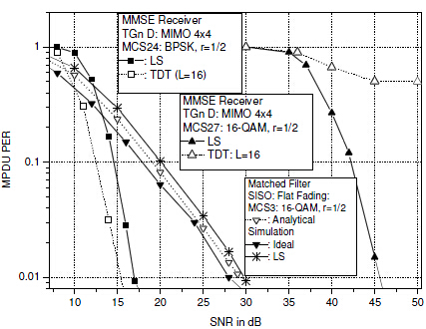
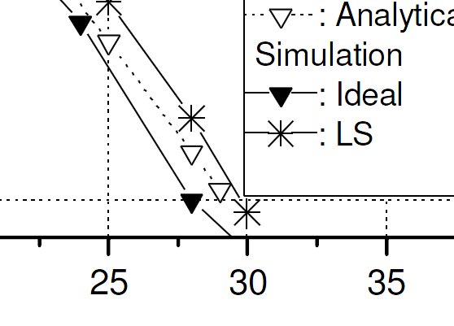
Questions & Replies
  This figure indicated that the PER gap of ideal and LS estimated channel is about 3 dB in such simulation setup: Simulation antennas:1x1, Modulation:16QAM.
  Figure reference：IEEE 802.11n On Performance of Channel Estimation Schemes over OFDM MIMO Spatially-Correlated Frequency Selective Fading TGn Channels.
Slide 23
Shiwen He, Haiming Wang
Notes:
23

Slide 24
Questions & Replies
  The corresponding simulation results of MCTF in IEEE 802.11aj in such simulation setup: Simulation antennas:1x1, Modulation:16QAM.
  This figure indicates that the PER gap of ideal and estimated channel is about 1.2dB. The enhance of the performance is because of we used the LS estimation with DFT correction. The performance of MCTF in channel estimation is accepted.
Slide 24
Shiwen He, Haiming Wang
Notes:
24

