Slide 1
More on Bufferbloat and making Wi-Fi fast
Date: 2014-09-17
Authors:

Slide 2
Abstract
Reducing Latency and Jitter in Wifi
Bandwidth does not equal “Speed”. Bandwidth = Capacity/interval. Real “speed”, in human terms, is measured by the amount of latency (lag), between an action and a response. In the quest for headline bandwidth in new network standards the industry has lost track of what real speed means.
The presence of large, unmanaged network buffers, primarily across the edge devices of the Internet. In wifi, especially, with wildly variable rates, shedding load to match the available bandwidth, doesn't presently happen, leading to huge delays for much wireless traffic, when under load.
The lag sources in wifi are by no means limited to bufferbloat, but buried deep in stacks that did not successfully absorb wireless-n concepts in the first place.
This talk goes into the problems that the large network queuing delays (bufferbloat) causes. It touches upon some new algorithms, now deployed and in the process of standardization, that produce enormous reductions in latency, and then details some steps the make-wifi-fast project plans to take to address it, on WiFi.

Slide 3
Overview
Overview of the bufferbloat.net effort
Fixing ethernet, cable, fiber, & DSL
What's the status of the standards?
On Reducing latency on wifi
How Codel and FQ_Codel work

Slide 4
Why am I here?
IETF is not the place to work on WiFi
Bufferbloat.net is starting up a new project, “make-wifi-fast” leveraging CeroWrt and OpenWRT.
  “The use of open source software to promote broad adoption and use of new technology is now well demonstrated... The CeroWrt/OpenWrt effort could have a similar effect.” – Vint Cerf, “Bufferbloat and other Internet Challenges”
We fixed ethernet, cable, fiber, and DSL already.
Experiences thus far with 802.11ac have been dismal.
Perhaps working with IEEE 802.11 is the right thing to find and fix all the sources of latency and jitter in the architecture.
It would be nice to get a grip on what's going on in 802.11ax

Slide 5
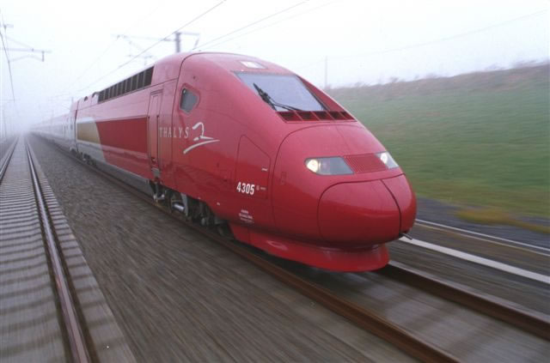

When do you drop packets?
(Excessive retries Brussels ↔ Paris)
--- lwn.net ping statistics ---
623 packets transmitted, 438 received,
29% packet loss, time 637024ms
rtt min/avg/max/mdev = 265.720/1094.646/14869.938/1730.424 ms, pipe 15

Slide 6
About Bufferbloat.net
An all-volunteer organisation providing wikis, project management, and email lists for those interested in speeding up the internet.
We've:
Gathered together experts to tackle networking queue management and system problem(s), particularly those that affect wireless networks, home gateways, and edge routers.
Spread the word to correct basic assumptions regarding goodput and good buffering on the laptop, home gateway, core routers and servers.
Produced tools to demonstrate and diagnose the problems.
Led a major advance in network Queueing theory
Did and continue to do experiments in advanced congestion management.
Produced patches to popular operating systems at the device driver, queuing, and TCP/ip layers to dramatically reduce latency for many devices.
Developed reference devices and firmware to push the state of the art forward, for everyone.

Slide 7
Bufferbloat.net Projects
Bloat – general site for bufferbloat info
Bismark – distributed network measurement
Codel and fq_codel: Algos for shedding load
CeroWrt – Reference router for the debloaters
Make-Wifi-Fast – Lowering lag on wifi

Slide 8
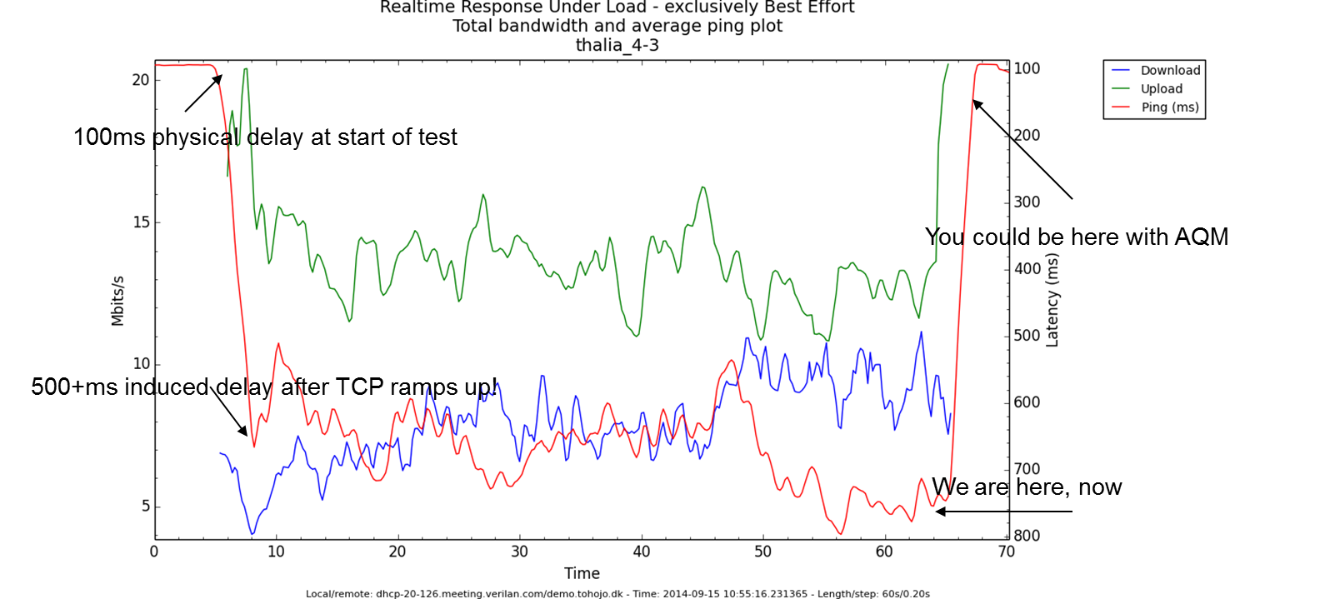
Potential Benefits of Fair/Flow Queuing and
Active Queue Management on Internet Edge Gateways

Slide 9
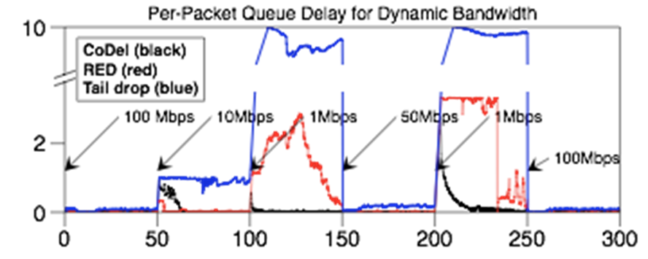
Codel concept shows promise in adapting to varying link rates
Nominal 100 Mbps link with rate changes, buffer size of 830 packets
4 FTPs, 5 packmime connections/sec
ACM Queue: “Controlling Queue Delay”
– Kathie Nichols and Van Jacobson
    http://queue.acm.org/detail.cfm?id=2209336
    See also: “Bufferbloat”
      http://queue.acm.org/detail.cfm?id=2071893

Slide 10
Why Does Bufferbloat Happen?

Slide 11
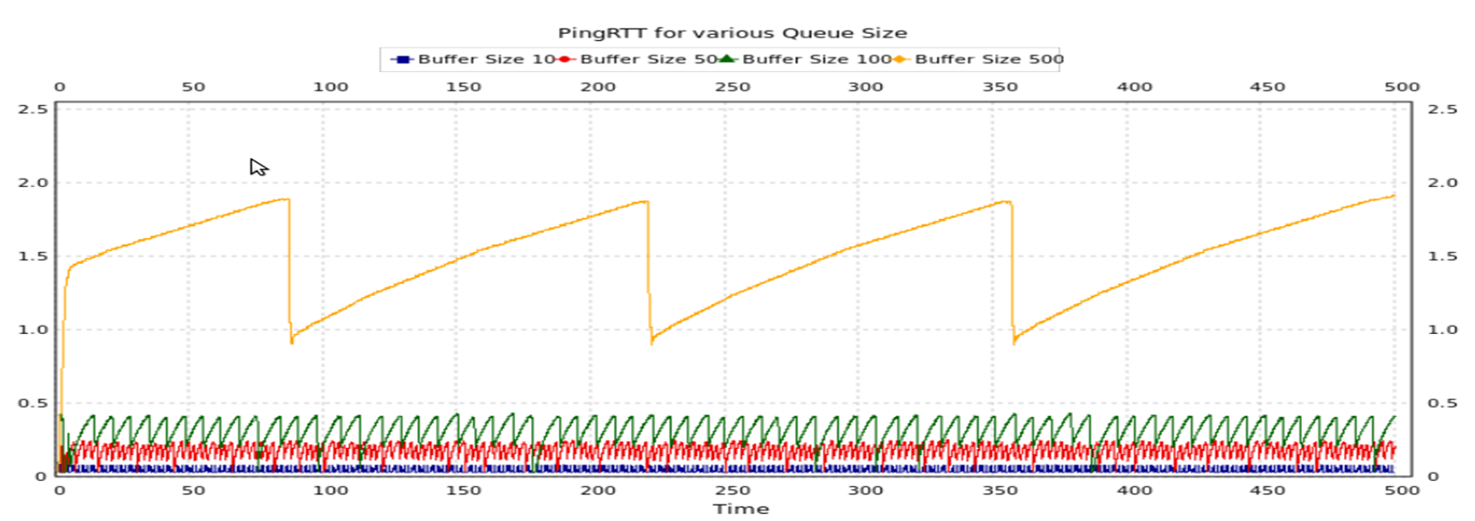
It comes from TCP’s bandwidth probing behavior (TCP 101)
TCP will always fill the biggest buffer on the path
As the delays get larger – congestion avoidance mode geometrically gets slower
With CUBIC, the sawtooth looks more like an S-curve
http://staff.science.uva.nl/~delaat/netbuf/bufferbloat_BG-DD.pdf
(.5Mbit uplink)

Slide 12
And dramatic overbuffering, everywhere
Unmanaged buffers in network stacks
  Sized for the maximum bandwidth the device can sustain
  Not managed for the actual bandwidths achieved
  Often behind proprietary firmware where it can't be fixed.
  With things like packet aggregation providing illusory gains on simple minded benchmarks but not real traffic

Slide 13
Consequences of TCP’s design
A single connection will fill any size buffer put in front of it at the path's bottleneck, given time: adds one packet/ack to the buffer
Timely dropping or marking of packets is necessary for correct operation of TCP on a saturated link.
Even IW4 is an issue at low bandwidths (e.g. VOIP over busy 802.11 network): do the math. Just "fixing" TCP does not fix the network.
Better queuing is essential. Congestion window is not shared among connections (currently). Current web server/client behavior means head of line blocking causes bad transients.
Sharing responsiveness is quadratic in delay. Elephant flows become mammoth flows in the face of overbuffering.

Slide 14
In a Web TCP transaction
SYN → SYN/ACK 1 RTT
SSL NEGOTIATION 2 RTTs
DATA REQUEST/Transfer – 1 RTT 10 packets
(90% of all web transactions are one IW10 burst)
FIN – FIN/ACK 1 RTT
CLOSE 1 packet
Only 1 TXOP in 10 can aggregate!
Excessive base RTT adds up!

Slide 15
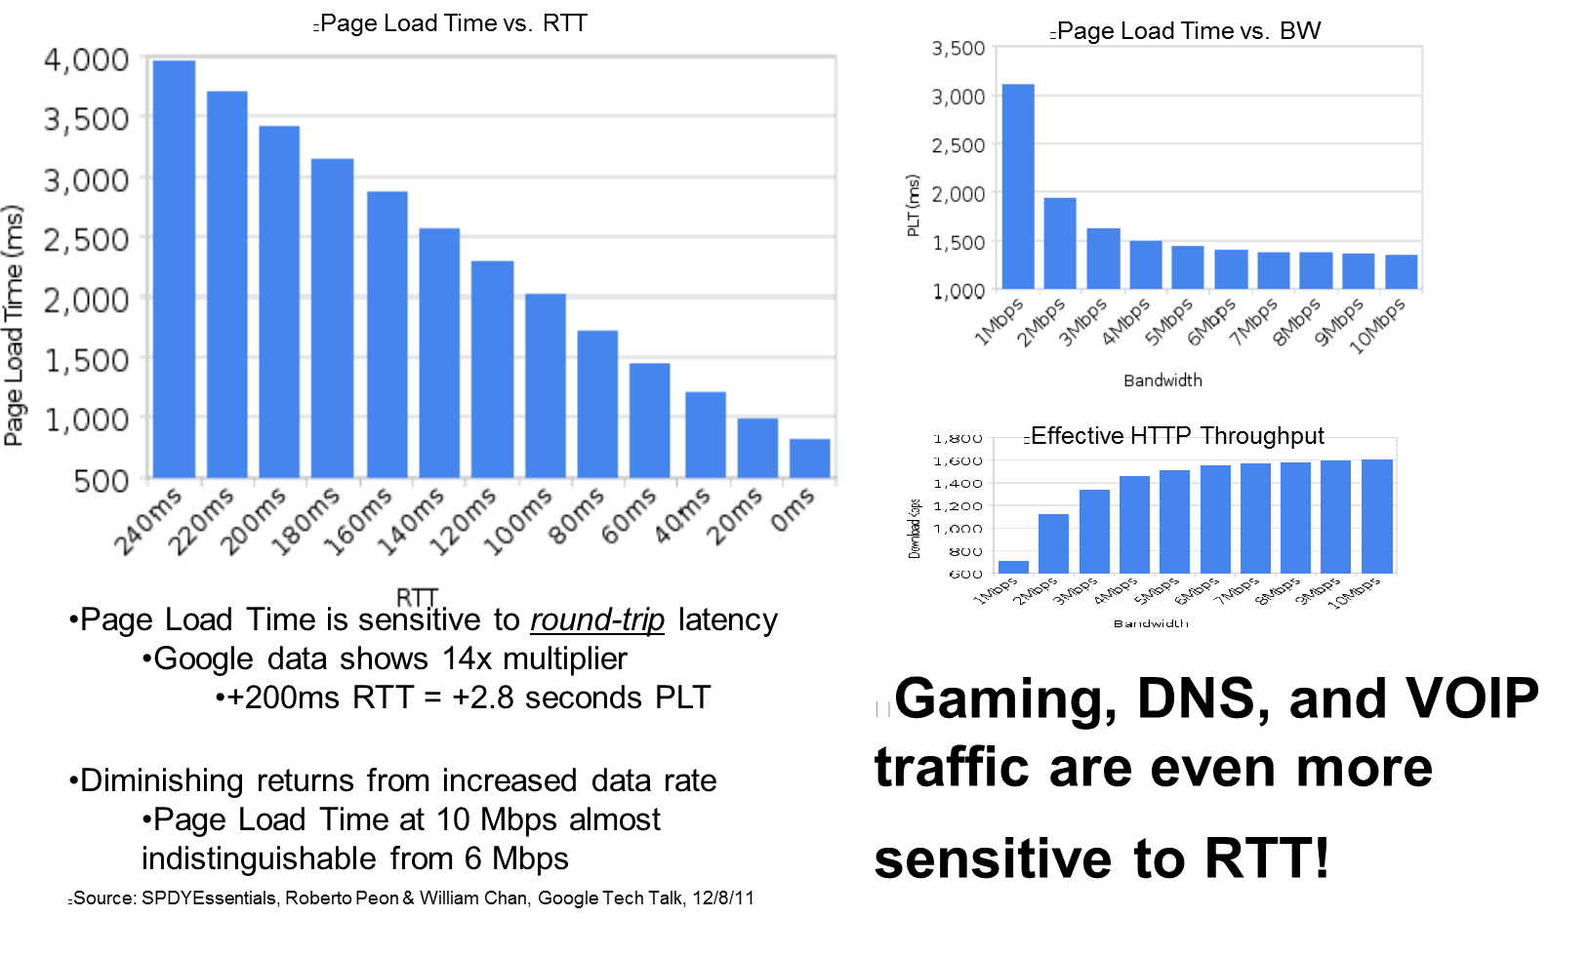
Web Browsing is dependent on RTT

Slide 16
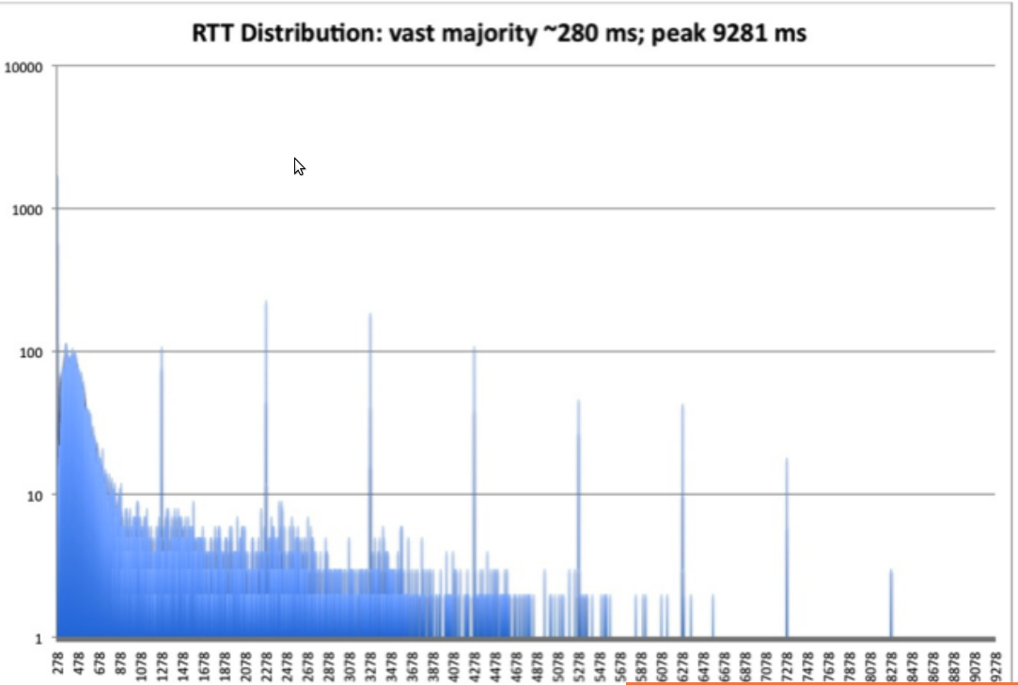
Too much delay and you get layer 3 adding even more packets...

Slide 17
The good news
Bufferbloat is basically fixed on ethernet, cable, dsl, and fiber, with the new algorithms (codel, fq_codel, pie) ,and improvements in the Linux network stacks,
  2-3 orders of magnitude reductions in network latency being seen AND improvements in goodput
Algos are now deployed in several products, and in nearly every third party router firmware.
Patent free and open sourced code widely available
Standardization activities in the IETF

Slide 18
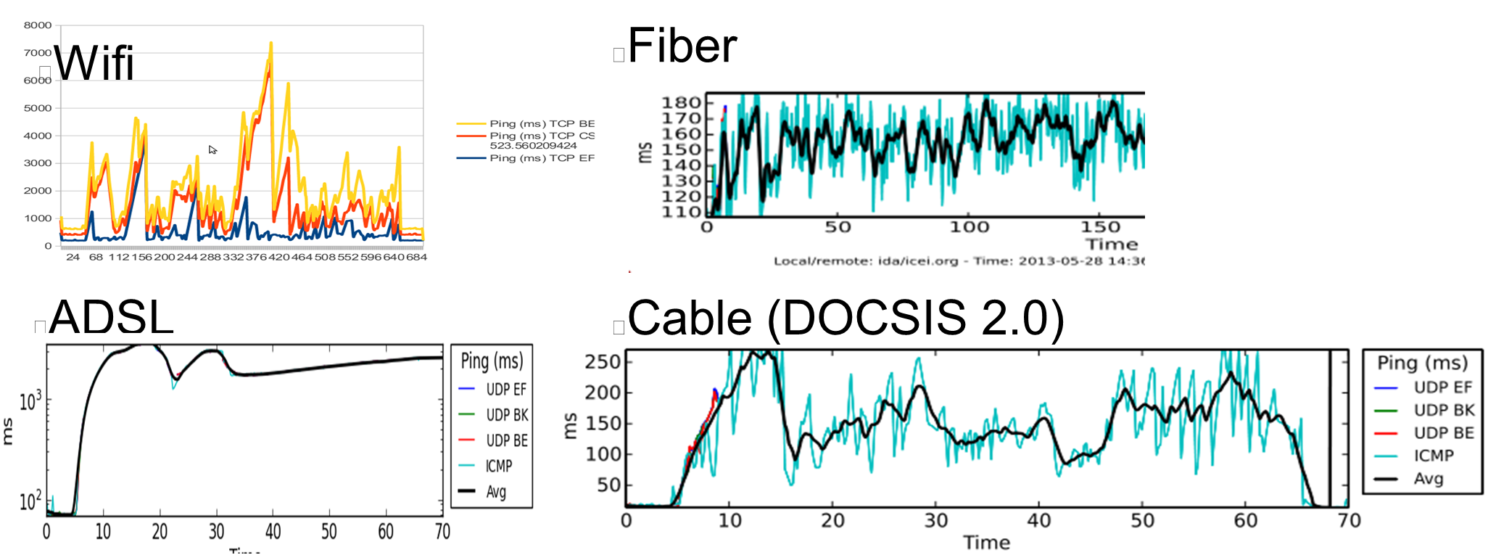
Typical Latency with Load Today
Reducing Latency and Jitter in Wifi
Much of this latency comes from Queue Delay (bufferbloat)

Slide 19
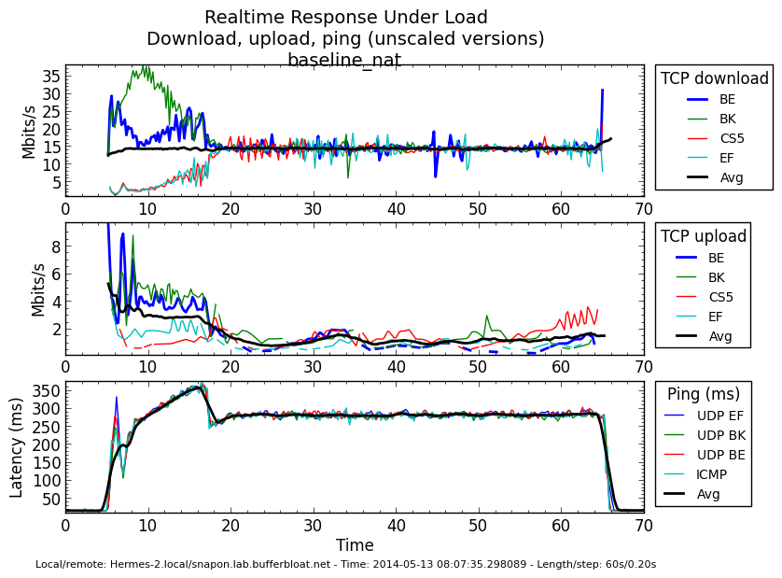
Ex: 300ms excess latency on cable

Slide 20
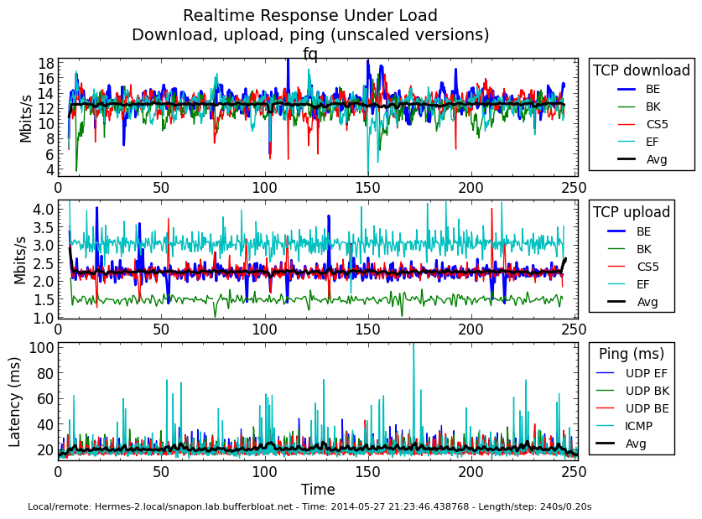
Cut to ~10ms with fq_codel
Source: http://burntchrome.blogspot.gr/2014_05_01_archive.html

Slide 21
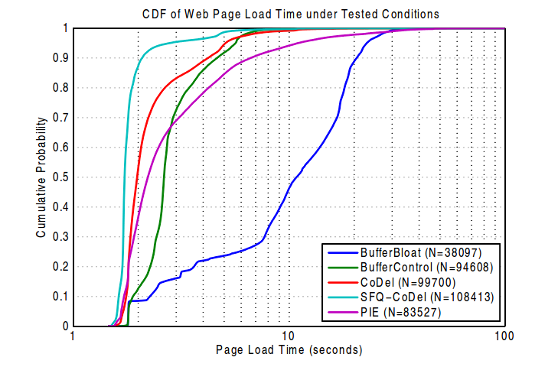
Web page load time wins
Video at: http://www.youtube.com/watch?v=NuHYOu4aAqg
From:http://www.cablelabs.com/wp-content/uploads/2013/11/Active_Queue_Management_Algorithms_DOCSIS_3_0.pdf

Slide 22
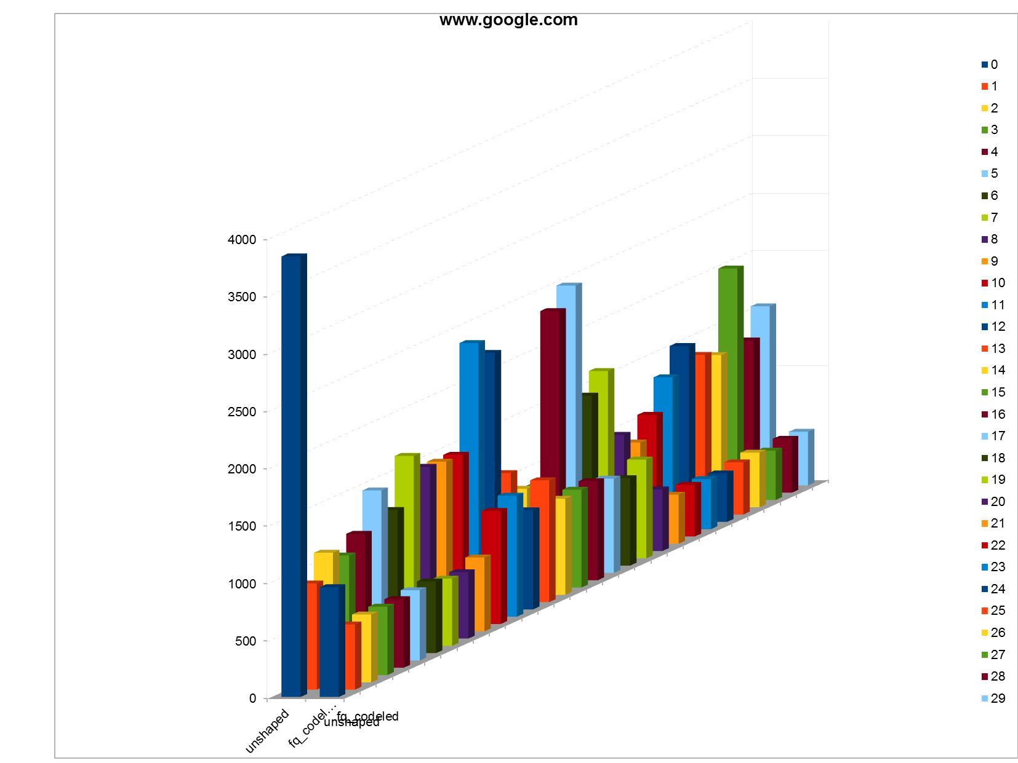
Chrome Benchmark Web Page completion time during RRUL benchmark
Drop tail vs nfq_codel

Slide 23
Linux TCP/AQM/FQ Advances: 2010-2014
Linux 3.0: Proportional Rate Reduction
Linux 3.3: Byte Queue Limits
Linux 3.4 RED bug fixes & IW10 added & SFQRED
Linux 3.5 Fair/Flow Queuing packet scheduling (fq_codel, codel)
Linux 3.6 Stability improvements to fq_codel
Linux 3.7 TCP small queues (TSQ)
Linux 3.8 HTB breakage
Linux 3.11 HTB fixed
Linux 3.12 TSO/GSO improvements
Linux 3.13 Host FQ + Pacing
Linux 3.14 Pie added
Linux 3.15 Change to microseconds from milliseconds throughout networking kernel
Linux 3.17? Network Batching API
The Linux stack is now mostly “pull through”, where it used to be “push”, and looks nothing like it did 4 years ago.
At least a dozen other improvements I forget and no sign other Oses are paying attention

Slide 24
IETF AQM Working Group Status
AQM working group
https://datatracker.ietf.org/doc/charter-ietf-aqm/
Pending drafts:
http://snapon.lab.bufferbloat.net/~d/draft-taht-home-gateway-best-practices-00.html
http://tools.ietf.org/html/draft-white-aqm-docsis-pie-00
http://tools.ietf.org/html/rfc2309 Is beiing revised
http://tools.ietf.org/html/draft-ietf-aqm-recommendation-03
http://tools.ietf.org/id/draft-kuhn-aqm-eval-guidelines-00.txt
http://tools.ietf.org/html/draft-hoeiland-joergensen-aqm-fq-codel-00
http://tools.ietf.org/html/draft-nichols-tsvwg-codel-02
http://sandbox.ietf.org/doc/draft-baker-aqm-sfq-implementation/

Slide 25
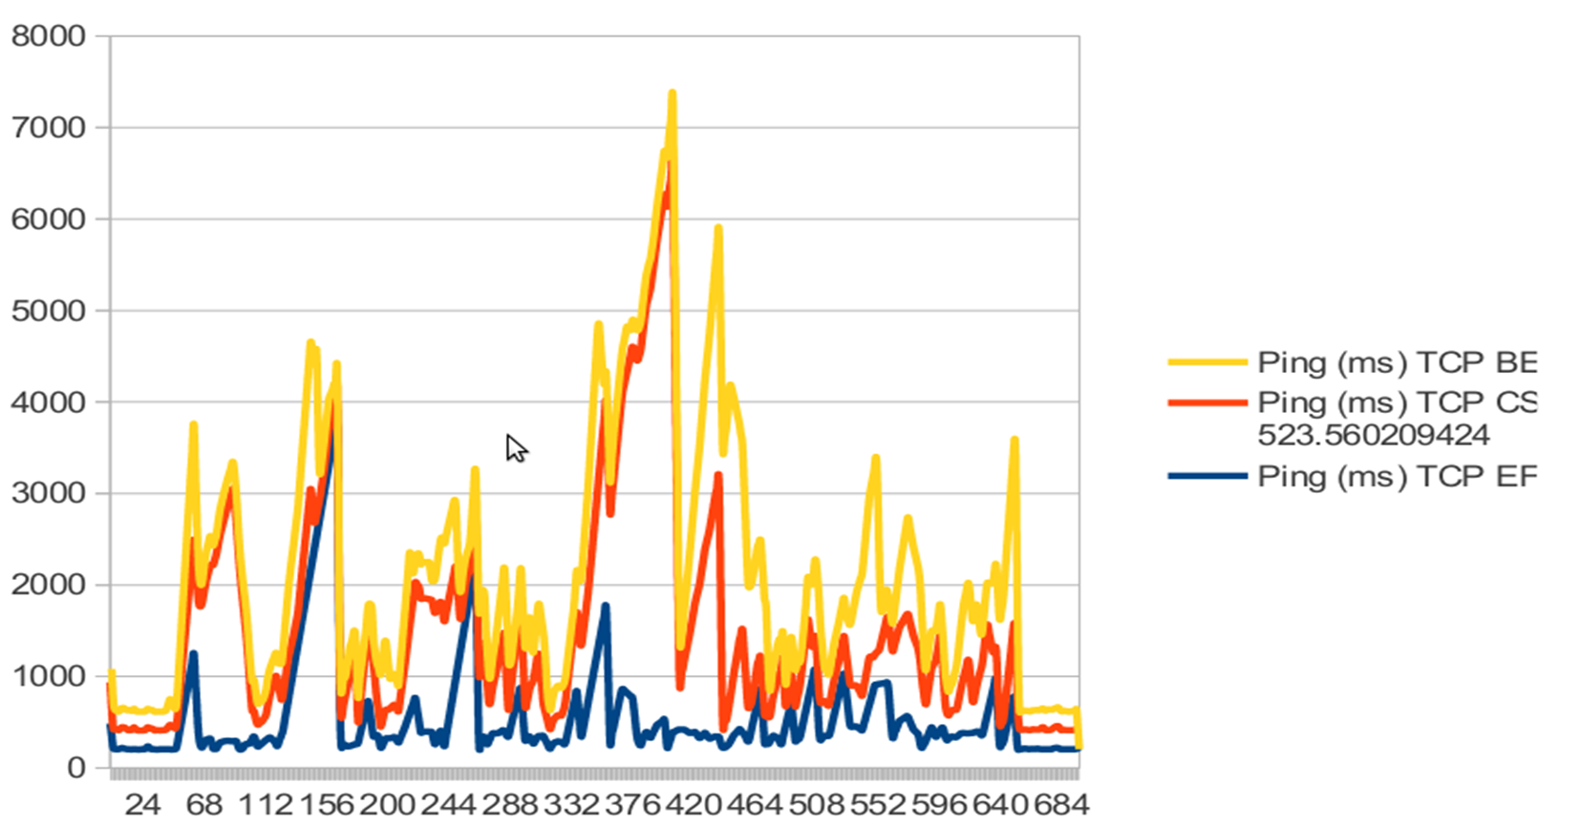
The bad news: Latency problems on WiFi are not just bufferbloat

Slide 26
How to make WiFi truly faster on stations and Access points?
With new AQM and packet scheduling algorithms?
With Packet aggregation?
With EDCA scheduling?
With 802.11e prioritization?
Increasing numbers of stations and contending access points?
Excessive multicasts and retransmissions?
With upcoming standards like 802.11ax?
? ? ? ? ? ? ? ? ? ? ? ? ? ? ? ? ? ? ? ? ? ? ? ? ? ? ? ? ? ? ?
New project: https://lists.bufferbloat.net/listinfo/make-wifi-fast/

Slide 27
Linux WiFi stack –
Planned fixes in make-wifi-fast
Better Benchmarks and Tools
Rework the stack
  Per station queueing
  Single queue promotion to 802.11e
  MU-MIMO support
  Obsolete VO Queue
Improve the minstrel rate selection algorithm
  Smarter Math
  Better aggregation awareness
  W/Power aware scheduling (minstrel-ht-blues)
  Reducing retransmits & selective retransmit
Add AQM/Fair Queuing Algorithms
  Codel, Pie, fq_pie
  Sort on dequeue
Take advantage of new statistics and possibilities in new 802.11 standards
  ? ? ? ? ? ? ? ? ? ? ? ? ?

Slide 28
Some useful tools for looking at the Bufferbloat Problem
Tcptrace and xplot.org
Netperf-wrapper (by Toke Hoeiland-Joergensen)
  Standardized data format, 30+ network specific tests testing for latency under load, 20+ plot types, extensive support for batching and other automation, usage of alternate TCP algorithms, in combination with other web and voip-like traffic.
Linux Kernel mainline, Codel, fq_codel and pie in most distributions now (Redhat 7, ubuntu, debian, etc)
CeroWrt
  Inexpensive actual router configurable with nearly every AQM and FQ algorithm using “SQM”
  Emulations of common CMTS and DSLAM behavior
  Results proven sane to 50mbits
  Most of cerowrt is already in openwrt “Barrier Breaker”.
SQM (“Smart Queue Management”)
  Drop in replacement for wondershaper portable to all modern linuxes
  Uses fq_codel by default, pie, sfq, codel optionally
Openwrt “Barrier Breaker”, ipfire, pfsense, other third party router firmwares have support also
NS2 models of codel, sfq_codel, and pie in ns2 mainline
NS3 models of codel, fq_codel, asymmetric edge networks, etc,
  From Google 2014 summer of code
  Codel in in September ns-3.21, sfq_codel in ns-3.22, December, 2014
  Wifi mac support, LTE, etc

Slide 29
Adding AQM and Fair Queuing
Codel
  While codel appears to be a great start in managing overall queue length, it is apparent that modifications are needed to manage txops rather than packets, and the parking lot half duplex topology in wifi leads to having to manage the target parameter (at least) as a function of the number of active stations, and closer integration into minstrel for predictive scheduling seems needed also.
fq_codel
  A perhaps saner approach than a stochastic hash is merely to attempt to better "pack" aggregates with different flows whenever possible, taking into account loss patterns, etc. Using a deterministic per-station hash and setting aside 42 buckets for each station is not a lot of overhead.
Not doing Pie
  Timestamping and invsqrt are easy, so we think an fq_codel derived approach is best.

Slide 30
Planned Rate selection Improvements
“Bard” Minstrel-2 rate selection algorithm
The minstrel rate selection algorithm was originally developed against wireless-g technologies in an era (2006) when competing access points were far less prevalent. While updated significantly for wireless-n a thorough analysis has not been performed in the wide variety of rates and modern conditions. Also, some new mathematical techniques have been developed since 2009 that might make for better rate control overall. A new ns3 model will be developed to mirror these potential changes and a sample implementation produced for the ath9k chipset (at minimum). Minstrel2, tentatively named "BARD", will do a much better job on aggregation and in MU-MIMO conditions.
Power aware scheduling
It may be possible to do transmits at "just the right power" for the receiving station. Minstrel-Blues
Reducing retransmits
Retransmit attempts will move from counter based to a time and other workload based scheduler. This will help keep bad stations from overwhelming the good, and reduce latencies overall. Losing more packets is fine in the pursuit of lower latency for all.
Selective (re)transmit
Currently all Linux wifi drivers are dumb when it comes to retransmitting portions of an aggregate that fail, attempting to perfectly transmit the entire aggregate. In the general case, not all packets need to be retransmitted - examples include all but the final tcp ack in a flow, all but the last voip packet in a flow, and so on.

Slide 31
Sort on dequeue
An aggregate of packets arrives and is decoded all at once, and then delivered in FIFO order at a high rate (memory speeds) to another device, usually ethernet. However that high rate is often still too slow for a fq_codel qdisc attached to that ethernet device to actually do any good, so it would be better to sort on the dequeue (of up to 42 packets), then deliver them to the next device.
We believe that if the delivery is sorted (fair/flow queued), that more important packets will arrive first elsewhere and achieve better flow balance for multiple applications.
Multiple chipsets deal with packet aggregation in different ways, as does firmware - some can't decode any but the entire aggregate when encrypted, for example, they arrive as a binary blob, and there are numerous other chipset and stack specific problems.

Slide 32
Remove Reorder Buffers
The linux tcp/ip stack can handle megabytes of packets delivered out of order. So can OSX. Windows can't. We don't care.
In the quest for low latency, a few out of order packets shouldn't matter.
When we can identify flows, clearly, we can do a better job...

Slide 33
AP Per Station Queues
Single queue promotion to 802.11e
Per station queueing
The current structure of the linux wifi stack exposes only the 802.11e wifi queues, not multicast, and not the queues needed for multiple stations to be sanely supported. Repeated tests of the 802.11e mechanism shows it to be poorly suited for a packet aggregation world. By reducing the exposed QoS queue to one, we can instead expose a per-station queue (including a multicast queue) and manage each TXOP far more sanely.
There are a few other options as to what layer this sort of rework goes into. Given the current structure of the mac80211 stack, it may be that all this work (exposure of the station id), has to take place at that layer, rather than the higher level qdisc layer.
MU-MIMO support
Nearly all of the changes above have potentally great benefit in a MU-MIMO world, and are in fact, needed in that world. Regrettably none of the major chipset makers nor router makers seem to be co-ordinating on a standard api structure for doing this right, and it is hoped that by finding and targetting at least one MU MIMO chipset that progress will be made.

Slide 34
Station improvements?
While many of the above improvements also apply to stations, the benefits are more limited. The overall approach should be to do better mixing and scheduling of the aggregates that a station generates, and to hold the queue size below 2 full aggregates whenever possible. Further improvements in station behavior include predictive codel-ing for measuring the how and when EDCA scheduling opportunities are occurring, and so on.
The primary focus is on APs, since that's where most of the problems are, today.

Slide 35
Some details on CoDel & Fq_CoDel
Various talks: http://www.bufferbloat.net/projects/cerowrt/wiki/Bloat-videos
ACM Queue
http://queue.acm.org/detail.cfm?id=2209336
Internet Drafts:
https://datatracker.ietf.org/doc/draft-nichols-tsvwg-codel/
http://tools.ietf.org/html/draft-hoeiland-joergensen-aqm-fq-codel-00
Source Code in Linux 3.6 and later

Slide 36
Introducing Kathie Nichols and Van Jacobson's Codel algorithm
Measure the latency in the queue, from ingress to egress, via timestamping on entry and checking the timestamp on exit.
When latency exceeds target, think about dropping a packet
After latency exceeds target for an interval, drop a packet at the HEAD of the queue (not the tail!)
If that doesn't fix it, after a shorter interval (inverse sqrt), drop the next packet sooner, again, at the HEAD.
Keep decreasing the interval between drops per the control law until the latency in the queue drops below target. Then stop. Save the value and increase it while no drops are needed.
We start with 100ms as the interval for the estimate, and 5ms as the target. This is good on the world wide internet
Data centers need much smaller values.

Slide 37
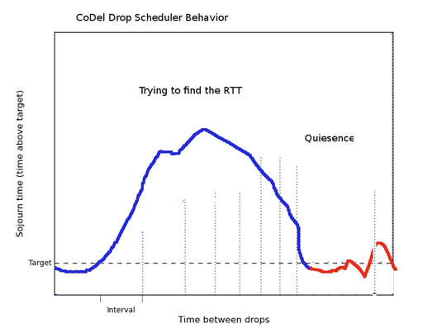
CoDel Drop Scheduler Behavior

Slide 38
FQ_Codel Principles
HEAD DROP, not tail drop.
Fill the pipe, not the queue
Queues are shock absorbers
What matters is the delay within a flow.
Shoots packets in elephant flows after they start accumulating delay. Don't shoot anything else!
Provide better ack clocking for TCP and related protocols
Let smaller, sparser streams, like VOIP, & DNS slip through

Slide 39
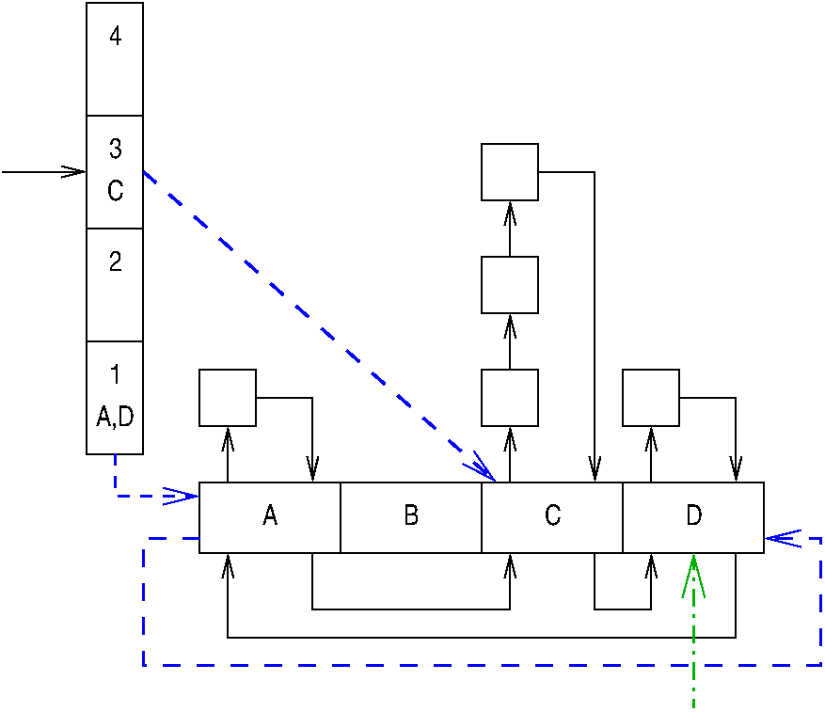
FQ_Codel starts with DRR Fair Queuing, flows by quintuple

Slide 40
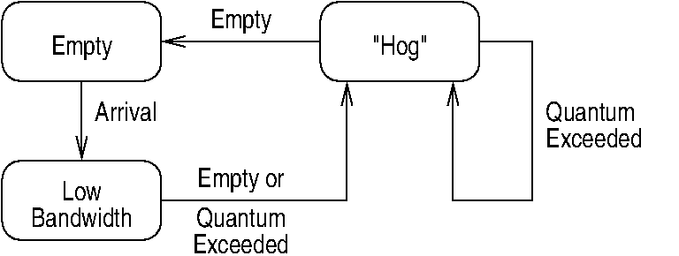
Adds optimizations for sparse streams, which almost eliminates the need for prioritization

Slide 41
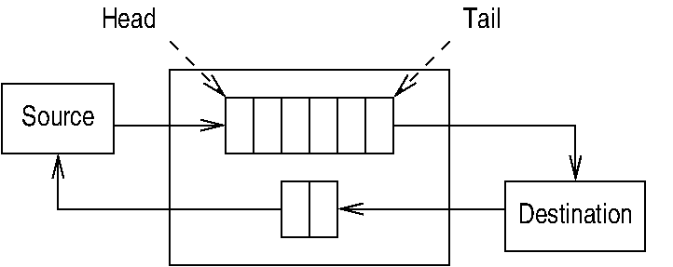
And given codel's measurements... drops packets from the HEAD of the queues when things get out of hand

Slide 42
fq_codel's short signaling loop and better mixing
Increases network utilization
Dramatically improves response time
Improves interactive traffic enormously
Makes for a more “shareable” home, small business, or corporate network
And is implementable, in everything that needs it, in a few hundred lines of code.

Slide 43
“FQ_Codel provides great isolation... if you've got low-rate videoconferencing and low rate web traffic they never get dropped. A lot of issues with IW10 go away, because all the other traffic sees is the front of the queue. You don't know how big its window is, but you don't care because you are not affected by it.
FQ_Codel increases utilization across your entire networking fabric, especially for bidirectional traffic...”
“If we're sticking code into boxes to deploy codel,
don't do that.
Deploy fq_codel. It's just an across the board win.”
- Van Jacobson
IETF 84 Talk

Slide 44
What role for this work with IEEE 802.11?
Discussion of relevant standards and modification of standards...
Shared development, modeling and testing
Improvements to hardware offload architectures
And
Better Wifi for everyone...
Hopefully.

Slide 45
Bufferbloat.net Resources
Reducing network delays since 2011...
Bufferbloat.net: http://bufferbloat.net
Email Lists: http://lists.bufferbloat.net (codel, bloat, cerowrt-devel, etc)
IRC Channel: #bufferbloat on chat.freenode.net
Codel: https://www.bufferbloat.net/projects/codel
CeroWrt: http://www.bufferbloat.net/projects/cerowrt
Other talks: http://mirrors.bufferbloat.net/Talks
Jim Gettys Blog: http://gettys.wordpress.com
Talks by Van Jacobson, Gettys, Fred Baker, others:
http://www.bufferbloat.net/projects/cerowrt/wiki/Bloat-videos
Netperf-wrapper test suite:
https://github.com/tohojo/netperf-wrapper

