Slide 1
A Bit about Bufferbloat
Date: 2014-09-16
Authors:

Slide 2
Abstract
“Bufferbloat” is the presence of large, unmanaged network buffers, primarily across the edge devices of the Internet. In wifi, especially, with wildly variable rates, shedding load to match the available bandwidth, doesn't presently happen, leading to huge delays for much network traffic, when under load.
This talk goes into the problems that the large network queuing delays (bufferbloat) causes. It touches upon some new algorithms, now deployed and in the process of standardization, that produce enormous reductions in latency, gives an update on the work of the IETF AQM working group and closes with some of the latency under load problems 802.11 based networks are experiencing today that could possibly be addressed given the new algorithms.

Slide 3
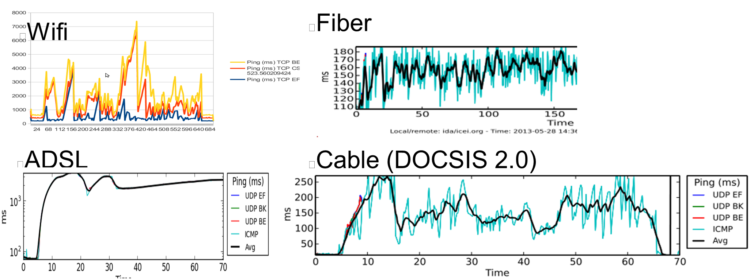
Latency with Load Today
Much of this latency comes from Queue Delay (bufferbloat)

Slide 4
Bufferbloat is a cross layer problem
Virtual machines on virtual network interfaces
Applications
TCPs
CPU schedulers
Network Queuing Systems between the app and device (qdiscs)
The encapsulators (PPPoe and VPNs)
The device drivers (tx rings & buffers)
The firmware interfaces
The devices themselves
The mac layer (on the wire for aggregated traffic)
The standards

Slide 5
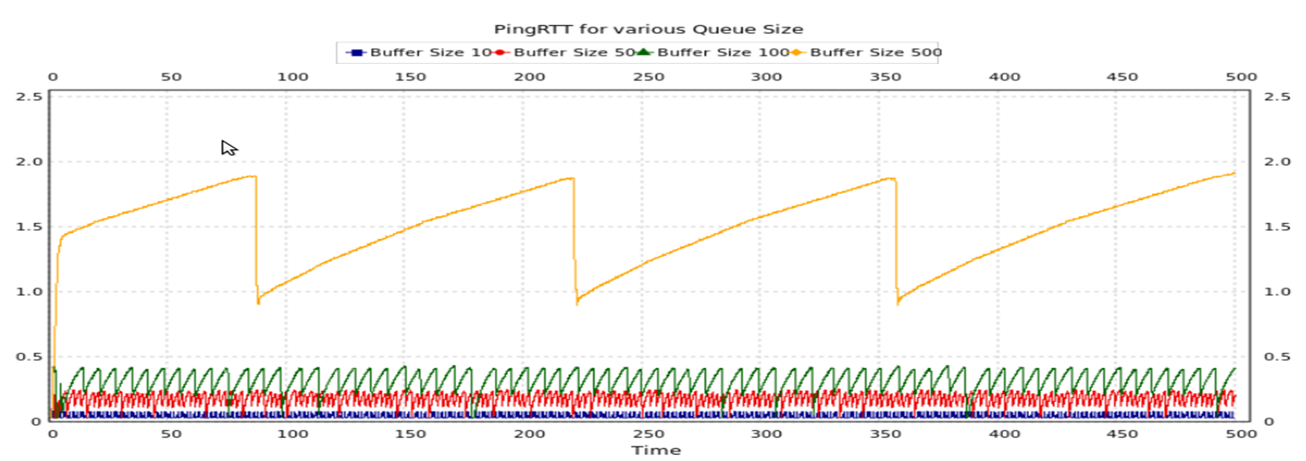
It comes from TCP’s bandwidth probing behavior (TCP 101)
TCP will always fill the biggest buffer on the path
As the delays get larger – congestion avoidance mode geometrically gets slower
With CUBIC, the sawtooth looks more like an S-curve
http://staff.science.uva.nl/~delaat/netbuf/bufferbloat_BG-DD.pdf
(.5Mbit uplink)

Slide 6
Consequences of TCP’s design
A single connection will fill any size buffer put in front of it at the path's bottleneck, given time: adds one packet/ack to the buffer
Timely dropping or marking of packets is necessary for correct operation of TCP on a saturated link.
Even IW4 is an issue at low bandwidths (e.g. VOIP over busy 802.11 network): do the math. Just "fixing" TCP does not fix the network.
Better queuing is essential. Congestion window is not shared among connections (currently). Current web server/client behavior means head of line blocking causes bad transients.
Sharing responsiveness is quadratic in delay. Elephant flows become mammoth flows in the face of overbuffering.

Slide 7
In a Web TCP transaction
SYN → SYN/ACK 1 RTT
SSL NEGOTIATION 2 RTTs
DATA REQUEST/Transfer – 1 RTT 10 packets
(90% of all web transactions are one IW10 burst)
FIN – FIN/ACK 1 RTT
CLOSE 1 packet
Only 1 TXOP in 10 can aggregate!
Excessive base RTT adds up!

Slide 8
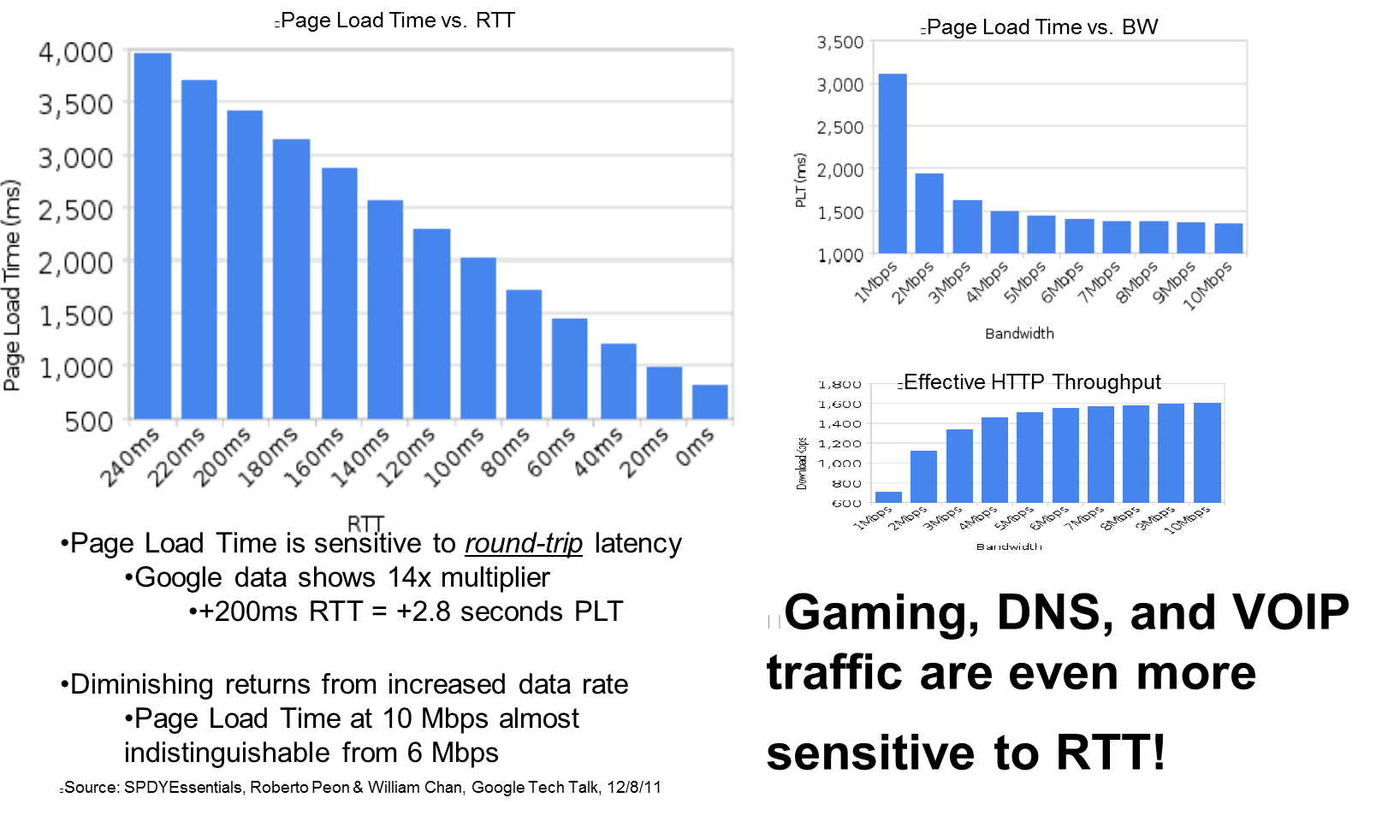
Web Browsing is dependent on RTT

Slide 9
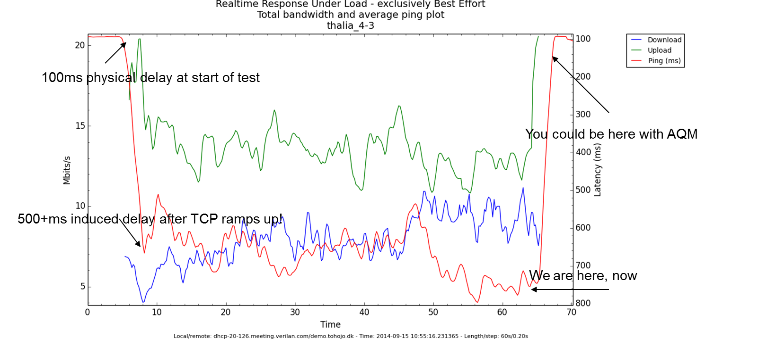
A network test here at IEEE Athens

Slide 10
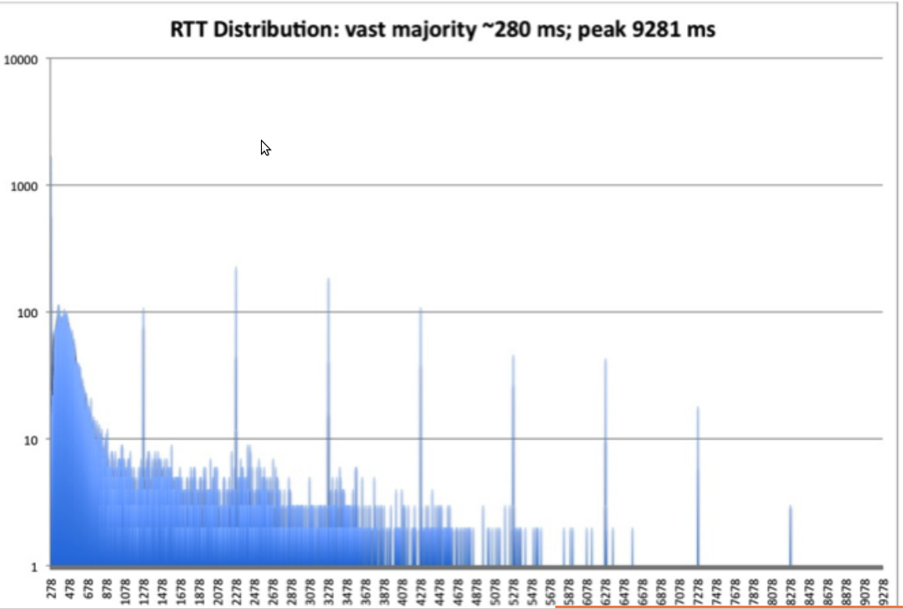
Too much delay and you get layer 3 adding even more packets...

Slide 11
The good news
Bufferbloat is basically fixed on ethernet, cable, dsl, and fiber, with the new algorithms (codel, fq_codel, pie) ,and improvements in the Linux network stacks,
  2-3 orders of magnitude reductions in network latency being seen AND improvements in goodput
Algos are now deployed in several products, and in nearly every third party router firmware.
Patent free and open sourced code widely available
Standardization activities in the IETF

Slide 12
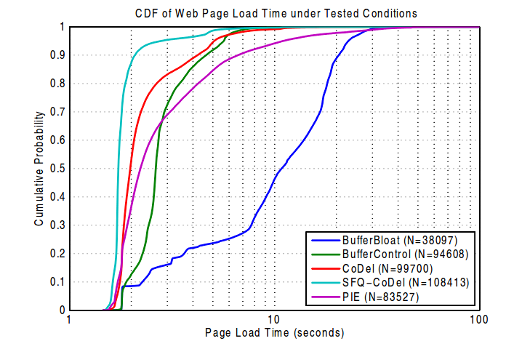
Web page load time wins
Video at: http://www.youtube.com/watch?v=NuHYOu4aAqg
From:http://www.cablelabs.com/wp-content/uploads/2013/11/Active_Queue_Management_Algorithms_DOCSIS_3_0.pdf

Slide 13
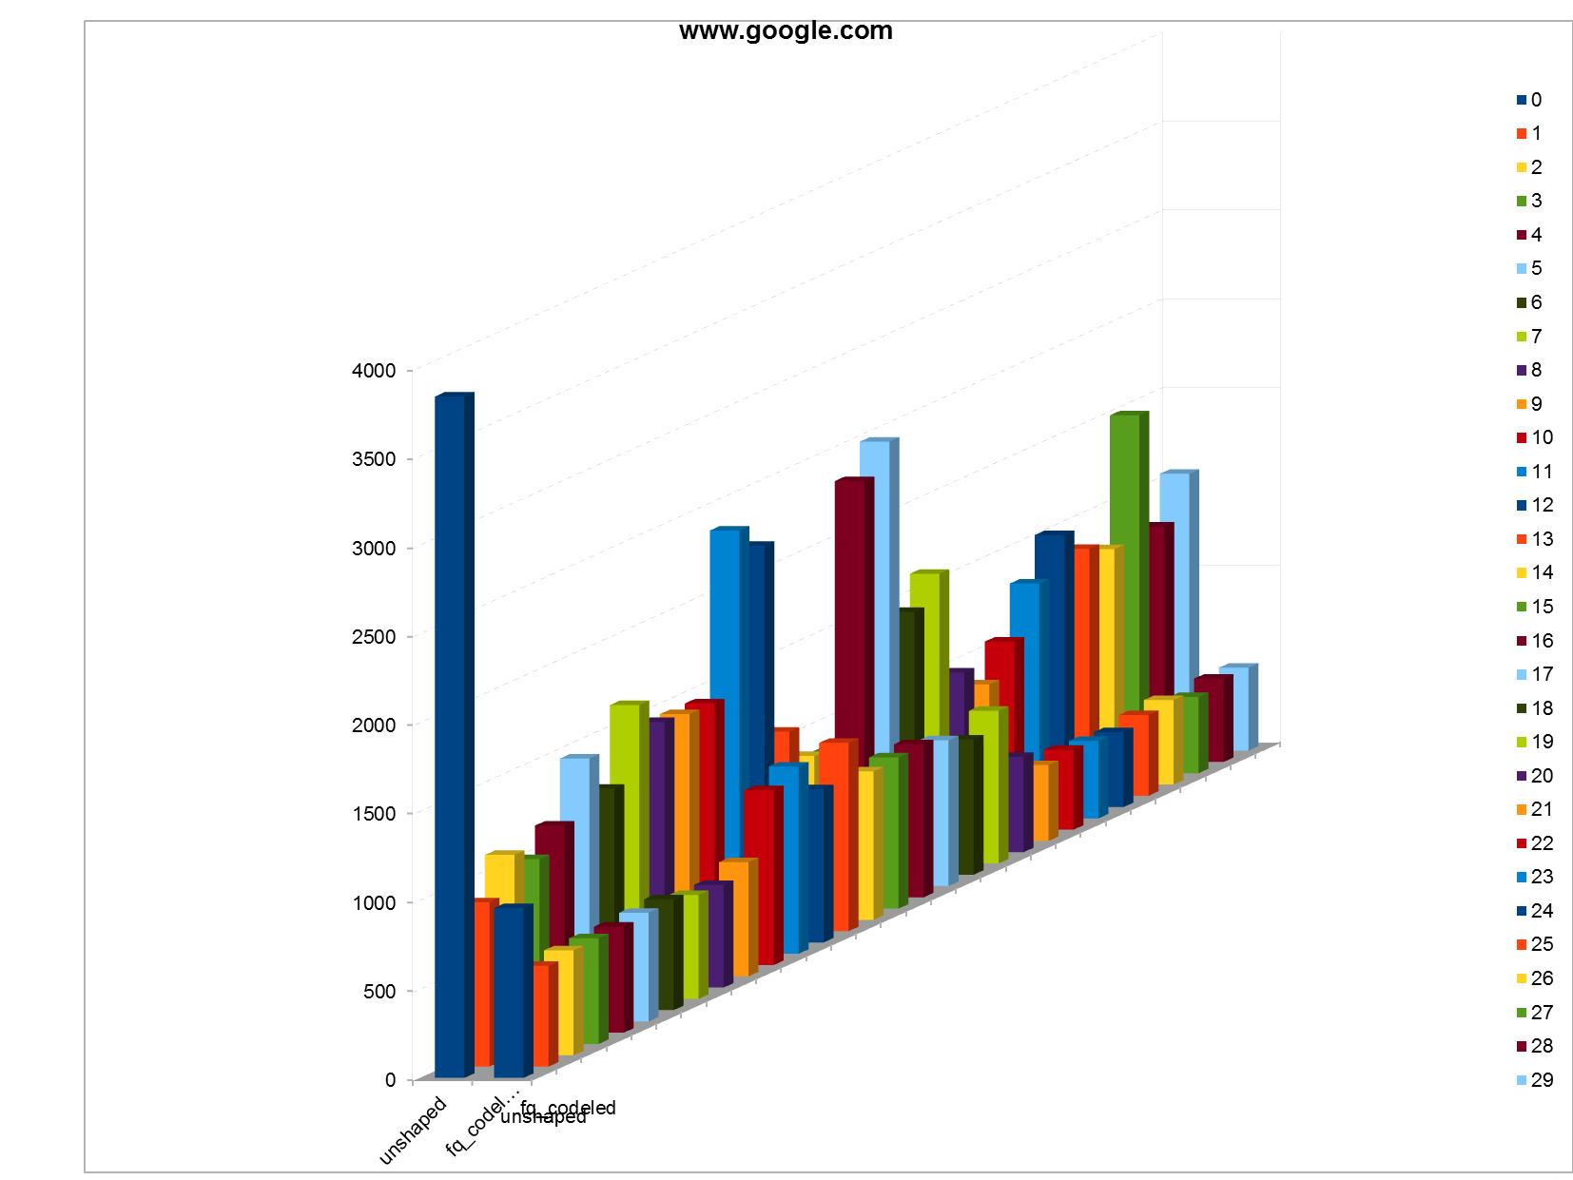
Chrome Benchmark Web Page completion time during RRUL benchmark
Drop tail vs nfq_codel

Slide 14
Linux TCP/AQM/FQ Advances: 2010-2014
Linux 3.0: Proportional Rate Reduction
Linux 3.3: Byte Queue Limits
Linux 3.4 RED bug fixes & IW10 added & SFQRED
Linux 3.5 Fair/Flow Queuing packet scheduling (fq_codel, codel)
Linux 3.6 Stability improvements to fq_codel
Linux 3.7 TCP small queues (TSQ)
Linux 3.8 HTB breakage
Linux 3.11 HTB fixed
Linux 3.12 TSO/GSO improvements
Linux 3.13 Host FQ + Pacing
Linux 3.14 Pie added
Linux 3.15 Change to microseconds from milliseconds throughout networking kernel
Linux 3.17? Network Batching API
The Linux stack is now mostly “pull through”, where it used to be “push”, and looks nothing like it did 4 years ago.
At least a dozen other improvements I forget and no sign other Oses are paying attention

Slide 15
IETF AQM Working Group Status
AQM working group
https://datatracker.ietf.org/doc/charter-ietf-aqm/
Pending drafts:
http://snapon.lab.bufferbloat.net/~d/draft-taht-home-gateway-best-practices-00.html
http://tools.ietf.org/html/draft-white-aqm-docsis-pie-00
http://tools.ietf.org/html/rfc2309 Is beiing revised
http://tools.ietf.org/html/draft-ietf-aqm-recommendation-03
http://tools.ietf.org/id/draft-kuhn-aqm-eval-guidelines-00.txt
http://tools.ietf.org/html/draft-hoeiland-joergensen-aqm-fq-codel-00
http://tools.ietf.org/html/draft-nichols-tsvwg-codel-02
http://sandbox.ietf.org/doc/draft-baker-aqm-sfq-implementation/

Slide 16
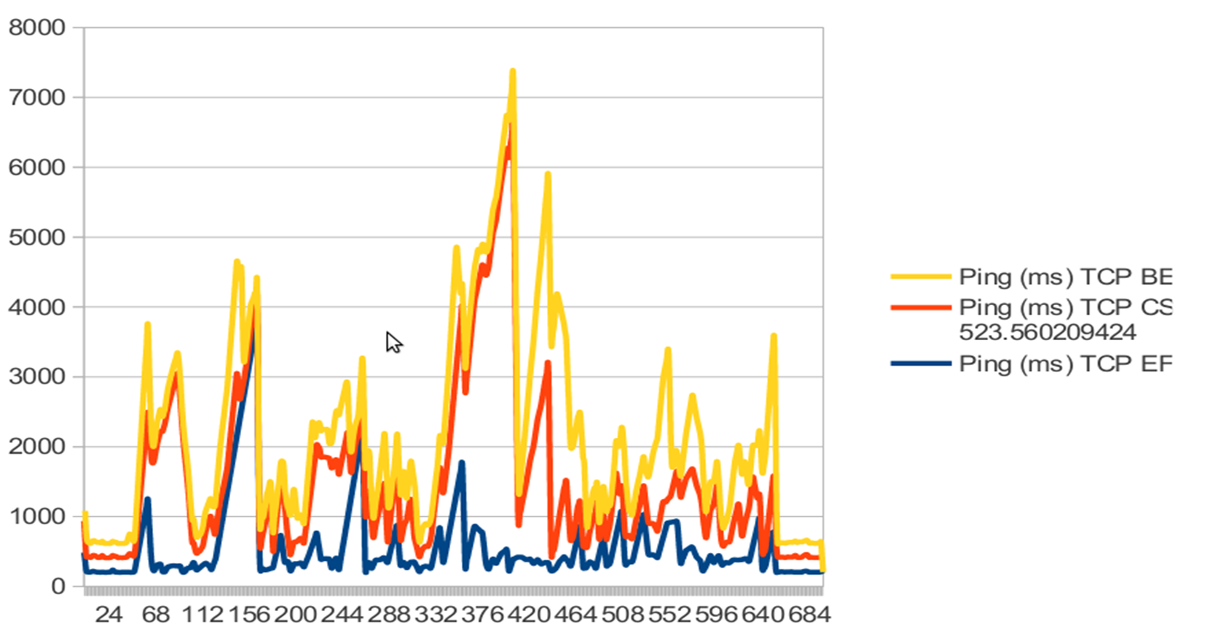
The bad news: Latency problems on WiFi are not just bufferbloat

Slide 17
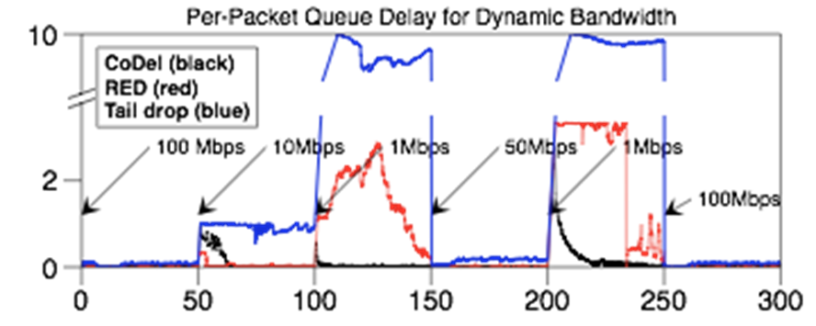
Codel concept shows promise in adapting to varying link rates
Nominal 100 Mbps link with rate changes, buffer size of 830 packets
4 FTPs, 5 packmime connections/sec
ACM Queue: “Controlling Queue Delay”
– Kathie Nichols and Van Jacobson
    http://queue.acm.org/detail.cfm?id=2209336
    See also: “Bufferbloat”
      http://queue.acm.org/detail.cfm?id=2071893

Slide 18
How to make WiFi truly faster on stations and Access points?
With new AQM and packet scheduling algorithms?
With Packet aggregation?
With EDCA scheduling?
With 802.11e prioritization?
Increasing numbers of stations and contending access points?
Excessive multicasts and retransmissions?
With upcoming standards like 802.11ax?
? ? ? ? ? ? ? ? ? ? ? ? ? ? ? ? ? ? ? ? ? ? ? ? ? ? ? ? ? ? ?
New project: https://lists.bufferbloat.net/listinfo/make-wifi-fast/

Slide 19
Some useful tools for looking at the Bufferbloat Problem
Tcptrace and xplot.org
Netperf-wrapper (by Toke Hoeiland-Joergensen)
  Standardized data format, 30+ network specific tests testing for latency under load, 20+ plot types, extensive support for batching and other automation, usage of alternate TCP algorithms, in combination with other web and voip-like traffic.
Linux Kernel mainline, Codel, fq_codel and pie in most distributions now (Redhat 7, ubuntu, debian, etc)
CeroWrt
  Inexpensive actual router configurable with nearly every AQM and FQ algorithm using “SQM”
  Emulations of common CMTS and DSLAM behavior
  Results proven sane to 50mbits
  Most of cerowrt is already in openwrt “Barrier Breaker”.
SQM (“Smart Queue Management”)
  Drop in replacement for wondershaper portable to all modern linuxes
  Uses fq_codel by default, pie, sfq, codel optionally
Openwrt “Barrier Breaker”, ipfire, pfsense, other third party router firmwares have support also
NS2 models of codel, sfq_codel, and pie in ns2 mainline
NS3 models of codel, fq_codel, asymmetric edge networks, etc,
  From Google 2014 summer of code
  Codel in in September ns-3.21, sfq_codel in ns-3.22, December, 2014
  Wifi mac support, LTE, etc

Slide 20
Bufferbloat.net Resources
Reducing network delays since 2011...
Bufferbloat.net: http://bufferbloat.net
Email Lists: http://lists.bufferbloat.net (codel, bloat, cerowrt-devel, etc)
IRC Channel: #bufferbloat on chat.freenode.net
Codel: https://www.bufferbloat.net/projects/codel
CeroWrt: http://www.bufferbloat.net/projects/cerowrt
Other talks: http://mirrors.bufferbloat.net/Talks
Jim Gettys Blog: http://gettys.wordpress.com
Talks by Van Jacobson, Gettys, Fred Baker, others:
http://www.bufferbloat.net/projects/cerowrt/wiki/Bloat-videos
Netperf-wrapper test suite:
https://github.com/tohojo/netperf-wrapper

Slide 21
Why am I here?
IETF is not the place to work on WiFi
Bufferbloat.net is starting up a new project, “make-wifi-fast” leveraging CeroWrt and OpenWRT.
  “The use of open source software to promote broad adoption and use of new technology is now well demonstrated... The CeroWrt/OpenWrt effort could have a similar effect.” – Vint Cerf,
    “Bufferbloat and other Internet Challenges”
Experiments thus far with 802.11ac have been dismal
Perhaps working with IEEE 802.11 is the right thing to find and fix all the excess sources of latency in the architecture.

Slide 22
Next up, a more detailed discussion

Slide 23
References

