Slide 1
Adaptive CCA for 11ax
Date: 2014-09-14
Authors:
Name | Affiliations | Address | Phone | email
Reza Hedayat Young Hoon Kwon Amin Jafarian Yonghu Seok Minho Cheong Hyoungjin Kwon | NEWRACOM | 9008 Research Drive, Irvine, CA 92618 |  | reza.hedayat at newracom.com younghoon.kwon at newracom.com amin.jafarian at newracom.com yongho.seok at newracom.com minho.cheong at newracom.com hj.kwon at newracom.com

Slide 2
Static vs Adaptive CCA
CCA is fixed in current IEEE amendments. However, theoretically it is better to adapt CCA, for each BSS, to an optimum level that depends on the locations of the STA vs the AP, and neighboring BSS/OBSS
For instance, in this BSS the STAs would backoff if they receive frame from any node within their coverage
However, given the location of the nodes in this BSS, they can adopt a CCA>-82dBm
  As long as the AP receives all the STAs above the new CCA
  As long as STAs defer to each other based on the new CCA value (preferably)
STA
AP
STA
BSS1
CCA=-82dBm

Slide 3
Static vs Adaptive CCA
Adapting the CCA level should consider potential STAs nearby
In Below, adopting a CCA>-82dBm by either of BSS is less likely to hurt the operation of the other BSS significantly
But this is not always the case …
STA
AP
STA
STA
AP
STA
BSS1
BSS2
CCA=-82dBm

Slide 4
Adaptive CCA
An immediate consequence of less sensitive CCA is additional hidden nodes that appear. All the classical problems (solutions) with hidden nodes apply to the newly introduced hidden nodes.
In this figure, STAs are not labeled as AP/client
Hidden STAs for CCA=-82dBm
STA0
STAs that become
hidden due to CCA>-82dBm
CCA=-82dBm
CCA > -82dBm

Slide 5
Challenges with Adaptive CCA
With less sensitive CCA, some frame exchanges that were functioning fine with CCA=-82dBm could break down due to newly introduced hidden nodes:
  Increased interference and possible collision: Frames sent by red STAs (e.g. STA3/STA4) reach STA0 below the new CCA level and STA0 assumes the channel is available, likely sending frames which causes additional interference to STA3/STA4 frame exchanges and likely causing collision.
  There is no classic 802.11 solution for this problem. Red STAs would gradually converge to lower MCS, and depending on the level of interference from STA0, they may or may not be able to exchange frames with low MCS.
3
4
1
STA0
6
5
2

Slide 6
Challenges with Adaptive CCA
With less sensitive CCA, some frame exchanges that were functioning fine with CCA=-82dBm could break down due to newly introduced hidden nodes: For instance:
  Collision with ACK: When STA2 sends ACK/BA in response to PPDUs from STA1, its ACK/BA reaches STA0 below the new CCA level and STA0 assumes the channel is available
  RTS/CTS solves this problem: STA1 sends RTS, and once it received CTS from STA2 it’d send the data frames. STA0 defer for the duration of NAV.
  But there is overhead associated with using RTS/CTS for every frame that is sent by STA1 (or STA2) …
3
4
1
STA0
6
5
2

Slide 7
Challenges with Adaptive CCA
  The higher CCA threshold value, the more chance of interference to the victim STA (Target receiver of ongoing frame).
  If MCS of ongoing frame didn’t consider this interference, collision will result in packet failure.
STA1’s coverage area
(-82dBm)
CCA threshold
(-82dBm)
STA1’s coverage area
(-82dBm)
CCA threshold
(-72dBm)
STA1
STA2
STA1
STA2
Possible victim area
STA2’s interference area
(-82dBm)
Possible victim area
STA2’s interference area
(-82dBm)
CCA = -82dBm
CCA > -82dBm

Slide 8
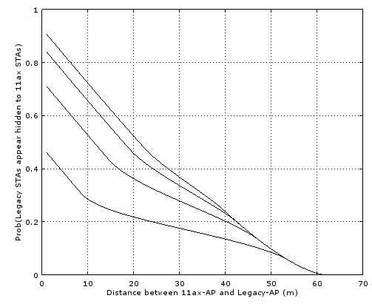
Challenges with Adaptive CCA: Unfairness to legacy STAs
Even if the additionally introduced hidden nodes due to CCA>-82dBm are dealt with by a smart design, the legacy devices have no idea that their neighboring nodes are using more aggressive CCA levels:
  Legacy devices back off more often, and have less chance of transmission
  Legacy devices appear hidden to the devices with aggressive CCA
  Front figure: chance of legacy devices become hidden to 11ax-AP due to CCA>-82dBm:
    Power=15dBm
    Mean value for shadowing fading of lognormal (0dB,5dB) is used.
CCA=-82dBm
CCA=-82dBm
CCA>-82dBm
11ax BSS
Legacy BSS
CCA = -62dBm
CCA = -67dBm
CCA = -72dBm
CCA = -77dBm
CCA = -82 dBm

Slide 9
Challenges with Adaptive CCA
As CCA threshold becomes higher, there’s more chance of interference fluctuation
  Several events can make interference level fluctuate during a packet transmission, which makes hard to estimate right MCS level
    Beginning of new transmission
    End of ongoing transmission
    Change of transmitter: ACK/BA transmission
    Change of transmitter: Different user scheduling during TXOP
Target STA
Data
I₁
I₂
Interfering STA1
Data
I₃
Interfering STA2
ACK/Data
ACK
Interfering STA3
Data

Slide 10
Challenges with Adaptive CCA
Noise level
  Numerical example:
    When a STA1 is transmitting to its target STA (STA2), interfering STA (STA3) finishes its transmission, and another STA (STA4) initiates another transmission.
    Under this situation, ran simulation on how much SINR at STA2 fluctuates when interference source changes (STA3 → STA4).
    Location of STA2 is randomly selected within -82dBm coverage area (MCS 0 coverage area) of STA1.
    Location of STA3 and STA4 is randomly selected within the coverage area between CCA threshold and noise level.
    SINR fluctuation: ΔSINR
MCS0 (-82dBm)
CCA threshold
STA2
I₁
STA3
S
STA1
I₂
STA4
STA1
Data
I₁
I₂
STA3
Data
STA4
Data
T1
T2

Slide 11
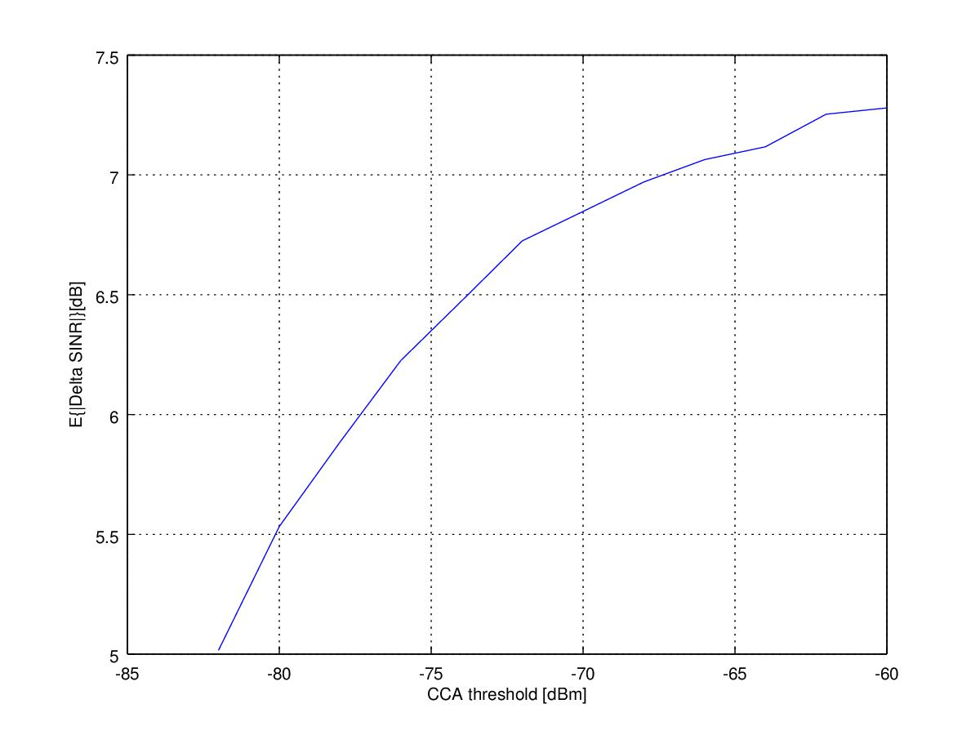
Challenges with Adaptive CCA
Numerical results
  As CCA threshold level increases, ΔSINR fluctuates more.
    Compared to -82dBm CCA threshold, -62dBm CCA threshold has more than 2dB additional SINR fluctuation.
    -62dBm CCA threshold requires more conservative MCS rate selection scheme to cope with additional SINR level fluctuation.
  Additional SINR fluctuations due to colliding PPDUs would require to consider larger margin in rate adaption
  As a side note, we suggest that PHY SLS simulations at least use a larger TBD margin for rate adaptation, as there is no justification to use perfect rate adaptation in simulations

Slide 12
Current Adaptive CCA Solutions
  Most of the contributions report large gain by using CCA >-82dBm based on PHY simulation [14/82r0, 14/83r0], and less gain based on PHY/MAC simulations [14/846r0, 14/861r0, 14/372r2] and sometimes negligible gain [14/578r0]
Current proposed solutions for adaptive CCA are:
  STAs adjust CCA based on Beacon’s RSSI [13/1290r0, 14/635r0, 14/294r0]
    Not clear what CCA level AP adopts
    Problem: even own BSS STAs might become hidden
  Adaptive CCA based on Color: use CCA=-82dBm for own BSS frames, but aggressive CCA for other frames [14/861r0, 14/372r2]
  STAs announce what level of CCA they tolerate [14/872r0]
    Promising solution, but interferes with MCS selection, makes the feedback loop complex and longer to converge
  …

Slide 13
General Adaptive CCA Solutions
Distributed: STAs decide on their own what CCA level to adopt
  Pros: Given each STA can acquire some knowledge of its surrounding, distributed solutions can reach some optimum level
  Cons: Given practical consideration in certifications, a poor implementation might affect other STAs beyond intention
Centralized: AP analyzes its surrounding and announces the best CCA level to its STAs
  Pros: Centralized and robust
  Cons: There would still be STAs hidden to the AP but not to some of its STAs
Centralized solutions inevitably are for a given duration, e.g. until AP establishes a new CCA threshold
Distributed solutions could be per-PPDU or per-duration

Slide 14
Conclusion
These contribution highlights the opportunities for adaptive CCA vs the static CCA used in current 802.11 amendments
However, we also point to the challenges that adaptive CCA brings
Particularly, we highlight that:
  additionally introduced hidden nodes due to CCA>-82dBm would increase collision and unfairness
  increased fluctuation of interference level during a packet transmission which requires more robust rate adaptation and larger margin
  increased overhead due to more frequent use of RTS/CTS for all frames
  unfairness toward legacy devices
Proposals for adaptive CCA should consider above challenges

