Slide 1
Ack Procedure for OFDMA
Date: 2014-09-14
Authors:

Slide 2
OFDMA for High Efficiency WLAN
OFDMA is a promising technology for enhancing the user experience by serving the heterogeneous users simultaneously
But, in order to sustain the gain, the efficient MAC protocol design is very important

Slide 3
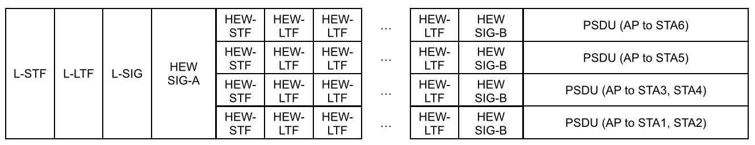
OFDMA for High Efficiency WLAN
For discussion purpose, we assume the following numerical parameters of OFDMA
  FFT size is increased 4 times as the following
    256 FFT on 20 MHz channel, 512 FFT on 40 MHz channel,
    1024 FFT on 80 MHz channel, 2048 FFT on 160 MHz channel
  One 256 FFT on 20 MHz channel is composed of four 64 FFT on 5 MHz channels
    One 5 MHz channel corresponds to one sub-channel in this presentation

Slide 4
Ack Procedure for OFDMA
In this presentation, we discuss the ACK procedures for OFDMA according to the unit of the channel bandwidth of the ACK frame
  Sub-channel based ACK
  Channel based ACK

Slide 5
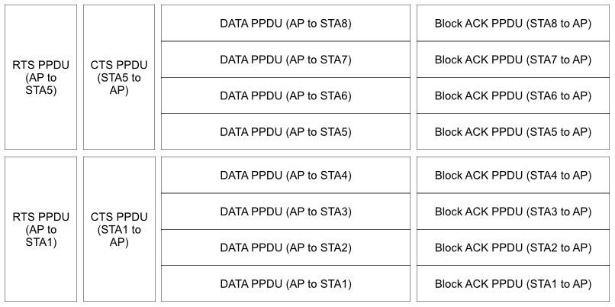
Proposed Ack Procedure for OFDMA
Sub-channel based ACK
  ACK PPDU is transmitted on the sub-channel of the eliciting PPDU
  ACK policy field of all eliciting PPDU is set to a implicit Block ACK Request

Slide 6
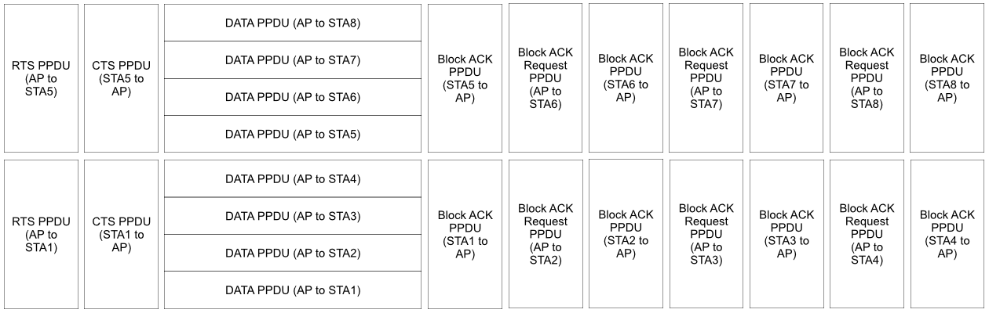
Proposed Ack Procedure for OFDMA
Channel based ACK
  ACK PPDU is transmitted on the channel of the eliciting PPDU
  ACK policy field of one eliciting PPDU among multiple DATA PPDUs transmitted on one channel is set to a implicit Block ACK Request

Slide 7
Ack Procedure Discussion
Sub-channel based ACK has less protocol overhead compared with Channel based ACK
But, Sub-channel based ACK has less robustness and unfairness issues compared with Channel based ACK
Slide 7

Slide 8
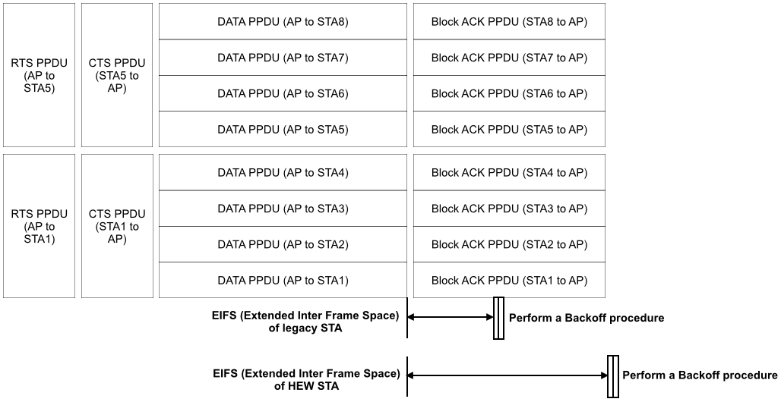
Ack Procedure Discussion
Robustness issue of Sub-channel based ACK
  When legacy STA and HEW STA are coexisting in a same BSS, the EIFS of the legacy STA does not help to protect the HEW control response frame
  Because the TXTIME of the HEW control response frame is also increased since the OFDM symbol time increases
Slide 8

Slide 9
Ack Procedure Discussion
Unfairness issue of Sub-channel based ACK
  Because legacy STA and HEW STA have different EIFS parameters, the channel access probability after receiving an erroneous frame is also different
  The STA having the shorter EIFS parameter has the higher channel access probability
Slide 9

Slide 10
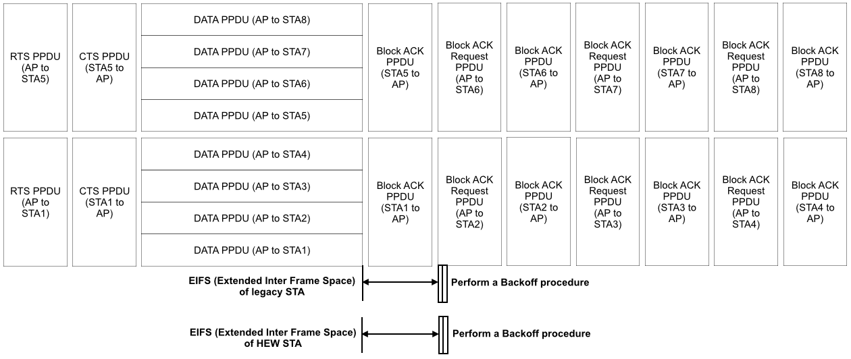
Ack Procedure Discussion
Channel based ACK has the slightly higher protocol overhead compared with Sub-channel based ACK
But, in the context of the robustness and fairness, Channel based ACK can be more better than the Sub-channel based ACK
Slide 10

Slide 11
Conclusion
It seems that previous discussions in IEEE 802.11ax are favoring on the OFDMA technology
But, the protocol overhead of the OFDMA have to be considered
Especially, the robustness and fairness of the ACK procedure have to be carefully evaluated before deciding the support of the OFDMA in IEEE 802.11ax

