Slide 1
Multiple RF operation for 802.11ax OFDMA
Date: 2014-09-17
Authors:

Slide 2
Contention overhead & MAC performance
11ax PAR is targeting to achieve throughput enhancement
of 4(~10) times
  for dense network environment
Contention overhead degrads MAC performance[1]
  As STA density increases
    Collision probability increases
    MAC efficiency decreases(MAC throughput/PHY rate)
    Medium access delay per user increases
  Contention overhead is more critical on AP side[2]
    UL/DL traffic asymmetry
    Same opportunity for accessing medium: 1/(N+1)
Reducing contention overhead is key solution for enhancing both
aggregated throughput and per user throughput experience

Slide 3
Multiuser widerband(OFDMA) operation
Exploiting OFDM & Widerband operation
  Reducing TXOP decreases MAC efficiency[1]
Aggregated Throughput↑
MAC efficiency ↓
Contention overhead ↓
(Contention isolation)
MAC efficiency↑
Per user access delay ↓

Slide 4
Expected form of OFDMA operation
Adjusting tx/rx timing for AP
  ACK cannot be received while AP is transmitting DL data
  Various data length
    <1500B with %40 chance for DL[3]
    Max A-MPDU Length: (1,048,575B)
  Unnecessary channel occupation, delay

Slide 5
  Inefficient utilizing of widerband
Rectangular shaped widerband operation
  Transmission/reception at a time
  Inefficient channel usage
  Unsuitable for multiuser operation
  Limitation of single RF chain
Additional RF chain could be a solution
Considering more RF chains at AP

Slide 6
Multiple RF chains
Exploiting multiple RF chains at AP
  Independent transmission/reception among different RF chains
  Much flexible channel utilizing
  Suitable for multiuser operation
  More opportunities for AP to access the medium
    Medium access opportunity of AP = x/(N+1)
  Reducing complexity of synchronization problem of OFDMA
SK telecom (Korea) developed
‘2FA (Frequency Assignment) Giga Wi-Fi’(June 2014) [4]
  exploits two separate RF chains for two 80MHz band.
Dual RF chains at AP might be feasible for 11ax generation

Slide 7
Utilizing Dual RF chains
Dual RF chains

Slide 8
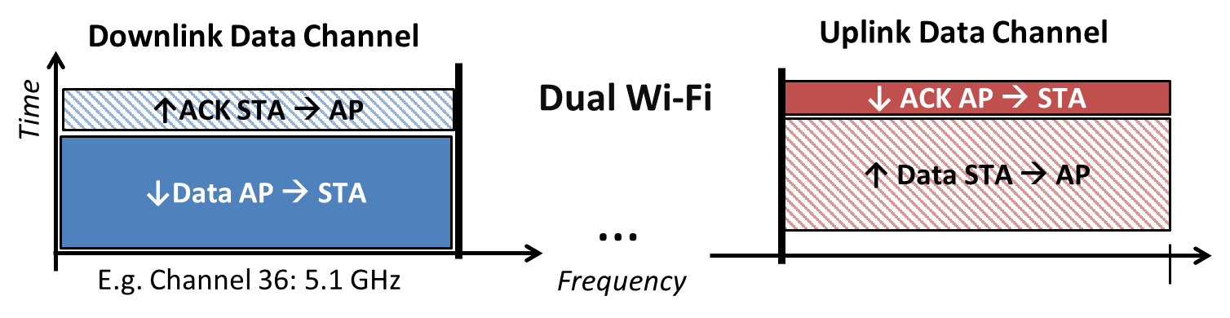
Dual RF extension
Dual wi-fi[5], DL only CH[2]
  Alleviating traffic asymmetry problem
DCF/PCF dual Channel
  FTP downloading, HTTP -> contention based CH
  Streaming, Control/management data -> scheduling based CH
  Contention isolation / Coordination gain

Slide 9
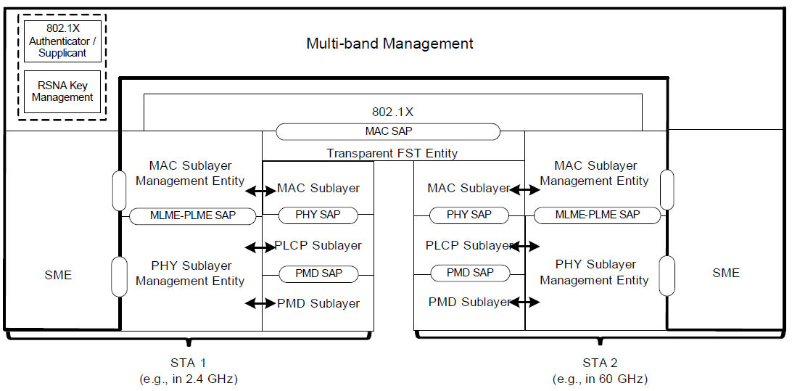
Considerations on multiple RF chains
Interworking structure of MAC/PHY layer
  Similar approach was accepted in 11ad
    Separate MAC/PLCP/PMD, sharing 802.1x MAC SAP
    Multi-band management entity

Slide 10
Considerations on multiple RF chains
Self-interference from adjacent band
  Self Interference Cancellation(SIC) techniques might be necessary
Modifications on protocols
  Connection (Session) management
  Multiuser access protocol
    RTS/CTS
    ACK
Etc.

Slide 11
Conclusion
Contention overhead is one of the biggest reasons that reduces the MAC efficiency of 802.11 networks
Multiuser widerband operation(OFDMA) might play a key role to reduce the contention overhead and enhance the overall MAC efficiency
However, existing single RF chain structure is not suitable for OFDMA operation
Adopting additional RF chains could increase the MAC efficiency of OFMDA
  Dual RF chains at AP
More investigations on multiple RF chains operation is necessary in 802.11ax

Slide 12
References
[1] 11-13-0505-00-0hew-mac-efficiecy-analysis-for-hew-sg
[2] 11-13-1377-00-0hew-dl-efficiency-enhancement-in-high-dense-network
[3] 11-14-1232-00-00ax-on-multi-sta-aggregation-mechanisms-in-11ax
[4] http://www.sk.com/Channel/News/view/1215
[5] 11-13-1409-00-0hew-dual-wi-fi-dual-channel-wi-fi-for-congested-wlans-with-asymmetric-traffic-loads

