Slide 1
Multiple RF operation for 802.11ax OFDMA
Date: 2014-09-xx
Authors:

Slide 2
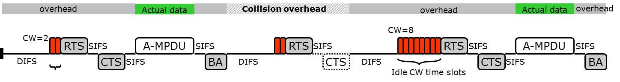
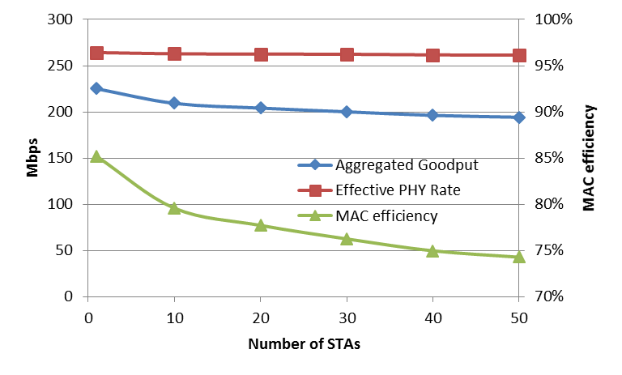
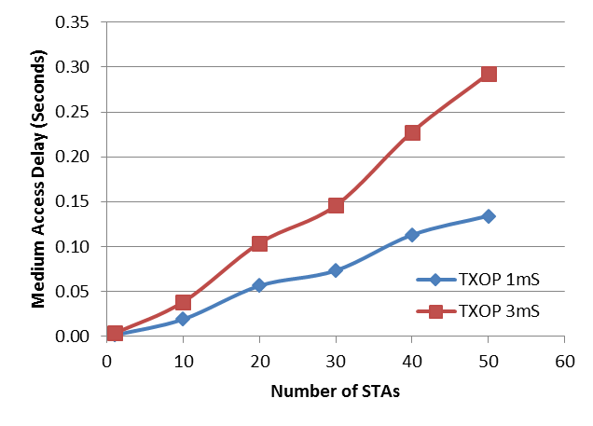
Contention overhead & MAC efficiency
11ax is targeting to achieve throughput enhancement of 4(~10) times
Contention overhead of WLAN[1]
  MAC efficiency drops as STA density increases

Slide 3
Multiuser widerband(OFDMA) operation
Exploiting OFDM & Widerband operation
Contention isolation
Aggregated Throughput↑
MAC efficiency ↓
Contention overhead ↓
MAC efficiency↑
Faster processing for upper layer(TCP)

Slide 4
Expected form of MU widerband op.(DL)
Adjusting tx/rx timing for AP
  Various data length
  ACK cannot be received while AP is transmitting DL data
  Unnecessary channel occupation, delay

Slide 5
Expected form of MU widerband op.(UL)
Difficult to synchronize medium access
of multiple STAs
  Fast transition of tx/rx for short messages (RTS/CTS)
Impossible to take additional access
(Specific access protocols need further discussion)

Slide 6
  Limitation of single RF chain
Rectangular shaped widerband operation
  Transmission/reception at a time
  Inefficient channel usage
  Unsuitable for multiuser operation
Adopting multiple RF chains at AP

Slide 7
Multiple RF structure
Multiple RF
  Independent transmission/reception among different RF chains

Slide 8
Utilizing Multiple RF(1)
Single RF chain

Slide 9
Utilizing Multiple RF(1)
Dual RF chains

Slide 10
Utilizing Multiple RF(1)
Dual RF chains

Slide 11
Utilizing Multiple RF(1)
Dual RF chains

Slide 12
Utilizing Multiple RF(1)
Multiple RF chains

Slide 13
Utilizing Multiple RF(2)
Unrestricted preferred CH access

Slide 14
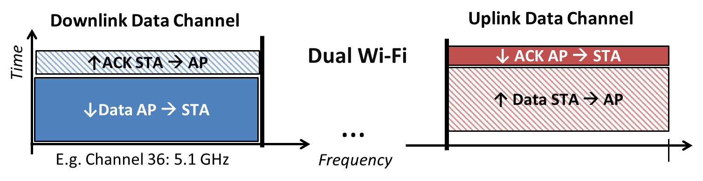
Multiple RF extension(1)
Dual wi-fi[2], DL only CH
  Traffic asymmetry

Slide 15
Multiple RF extension(2)
DCF/PCF dual Channel
FTP downloading, HTTP -> contention based CH
Streaming, Control/management data -> scheduling based CH
Contention isolation / Coordination gain

Slide 16
Conclusion
Contention overhead is one of the biggest reasons that reduces the MAC efficiency of 802.11 networks
Multiuser widerband operation(OFDMA) might play a key role to reduce the contention overhead and enhance the overall MAC efficiency
However, existing single RF chain structure is not suitable for MU widerband operation
Adopting multiple RF chains at AP could increase the utility of MU widerband operation
Multiple RF chains operation should be investigated more in 802.11ax

Slide 17
References
[1] 11-13-0505-00-0hew-mac-efficiecy-analysis-for-hew-sg
[2] 11-13-1409-00-0hew-dual-wi-fi-dual-channel-wi-fi-for-congested-wlans-with-asymmetric-traffic-loads

