Slide 1
Multicast Performance in OBSS
Date: 2014/9/15
Authors:

Slide 2
Abstract
Video distribution in dense environment (e.g., stadiums) could be one of the main use cases defined by TGax
Multicast could be the most efficient technique to achieve this use case
Legacy multicast performance in current simulation scenario (14/0980r2) is shown in this submission
More efficient multicast technique might be necessary

Slide 3
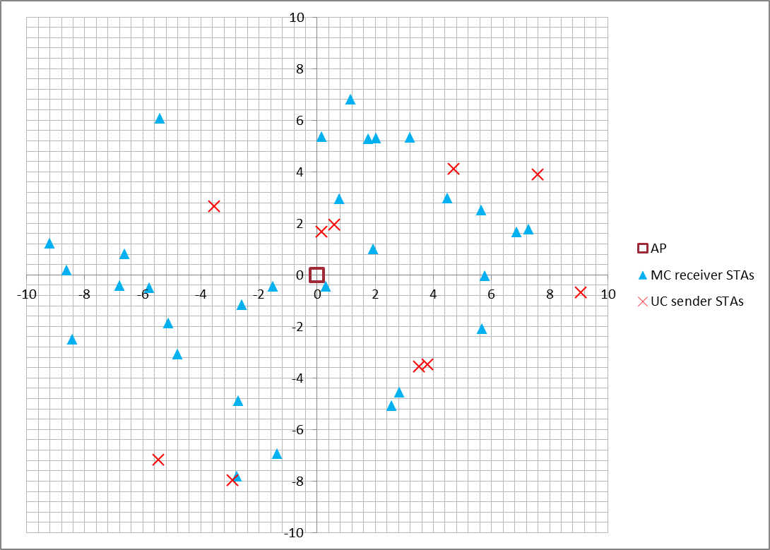
Multicast Performance in Single BSS
Only 1 BSS in a system
  3Mbps UDP multicast traffic from an AP to 30 STAs
  1Mbps UDP unicast traffic from 10 STAs to the AP
Detailed simulation conditions are shown in appendix

Slide 4
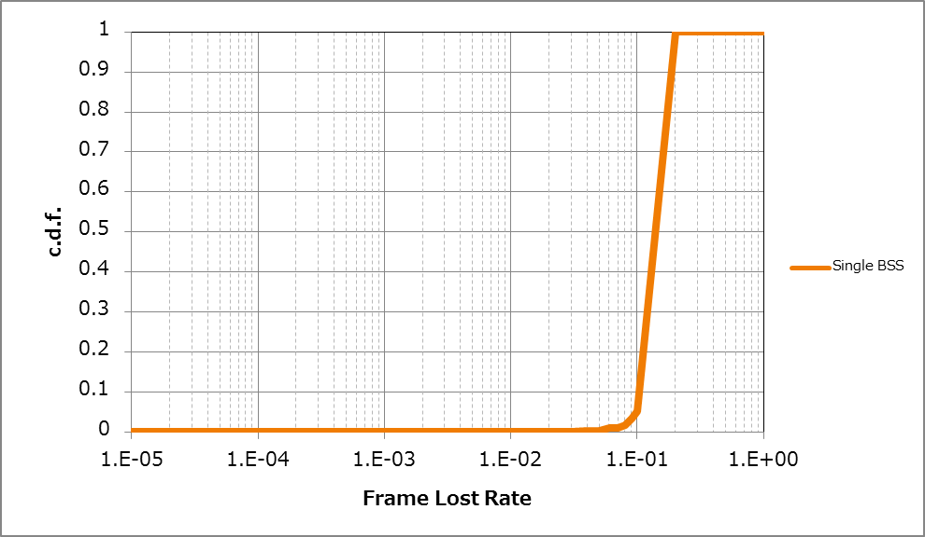
Simulation Result – Single BSS
Legacy multicast degrades due to interferences from its own BSS
since it has no retransmission mechanism
Almost all STAs failed to receive
10-20% of multicast frames!!

Slide 5
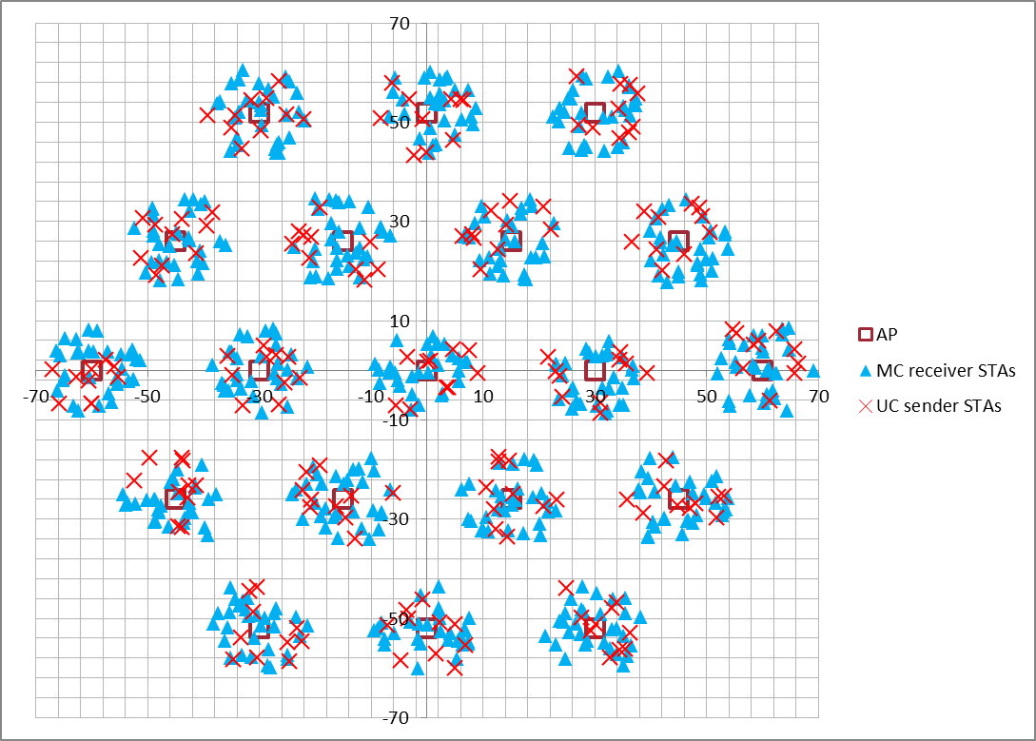
Multicast performance in Multiple BSSs
19 BSSs in a system
  3Mbps UDP MC traffic from AP to 30 associated STAs per BSS
  1Mbps UDP unicast traffic from 10 STAs to the AP per BSS
Detailed simulation conditions are shown in appendix

Slide 6
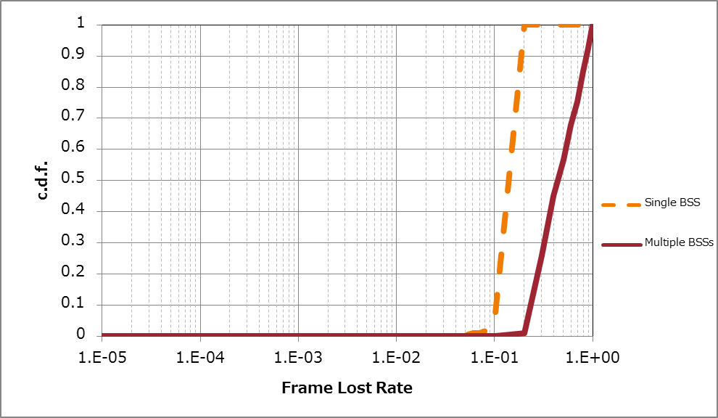
Simulation Results – Multiple BSSs
OBSS interferences make multicast performance worse
Nearly 50% of STAs failed to receive
more than 50% of multicast frames!!

Slide 7
Issues with Existing Multicast Mechanism
11a/n/ac multicast
  No retransmission
    Offers little reliability since frame collisions often occur in dense environment
  No feedback
    Cannot control PHY rate in accordance with traffic load or with QoS
      Cannot get the best MCS to transmit
11aa multicast
  BAR/BA based retransmission protocol with each STA
    Offers very high reliability but need more resources as the number of multicast STAs increases

Slide 8
Conclusion
Legacy multicast mechanisms under perform in dense environments
More efficient transmission technique needs to be considered for 11ax

Slide 9
Backup

Slide 10
Node | AP x 1, STA x 30（multicast）STA x 10 (unicast)
Num of Drops [times] | 19
Traffic Model & Load | Downlink CBR UDP 3Mbps (multicast) Uplink CBR UDP 1Mbps (uniicast)
Tx MC Frames from AP | 42000
Access Category | AC_BE (Priority=1) CWmin=15, CWmax=1023, AIFSN=3, TXOP limit=0
Tx Power [dBm] | +20(AP), +15(STA)
MCS | 7 ( 65Mbps)
Link Adaptation | Off
Packet Length [byte] | (MPDU, MSDU, APP)=(1530, 1500, 1472) Fixed
L2 Retry | ０(multicast)/ 10 (unicast)
Ack Rate | Lowest (MCS0:6.5Mbps)
RTS Threshold | 2346
Aggregation | (A-MPDU, A-MSDU)=(64KB, NA) (※unicast only)
NF [dB] | 7
Channel | (Dist, Shadow, Fading)=(TGn, σ=5dB, K=12dB-Rice)
Preamble Detect Th [dBm] | -82
Energy Detect Th [dBm] | -62
Channel Setting [MHz] | (CenterFreq, BW)=(2412, 20)
Antenna Gain [dBi] | 0(AP), -2(STA) [default=0]
Antenna Height [m] | 3(AP), 1.5(STA) [default=1.5]
Tx buffer size [Byte] | 750k
Wraparound | Enabled
TTL [sec] | 1 sec
PLCP Header Error Det | Enabled
Simulation Conditions for
multicast performance on 1BSS

Slide 11
Node | AP x 19, STA x 30 ( multicast）STA x 10 (unicast) per BSS
Num of Drops [times] | 1
Traffic Model & Load | Downlink CBR UDP 3Mbps (multicast) Uplink CBR UDP 1Mbps (uniicast)
Tx MC Frames from AP | 40000 (per BSS, average)
Access Category | AC_BE (Priority=1) CWmin=15, CWmax=1023, AIFSN=3, TXOP limit=0
Tx Power [dBm] | +20(AP), +15(STA)
MCS | 7 ( 65Mbps)
Link Adaptation | Off
Packet Length [byte] | (MPDU, MSDU, APP)=(1530, 1500, 1472) Fixed
L2 Retry | ０(multicast)/ 10 (unicast)
Ack Rate | Lowest (MCS0:6.5Mbps)
RTS Threshold | 2346
Aggregation | (A-MPDU, A-MSDU)=(64KB, NA) (※unicast only)
NF [dB] | 7
Channel | (Dist, Shadow, Fading)=(TGn, σ=5dB, K=12dB-Rice)
Preamble Detect Th [dBm] | -82
Energy Detect Th [dBm] | -62
Channel Setting [MHz] | (CenterFreq, BW)=(2412, 20)
Antenna Gain [dBi] | 0(AP), -2(STA) [default=0]
Antenna Height [m] | 3(AP), 1.5(STA) [default=1.5]
Tx buffer size [Byte] | 750k
Wraparound | Enabled
TTL [sec] | 1 sec
PLCP Header Error Det | Enabled
Simulation Conditions for
multicast performance on OBSS

Slide 12
Assumed Target PLR for Multicast
Assumptions:
  Network Requirement for applications: 1 packet loss in 10 min.
  Traffic load = 3Mbps, application payload = 1500byte/packet
  Required PLR on Applications : 6.7E-6
    (3 [Mbps] * 600 [s] / (8 [bit/byte] * 1500 [byte])^-1 = 6.7E-6
  Use Reed-Solomon Code for packet error correction to relax the required PLR on wireless system

Slide 13
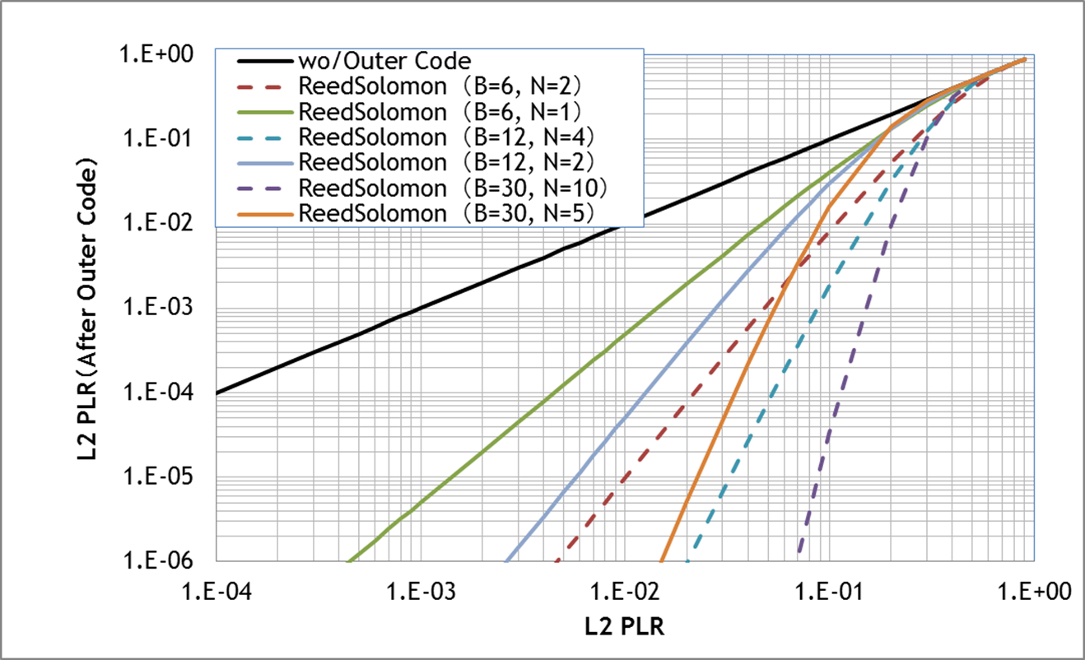
Target PLR on Wireless System for Multicast
= 2E -2
When utilizing (B, N) = (30, 5), Target PLR = 2E-2
B :Block length, N: Parity length Code rate = (B-N)/B
Required PLR on application
Solid line : Code Rate = 5/6
Dashed line : Code Rate = 2/3

