Slide 1
NG60 Use-Cases
Authors:
Date: 2014-09-15

Slide 2
Outline
Background
Use-Cases in NG60
Conclusion

Slide 3
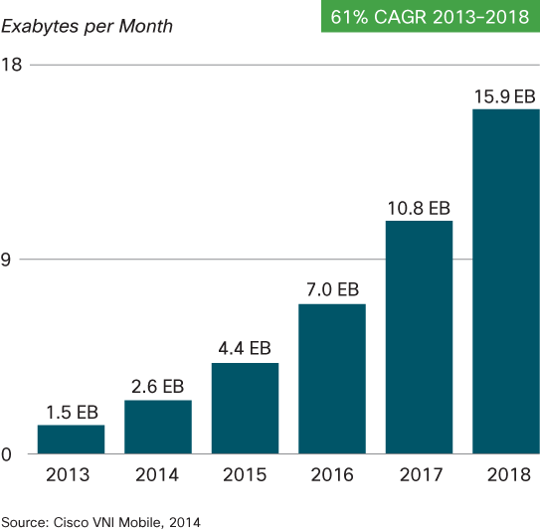
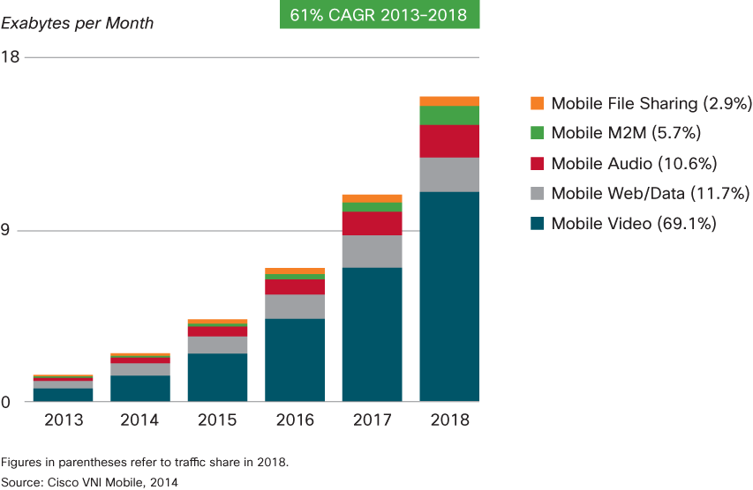
Background
Volume of data traffic continues to increase.
15.9 EB/month data traffic expected in 2018[1].
Video traffic will be dominant
detail
[1]Cisco Visual Networking Index: Global Mobile Data Traffic Forecast Update, 2013–2018

Slide 4


UseCase-1 : Traffic Offload
Video traffic will disturb other types of traffic in cellular NW (e.g. Voice, HTTP, etc…).
Even Wi-Fi (2.4 GHz/5 GHz) will be congested
⇒Need aggressive traffic offloading using 60 GHz
AP
AP
2.4GHz
60GHz
60GHz
5GHz
cellular to 60 GHz Wi-Fi
2.4GHz/5GHz Wi-Fi to 60 GHz Wi-Fi

Slide 5

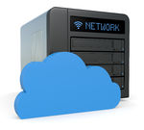





UseCase-2 : Cloud Storage
High-speed backup from handset to network access server (NAS).
Contents download from NAS, e.g. HD Video
e.g. residence, office
Cloud
Cloud
NAS
AP
AP
Backup/Synchronization
Contents download

Slide 6
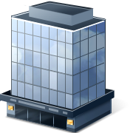
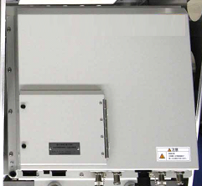
UseCase-3 : Mobile Backhaul/Fronthaul
Similar use-case discussed in [2][3]
60GHz
RRH
60GHz
Fronthaul
Backhaul
RRH
EPC
BBU
60GHz
[2]15-14-0177-04-003d-rof-based-terahertz-fronthaul.pdf
[3]11-14-0579-01-0wng-a-backhaul-use-case-for-ng-11ad.pptx

Slide 7
Conclusion
Volume of data traffic continues to increase, especially video traffic.
We expect NG60 to support following three use-cases to improve mobile users’ experience :
  (1) Traffic offload
  (2) Cloud Storage
  (3) Mobile Backhaul/Fronthaul

