Slide 1
WLAN Frame Collision Information
Date: 2014-09-05
Authors:

Slide 2
Abstract
Frame Collision in 11ax scenarios is a severe problem, which is an obstacle to realizing the goals of 11ax.
In this contribution, we propose that supporting the use of Frame Collision Detection(FCD) information will be useful for reducing collisions by management and control in 11ax.

Slide 3
Background 1/2
In high density environment of 11ax scenarios, there are many Frame Collisions [1][2].
Frame Collision is defined that frame signal is interfered with by another frame signal.
Frame Collision causes performance degradation[1][2].
Throughput degradation due to retransmission
Power efficiency degradation due to retransmission
Cause of Frame Collisions
Hidden-terminal / AP problem
Transmissions start at same time due to identical backoff

Slide 4
Background 2/2
Frame Collision Detection (FCD) is necessary for reducing Frame Collisions.
The optimal counter-measures to avoid loss can be chosen.
Examples of Applications of FCD
Site Survey
Channel Selection
Rate Control
Necessity of Collision management has been mentioned [3][4]

Slide 5
Introduction of FCD
FCD can be carried out in
Transmitter side,
Receiver side,
Solo sensor system.
Examples of FCD information
Existence or non-existence of collisions
Collision TYPE information (examples shown later) ,
Statistics of collisions
ex. number or percentage of collisions
Very useful for improving
network performance

Slide 6
Collision Control (1) Example of control using collision existence information
Incorrect control (unknown cause of loss):
Decrease
transmission rate
Leads to increased
probability of collision
No ACK received
Optimal control (loss cause known to be collision):
No ACK received
+ collision detected
Increase
transmission rate
Leads to decreased
probability of collision

Slide 7
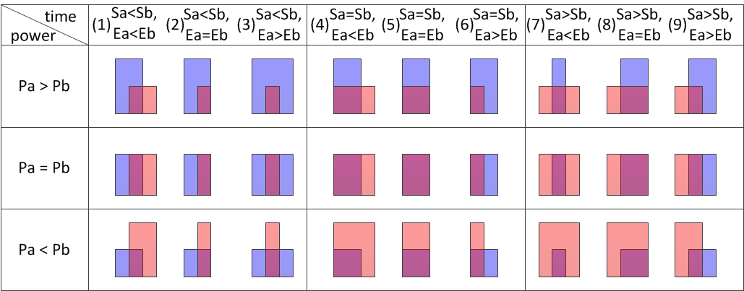
Example of classification of Collision Type
: Frame A
: Frame B(interference)
Power
Pa
Pb
t
Sa
Ea
Sb
Eb
Type I
transmitter of frame B
cannot sense frame A
Type II:
transmitters of A and B choose same backoff
Type III
transmitter of frame A
cannot sense frame B

Slide 8
Collision Control (2) Example of control using collision type information
Example of collision | Collision type | Collision control by transmitter of frame A
 | Type I: transmitter of frame B cannot sense frame A | Increase transmission power
 | Type II: transmitters of A and B choose same backoff | Increase CWmin
 | Type III: transmitter of frame A cannot sense frame B | Decrease CCA level
: Frame A
: Frame B(interference)

Slide 9
1. use power time series information from additional circuits on WLAN card or additional power signal sensor[7]
Examples of FCD methods(1)
(a) Evaluate the signals before start and after end of frame
frame collision pattern
sensed signals
Interference signals
Threshold
interference
時間
frame A
(b) Evaluate the power increase of the frame
Power increase caused by
interference
Threshold
interference
frame A
(c) Evaluate the power variance of the frame
Power fluctuation caused
by interference
interference
frame A

Slide 10
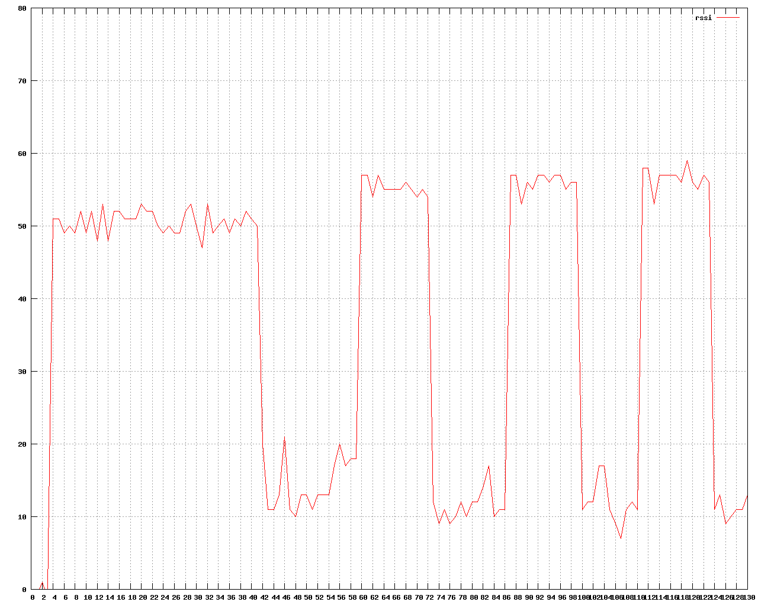
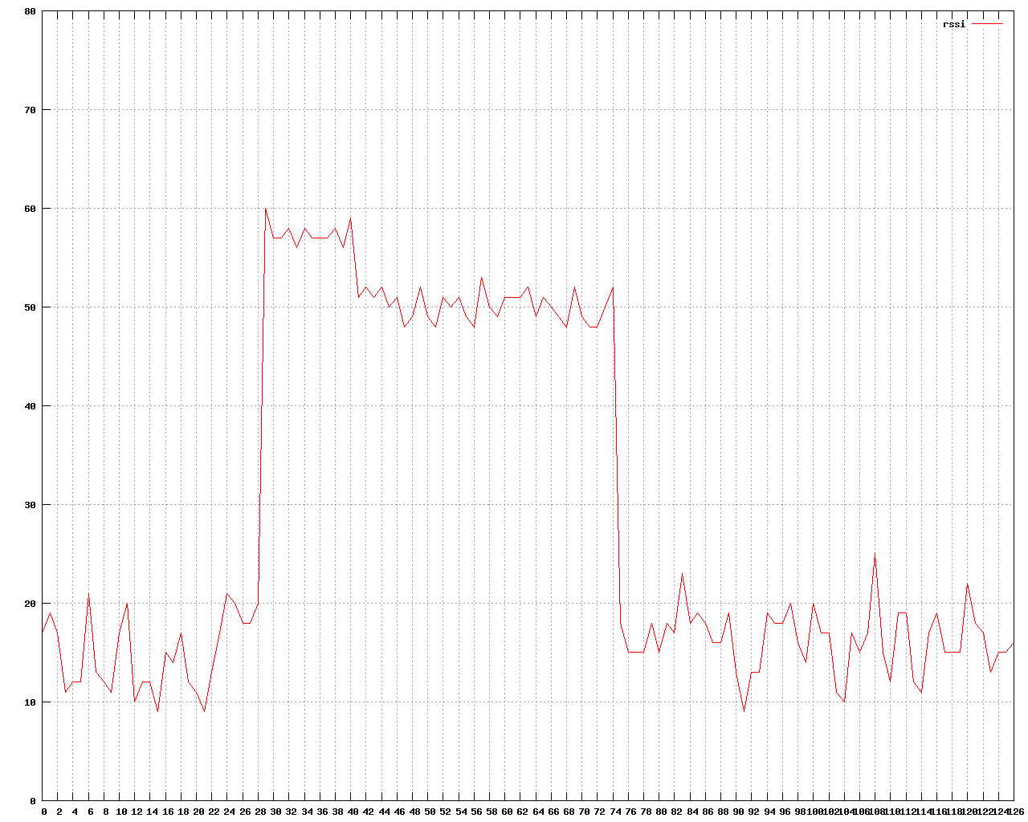
Examples of FCD methods(2)
use PHY state information [5] from transmit mode of WLAN card
use RSSI information from spectral scan mode [6] of WLAN card
count
tx_frame/2
rx_clear
time
power
power
RSSI
RSSI
Frame-B
Frame-A
Frame-A
Frame-A
Frame-A + Frame-B
time
time

Slide 11
Summary and Next Steps
Frame Collision Detection (FCD) information is necessary for reducing Frame Collisions in 11ax scenarios.
Various methods have been proposed for FCD
For example, FCD can be implemented at transmitter by analyzing power variation
FCD information can be used to improve performance of various control schemes
For greater effect, information of collision TYPES can be used.
Next
Propose method for handling FCD information in 11ax

Slide 12
Straw Poll
Do you agree that TGax should support a frame collision information?
Yes
No
Abstain

Slide 13
References
[1] “MAC Efficiency Analysis for HEW SG”, IEEE 802.11-13/0505r0, Minyoung Park (Intel)
[2] “Possible Approaches for HEW”, IEEE 802.11-13/0758r0, Katsuo Yunoki (KDDI Labs)
[3] “Understanding Current Situation of Public Wi-Fi Usage - Possible Requirements for HEW -”, IEEE 802.11-13/0523r2, Katsuo Yunoki (KDDI Labs)
[4] “Consideration on Efficiency Enhancement”, IEEE 802.11-13/0854r1, SangHyun Chang (Samsung
[5] “Fwd: FW: Channel busy cycles”, ath9k-devel ML, http://article.gmane.org/gmane.linux.drivers. ath9k.devel/9887/
[6] “ath9k spectral scan”, http://wireless.kernel.org/en/users/Drivers/ath9k/spectral_scan/
[7] P. Shao, IEICE Technical Report, SIP2012-125, p259-264, March 2014

Slide 14
Backup: rx_clear count & tx_frame count
power
symbol of frame
time
sampled data
0
2
4
4
4
4
2
0
time
rx_clear count/
tx_frame count
time
:0
:1

