Slide 1
Calibration of System Level Simulators
Date: 2014-07-14
Authors:

Slide 2
Outline
Abstract
Scenario1
Parameters
Results
Scenario3
Parameters
Results
Conclusions
Reference

Slide 3
Abstract
Simulation calibration verifies that simulators generate the same results on the same simulation scenario
Calibration improves simulations reliability
The presentation shows the calibration results for HEW scenario 1 and scenario 3 [1] with different channel allocation

Slide 4
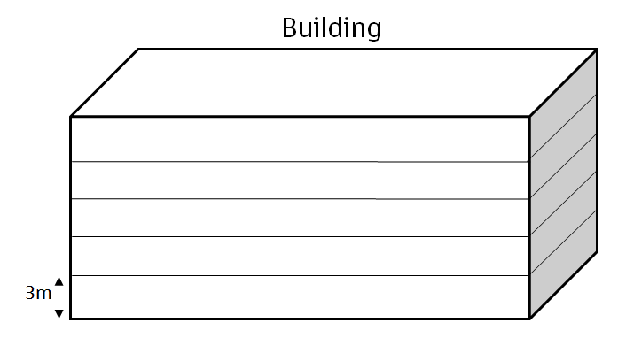
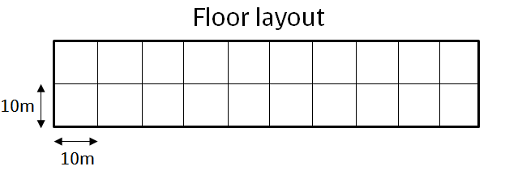
Scenario 1 and Parameters
Scenario:
5 floors building with 20 rooms (10x10x3) per each floor
One AP per each room, x and y randomly chosen, z=1.5
Same parameters as in [1], except:
Pathlos: 11nB
Wall loss: 12 dB
Floor loss: 17dB + 4dB per floor
TX Power: STA= 15dBm; AP= 20dBm;
1x1 antenna with 0dBi for AP’s, -2dBi for STAs
Full buffer traffic model
Static MCS7: 64QAM 5/6

Slide 5
Simulation Results
The presentation explains and shows results to following metrics:
SINR
Throughput
Number of concurrent transmissions
The results are presented for the following parameters:
Traffic: DL/UL
Number of STAs: 200, 1000

Slide 6
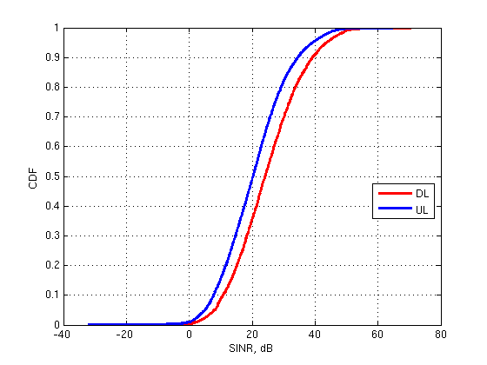
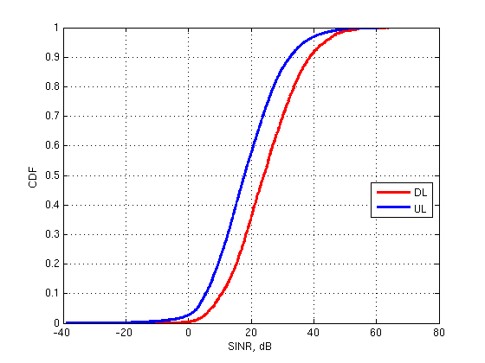
SINR
These figures show the CDF of SINR per MPDU containing user data
Left and right figures show SINR performance of 2 and 10 STAs per AP respectively

Slide 7
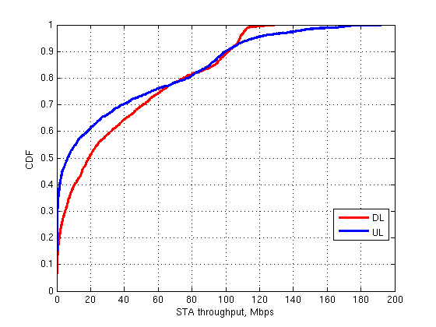
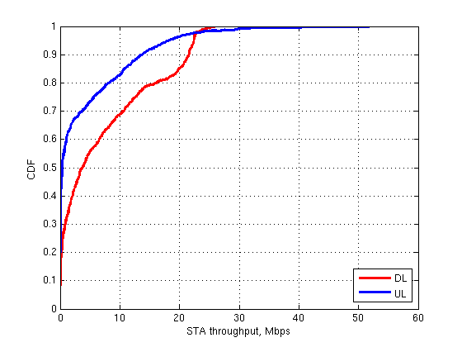
CDF of STA Throughput
Left and right figures show STA throughput performance of 2 and 10 STAs per AP respectively

Slide 8
Number of Concurrent Transmissions Statistics
The number of concurrent transmissions statistics shows the number of transmitting devices at the same symbol
This metric does not show the number of successful transmissions
The number of concurrent transmissions indicates the level of channel reuse
The physical and virtual carrier sensing affect to the number of simultaneous transmissions
EDCA parameters, number of competing STAs and traffic amount affect to the number of simultaneous transmissions
The number concurrent transmissions affects to the interference level

Slide 9
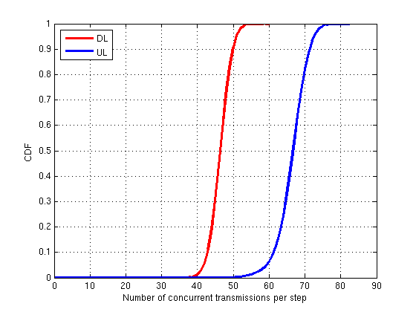
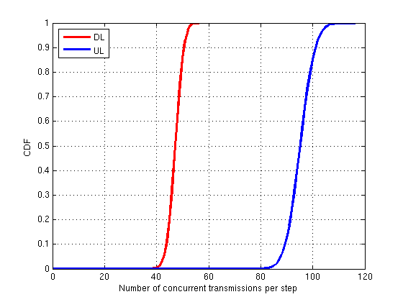
Number of Concurrent Transmissions
Left and right figures show the number of concurrent transmissions of 2 and 10 STAs per AP respectively

Slide 10
Scenario 3 and Parameters
Same parameters as in [1], except:
Pathlos: 11nD
TX Power: STA= 15dBm; AP= 20dBm;
1x1 antenna with 0dBi for AP’s, -2dBi for STAs
Full buffer traffic model
Static MCS7: 64QAM 5/6

Slide 11
Simulation Results
The presentation explains and shows results to following metrics:
SINR
Throughput
Number of concurrent transmissions
The results are presented for the following parameters:
Traffic: DL/UL
Number of STAs: 570

Slide 12
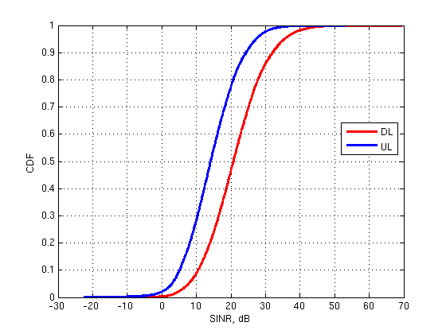
SINR

Slide 13
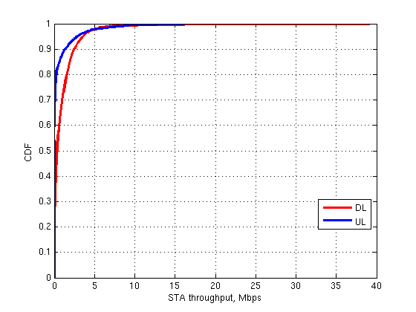
CDF of STA Throughput

Slide 14
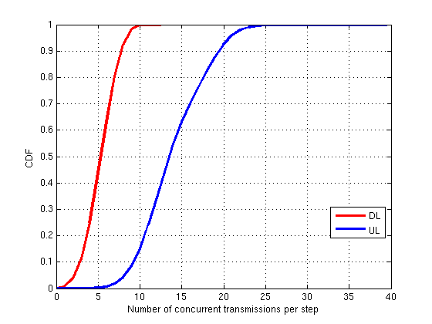
Number of Concurrent Transmissions

Slide 15
Conclusions
The presentation shows the calibration results for HEW scenario 1 and HEW scenario 3

Slide 16
References
[1] 11-14-0621-04-00ax-simulation_scenarios

