Slide 1
Generic Service Discovery Proposal: Dynamic Bloom Filter Operation
Date: 2014-07-14
Authors:

Slide 2
Agenda
Problem Statement & Design Goals
Challenges
Propose Solution: Dynamic Bloom Filter Operation
Conclusion

Slide 3
Design Goals
In designing a pre-association service discovery protocol, the following requirements must be met
  Goal 1: Efficiency- light weight discovery to not congesting the wireless network and save battery life of portable devices
  Goal 2: Speed of discovery- quickly identifying the right devices that offer the service for better user experience
  Goal 3: Scalability- ability to support beyond the typical number of services offered in the network

Slide 4
Challenges
Only limited information can be included in the beacon and probe response: How to reduce overhead?
Scalability issues: how to support practically large number if not unlimited number of services for future extensibility?
How to handle in use case (like in mall, airport) where a lot of STAs queries for services?

Slide 5
Proposal: Dynamic Bloom Filter Operation
Assumption: The Pre-association Service Discovery protocol is built on top of ANQP based 802.11u frame work currently used in Passpoint. It is important to note that the proposed solution can be equally applicable to other framework
To meet the design goals and alleviate the challenges highlighted in the previous slides, the Service information IE (see slide 6) is proposed to enable flexible pre-association service discovery based on dynamic Bloom filter operation.
AP should have the flexibility to advertise directly several services that are commonly used in a particular scenario (what services to be advertised directly is out of scope) e.g. in Mall, maybe a directory/map service with location service, on-sale and coupon service vs printing service

Slide 6
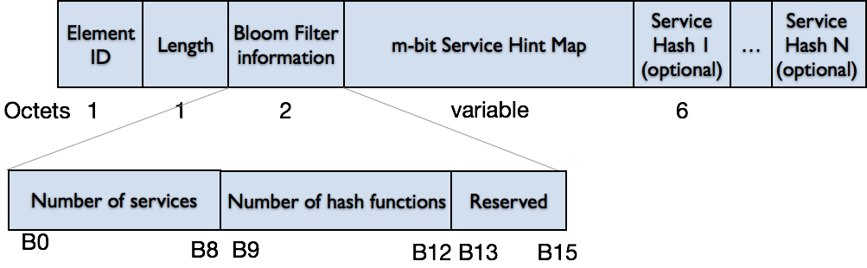
Option 1: Service Information IE
Element ID field is TBD
Length field is 1 bytes whose value is set to 1 + (m/8) + 6N. Note that m can be derived from the Bloom Filter Information field and thus there is no need to have an extra length field separately to indicate the length of the variable m-bit Service Hint Map
Bloom Filter Information is 2 byte
  B0-B8 are used to indicate the maximum number of services, n that can be offered by the AP. The maximum number of services are 512
  B9-B12 are used to indicate the number of hash functions, k (out of total of 16) used by the Bloom filter. e.g. 0001 means the first 2 hash functions (i.e. H1 and H2) will be used
  B13-B15 are reserved
Service Hash field is an optional field up to N number of Service Hashes

Slide 7
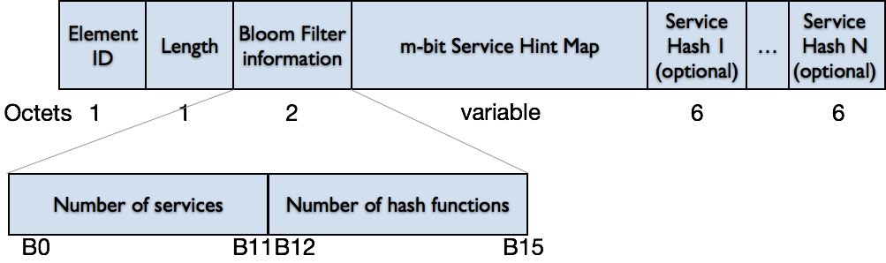
Option 2: Service Information IE
Element ID field is TBD
Length field is 2 bytes whose value is set to 1 + (m/8) + 6N. Note that m can be derived from the Bloom Filter Information field and thus there is no need to have an extra length field separately to indicate the length of the variable m-bit Service Hint Map
Bloom Filter Information is 2 byte
B0-B11 are used to indicate the maximum number of services, n that can be offered by the AP. The maximum number of services are 4096
B12-B15 are used to indicate the number of hash functions, k (out of total of 16) used by the Bloom filter. e.g. 0001 means the first 2 hash functions (i.e. H1 and H2) will be used
Service Hash field is an optional field up to N number of Service Hashes
Note: The Service Hint Map plus Bloom filter information plus Service Hash may not fit into a single element and therefore the data following the
length field of a Service Hash (if present) or Service Hint Map, a fragmentation using Fragment elements

Slide 8
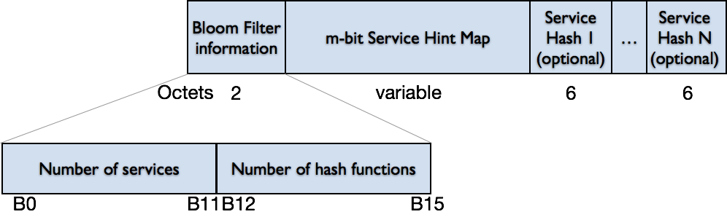
Option 3: Service Hint Map
Name | Type | Length (Octets) | Value | Scope/Country Code
Service Hint Map | TBD | variable | See below figure | N/A
Length field is variable length bytes up to 2304 bytes, whose value is set to 2 + (m/8) + 6N. Note that m can be derived from the Bloom Filter Information field and thus there is no need to have an extra length field separately to indicate the length of the variable m-bit Service Hint Map
Bloom Filter Information is 2 byte
B0-B11 are used to indicate the maximum number of services, n that can be offered by the AP. The maximum number of services are 4096
B12-B15 are used to indicate the number of hash functions, k (out of total of 16) used by the Bloom filter. e.g. 0001 means the first 2 hash functions (i.e. H1 and H2) will be used
Service Hash field is an optional field up to N number of Service Hashes

Slide 9
Dynamic Bloom Filter Operation (1)
The m-bit Service Hint Map provides hint of the services offered by the infrastructure AP/STA in a compact way than directly advertising individual services (Goal 1 and 3)
Operation steps/procedures:
  AP selects numbers of services, n to be advertised
  AP selects an acceptable false positive rate, P_{f}, depending on the design tradeoff and computes the required number of hash functions, k
  AP computes value of m i.e. the Bloom filter size based on k and n values
The STA can infer the value of P_{f} by decoding the Service Information IE from the received beacons.
If P_{f} turns out to be low (e.g. <1%), then STA may directly send GAS Query to obtain more information about the service since STA has high confidence that the service was indeed provided by the network (Goal 2)
If P_{f} turns out to be high (e.g. >10%), STA may want to send Probe Request to confirm the right service before sending GAS Query

Slide 10
Dynamic Bloom Filter Operation (2)
If the number of services offered by the AP is large and P_{f} is low, AP may not include Service Hash(es) in the Beacon
Service Hash field is an optional field which may be included in the beacon to reduce STAs from flooding the network with probe requests. The protocol enables up to N Service Hashes may be included. This enables the direct advertisement of commonly used services (which scenario/deployment specific) than providing hint (Goal 1). Any additional Service Hashes are available via ANQP query

Slide 11
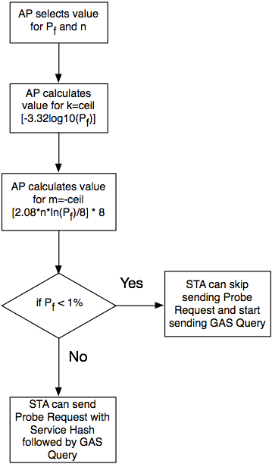
Dynamic Bloom Filter Operation (3)

Slide 12
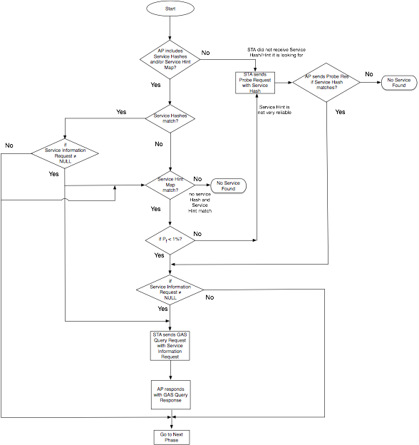
Example of Pre-association Discovery Flow

Slide 13
Hash Functions for Bloom Filter
B12-B15 | Hash Function
0000 | H1
0001 | H2
0010 | H3
0011 | H4
0100 | H5
0101 | H6
0110 | H7
0111 | H8
1000 | H9
1001 | H10
1010 | H11
1011 | H12
1100 | H13
1101 | H14
1110 | H15
1111 | H16

Slide 14
Service Hint-Map vs Service Hash Efficiency
A Bloom filter with P_{f} of 0.001, 0.01, 0.1 and an optimal value of k (10, 7, 4) , requires m of 14.4, 9.6, 4.8 bits per element, respectively — regardless of the size of the elements.
Compare to Hash-value this is 70%, 80%, 90% reduction in space
The P_{f} decreases as m increases, and increases as n increases.

Slide 15
Conclusions
The proposed Pre-Association Service Discovery Protocol based on Dynamic Bloom Filter Operation meeting the goals of
  ^{Efficiency}
  ^{Speed of discovery}
  ^{Scalability}
The protocol is very flexible and can be deployed in many different scenarios e.g. Wi-Fi Infrastructure and P2P network

