Slide 1
Impact of CCA adaptation on spatial reuse in dense residential scenario
Date: 2014-07-14
Authors:

Slide 2
Background and Motivation
CCA threshold adaptation
CCA threshold adaptation was investigated in [1]
It was observed that at least 2X gain in throughput metrics (mean and 5% throughput) by increasing threshold to the [-70,-60] dBm
In this contribution:
Integrated PHY-MAC simulations take into account MAC protocol (impact of backoff, collisions, retransmissions, MAC overhead, etc.)
Approach 1: Joint adaptation of CCA threshold and receiver (Rx) sensitivity to allow channel spatial reuse
Transmission is deferred when a PHY header is decoded (at the lowest Rx sensitivity)
CCA threshold = Rx sensitivity is varied

Slide 3
Background and Motivation (cont)
BSS Color Concept
BSS Color concept, introduced by 11ah, is evaluated in [2]
It is observed that increasing CCA level with BSS Color can improve spatial reuse in HEW BSS and boost the throughput
In this contribution (Approach 2:)
Transmissions within BSS deferred based on the lowest sensitivity level (to prevent intra-BSS collisions)
OBSS CCA threshold variation is evaluated in a dense scenario
Assume all OBSS transmissions can be distinguished, i.e. no quantization effects due to finite number of color bits

Slide 4
Simulation Setup
Integrated PHY/MAC Simulator
PHY+MAC layers
Network layout and radio environment
Traffic generation
Indoor Scenario
Residential scenario defined in [3]
One randomly distributed AP per room at 1.5m above floor level
2 randomly distributed STAs per AP at 1.5m above floor level
Residential Scenario [3]
3 m
Floor layout
10 m
10 m

Slide 5
Simulation Parameters
Parameter | Value
PHY Mode | 802.11ac / 80 MHz channels / 5 GHz
Number of non-overlapping channels | 1 and 3 (random assignment)
CCA Approach | BSS Color / Rx Sensitivity Adaptation
Tx Power / Antenna Gain | AP: [ 20 dBm / 0dB ], STA: [ 15 dBm / -2dB ], 1x1
MAC | EDCA (RTS/CTS off), implicit BAR. A-MPDU aggregation (Max = 64 MPDUs)
Traffic Model | Full-Buffer, Packet size 1500B (AC_VI)
Propagation Model | TGac B indoor, 5 dB wall with linear sum and 18.3 dB floor with nonlinear sum [3] Shadowing: iid with 5 dB standard deviation for every link
Link Adaptation | SINR-based
MCS Indexes | 0-8 (Lowest: BPSK ½ , Highest: 256QAM 3/4)
Noise Figure | 7 dB
PHY Abstraction | EESM

Slide 6
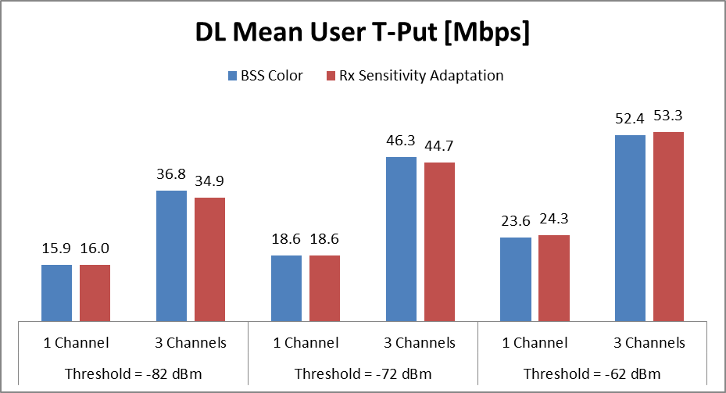
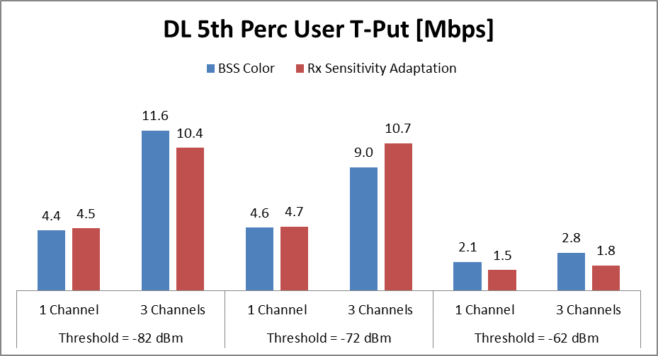
Results: 100% DL Full-Buffer (Throughput)
BSS Color
Threshold = OBSS Color CCA Threshold
Rx Sensitivity Adaptation
Threshold = CCA Threshold = Lowest Rx sensitivity
Mean Throughput
Increasing CCA threshold improves channel spatial reuse leading to higher mean thrroughput
Both RxSensitivity adaptation and color bit based CCA adaptation have similar improvements
Increasing the CCA threshold leads to maximum mean throughput gain of ~52%
5% Throughput
Increasing CCA threshold raises interference level and reduces throughput for less favored users
Rx sensitivity adaptation becomes slightly worse than BSS Color for higher thresholds

Slide 7
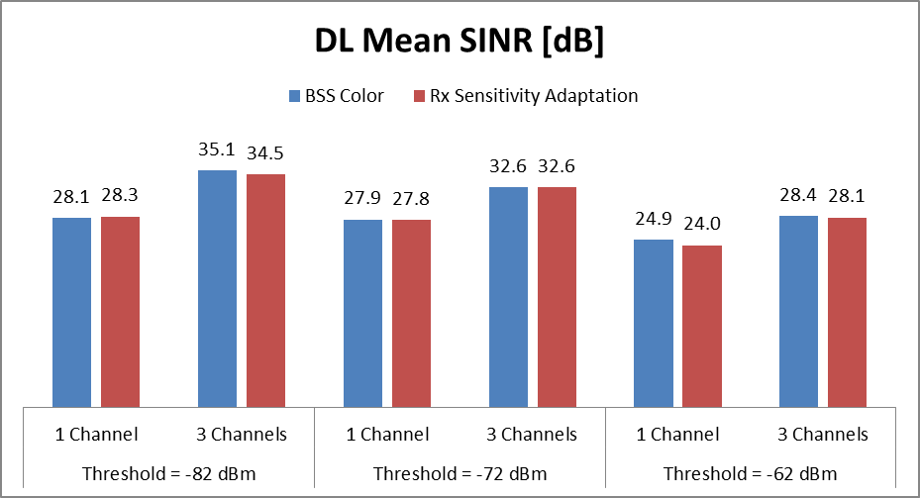
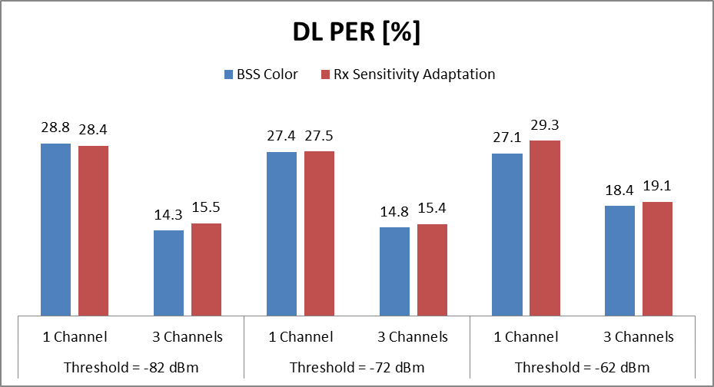
Results: 100% DL Full-Buffer (PER and SINR)
BSS Color
Threshold = OBSS Color CCA Threshold
Rx Sensitivity Adaptation
Threshold = CCA Threshold = Lowest Rx sensitivity
SINR
Increasing threshold decreases SINR. However, the observed SINR levels are still reasonably high
PER
Increasing threshold increases interference leading to higher PER
Both CCA approaches have similar effect on PER

Slide 8
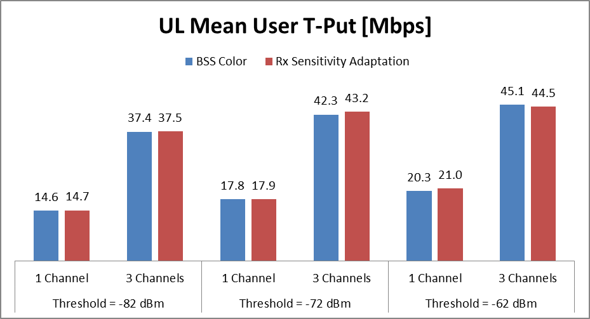
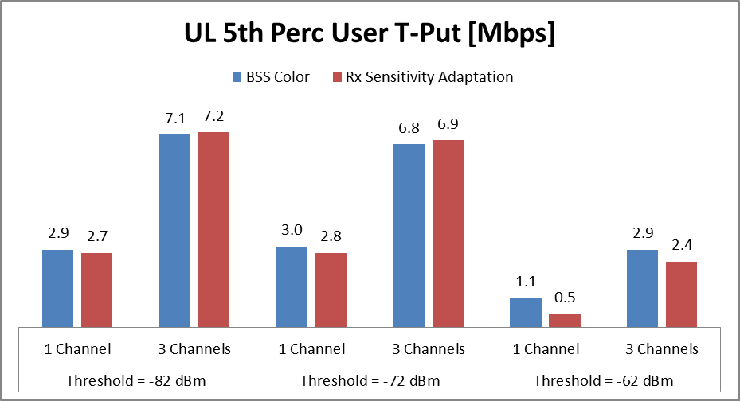
Results: 100% UL Full-Buffer (Throughput)
BSS Color
Threshold = OBSS Color CCA Threshold
Rx Sensitivity Adaptation
Threshold = CCA Threshold = Lowest Rx sensitivity
Mean Throughput
Increasing threshold improves channel spatial reuse
Both CCA approaches have similar improvements
Increasing the threshold leads to mean throughput gains: up to 42% for the 1 channel and 20% for 3 channels scenario
Lower gains campared to DL due to intra-BSS collisions and lower SINRs
5% Throughput
Increasing threshold rises interference. However, a trade-off between simultaneous transmissions (channel reuse) and interference is observed for less favored users
Rx sensitivity adaptation performs worse than BSS Color for -62 dBm case

Slide 9
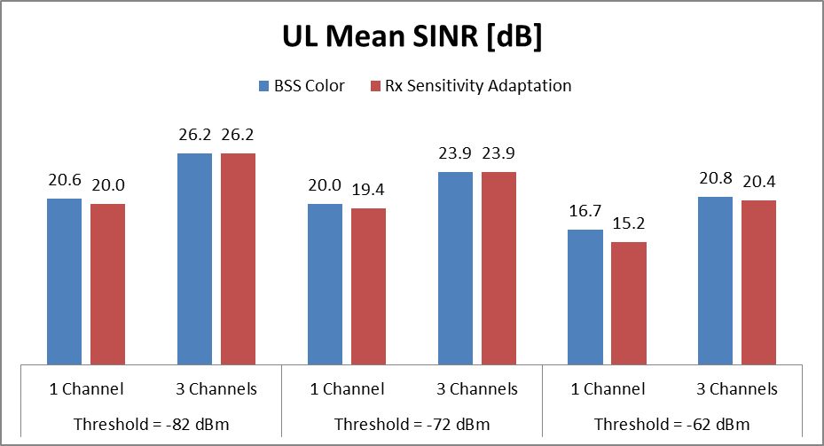
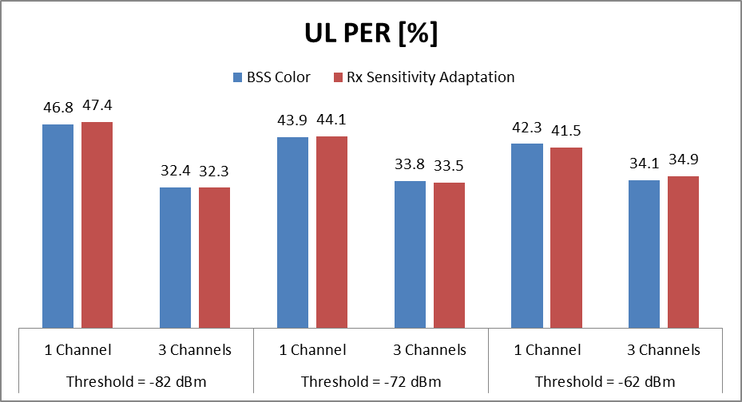
Results: 100% UL Full-Buffer (PER and SINR)
BSS Color
Threshold = OBSS Color CCA Threshold
Rx Sensitivity Adaptation
Threshold = CCA Threshold = Lowest Rx sensitivity
SINR
Increasing threshold decreases SINR. However, the observed SINR levels are still high
PER
Increasing threshold increases interference.
Increased collisions lead to a high PER

Slide 10
Conclusions
Both CCA approaches (BSS Color and Rx Sensitivity Adaptation) can lead to higher spatial reuse
By including MAC protocol, mean throughput gains around 18-52% are observed (gains are dependent on scenario)
However, increased spatial reuse also increases the interference and 5-percentile throughput degrades significantly
Mechanisms to deal with high interference and coordinate OBSS transmissions would be required to maximize these gains
Need to investigate the achievable gains in different scenarios (e.g., outdoor) and heterogeneous environments (e.g., in presence of legacy nodes or apartment building scenario with different BSS’s using different CCA levels)

Slide 11
References
[1] IEEE 802.11-14/0082r0 – Improved Spatial Reuse Feasibility – Part I
[2] IEEE 802.11-14/0372r2 – System Level Simulations on Increased Spatial Reuse
[3] IEEE 802.11-14/0621r4 – TGax Simulation Scenarios
[4] IEEE 802.11-14/0523r0 – MAC simulation results for DSC and TPC
[5] IEEE 802.11-14/0635r1 – DSC Implementation
[6] IEEE 802.11-14/0578r0 - Residential Scenario CCA/TPC Simulation Discussion
[7] IEEE 802.11-14/0628r0 - Measurements on CCA Thresholds in OBSS Environment

