Slide 1
DSC and Legacy Coexistence
Date: 14/07/2014
Authors:

Slide 2
Abstract
Dynamic Sensitivity Control (DSC) techniques as discussed to date in TGax have shown promise to improve TGax STA performance.
However, TGax STA improvements using DSC should not adversely affect performance of legacy STAs.
Effects of DSC in mixed networks therefore needs careful study and proper mitigation methods should be considered.

Slide 3
Introduction
DSPG’s presentation (11-14-0779-00-00ax-dsc-practical-usage) says,
Legacy STA in the same network as a DSC STA is completely unaffected by the DSC STAs.
The legacy STA may be held off from transmitting by STA in OBSS, but will compete equally with DSC STAs in same BSS
As other DSC STAs will ignore OBSS STAs their traffic is often occurring during a time when the legacy STA cannot TX, and hence overall contention is lessened.
This effect cannot be ignored in the evaluation of 11ax.

Slide 4
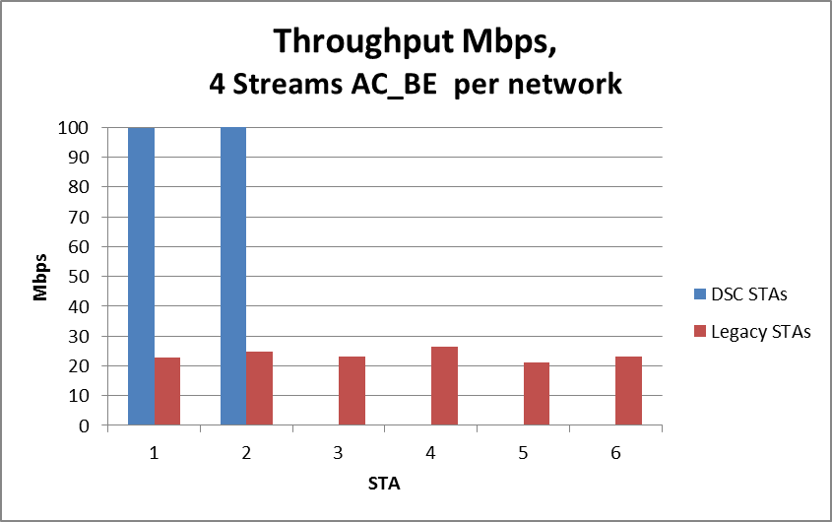
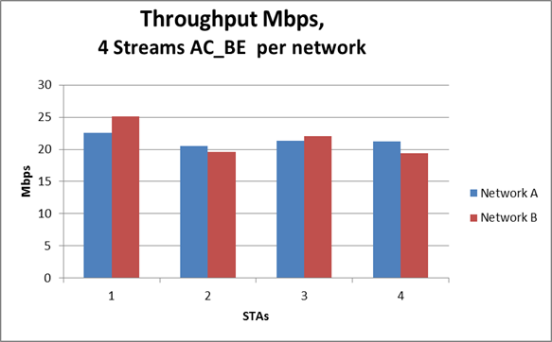
DSPG’s Simulation Results
Quoted from:
11-14-0779-00-00ax-dsc-practical-usage
DSC 100Mbps
Legacy ~22Mbps
DSC Network with
2 DSC STAs
2 Legacy STAs
OBSS Network
4 Legacy STAs
Legacy ~22Mbps
Legacy STAs are not affected
BUT look at the DSC STAs!

Slide 5
Simulation Conditions
Each STA sends uplink UDP traffic (Full-buffer condition).
See backup slide for more detail.
Case 1 (2 STAs per BSS)
DSC STA or Legacy STA
DSC STA or Legacy STA
Legacy STA
Legacy STA
3m
50m
3m
AP1
Packets from OBSS can be detected by only Legacy STAs. (See next slide)
AP2
Each STA is close enough to their AP so that each link satisfies the required SNR for used MCS, even if interference from OBSS is observed.
Case 2 (24 STAs per BSS)
3m
50m
3m
AP1
Packets from OBSS can be detected by only Legacy STAs.
AP2

Slide 6
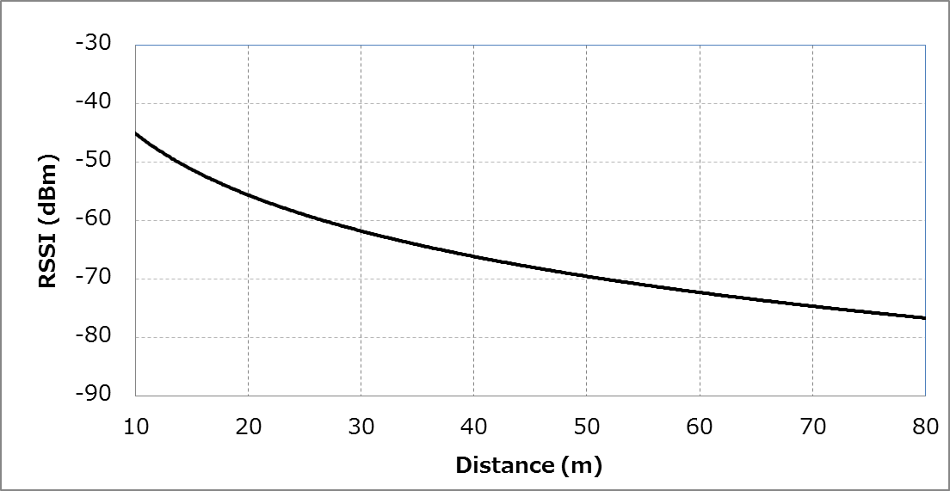
Simulation Conditions (Relation between preamble detection threshold and distance from OBSS)
Receive level when Tx power is +15dBm
(Note)
Propagation loss model of TGn is used.
Fluctuation by fading is
not illustrated.
Preamble detection
threshold for DSC STA
set to -62 dBm
DSC STA cannot detect
packets from OBSS
Legacy STA can detect
packets from OBSS
Preamble detection
threshold for Legacy STA
set to -82 dBm

Slide 7
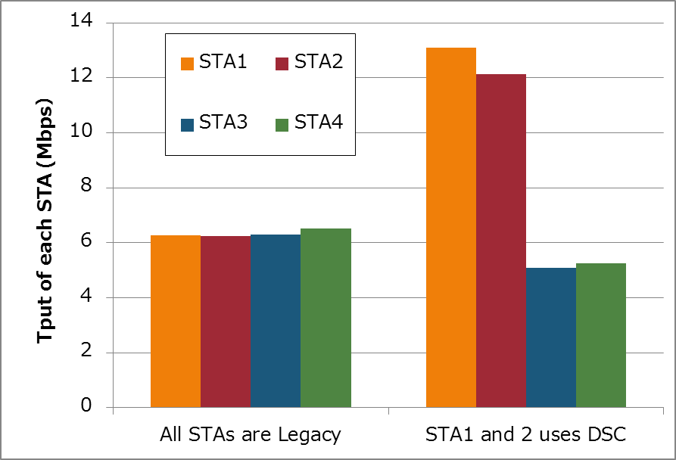
Simulation Results (Case 1: 4 STAs)
STA1
STA2
50m
STA1 (DSC STA or Legacy STA)
3m
3m
STA2 (DSC STA or Legacy STA)
AP1
AP2
STA3 (Legacy STA)
STA4 (Legacy STA)
STA3
STA4
If the number of STAs is few,
there is less difference of Legacy STAs’ performance.
But...
DSC
Legacy

Slide 8
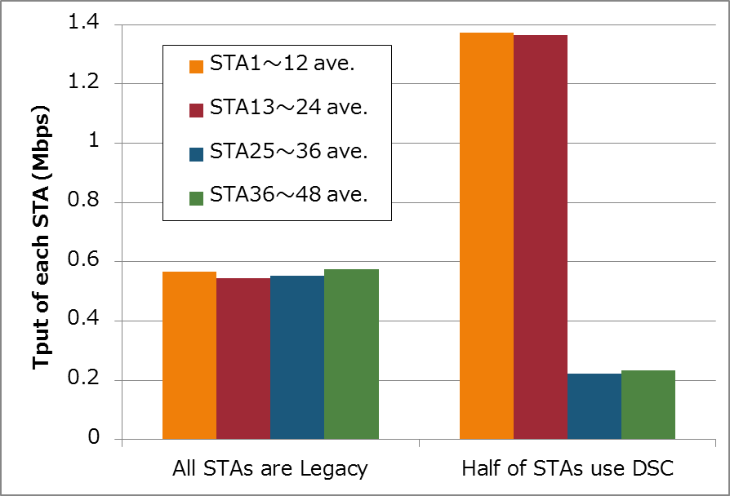
Simulation Results (Case 2: 48 STAs)
3m
50m
3m
STA1~12 (DSC STA or Legacy STA)
AP1
AP2
STA13~24 (DSC STA or Legacy STA)
STA25~36 (Legacy STA)
STA37~48 (Legacy STA)
As the number of STAs increases,
there is noticeable performance degradation of Legacy STAs.
DSC
Legacy
It is not negligible, especially in a dense scenario.

Slide 9
Simulation Results (Throughput Summary)
Case 1 (2 STAs per BSS)
Case 2 (24 STAs per BSS)
Throughput [Mbps] | All STAs are Legacy | STA1 and 2 use DSC
System Total | 25.32 | 35.60
DSC Total (per STA) | - | 25.25 (12.62)
Legacy Total (per STA) | 25.32 (6.33) | 10.35 (5.18)
Throughput [Mbps] | All STAs are Legacy | Half of STAs use DSC
System Total | 26.91 | 38.36
DSC Total (per STA) | - | 32.86 (1.37)
Legacy Total (per STA) | 26.91 (0.56) | 5.50 (0.23)
40% Up
42% Up
18% Down
59% Down
Throughput degradation for Legacy STA
depends on the number of STAs.

Slide 10
Summary
The impact of using DSC in TGax on other Legacy STA exists and is not negligible.
As the number of STAs increases (e.g., dense scenarios), the degradation on performance of Legacy STAs also increases.
Suggest to evaluate impact on fairness with legacy STAs when conducting DSC simulations.

Slide 11
Backup

Slide 12
Simulation Conditions
Node & Topology | See right figures
Traffic Model & Load | Uplink UDP 100Mbps (from all STA)
Traffic Duration [sec] | 20
Access Category | AC_BE (CWmin=15, CWmax=1023, AIFSN=3)
Tx Power [dBm] | +15dBm
MCS | MCS5 (52Mbps) Fixed
Packet Length [byte] | (MPDU, MSDU, APP)=(1530, 1500, 1472) Fixed
L2 Retry | 10
Ack Rate | MCS0 Fixed
RTS/CTS | Disabled
Aggregation | Disabled
Channel | (Propagation, Shadow, Fading)= (TGn, Disabled, Flat Rayleigh)
Preamble Detection Threshold. [dBm] | -62 (on DSC STA, AP), -82 (on Legacy STA)
Energy Detection Threshold [dBm] | -62
Channel Setting [MHz] | (Center Freq, BW)=(2412, 20)
Detection Cancel behavior on PLCP error | Not emulated
DSC STA or Legacy STA
DSC STA or Legacy STA
Legacy STA
Case 1
Legacy STA
3m
50m
3m
AP1
AP2
Case 2
3m
50m
3m
AP1
AP2

Slide 13
Confirmation of simulation conditions
What is the behavior of each STA when PLCP header has an error ?
Is Rx canceled or does it continue to receive?
Does AP also enable DSC ?

Slide 14
Behavior of DSC and Rx cancel on PLCP error
DSC
Preamble
SIG
Data
STA
Not detect due to
high threshold
AP
Rx cancel on PLCP error
Preamble
SIG
Data
STA
Detect depend on preamble level
When CRC of SIG is error,
Then Rx is cancelled.
Rx
“Busy” or “Idle” depends on Energy-Detection result
AP

