Slide 1
Discussion on dual-link STR in IEEE 802.11ax
Date: 2014-07-16
Authors:

Slide 2
Introduction
In-band STR is emerging as a novel technique which could lead a great throughput enhancement
In order to meet the level of enhancement in IEEE 802.11ax PAR, in-band STR is expected to play a key role
  4(~10) times greater
  However, feasibility and effective throughput enhancement need further study
Especially, Dual-link setup could be one of the most crucial procedure defining the time average throughput enhancement
Along with technical analysis, it is a good time to setup a plan for STR in 802.11ax

Slide 3
Summary of Previous Contributions
A number of H/W level approaches implementing STR on 802.11.
  Up to ~110dB Self Interference Cancellation(SIC) was achieved by antenna, analog and digital cancellation[1].
Reference | Cancellation (dB) |  |  | Total (dB)
 | Antenna | Analog | Digital
Rice | 39~45 | 31~33 |  | 78~80
Stanford(1) | 30 | 20 | 10 | 60
Stanford(2) |  | 60 | 50 | 110
NEC | 55 |  | 20 | 75

Slide 4
Summary of Previous Contributions
MAC level approaches to solve potential problems in applying STR to 802.11 networks
  Protocol adjustment
    Modifying DCF[6], [2], [5], PPDU preamble[3]
    Proposing a new protocol[4]
    Modifying ACK mechanism
  Fairness problem between Legacy and STR devices
    Utilizing EIFS [5]
Considering the H/W and protocol level advances,
STR could be feasible for IEEE 802.11ax.

Slide 5
Dual-link setup for STR
Can STAs perform STR for every single transmission?
  depends on whether there exists any proper STR candidate
Conditions for dual-link setup
  One of the primary link members
  might initiate secondary link
  1) Secondary link must not
  interfere the primary transmission
  2) There must be an available
  pair-wise data between the
  secondary link members
  at the desired transmission time

Slide 6
Expected form of dual-link
The Best dual-link setup is to decide the best secondary pair
  The efficiency of dual-link setup might determine the level of overall throughput enhancement of STR
Expected forms of dual-link setup
  Pair-wise form
    (A↔B, B↔A)
  3-node form
    (A↔B, B↔C)

Slide 7
Pair-wise form (Push)
STA1
STA2
  Push: Primary RX initiates secondary link

Slide 8
Pair-wise form (Pull)
STA1
STA2
  Pull: Primary TX initiates secondary link

Slide 9
3-node form (Push)
STA1
STA2
STA3

Slide 10
3-node form (Pull)
STA1
STA2
STA3

Slide 11
Insights for dual-link setup
Link setup form (interference level)
  Pair-wise form
    Much simpler to initiate the secondary link
    All STR participants must be STR-capable (SIC)
    Less chance to perform STR
  3-node form
    Requires further information to setup the secondary link
    Not every STR participant have to be STR-capable (but STR-awareness)
    More chance to perform STR
Link direction (buffer status)
  Push vs. Pull
    Pushing requires less information, has less chance to perform STR
    Pulling has more chance to perform STR, requires more information

Slide 12
Insights for dual-link setup
Methods for designing dual-link setup schemes
  Coordination-oriented
    Feedback
  Opportunistic
  Hybrid
Reference | Form | Link direction | Method
ContraFlow[2] | Unrestricted | Push | Opportunistic
Simplified STR[3] | 3-Node form | Push & Pull | Hybrid
Janus[4] | Unrestricted | Pull | Coordination
FD-MAC[5] | Pair-wise | Pull | Opportunistic
d-STR[6] | Pair-wise | Pull | Opportunistic

Slide 13
Insights for dual-link setup
APs are highly expected to be the second link initiator
  Considering functional difference between AP and mobile STA
2 phased approach can be expected
  Phase 1) 3-node form (AP centric), Opportunistic (or hybrid),
  push (or both direction)
  Phase 2) Unrestricted form(3-node form + pair-wise),
  Hybrid or coordination, both direction

Slide 14
Conclusion
Dual-link setup is important to fully exploit the spectral efficiency gain of STR
Categories of dual-link setup
  Form: (Pair-wise, 3-node, Unrestricted form), (Push, Pull)
  Method: (Coordination-oriented, Opportunistic, Hybrid)
Expected approach of dual-link setup in 802.11ax
  Phase 1) 3-node form (AP centric), Opportunistic
  Phase 2) Unrestricted form(3-node form + pair-wise),
  Hybrid or coordination
  There is no definite solution for dual-link setup, so far.
Further discussions are necessary to take advantage of STR in 802.11ax

Slide 15
Straw Polls (1)
Should in-band STR feature be considered in 802.11ax (including adoption as an optional feature)? (Y/N/A)

Slide 16
References
IEEE 802.11-13/1122r1, “Considerations for In-Band Simultaneous Transmit and Receive (STR) feature in HEW”
Singh, Nikhil, et al. "Efficient and fair MAC for wireless networks with self-interference cancellation." Modeling and Optimization in Mobile, Ad Hoc and Wireless Networks (WiOpt), 2011 International Symposium on. IEEE, 2011
IEEE 802.11-14/0340r0, “A Simplified Simultaneous Transmit and Receive MAC Proposal”
Kim, Jae Young, et al. "Janus: A novel MAC protocol for full duplex radio." CSTR July (2013)
Duarte, Melissa, et al. "Design and characterization of a full-duplex multi-antenna system for WiFi networks." (2012)
Choi, Y., and Hooman Shirani-Mehr. "Simultaneous transmission and reception: Algorithm, design and system level performance." (2013): 1-19

Slide 17
Appendix

Slide 18
STR Protocols in terms of dual-link setup
ContraFlow[2]: Unrestricted, Push, Opportunistic
  Weighted value table: Proportion of successful secondary transmission in the past
  Pros: no overhead, relatively simple
  Cons: table setup time, opportunistic dual-link setup,
  unstable at highly mobile and dense network

Slide 19
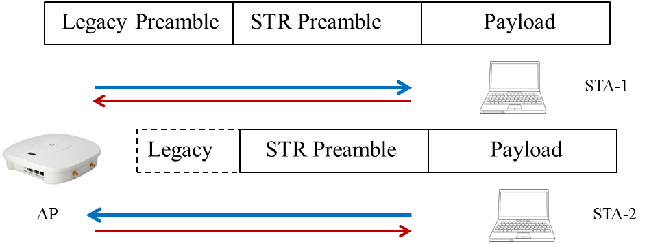
STR Protocols in terms of dual-link setup
Simplified STR[3]: 3-node form, Push & Pull, Hybrid
  Coordination, when the primary link is DL
    Interference/buffer status feedback from STAs
  Opportunistic, when the primary link is UL
  Pros: relatively simple, little modification of existing MAC
  Cons: the amount of feedback could vary severely depending on the mobility and density of network(feedback mechanism is not specified

Slide 20
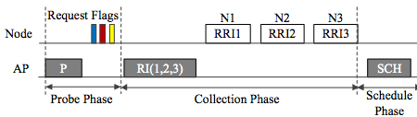
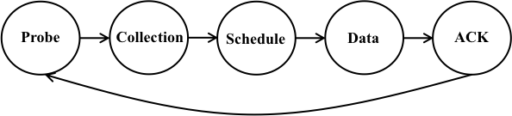
STR Protocols in terms of dual-link setup
Janus[4]: Unrestricted, Pull, Coordination-oriented
  Probe & Collection
  Full scale feedback
    Polling, measured interference level, transmission length
  Pros: coordination gain
  Cons: high overhead, whole new signaling design,
  high variance of coordination gain, feedback delay

Slide 21
STR Protocols in terms of dual-link setup
FD-MAC[5]: Pair-wise, Pull, Opportunistic
d-STR[6]: Pair-wise, Push & Pull, Opportunistic
  existing RTS/CTS, BA based opportunistic STR
  Pros: Simplest, no feedback
  Cons: pair limited, opportunistic

