Slide 1
Date: 2014-07-11
Technical discussion on Re-channelization Proposal for DSRC band coexistence

Slide 2
Agenda
In this document, we address some of the concerns related to band sharing proposal presented 13-1276r1 and 13-1449r2.

Slide 3
Overview of the Proposal
Proposed boundary of UNII4
DSRC Band
DSRC Channels
173
177
161
165
169
173
177
Wi-Fi Channels
80MHz
80MHz
3 Dedicated 10MHz
DSRC high-avail Channels
160MHz
Dedicated DSRC spectrum
  Open only the lower part of the spectrum to UNII devices
  Leave 20MHz or 30MHz dedicated spectrum for DSRC high-avail channels
  Share the Channel 173 and 177 between DSRC service channels and UNII devices
For the shared spectrum
  Encourage 20MHz DSRC service-channel operation → would allow for more effective detection of the DSRC signals
  Develop sharing solutions in IEEE (example: 994r0)
Service channels can also use 802.11n/ac in any 5GHz band for service applications

Slide 4
Previous Technical Concerns Raised
Technical concerns with the band sharing proposal from Slide 3 can be grouped in to 4 areas as following:
  Interference from UNII devices to DSRC
  Cross channel interference between DSRC channels
    Interference from high-power channel to safety of life applications
  Interference from uplink satellites (C-band) to DSRC
  20MHz waveforms are inferior to 10MHz for DSRC applications
In this document, we want to initiate further discussions on these concerns

Slide 5
Concern #1: Unlicensed Device Interference
Consider the following adjacent channel OOBE scenarios
  WLAN OOBE according to recently announced UNII-3 rules
  ISM device OOBE from devices operating in 5725-5850MHz (analog)
Goal: Design a sharing solution that results in unlicensed devices not causing harmful interference to ITS applications

Slide 6
OOBE from WLAN UNII-3 Devices (new rules)
184
172
178
157
161
165
-17dBm/MHz
-27dBm/MHz
WLAN (UNII-3)
DSRC Band
5725
5825
5835
5850
5875
5895
5925
Frequency [MHz]
Consider WLAN operating in Channel 165.
  Allowed Tx power is 30dBm with OOBE restrictions
  Regulatory limit:
    Channel 172 is < 20MHz away from band edge
    Regulatory limit is -17dBm/MHz on the lower 5MHz and -27dBm/MHz on the upper 5MHz
  Practical:
    IEEE Mask is -40dBr @20MHz of band-edge → 30-40=-10dBm/20MHz → -23dBm/MHz OOBE potential
Hence, the OOBE from Channel 165 would be -23dBm/MHz

Slide 7
OOBE from ISM devices (previous and new rules)
Existing PSD limit for ISM band is 33dBm/MHz (8dBm/3kHz), and max power is 30dBm
  This illustrates what is possible under previous and new rules for analog devices
  New FCC rules will prohibit digitally modulated devices, i.e. WLAN, for such operation
ISM band has OOBE rule of only -20dBr from the PSD limit
Max transmit power can be 30dBm. Hence, Ch172 can potentially see maximum +10dBm/MHz OOBE leakage from ISM band
172
178
184
20dBr
ISM Device FCC 15.24
DSRC Band
5725
5825
5835
5850
5875
5895
5925
Frequency [MHz]
Our assumption is that DSRC devices account for such amount of interference

Slide 8
UNII Device OOBE (Proposed)
We previously proposed to have OOBE limits lower than what is possible with existing rules (see Slide 7). We request input from ITS interests on required OOBE limits to channels 180 and 182 with the following constraints:
  Harmful interference to DSRC operation is prevented
  Filtering requirements on the unlicensed WLAN devices are minimal
180
184
182
161
165
169
173
177
U-NII 3
U-NII 4
L1 dBm/MHz
L2 dBm/MHz
Available for WLAN
DSRC Band
5725
5825
5835
5850
5875
5895
5925
Frequency [MHz]

Slide 9
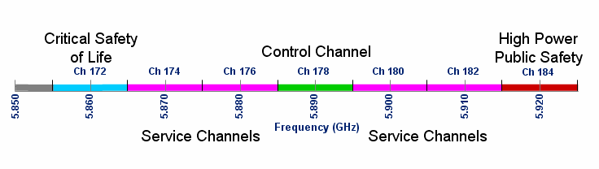
Concern #2: Cross-Channel Interference between DSRC Channels
In current DSRC channelization, service channel and high-avail channels are next to each other with no guard band
  When transmitting at service channel, the leakage could contaminate the reception capability on the high-avail channel [1]
  May be controlled by lowering the maximum allowed power on service channel
  Cross-channel interference has always been a problem between existing service channels and high-avail channels; the proposed channelization does not increase the interference

Slide 10
Concern #3: Interference from Satellite systems
Fixed Satellite Service (FSS) earth stations are licensed on a primary basis both in the DSRC band (5850-5925 MHz) and in the adjacent 5925-6425 MHz band
  Earth-to-Space operation for media and phone applications
  The band is known as C-Band
Concern is that safety channel (172) will move close to the band edge; hence, it will observe more interference from FSS earth stations.
  Limited number of uplink stations for extension band (5850-5925MHz)
  Thousands of stations in the C-band (5925-6425MHz)
We request analysis for collected data from ITS interest on these points so we can more fully engaged.

Slide 11
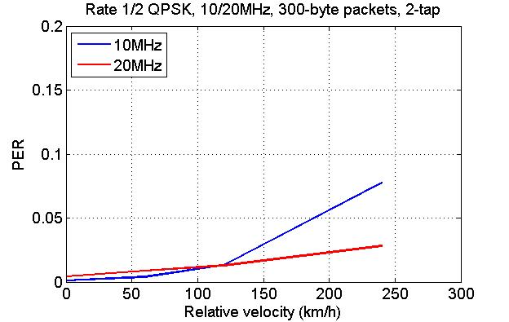
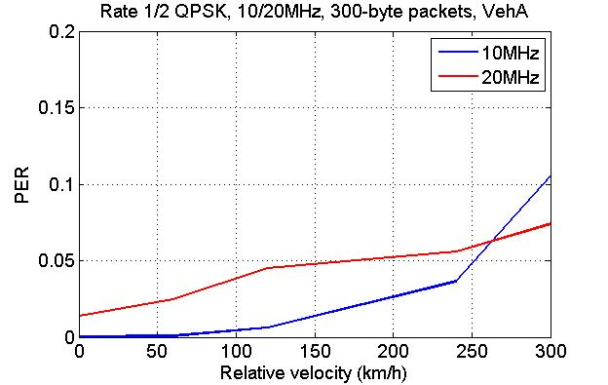
Concern #4: 20MHz Channelization Performance for Service Channel Operation
High-avail channels would still use 10MHz channelization
Comparable performance for most vehicular channels as compared to 10MHz
  20MHz leads to shorter packet transmission and thus better channel tracking in high mobility channel models, as compared to 10Mhz channelization
  20MHz has shorter GI (0.8us) and thus more self-interference when delay spread is longer than GI
Maximum excess delay: 0.5us
Maximum excess delay: 2.5us

Slide 12
Conclusion
In this presentation, we offer a path forward to address ITS concerns
As a next step, we request the following so we can deepen our analysis:
  What would be the required OOBE limits from lower UNII-4?
  Current noise tolerance of DSRC from existing sources
    In-band and out of band FSS
    Radars
    Adjacent-channel unlicensed devices: FCC ISM rules, UNII-rules (wifi)
  DSRC service channel use cases
  DSRC public safety channel scenario analysis
  Views on 20 MHz DSRC service channel performance
  Michigan test report and data
  Additional information as analysis progresses

Slide 13
References
[1] IEEE 802.11 11-07-2133r0
[2] FCC 47.25.202

Slide 14
Appendix

Slide 15
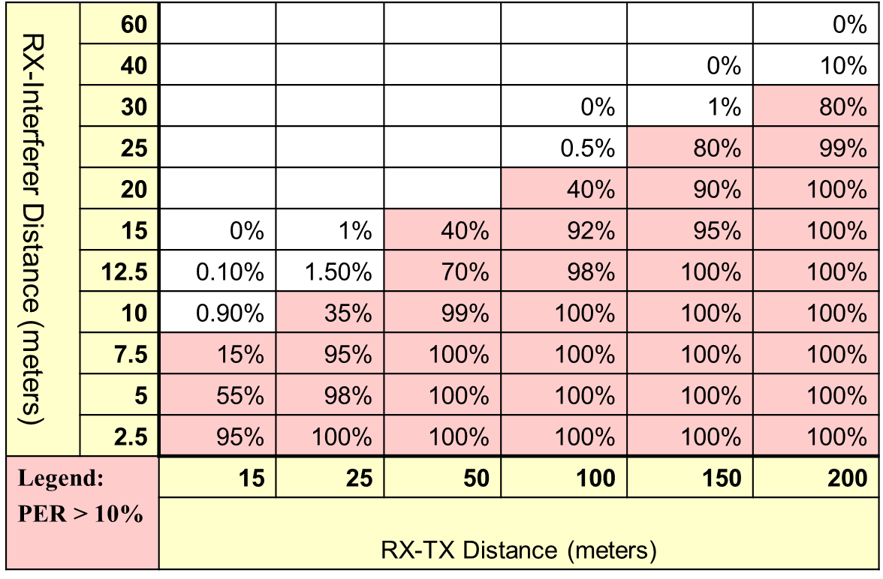
ITC Test Results:
PER for off-vehicle Ch 174 interferer

Slide 16
