Slide 1
Synchronization Requirements
Date: 2014-07-14
Authors:
Name | Affiliation | Address | Email
Yonggang Fang | ZTE |  | yfang@ztetx.com
Bo Sun | ZTE |  | sun.bo1@zte.com.cn
Ke Yao | ZTE |  | ke.yao@zte.com.cn
Kaiying Lv | ZTE |  | lv.kaiying@zte.com.cn
Kaibo Tian | ZTE |  | tian.kaibo@zte.com.cn
Zhendong Luo | CATR |  | luozhendong@catr.cn
Meng Yang | CATR |  | yangmeng1@catr.cn
Jiadong Du | CATR |  | dujiadong@catr.cn

Slide 2
Abstract
The synchronization between AP and multiple STAs is needed for some features, like UL OFDMA, UL MU MIMO and code based contention to improve the spectrum efficiency.
This contribution analyzes the frequency and timing synchronization via comparing the results from difference source and the similar requirements from LTE, and suggests some synchronization requirements in IEEE 802.11 AX specification.

Slide 3
Overview
OFDM system is sensitive to synchronization error. Therefore some features require synchronization error between multiple STAs and AP within a given threshold.
  UL MU OFDMA [8]
  UL MU MIMO [9]
  Enhancement of CSMA/CA [10]
Synchronization requirements contain two aspects:
  frequency synchronization and
  timing synchronization.
Synchronization error would impact system performance.
Each wireless specification needs to give its synchronization requirements so as to achieve the expected system performance in the wireless transmission.

Slide 4
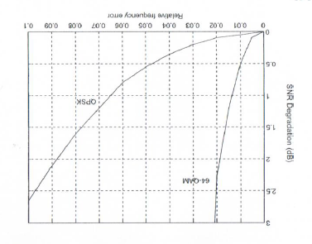
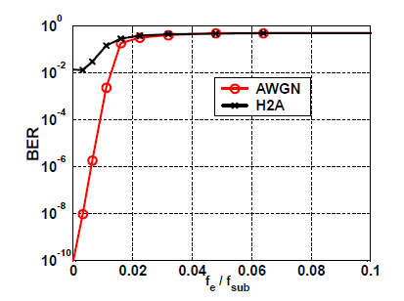
Impact by Frequency Synchronization Error
SNR Degradation
  [1], [2] and [4] give the overall impact on SNR for relative small frequency errors. The degradation could be formulated by
    SNR_{loss} = 10 (πTf_{Δ})²E_{s} /(3ln10) N₀ (dB)
  From the analysis, 1% frequency synchronization error will cause 0.5dB SNR degradation at 64 QAM, or 10-4 BER.

Slide 5
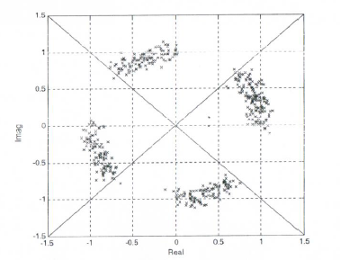
Impact by Frequency Synchronization Error
Constellation Rotation
  Frequency synchronization errors will cause constellation rotation, especially in long frame transmission
  [3] shows the constellation rotation in 10 received symbols at frequency 1% synchronization errors.

Slide 6
Frequency Synchronization Analysis
IEEE802.11 High Throughput PHY Specification [4]
  But it does not define the requirement for the frequency synchronization error between carrier frequency of STA and AP.
Parameters | Requirements | Notes
Transmit center frequency and symbol clock frequency tolerance | ± 20 ppm for 5GHz band ± 25 ppm for 2.4GHz band | = ±100 KHz = 31% error of subcarrier spacing = ±60 KHz = 19% error of subcarrier spacing Subcarrier spacing = 312.5 KHz

Slide 7
Frequency Synchronization Analysis
3GPP Frequency Synchronization [7]
Parameters | Requirements | Notes
BS Frequency Tolerance | ±0.05 ppm (wide area BS) ±0.10 ppm (local area BS) ±0.25 ppm (home BS) | = ±100 Hz = 0.6% = ±200 Hz = 1.3% = ±500 Hz = 3% error of subcarrier spacing (15KHz)
UE Frequency Tolerance | UE carrier frequency shall be accurate to within ±0.1 ppm observed over a period of one time slot (0.5 ms) compared to the carrier frequency received from the E-UTRA Node B
UE Intra-band contiguous carrier aggregation | UE modulated carrier frequencies per band shall be accurate to within ±0.1 ppm observed over a period of one timeslot compared to the carrier frequency of primary component carrier received from the E-UTRA in the corresponding band.
UE UL-MIMO | UE modulated carrier frequency at each transmit antenna connector shall be accurate to within ±0.1 PPM observed over a period of one time slot (0.5 ms) compared to the carrier frequency received from the E-UTRA Node B.

Slide 8
Frequency Synchronization Analysis
Frequency Synchronization Tolerance
  [6] presented the simulation result on the impact of PER-SNR by UL frequency difference among STAs.
  AP has 8 antennas,
  6 STAs with single stream uplink
  MMSE with ideal training but with pilot phase tracking per client
  1000B packets, 64-QAM, rate 5/6, channel D-NLOS
  Frequency errors
  a) 0, b) 2 kHz,
  c) 4 kHz, d) 8 kHz

Slide 9
Proposal - 1
Requirement of Frequency Synchronization
  For 5GHz band, the carrier frequency synchronization error between the carrier frequency of STA and the carrier frequency received from the AP shall be within ±N1 ppm (TBD)
    Note: this will be equivalent to N% (TBD) error at 312.5 subcarrier spacing.
  For the 2.4GHz band, the carrier frequency synchronization error between the carrier frequency of STA and the carrier frequency received from the AP shall be within ±N2 ppm (TBD)
    Note: this will be equivalent to N% (TBD) error at 312.5 subcarrier spacing.

Slide 10
Timing Synchronization Analysis
IEEE 802.11 Timing Requirements
  Assume to use parameters defined in current IEEE 802.11 spec
    In TGn and TGac, the GI (or CP) of symbol is defined as 0.8us.
  Channel Models A-E used for indoor [5].
  Timing synchronization error tolerance may be related to GI (or CP).
 | Channel Model
 | A | B | C | D | E
# of clusters | 1 tap | 2 taps | 2 taps | 3 taps | 4 taps
RMS Delay Spread (ns) | 0 | 15 | 30 | 50 | 100
Max delay (ns) | 0 | 80 | 200 | 390 | 730
Max Cell Size (CP = 800ns) | 120m | 108m | 90m | 61m | 10m

Slide 11
Timing Synchronization Analysis
IEEE 802.11 Timing Requirements
  IEEE 802.11 does not define the timing synchronization requirement between STA and AP.
  The timing synchronization error between the AP and STAs will reduce the delay tolerance in GI/CP for multi-path protection. The more error in the timing synchronization, the less multi-path tolerance. The longer CP, the loose timing synchronization requirement, but it would reduce the efficiency.
Timing Synchronization
Error
Max delay
CP

Slide 12
Timing Synchronization Analysis
3GPP LTE Timing Requirements [7]
  For UL-MIMO
    For UE(s) with multiple transmit antenna connectors, the Time Alignment Error (TAE) shall not exceed 130 ns.

Slide 13
Timing Synchronization Analysis
UL Timing Difference Impact on PER-SNR
  [6] also simulated the cases for different timing error to impact the PER-SNR curves
  AP has 8 antennas,
  6 STAs with single stream uplink
  MMSE with ideal training but with pilot phase tracking per client
  1000B packets, 64-QAM, rate 5/6, channel D-NLOS
  Timing differences
  a) 0, b) 200ns,
  c) 400ns, d) 600ns

Slide 14
Proposal-2
    Timing Synchronization Requirement
  We suggest to define the time synchronization requirement as
    The symbol timing synchronization between the transmit symbol boundary of STA and the received symbol boundary from the AP shall be aligned within the M ns (TBD) for the current CP length defined in IEEE 802.11.

Slide 15
Summary
    Benefits of Control Frequency/Timing Sync Errors
      Improve the system performance (SINR, PER)
      Improve the multipath tolerance in OFDM system
    We suggest to define requirements for synchronization
  The carrier frequency synchronization error between the carrier frequency of STA and the carrier frequency received from the AP shall be within N% (TBD) of sub-carrier space.
  The transmit time measured at the STA antenna port shall be aligned with the symbol boundary of received frame from AP within M ns (TBD).

Slide 16
Straw Poll – 1
    Do you support to add the requirement about the residual error of frequency synchronization between the carrier frequency of STA and the carrier frequency received from the AP for UL OFDMA and UL MU MIMO?
      Yes: 54
      No: 2
      Abstain: 64

Slide 17
Straw Poll – 2
    Do you support to add the requirement about the transmit timing alignment with the symbol boundary of received frame from AP for UL OFDMA and UL MU MIMO?
      Yes: 41
      No: 5
      Abstain: 75

Slide 18
References
T Pollet, M. etc. “BER Sensitivity of OFDM Systems to Carrier Frequency Offset and Wiener Phase Noise”, IEEE Transactions on Communiucations, Vol 43, Issue 2, Part 3, February, March, April 1995, pp. 191-193
Ting-Jung Liang, etc. “Synchronization in OFDM-based WLAN with Transmit and Receive Diversities”,
Juha Heiskala, etc. OFDM Wireless LANs: A Theoretical and Practival Guide.
IEEE 802.11 Specification
IEEE 802.11 11-03-0940-04-000n-tgn-channel-models
IEEE 802.11 11-09-1036-00-00ac-uplink-mu-mimo-sensitivity-to-power-differences-and-synchronization-errors
3GPP TS 36.101
IEEE 802.11 11-13-1388-00-0hew-ul-mu-transmission
IEEE 802.11 11-09-0852-00-00ac-ul-mu-mimo-for-11ac
IEEE 802.11 11-14-0616-00-00ax-CSMA-enhancement-suggestion

