Slide 1
802.11 July 2014 Closing Reports
Date: 2014-07-17
Authors:

Slide 2
Abstract
This document is a digest of the closing reports of all 802.11 sub-groups for presentation at the July 2014 closing plenary meeting. Attendance information is also included.

Slide 3
Attendance

Slide 4
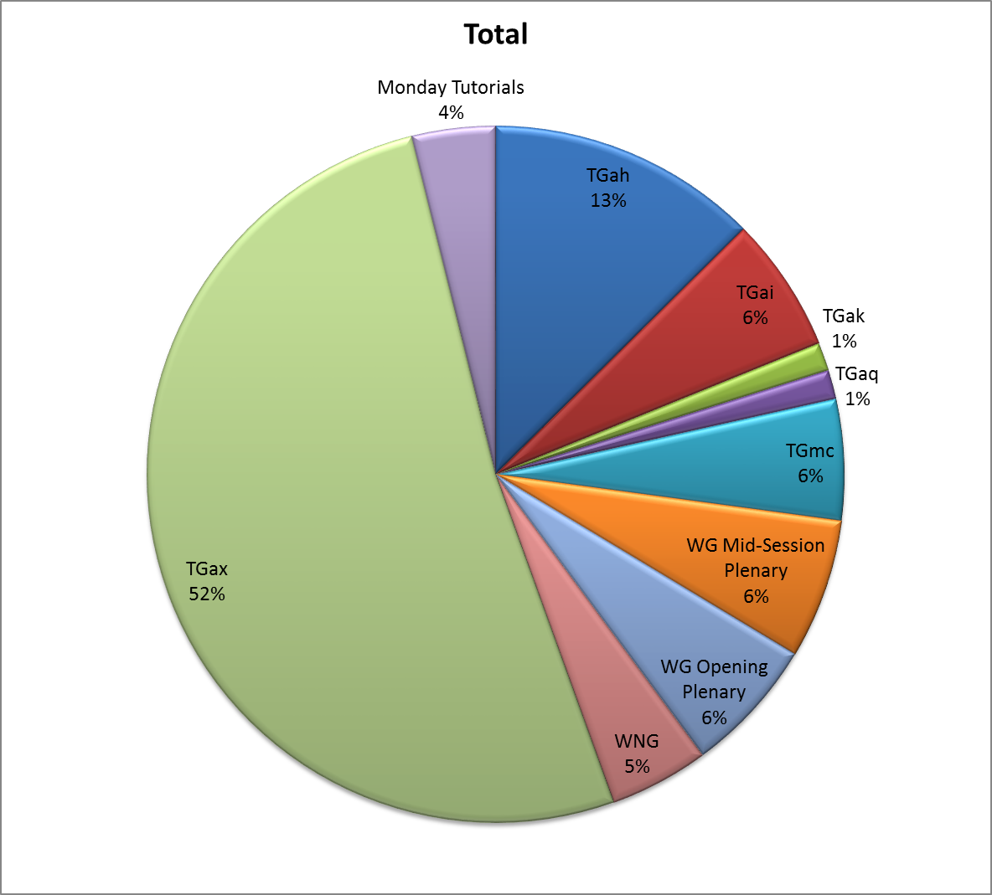
Attendance Total

Slide 5
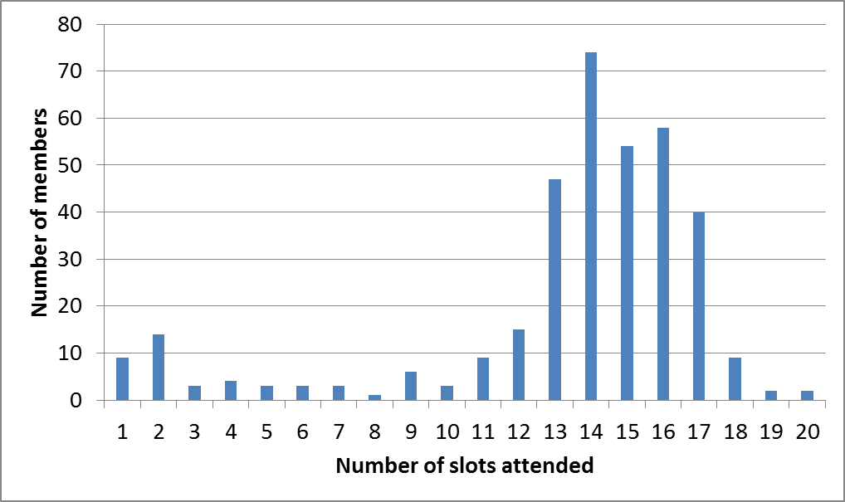
Attendance Histogram (Thu)

Slide 6
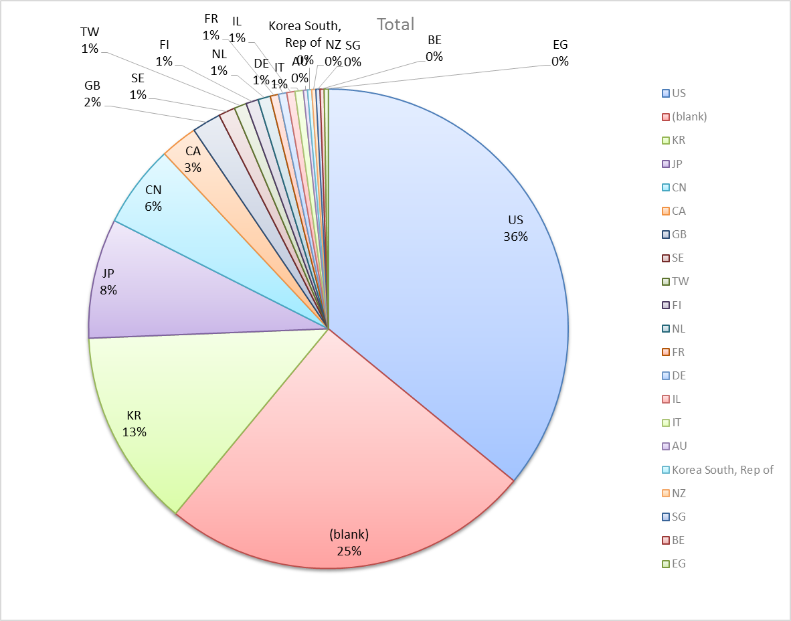
Attendance by Country

Slide 7
Type of Groups
Type of Group | Description
WG | Working Group
SC | Standing Committee
TG | Task Group
SG | Study Group

Slide 8
Groups
Type | Group | Description | Chair
WG | WG11 | The IEEE 802.11 Working Group | Adrian Stephens
SC | PUB | Publicity | Stephen McCann
SC | WNG | Wireless Next Generation | Clint Chaplin
SC | ARC | Architecture | Mark Hamilton
SC | JTC1 | ISO/IEC/JTC1/SC6 shadow committee | Andrew Myles
SC | REG | Regulatory | Richard Kennedy
TG | MC | Maintenance (Revision C) | Dorothy Stanley
TG | AH | Operation in 900 MHz bands | Dave Halasz
TG | AI | Fast Initial Link Setup | Hiroshi Mano
TG | AJ | China Millimeter Wave (CMMW) | Xiaoming Peng
TG | AK | General Link Setup | Donald Eastlake 3rd
TG | AQ | Pre-association Discovery | Stephen McCann
TG | AX | High Efficiency Wireless LAN (HEW) | Osama Aboul-Magd

Slide 9
802.11 WG Editor’s Meeting (July ‘14)
Date: 2014-07-14
Authors:
from slide 1/7 of 11-14-0887 by Peter Ecclesine (Cisco Systems)
Notes:
July 2007

Slide 10
Volunteer Editor Contacts
TGmc – Adrian Stephens – adrian.p.stephens@intel.com, Edward Au – edwardau@marvell.com, Emily Qi – emily.h.qi@intel.com
TGah – Yongho Seok yongho.seok@gmail.com, Alfred Asterjadhi – aasterja@qti.qualcomm.com
TGai – Lee Armstrong – LRA@tiac.net, Ping FANG Ping.FANG@huawei.com
TGaj – Jiamin CHEN – jiamin.chen@mail01.huawei.com
TGak – Donald Eastlake – d3e3e3@gmail.com
TGaq – Dan Gal – ddrgal@gmail.com
Editors Emeritus:
  TGaa – Alex Ashley – alex.ashley@hotmail.co.uk
  TGac – Robert Stacey – robert.stacey@intel.com
  TGad – Carlos Cordeiro – carlos.cordeiro@intel.com
  TGae – Henry Ptasinski – henry@LOGOUT.COM
  TGaf – Peter Ecclesine – pecclesi@cisco.com
from slide 2/7 of 11-14-0887 by Peter Ecclesine (Cisco Systems)
Notes:
July 2007

Slide 11
MDR Status
802.11 Working Group Mandatory Draft Review
  802.11-11/615r4 documents the process. There is an r5.
  MDR now in the 802.11 Operating Manual 802.11-09/0002r12
P802.11aa D5.0 went through Working Group Mandatory Editorial Coordination before July 2011
P802.11ad D4.0 went through Working Group Mandatory Editorial Coordination before July 2011
P802.11ae D4.0 went through Working Group Mandatory Editorial Coordination before July 2011
P802.11ac D4.0 went through Working Group Mandatory Draft Review before January 2013
P802.11af D4.0 went through Working Group Mandatory Draft Review before Saturday May 18, 2013
We are in the REVmc MDR process - 802.11-14/781r2
from slide 3/7 of 11-14-0887 by Peter Ecclesine (Cisco Systems)

Slide 12
802.11 Style Guide
See 11-09-1034-09-0000-wg11-style-guide.doc
  We updated 802.11 WG Style Guide based on 2012 IEEE Standards Style Manual and consistency changes in final publication of the 802.11 standard
Editor’s responsibility includes checking the 2014 IEEE Standards Style Manual when creating or updating drafts. https://development.standards.ieee.org/myproject/Public/mytools/draft/styleman.pdf
Submissions with draft text should conform to both the WG11 Style Guide and IEEE Standards Style Manual
Note that the Style Guide evolves with our practice
from slide 4/7 of 11-14-0887 by Peter Ecclesine (Cisco Systems)

Slide 13
Editor Amendment Ordering
Data as of July 2014
See http://grouper.ieee.org/groups/802/11/Reports/802.11_Timelines.htm
July 2014 Editors changed the running order and will revisit in November 2014, maintaining this order in the interim
Amendment Number | Task Group | REVCOM Date
802.11-2012 Amendment 1 | TGae | Mar 2012
802.11-2012 Amendment 2 | TGaa | Jun 2012
802.11-2012 Amendment 3 | TGad | Oct 2012
802.11-2012 Amendment 4 | TGac | Dec 2013
802.11-2012 Amendment 5 | TGaf | Dec 2013
802.11REVmc | TGmc | Mar 2015
802.11-2015 Amendment 1 | TGai | Mar 2016
802.11-2015 Amendment 2 | TGah | Mar 2016
Amendment numbering is editorial! No need to make ballot comments on these dynamic numbers!
from slide 5/7 of 11-14-0887 by Peter Ecclesine (Cisco Systems)
Notes:
July 2007

Slide 14
Draft Development Snapshot
July 2014
TG | Published or Draft Baseline Documents |  |  |  |  |  |  |  | Source | MDR | Style Guide | Editor | Snapshot Date
 | Published | mc | ai | ah | aj | ak | aq | ax
mc | N | 3.0 |  |  |  |  |  |  | Frame 10.0 | No | 2012 | Adrian Stephens Edward Au Emily Qi | 15-Jul
ai | N | 1.0 | 2.0 |  |  |  |  |  | Frame 9.0 | No | 2012 | Lee Armstrong Ping FANG | 15-Jul
ah | N | 2.5 |  | 2.0 |  |  |  |  | Frame 11.0 | No | 2012 | Yongho Seok Alfred Asterjadhi | 15-Jul
aj | N |  |  |  | 0.2 |  |  |  | Frame 10.0 | No | 2012 | Jiamin Chen | 15-Jul
ak | N | 3.0 |  |  |  | 0.02 |  |  | Word | No | 2012 | Donald Eastlake | 15-Jul
aq | N |  |  |  |  |  | 0.01 |  | Word | No | 2012 | Dan Gal | 15-Jul
ax | Y |  |  |  |  |  |  |  |  | No | 2012
Most current doc shaded green.
Changes from last report shown in red.
from slide 6/7 of 11-14-0887 by Peter Ecclesine (Cisco Systems)
Notes:
July 2009
July 2007
Peter Ecclesine (Cisco Systems)
Page 14

Slide 15
MIB style, Visio and Frame practices
I’m going to suggest going forward we use a single style with appropriately set tabs, and use leading Tabs to distinguish the syntax and description parts. (Adrian Stephens Feb 9, 2010)
Keep embedded figures using visio as long as possible
  Near the end of sponsor ballot, turn these all into .wmf (windows meta file) format files (you can do this from visio using “save as”). Keep separate files for the .vsd source and the .wmf file that is linked to from frame. There is likelihood we should use .emf
Frame templates for 11aa, 11ac, 11af
Text version of MIB is available (2012, ae2012, aa2012, ad2012, acD5.0, afD5.0. mcD3.0)
from slide 7/7 of 11-14-0887 by Peter Ecclesine (Cisco Systems)

Slide 16
Publicity Closing Report
Date: 2014-07-17
Authors:
from slide 1/3 of 11-14-0976 by Stephen McCann, Blackberry

Slide 17
Abstract
Closing report for the Publicity Standing Committee for July 2014, San Diego, CA, USA.
from slide 2/3 of 11-14-0976 by Stephen McCann, Blackberry

Slide 18
Discussion topics
  “What’s IEEE 802.11 doing” Presentation
  Template from IEEE-SA Marketing
  TGaq example
  How to share and edit
  IEEE-SA copyright
Plans for September
  1 slot
  Merge in more material
from slide 3/3 of 11-14-0976 by Stephen McCann, Blackberry

Slide 19
WNG Closing Report
Date: 2014-07-18
Authors:
from slide 1/3 of 11-14-0974 by Jim Lansford (CSR Technology)

Slide 20
Abstract
Closing report for WNG SC for July 2014, San Diego, California USA
from slide 2/3 of 11-14-0974 by Jim Lansford (CSR Technology)

Slide 21
Presentations at July 2014 meeting
  Agenda: https://mentor.ieee.org/802.11/dcn/14/11-14-0878-00-0wng-agenda-for-802-11wng-2014-07.ppt
Tuesday AM1 session
  Security and Privacy Enhancements for 802.11 – Paul Lambert (Marvell)
  https://mentor.ieee.org/802.11/dcn/14/11-14-0888-00-0wng-security-and-privacy-enhancements-for-802-11.pptx
Attendance
  Tuesday AM1: ~155
Minutes
  https://mentor.ieee.org/802.11/dcn/14/11-14-0909-00-0wng-july-2014-wng-meeting-minutes-san-diego.doc
Plans for September 2014
  One 2-hour session
from slide 3/3 of 11-14-0974 by Jim Lansford (CSR Technology)

Slide 22
ARC Closing Report
Date: 2014-07-17
Authors:
from slide 1/6 of 11-14-0982 by Mark Hamilton, Spectralink, Corp.

Slide 23
Abstract
This document is the closing report for ARC SC,
July 2014, San Diego meeting
from slide 2/6 of 11-14-0982 by Mark Hamilton, Spectralink, Corp.

Slide 24
Work Completed
Joint meeting with 802.1 TSN/IWK
  Discussed 802.11 DS and Portal architecture (and Annex R)
  Discussed 802.1AC sections 12.2.1 and 12.2.3 draft text
  Noted 802.1AC WG Letter Ballot is open (closes July 18), and 802.11 voting members are invited to vote and submit comments
Joint meeting with TGak, and 802.1 TSN/IWK
  Furthered above discussion, to add TGak architecture concepts
  Discussed 802.1AC section 12.2.2 draft text (which has TGak concepts)
from slide 3/6 of 11-14-0982 by Mark Hamilton, Spectralink, Corp.

Slide 25
Work Completed (con’t)
IETF/802 coordination update – Dorothy Stanley
  CAPWAP Extensions for 802.11n and channel/power autoconfiguration:
    Reviewed draft. Comments were formulated, and a motion approved to ask the WG to direct a liaison response back to the IETF.
    Comments are in: https://mentor.ieee.org/802.11/dcn/14/11-14-0913-01-0000-liaison-response-opsawg-capwap-extension.docx
Introduced work item request from WG Chair:
  Produce a “Design Pattern” for use of “…Implemented” and “…Activated” MIB attributes.
  Will be discussed on a telecon, to review the request in detail and form plan of attack
from slide 4/6 of 11-14-0982 by Mark Hamilton, Spectralink, Corp.

Slide 26
Teleconference(s)
One expected, will schedule with 10 days notice
  Begin discussion on “Design Pattern” work item
from slide 5/6 of 11-14-0982 by Mark Hamilton, Spectralink, Corp.

Slide 27
September 2014 Goals
Two standalone meeting slots planned:
  Design Pattern for MIB attribute use
  802.11 Architecture topics: AP/DS/Portal, 802.1AC
  IETF/802: CAPWAP, PAWS
    As needed
  IEEE 1588, if needed.
One joint session with TGak
  11ak architecture discussions
from slide 6/6 of 11-14-0982 by Mark Hamilton, Spectralink, Corp.

Slide 28
IEEE 802 JTC1 SC closing report
(July 2014)
Date: 2014-05-16
Authors:
from slide 1/12 of 11-14-0971 by Andrew Myles, Cisco

Slide 29
Abstract
Closing report for IEEE 802 JTC1 SC
for July 2014 in San Diego
from slide 2/12 of 11-14-0971 by Andrew Myles, Cisco

Slide 30
IEEE 802 has pushed seven standards completely through the PSDO ratification process …
IEEE 802 standard | 60 day pre-balllot | 5 month FDIS ballot | Comments resolved by IEEE
802.11 | Passed (2012) | Passed in 2012 | Liaised in Nov 2013
802.1X | Passed (2013) | Passed (21 Oct 2013) | Liaised in Jan 2014
802.1AE | Passed (2013) | Passed (21 Oct 2013) | Liaised in Jan 2014
802.1AB | Passed (May 2013) | Passed (18 Dec 2013) | Liaised in May 2014
802.1AR | Passed (May 2013) | Passed (18 Dec 2013) | Liaised in May 2014
802.1AS | Passed (May 2013) | Passed (18 Dec 2013) | Liaised in May 2014
802.3 | Passed (2013) | Passed (16 Feb 2014) | Not required
from slide 3/12 of 11-14-0971 by Andrew Myles, Cisco

Slide 31
… and IEEE 802 has six standards in the pipeline for ratification under the PSDO process
July 2014
IEEE 802 standard | 60 day pre-balllot | 5 month FDIS ballot | Comments resolved
802.11aa | Passed (Feb 2013) | Passed (28 Jan 2014) | FDIS comments will be liaised next week
802.11ad | Passed (Feb 2013) | Passed (28 Jan 2014)
802.11ae | Passed (Feb 2013) | Passed (28 Jan 2014)
802.1AEbw | Passed (Jan 2014) | - | FDIS ballot will start soon
802.1AEbn | Passed (Jan 2014) |  | FDIS ballot will start soon
802.22 | Passed (May 2014) | - | Waiting for comment resolutions
from slide 4/12 of 11-14-0971 by Andrew Myles, Cisco

Slide 32
… with a large number of other standards ready to enter the PSDO pipeline soon
Documents at liaison stage
  802.1AXrev draft
  802.1ACrev draft, once in SB
Documents about to enter the PSDO pipeline
  802
  802.1Xbx, once published
  802.1Qrev, once published
  802.3.1, once published
  802.11ac, may be approved today
  802.11af, may be approved today
  802.22a, once 802.22 is ratified under PSDO (also need to allocate responsibility for maintenance of 802.22 to WG)
from slide 5/12 of 11-14-0971 by Andrew Myles, Cisco

Slide 33
The SC6 discussed other possible proposals in SC6 in preparation for London meeting
No news on TePA proposals, including WAPI
No news on UHT/EUHT proposals
Discussion in WG7 on “Virtual AP”
  Allows multiple SPs to share an AP
  Will consider detailed response in Sept
Discussion in WG7 on “Optimization technology in WLAN”
  Defines a sniffer to server interface
  Will consider detailed response in Sep
Empowerment of a HoD for London meeting
from slide 6/12 of 11-14-0971 by Andrew Myles, Cisco

Slide 34
The SC will focus in Athens on preparing for the SC6 meeting in London
Prepare status updates for London
  802, 802.1, 802.3, 802.11, 802.15, 802.22, …
Deal with “Virtual AP”
Deal with “Optimization technology in WLAN”
Respond to any new documents on SC6 server
Appoint IEEE 802 delegation
…
from slide 7/12 of 11-14-0971 by Andrew Myles, Cisco

Slide 35
The IEEE 802.11 WG will consider sending 802.11ac/af through PSDO
Motion
  The IEEE 802.11 WG recommends to the IEEE 802 EC that IEEE 802.11ac-2013 and IEEE 802.11af-2013 be submitted to ISO/IEC JTC1/SC6 for ratification under the PSDO process
  Moved:
  Seconded:
Notes
  Approved by IEEE 802 JTC1 SC
  Will hopefully be considered by IEEE 802 EC today
from slide 8/12 of 11-14-0971 by Andrew Myles, Cisco

Slide 36
The IEEE 802 EC will consider various motions related to JTC1
IEEE 802.1 WG will provide motions to
  Liaise 802.1AXrev draft to SC6
  Forward 802 through PSDO
IEEE 802.11 WG will provide motions to
  Approve FDIS comment responses for 802.11aa/ad/ae
  Forward 802.11ac through PSDO
  Forward 802.11af through PSDO
from slide 9/12 of 11-14-0971 by Andrew Myles, Cisco

Slide 37
The IEEE 802 EC will consider various motions related to JTC1
IEEE 802.3 WG will provide motions to
  Forward 802.3.1 through PSDO
IEEE 802.22 WG will provide motions to:
  Forward responses to SC6 on pre-ballot by SC6 on IEEE 802.22
  Send liaison to SC6 asking that 802.22 WG have ongoing maintenance responsibility for 8802-22 series
from slide 10/12 of 11-14-0971 by Andrew Myles, Cisco

Slide 38
IEEE 802 EC will consider HoD appointment process
Motion
  The IEEE 802 EC empowers the IEEE 802 Chair be to appoint the IEEE 802 HoD to the ISO/IEC JTC1/SC6 meeting in London in October 2014
  Moved
  Seconded
Notes:
  Approved by IEEE 802 JTC1 SC by ~16/0/2
  Likely appointee is Bruce Kraemer
  Hoping to include a HoD-in-training in delegation
from slide 11/12 of 11-14-0971 by Andrew Myles, Cisco

Slide 39
IEEE 802 EC will consider HoD empowerment
Motion
  The IEEE 802 EC authorises the IEEE 802 HoD to the ISO/IEC JTC1/SC6 meeting in London in October 2014 to:
    Appoint the IEEE 802 delegation
    Approve any necessary submissions
    Call any necessary preparation teleconferences
  Moved
  Seconded
Notes:
  Approved by IEEE 802 JTC1 SC by ~16/0/2
  This is similar to previous motions
from slide 12/12 of 11-14-0971 by Andrew Myles, Cisco

Slide 40
IEEE 802.11/15 Regulatory SC
San Diego Closing Report
Date: 2014-07-18
Authors:
from slide 1/6 of 11-14-0808 by Rich Kennedy, MediaTek

Slide 41
Abstract
This presentation is the closing report for the July 2014 IEEE 802.11/15 Regulatory Standing Committee meeting in San Diego.
from slide 2/6 of 11-14-0808 by Rich Kennedy, MediaTek

Slide 42
Agenda
Introduction – just expanded to add 802.15
Regulatory summaries
[Potential] Action items
DSRC Coexistence
AOB
Adjourn
from slide 3/6 of 11-14-0808 by Rich Kennedy, MediaTek

Slide 43
Accomplishments
Regulatory summaries
  Asia
    Japan 5.1 GHz band
  EU
    Ofcom PSSR consultation results (responses just now posted)
    EN 300 328 v1.9.1
    TVWS Report to ECC from WG FM
    Ofcom WRC-15 Preparation consultation
    Ofcom TVWS trial extension, and SE24 WI52 on sharing in 5725-5925 MHz
  North America
    Globalstar NPRM Reply Comments [due June 4]
    NPRM 13-22 – R&O (FCC 14-30)
      Many Ex Partes from WISPs
      Prep for WRC15 complete(?)
    FCC 3.5 GHz FNPRM [Comments were due July 14]
    FCC/NTIA “Model City”
DSRC Coexistence Tiger Team update
No action items
from slide 4/6 of 11-14-0808 by Rich Kennedy, MediaTek

Slide 44
Teleconferences
Regulatory SC
  Bi-weekly on Thursdays, 12:30 to 13:30 ET
  Through November 30th
DSRC Coexistence Tiger Team
  Weekly on Fridays, 13:00 to 14:00 ET
  Through November 30th
from slide 5/6 of 11-14-0808 by Rich Kennedy, MediaTek

Slide 45
References
  Globalstar TLPS NPRM
    http://transition.fcc.gov/Daily_Releases/Daily_Business/2013/db1126/FCC-13-147A1.pdf
  5 GHz R&O FCC 14-30
    http://transition.fcc.gov/Daily_Releases/Daily_Business/2014/db0401/FCC-14-30A1.pdf
  FCC 3.5 GHz band FNPRM
    http://transition.fcc.gov/Daily_Releases/Daily_Business/2014/db0425/FCC-14-49A1.pdf
  Ofcom Public Sector Spectrum Release consultation
    http://stakeholders.ofcom.org.uk/binaries/consultations/pssr-2014/summary/pssr.pdf
  DSRC Coexistence Tiger Team update
    https://mentor.ieee.org/802.11/dcn/14/11-14-0675-00-0reg-dsrc-tt-activities-mar-may-2014.ppt
  FCC/NTIA Model City Initiative
    http://transition.fcc.gov/Daily_Releases/Daily_Business/2014/db0711/DA-14-981A1.pdf
from slide 6/6 of 11-14-0808 by Rich Kennedy, MediaTek

Slide 46
IEEE 802.11mc Closing Report for
July 2014
Date: 2014-07-17
Authors:
from slide 1/10 of 11-14-0986 by Dorothy Stanley (Aruba Networks)

Slide 47
Abstract
This document contains the TGmc closing report for July 2014.
from slide 2/10 of 11-14-0986 by Dorothy Stanley (Aruba Networks)

Slide 48
Status
Began processing comments received in LB 202 – Second recirculation (779 comments, approximately 400 editorial)
  Approximately 60 CID resolutions approved; many more developed and ready for review. Also considered MDR comments (11-14-781).
Developed
  3GPP Liaison response https://mentor.ieee.org/802.11/dcn/14/11-14-0936-03-000m-liaison-response-followup-to-3gpp-tsg-ran-wg2.docx
  Changes for shwmp code point request, https://mentor.ieee.org/802.11/dcn/14/11-14-0848-01-000m-shwmp-text-changes-and-ana-allocation.docx
Agenda, includes motions and list of comment submissions ready to review
  in https://mentor.ieee.org/802.11/dcn/14/11-14-0747-06-000m-tgmc-july-2014-agenda.pptx
from slide 3/10 of 11-14-0986 by Dorothy Stanley (Aruba Networks)

Slide 49
LB 202 CID Assignees – more to be added
Gabor Bajko
Carlos Cordiero
Peter Ecclesine
Vinko Erceg
Matthew Fischer
Mark Hamilton
Dan Harkins
Brian Hart
VK Jones
Stephen McCann
Michael Montemurro
Eldad Perahia
Ron Porat
Mark Rison
Jon Rosdahl
Yongho Seok
Graham Smith
Dorothy Stanley
Adrian Stephens
Bo Sun
Fei Tong
Qi Wang
Menzo Wentink
from slide 4/10 of 11-14-0986 by D. Stanley, Aruba Networks

Slide 50
TGmc Plan of Record
20 July 2012 – 12 Sept 2012 – Call for Comment/Input
29-30 Aug 2012 – NesCom, SASB PAR Approval
Sept 2012 – Begin to process input
Sept 2012 – 11aa, 11ae integration
Jan – First WG Letter ballot - without 11ad
Dec 2012 – March/May 2013 – 11ad integration
Sept 2013 – Letter ballot on D2.0
Dec 2013 – May 2014 – 11ac, 11af integration – D3.0 in May 2014
July 2014 – Mandatory Draft Review
Jul - Aug 2014 – Form Sponsor Pool (45 days)
Nov 14 – Initial Sponsor Ballot
July 2015– WG/EC Final Approval
Dec 2015 – RevCom/SASB Approval
Slide 50
from slide 5/10 of 11-14-0986 by Dorothy Stanley (Aruba Networks)
Notes:
doc.: IEEE 802.11-10/0503r4
May 2010
Michael Montemurro, Research in Motion
Page 50

Slide 51
TGmc Plan of Record – changes
Form Sponsor Ballot Pool: Open Sept 15th, Close end Oct 2014 – Form Sponsor Pool (45 days); good for 6 months (end of April 2015)
Nov 2014 – D4.0 Recirculation, follow with D5.0 changed if needed, D6.0 unchanged
EC unconditional SB approval March 2015
Initial SB March 2015
Nov 2015/March 2016 – WG/EC Final Approval
March 2016 – RevCom/SASB Approval
Slide 51
from slide 6/10 of 11-14-0986 by Dorothy Stanley (Aruba Networks)
Notes:
doc.: IEEE 802.11-10/0503r4
May 2010
Michael Montemurro, Research in Motion
Page 51

Slide 52
Teleconferences
Conference Calls 10am Eastern (2 hours)
  August 1, 8, 15, 22, 29
  September 5
from slide 7/10 of 11-14-0986 by Dorothy Stanley (Aruba Networks)

Slide 53
Motion – shwmp liaison text changes and ANA allocation
  Move to approve the text changes in https://mentor.ieee.org/802.11/dcn/14/11-14-0848-01-000m-shwmp-text-changes-and-ana-allocation.docx
  And approve the request that the ANA administer the Active Path Selection Protocol Identifier values, and assign the reserved shwmp value.
Moved: Stephen McCann
Seconded: Guido Hiertz
Result: 29-0-2 Passes
from slide 8/10 of 11-14-0986 by Dorothy Stanley, Aruba Networks

Slide 54
Motion – 3GPP liaison
  Approve the liaison statement in https://mentor.ieee.org/802.11/dcn/14/11-14-0936-03-000m-liaison-response-followup-to-3gpp-tsg-ran-wg2.docx
  And request that the WG chair send the liaison as indicated, with editorial license.
Moved: Youhan Kim
Seconded: Matthew Fischer
Result: 30-7-7 Passes
from slide 9/10 of 11-14-0986 by Dorothy Stanley, Aruba Networks

Slide 55
Next Steps
Complete comment resolution of comments received from WGLB on P802.11REVmc D3.0
from slide 10/10 of 11-14-0986 by Dorothy Stanley (Aruba Networks)

Slide 56
IEEE 802.11ah Closing Report for
July 2014
Date: 2014-07-18
Authors:
from slide 1/6 of 11-14-0987 by Yongho Seok (Self)

Slide 57
Abstract
July 2014
This presentation is the closing report for the San Diego meeting of the IEEE 802.11 TGah.
from slide 2/6 of 11-14-0987 by Yongho Seok (Self)

Slide 58
Activity in TGah
Letter Ballot 203 for Draft 2.0 closed July 7th
  1214 comments received
Total 366 comments with 12 submissions addressed in this week)
  848 comments unresolved after July F2F meeting
  LB203 comment spreadsheet: 11-14/79r3
Instructed the editor to generate Draft 2.1
from slide 3/6 of 11-14-0987 by Yongho Seok (Self)

Slide 59
Going forward
Continue to address LB203 comments and start Initial WG Recirculation Letter Ballot in September
from slide 4/6 of 11-14-0987 by Yongho Seok (Self)

Slide 60
Teleconference
July 29 (Tuesday), 8PM ET for 2 hour
August 5 (Tuesday), 8PM ET for 2 hour
August 12 (Tuesday), 8PM ET for 2 hour
August 19 (Tuesday), 8PM ET for 2 hour
August 26 (Tuesday), 8PM ET for 2 hour
September 2 (Tuesday), 8PM ET for 2 hour
September 9 (Tuesday), 8PM ET for 2 hour
from slide 5/6 of 11-14-0987 by Yongho Seok (Self)

Slide 61
TGah Timeline – No change
Internal Task Group Ballot : May 2013
Initial Letter Ballot : September 2013
Initial Recirculation Letter Ballot : September 2014
Initial Sponsor Ballot : February 2015
Initial Recirculation Sponsor Ballot : November 2015
EC Approval : January 2016
Revcom Approval : March 2016
from slide 6/6 of 11-14-0987 by Yongho Seok (Self)

Slide 62
IEEE 802.11TGai
Closing Report
July 2014
Date: 2014-7-18
Authors:
Name | Company | Address | Phone | email
Hiroshi MANO | Koden Techno Info K.K. | Fuji Blg 28 2F, 2-7-26 Kita-Aoyama, Minato-ku, Tokyo, 107-0061, Japan | +81-3-6890-0594 | mano@koden-ti.com hiroshi@manosan.org
from slide 1/9 of 11-14-0978 by Hiroshi Mano (KDTI)

Slide 63
Abstract
This presentation is the closing report for the San Diego meeting of the IEEE 802.11 TGai.
from slide 2/9 of 11-14-0978 by Hiroshi Mano (KDTI)

Slide 64
IEEE 802.11 FILS TGai –
July 2014 San Diego meeting
Goals for the Meeting:
  Approve minutes of past meeting and teleconference
  Officer Election
  Comment resolution of WG LB for D2.0.
  Approve Timeline
  Approve Teleconference schedule
  Approve Plan for July
from slide 3/9 of 11-14-0978 by Hiroshi Mano (KDTI)

Slide 65
Accomplishments TGai 1/2
1adhoc + 9 regular slots
Approve the minutes of past meetings
  Approve TGai Meeting Minutes
  (11-14/633r0) for the IEEE 802.11 Waikoloa meeting:
  Approve TGai teleconference meeting minutes
  Waikoloa to San Diego meeting (11-14/731r5)
  Approve meeting minutes
  San Diego Ad-Hoc meeting (11-14/884r0)
from slide 4/9 of 11-14-0978 by Hiroshi Mano (KDTI)

Slide 66
Accomplishments TGai 2/2
1186 comments were received by WG LB201
  This week
    956 without resolution (all CIDs were assigned to champions )
    467 editorial
    489 Technical
  47 open
Approved Plan for Sep
Approved Time line
Approved Teleconference schedule
from slide 5/9 of 11-14-0978 by Hiroshi Mano (KDTI)

Slide 67
Plan for Sep
Goals for the Meeting:
  Approve minutes of past meeting and teleconference
  Comment resolution of WG
  Approve to forward the draft to WG Recirc LB
  Approve Timeline
  Approve Teleconference schedule
  Approve Plan for Nov
from slide 6/9 of 11-14-0978 by Hiroshi Mano (KDTI)

Slide 68
Time line of TGai
  PAR Approved, Modified, or Extended 2010-12-08
  WG Letter Ballots Initial / Recirc Mar14/Sep14/Jan15
  MEC Done Nov14
  Form Sponsor Ballot Pool / Reform Mar15
  IEEE-SA Sponsor Ballots Initial / Recirc Jul15/ Sep 15
  Final 802.11 WG Approval Nov 15
  final or Conditional 802 EC Approval Nov 15
  RevCom & Standards Board Final or
  Continuous Process Approval Mar 16
  ANSI Approved N/A
from slide 7/9 of 11-14-0978 by Hiroshi Mano (KDTI)

Slide 69
Teleconference Schedule
July 2014
Motion:
  Approve the following schedule of weekly teleconferences between July 29th to Sep 9th.
  Tuesdays 10:00 ET
  Duration 1Hour
  Using WEB-EX that will be provided by Task Group Chair
Approved by unanimous consent
from slide 8/9 of 11-14-0978 by Hiroshi Mano (KDTI)

Slide 70
Reference
Motions
  14-1186r5 TGai-Motion-deck
TGai LB201 comments for Draft 2.0
  14-0565r18 TGai LB201 comments for Draft 2.0
from slide 9/9 of 11-14-0978 by Hiroshi Mano (KDTI)

Slide 71
IEEE 802.11aj Task Group July 2014 Closing Report
Date: 2014-07-18
Authors:
from slide 1/12 of 11-14-0956 by Xiaoming Peng

Slide 72
Abstract
This document is the closing report for IEEE 802.11aj Task Group for the July 2014 session in San Diego, USA.
from slide 2/12 of 11-14-0956 by Xiaoming Peng

Slide 73
Work Completed (1/4)
The CIDs for CC12 have been discussed
11-14/0333r3 – TGaj Editor Report for CC12
11-14/0332r4 – TGaj D0.01 comment database (CC12)
11-14/0842r0 – TGaj Editor Report for CC19
11-14/0785r1 – TGaj D0.2 comment database (CC19)
11-14/0759r3 – Proposed text resolution to CID 127 in CC12
11-14/0758r2 - CID 150 resolution in CC12
11-14/0782r2 - Proposed resolution to CID 120 in CC12
11-14/0786r1 - Proposed resolution to CID 26, 27, 37, 38, 40-47, 49-53, 67-71, 114, 115, 118 and 124 in CC12
  11-14/783r0 –Proposed text resolution for CID 26, 27, 37, 38, 40-47, 49-53, 67-71, 114, 115, 118, 120 and 124 in CC12
  11-14/0759r4 - proposed-text-resolution-to-cid-127-in-cc12
  11-14/0941r0 – comment resolution for CC12
from slide 3/12 of 11-14-0956 by Xiaoming Peng

Slide 74
Work Completed (2/4)
  CIDs in CC19 have been presented and discussed
  11-14/ 0828r0- Proposed Resolution to CID 1, 4, 5, 8, 9 in CC19
  11-14/ 0829r0- Proposed Resolution to CID 10-12 in CC19
  11-14/ 0830r0- Proposed Resolution to CID 2, 3 in CC19
  11-14/0953r0 - Comment resolution for CC19
from slide 4/12 of 11-14-0956 by Xiaoming Peng

Slide 75
Work Completed (3/4)
Contribution for 45GHz
11-13/1365r3 – 45GHz Spectrum Allocation in China
  Update on the 45GHz Spectrum Allocation with the carrier freq adjustment
11-14/0806r0 - 45GHz Channelization and Channel Operation
  45GHz channelization scheme and Channel operation mechanism have been discussed
11-14/0893r0 – Channel Model Description and Channel Generation for IEEE 802.11aj (45GHz)
  A matlab code has been provided for 45GHz channel model
from slide 5/12 of 11-14-0956 by Xiaoming Peng

Slide 76
Work Completed (4/4)
11-14/0807r0 - LDPC Coding for 45GHz
  A new LDPC base matrix with better performance has been proposed for 45GHz for group discussion
11-14/0881r0 – LDPC Tone Mapping for IEEE 802.11aj (45GHz)
  Tone Mapping is suggested for OFDM for 45GHz
  Optimal Dtm = 6 for 540MHz, and =12 for 1080MHz
11-14/0883r0 – PHY SIG Frame Structure for IEEE 802.11aj (45GHz)
  A PHY SIG frame structure has been presented to enable MU-MIMO for 45GHz
from slide 6/12 of 11-14-0956 by Xiaoming Peng

Slide 77
Motion 1
To approve the comment resolution for the following CIDs for CC12
  CID 120 (from 11-14/0782r2, 11-14/0783r0)
  CID 127 (from 11-14/0759r4)
  CID 150 (from 11-14/0758r2)
  CID 26, 27, 37, 38, 40-47, 49-53, 67-71, 114, 115, 118, 124 (from 11-14/0786r1, 11-14/783r0)
  CID 33, 35, 66, 125, 130, 132, 142, 151 (from 11-14/0941r0)
Moved by: Jiamin CHEN
Seconded by: Weixia ZOU
Results: Y 5 N 0 A 0
Motion passed
from slide 7/12 of 11-14-0956 by Xiaoming Peng (I2R)

Slide 78
Motion 2
To approve the comment resolution for the following CIDs for CC19
  CID 1, 4, 5, 8, 9 (from11-14/ 0828r0)
  CID 2, 3 (from 11-14/ 0830r0)
  CID 6,7 (from 11-14/0953r0)
  CID10, 11, 12 (from 11-14/ 0829r0)
Moved by: Weixia ZOU
Seconded by: Jiamin CHEN
Results: Y 5 N 0 A 0
Motion passed
from slide 8/12 of 11-14-0956 by Xiaoming Peng (I2R)

Slide 79
Proposed Technical Draft Plan
TG approves creation of new technical draft (D0.5) with all comments that have been approved on 17 July 2014
TGaj technical draft D0.5 is ready for the start of the new comment collection by 25 July (at least 30 days for the comment collection, the proposed deadline is 25 August)
Schedule a conference call on 28 August, 2014
from slide 9/12 of 11-14-0956 by Xiaoming Peng (I2R)

Slide 80
Next Meeting for 802.11aj
Next China Interim Meeting will be held on Sept 9-10, 2014 in Chengdu, China
Meeting Logistic: http://www.ieee802.org/11/Meetings/Meeting_Plan.html
from slide 10/12 of 11-14-0956 by Xiaoming Peng (I2R)

Slide 81
Goals for Sept 2014 Meeting
Comment Resolution for 60GHz
Proposal Presentation for 45GHz
from slide 11/12 of 11-14-0956 by Xiaoming Peng (I2R)

Slide 82
Conference call times
  August 28, 2014, 9pm (ET)
    Beijing Time: August 29, 2014, 9am
from slide 12/12 of 11-14-0956 by Xiaoming Peng (I2R)

Slide 83
TGak May Closing Report
Date: 2014-07-17
Authors:
Name | Address | Affiliations | Phone | Email
Donald Eastlake, 3rd | Huawei Technologies | 155 Beaver Street, Milford, MA 01757 USA | +1-508-333-2270 | d3e3e3@gmail.com
from slide 1/5 of 11-14-0988 by Donald Eastlake, Huawei Technologies

Slide 84
Abstract
Closing Report of IEEE 802.11 Task Group AK at the IEEE 802.11 Meeting, July 2014, held in San Diego, California.
from slide 2/5 of 11-14-0988 by Donald Eastlake, Huawei Technologies

Slide 85
TGak Closing Report
Accomplishments
  Met jointly with 802.1 IWK, 802.1 TSN, and 802.11 ARC SC Thursday AM1.
  Resolved 9% more of the comments from CC17. A D0.03 will be produced and posted.
  Received and discussed the submissions listed on next page.
  Adopted a revised time line.
  The minutes of this TGak meeting will be in 11-14/0989 and an annotated agenda is in 11-14/0742r9.
from slide 3/5 of 11-14-0988 by Donald Eastlake, Huawei Technologies

Slide 86
TGak Closing Report
Submissions
  11-14/0867, “A Subsetting and EPD Approach”
  11-14/0766r0, “Proposed Resolution of CC17 CID8”
  11-14/0767r0, “PCP to UP to AC comments resolution”
  11-14/562r1, “802.11ak and 802.1AC Convergence Function”
  11-14/0977r0, “EPD, Mixed BSSes, and Group RAs”
from slide 4/5 of 11-14-0988 by Donald Eastlake, Huawei Technologies

Slide 87
TGak Closing Report
Teleconferences
  Decided to hold 1 ½ hour teleconferences, to be joint with 802.1Qbz, on Monday, July 28th, August 11th, and August 25th, all at 5pm Eastern US time.
September 2014 Plans
  Complete comment resolution on CC17.
  Receive and discuss technical presentations.
  Produce a D1.0 and go to Letter Ballot
  Joint meeting with 802.11 ARC.
from slide 5/5 of 11-14-0988 by Donald Eastlake, Huawei Technologies

Slide 88
TGaq Closing Report
Date: 2014-07-17
Authors:
from slide 1/3 of 11-14-0968 by Stephen McCann, Blackberry

Slide 89
Abstract
Closing report for TGaq (Pre-Association Discovery) for July 2014, San Diego, CA, USA.
from slide 2/3 of 11-14-0968 by Stephen McCann, Blackberry

Slide 90
Technical presentations
    11-14-0877r2 Generic Service Discovery Proposal: Dynamic Bloom
    Filter Operation
    11-14-0433r2 PADP(Pre-Associated Discovery Protocol
    11-14-0912r2 TGaq-CAG-Number-text-proposal
    11-14-0970r0 Brief Queries in Probe Frames
Editorial presentations
    11-14-0925r0 editorial-comments-on-D0.01
Teleconference: 26th August 2014 , 10:00 ET
Plans for September 2014
  Addition of text to Draft 0.01 to form D0.02
  Start of comment collection on Draft 0.02
from slide 3/3 of 11-14-0968 by Stephen McCann, Blackberry

Slide 91
TGax July 2014 Closing Report
Date: 2014-07-17
Authors:
from slide 1/7 of 11-14-0984 by Osama Aboul-Magd (Huawei Technologies)

Slide 92
Abstract
This document is the closing report for the TGax for the July 2014 session.
from slide 2/7 of 11-14-0984 by Osama Aboul-Magd (Huawei Technologies)

Slide 93
TG Structure
The TG agreed to elect two vice chairs in September
The TG agreed to defer the discussion on the ad hoc structure
  How many Ad Hocs?
  Ad Hoc topics?
  How many chair per Ad Hoc?
from slide 3/7 of 11-14-0984 by Osama Aboul-Magd (Huawei Technologies)

Slide 94
Work Completed – TG Documents
Approved new revisions of TG Evaluation Methodology (11-14/ and Simulation Scenarios.
  https://mentor.ieee.org/802.11/dcn/14/11-14-0571-03-00ax-evaluation-methodology.docx
  https://mentor.ieee.org/802.11/dcn/14/11-14-0980-01-00ax-simulation-scenarios.docx
Approved the first revision of the TG Channel Models.
  https://mentor.ieee.org/802.11/dcn/14/11-14-0972-00-00ax-mac-calibration-test-case-for-20-40-mhz-channel.docx
Approved the first revision of the TG Selection Procedure.
  https://mentor.ieee.org/802.11/dcn/14/11-14-0938-04-00ax-802-11ax-selection-procedure.doc
Discussion on the Functional Requirement document.
from slide 4/7 of 11-14-0984 by Osama Aboul-Magd (Huawei Technologies)

Slide 95
Work Completed – Technical Presentation
Over 40 submissions were covered during the week.
A list of the submissions is available in the agenda document available at:
  https://mentor.ieee.org/802.11/dcn/14/11-14-0748-06-00ax-tgax-july-2014-meeting-agenda.ppt
from slide 5/7 of 11-14-0984 by Osama Aboul-Magd (Huawei Technologies)

Slide 96
September 2014 Goals
TG Vice Chairs election.
Continue to advance TG documents.
Technical Presentations.
from slide 6/7 of 11-14-0984 by Osama Aboul-Magd (Huawei Technologies)

Slide 97
Conference Call Times
Thursday August 14 – 10:00 -12:00 ET
from slide 7/7 of 11-14-0984 by Osama Aboul-Magd (Huawei Technologies)

Slide 98
802.15 Liaison Report
Date: 2014-05-16
Authors:
from slide 1/12 of 11-14-0990 by Al Petrick (JPA)
Notes:
January 2009September 2008
September 2008

Slide 99
Abstract
Liaison report on 802.15 as presented to 802.11
from slide 2/12 of 11-14-0990 by Al Petrick (JPA)
Notes:
January 2009September 2008
September 2008

Slide 100
802.15.4n
Chinese Medical Band
Completed comments resolution for LB93 for IEEE802.15.4N Draft 0:
  d0P802-15 -4n_Draft_Standard.pdf
Updated Draft 1 and issue re-circulation letter ballot
September 2014 plans
  Begin comment resolution on re-circulation letter ballot
Slide 100
Slide 100
from slide 3/12 of 11-14-0990 by Al Petrick (JPA)
Notes:
January 2009September 2008
doc.: IEEE 802.11-08/xxxxr0
September 2008
Clint Chaplin, Samsung Electronics
Page 100
doc.: IEEE 802.11-08/0697r0
May 2008
Clint Chaplin, Samsung
Page 100

Slide 101
802.15.4q
Ultra Low Power
Sought and received comments in reference to the draft
Reviewed all comments
Prepared comments/resolutions list on 802.15.4q technical draft
Issue Letter ballot in August 2014
September 2014 Goals
  Begin commnet resolution on 802.15.4q draft
Slide 101
Slide 101
from slide 4/12 of 11-14-0990 by Al Petrick (JPA)
Notes:
January 2009September 2008
doc.: IEEE 802.11-08/xxxxr0
September 2008
Clint Chaplin, Samsung Electronics
Page 101
doc.: IEEE 802.11-08/0697r0
May 2008
Clint Chaplin, Samsung
Page 101

Slide 102
802.15.4r
Ranging
Work focused on Technical Guidelines Document
(15-14-0297-01-004r-tg4r draft for TGD for TG4r.docx)
Updated Call for Proposal Time Lines
(15-14-0296-02-004r-draft of call-for-proposals.docx)
September 2014 Goals: Create New Time Line for Call for Preliminary Proposals
  Review technical submissions
Slide 102
Slide 102
from slide 5/12 of 11-14-0990 by Al Petrick (JPA)
Notes:
January 2009September 2008
doc.: IEEE 802.11-08/xxxxr0
September 2008
Clint Chaplin, Samsung Electronics
Page 102
doc.: IEEE 802.11-08/0697r0
May 2008
Clint Chaplin, Samsung
Page 102

Slide 103
802.15.8 Peer Aware Communications
PHY Harmonization is completed
10 Presentations on technical contribution and harmonization
  Covering: Frame structure, Power control, MAC synchronization, PAC framework and Discovery
September 2014 Goals
  Begin technical draft of v0.1
Slide 103
Slide 103
from slide 6/12 of 11-14-0990 by Al Petrick (JPA)
Notes:
January 2009September 2008
doc.: IEEE 802.11-08/xxxxr0
September 2008
Clint Chaplin, Samsung Electronics
Page 103
doc.: IEEE 802.11-08/0697r0
May 2008
Clint Chaplin, Samsung
Page 103

Slide 104
802.15.10 Layer 2/Mesh Under Routing (L2R)
Recap May 802.15 Interim and Current Status
Prepare for and Participate in 802.1/802.15 Joint Session
Heard 4 Final Proposals and Partial Analysis Results
Decided Not to Add Linear Scenario to TGD/Req. Analysis
Reviewed TG10 Timeline – One Mtg. Adjustment Needed
Slide 104
Slide 104
from slide 7/12 of 11-14-0990 by Al Petrick (JPA)
Notes:
January 2009September 2008
doc.: IEEE 802.11-08/xxxxr0
September 2008
Clint Chaplin, Samsung Electronics
Page 104
doc.: IEEE 802.11-08/0697r0
May 2008
Clint Chaplin, Samsung
Page 104

Slide 105
Better Use of Spectrum Resources in WPANs (SRU) SG
4 meetings were held
Approved meeting minutes
  SG SRU May 2014 Meeting Minutes (15-14-0323)
Worked responses PAR and CSD comments from Other WG.
  Responses to 802.15.4s PAR and CSD comments (15-14-0426-00)
September 2014 Goals
  Review technical documents
  Develop Technical Guidance Document
Slide 105
Slide 105
from slide 8/12 of 11-14-0990 by Al Petrick (JPA)
Notes:
January 2009September 2008
doc.: IEEE 802.11-08/xxxxr0
September 2008
Clint Chaplin, Samsung Electronics
Page 105
doc.: IEEE 802.11-08/0697r0
May 2008
Clint Chaplin, Samsung
Page 105

Slide 106
802.15.7a Optical Camera Communication SG
Main focus of OCC SG:
OCC applications (data communications, localization,
LoS marketing, LED-ID, information reception from
light sources and etc.)
ITS/Telematics/Air-craft based applications (Traffic control and
tracking, etc.)
Discuss PAR in detail
September 2014 Goals
  Complete PAR and CSD for IEEE802.15.7a
  Review technical presentations on LED-ID applications
Slide 106
Slide 106
from slide 9/12 of 11-14-0990 by Al Petrick (JPA)
Notes:
January 2009September 2008
doc.: IEEE 802.11-08/xxxxr0
September 2008
Clint Chaplin, Samsung Electronics
Page 106
doc.: IEEE 802.11-08/0697r0
May 2008
Clint Chaplin, Samsung
Page 106

Slide 107
Dependable (dep) IG
Heard Presentations and Discussion on them Application and Dependability Matrix by Jussi Haapola (CWC) doc. 15-14-0437-01
Use cases and Requirement of Dependability in Car Sensing and Controlling by Ryuji Kohno(YNU/CWC-Nippon)
Dependability in MAC as well as PHY for life critical applications
Other Use cases and technologies for dependable Wireless than Human and Car bodies
Discussed on Focused Use Cases, Necessity, and Requirements of Dependability in Vehicle Communications for Sensing and Controlling Translation of Requirement of Internal car sensing and controlling into Communication Parameters
Classification of Priority Order of Contexts for Dependability in sensing and controlling information in can and human bodies.
Necessary Process and Possible Timeline to SG and higher steps Call for Interest(CFI): RELEASE DATE: July 17, 2014, CLOSE DATE: March 17, 2015 (802 Plenary Session in Berlin, Germany)
Goals for September 2014: Complete Time Line; PAR and 5C
Slide 107
Slide 107
from slide 10/12 of 11-14-0990 by Al Petrick (JPA)
Notes:
January 2009September 2008
doc.: IEEE 802.11-08/xxxxr0
September 2008
Clint Chaplin, Samsung Electronics
Page 107
doc.: IEEE 802.11-08/0697r0
May 2008
Clint Chaplin, Samsung
Page 107

Slide 108
IG THz
Accomplishments
  Reviewed presentation and discussion of the Liaison statement from ITU-R (doc. 18-14-0042-00-0000) requesting comments on the ITU-R preliminary draft new report on "Technology trends of active services in the band above 275 GHz" (doc. 18-14-0043-00-0000).
September 2014 Goals
  Prepare documentation for joint meeting with TG3d in November 2014.
Slide 108
Slide 108
from slide 11/12 of 11-14-0990 by Al Petrick (JPA)
Notes:
January 2009September 2008
doc.: IEEE 802.11-08/xxxxr0
September 2008
Clint Chaplin, Samsung Electronics
Page 108
doc.: IEEE 802.11-08/0697r0
May 2008
Clint Chaplin, Samsung
Page 108

Slide 109
References
This document
All Documents
  https://mentor.ieee.org/802.15/documents
    Current draft is in the members-only area
      http://www.ieee802.org/15 → Members_Only_Area
      802.11 members log in using 802.11 username and password
Slide 109
from slide 12/12 of 11-14-0990 by Al Petrick (JPA)
Notes:
January 2009September 2008
September 2008
doc.: IEEE 802.11-08/0697r0
May 2008
Clint Chaplin, Samsung
Page 109

Slide 110
RR-TAG (802.18) to 802.11 Liaison Report
Date: 2014-07-18
Authors:
from slide 1/6 of 11-14-0979 by Rich Kennedy, MediaTek

Slide 111
Overview
This document summarizes the activities of the IEEE 802.18 Radio Regulatory Technical Advisory Group (RR-TAG) during the IEEE 802 July 2014 Plenary Meeting in San Diego.
from slide 2/6 of 11-14-0979 by Rich Kennedy, MediaTek

Slide 112
RR-TAG Actions Taken
Update on 18-13-0117 (a.k.a. IEEEE-02-E); the ITU-R SM.[SMART_GRID] report
Reviews of PARs submitted at this Plenary
  Sent comments on 802.22 and 802.15 PARs and CSDs
Discussed WP1A SG1 document on Spectrum Management regarding real world challenges of PLC/PLT
Reviewed ITU-R WP1A document titled “PRELIMINARY DRAFT NEW REPORT ITU-R SM.[THZ_TREND] Technology trends of active services in the bands above 275 GHz
Reviewed ITU-T SG15 document on the g.9955; COLLABORTAION WITH IEC TC57 WG20 on narrow-band PLT
Discussed status of 3GPP RAN 64 activity re LTE-U
WTB seeks comments on Spectrum Networks Group, LLC to provide M2M on 900MHz B/I channels.
from slide 3/6 of 11-14-0979 by Rich Kennedy, MediaTek

Slide 113
RR-TAG Actions Taken [2]
Reviewed FCC/NTIA joint Public Notice on Model City for demo and evaluation of advanced wireless sharing technologies.
WP5A asking for comments from 802.11 on ITU-R M.[V2X] (vehicle to vehicle and vehical to infrastructure)
  Request from IEEE 802.11 to provide response
  Completed with M.1450 data on 802.11p
Reviewed ITU-R WP5D draft new Recommendations ITU-R M.[IMT.OOBE.X]
Reviewed the status of the 802.18 Operation Manual
  Plan to complete for EC review in November
from slide 4/6 of 11-14-0979 by Rich Kennedy, MediaTek

Slide 114
ITU-R Documents Approved
On behalf of 802.16: Proposed LS to ITU-R WP 5D: OOBE information for WirelessMAN-Advanced, 18-14/46r2
On behalf of 802.11: Annex 19 working document toward a preliminary draft new recommendation ITU-R M.[V2X], 18-14/48r2
from slide 5/6 of 11-14-0979 by John Notor, Notor Research

Slide 115
References
ITU-R SMART GRID report
  https://mentor.ieee.org/802.18/dcn/13/18-13-0117-06-0000-802-24-draft-for-itu-r-q236.docx
ITU-R WP1A “PRELIMINARY DRAFT NEW REPORT ITU-R SM.[THZ_TREND] Technology trends of active services in the bands above 275 GHz
  https://mentor.ieee.org/802.18/dcn/14/18-14-0043-00-0000-pdnr-itu-r-sm-thz-trend-above-275-ghz.docx
  https://mentor.ieee.org/802.18/dcn/14/18-14-0044-00-0000-3gpp-liaison-reponse-to-802.doc
FCC/NTIA joint Public Notice on Model City
  https://mentor.ieee.org/802.18/dcn/14/18-14-0040-00-0000-et-docket-no-14-99-model-city-for-demonstrating-and-evaluating-advnaced-sharing-technologies.pdf
WP5A information request onITU-R M.[V2X]
  https://mentor.ieee.org/802.18/dcn/14/18-14-0048-02-0000-annex-19-working-document-toward-a-preliminary-draft-new-recommendation-itu-r-m-v2x.docx
from slide 6/6 of 11-14-0979 by Rich Kennedy, MediaTek

Slide 116
802.24
Smart Grid Technical Advisory Group
Liaison Report (July 2014)
Date: 2014-07-18
Author:
from slide 1/5 of 11-14-0981 by Tim Godfrey, EPRI

Slide 117
802.24 Introduction and Meeting Plan
802.24 is the Smart Grid Technical Advisory Group
Formed Nov 2012 to coordinate internal to and external to IEEE 802 in matters related to Smart Grid standards
Established meeting plan is 3 slots: PM2 on Monday, Tuesday and Wednesday
Participation from all 802 working groups is invited
  Reciprocal attendance credit is available
from slide 2/5 of 11-14-0981 by Tim Godfrey, EPRI

Slide 118
July 2014 activities
Change in scope from “Smart Grid TAG” to “Vertical Applications TAG”
  Allow multiple applications involving multiple IEEE 802 WGs
  Specific applications will be handled in Task Groups in the .24 TAG
  Smart Grid Task Group carries on the original 802.24 Scope
Procedure for starting new Task Groups defined
  24-14-0016-03-0000-process-for-createing-new-tg-2
The Smart Grid TG is following the procedure
  New Scope Statement in 24-14-0015-03-0000-smart-grid-tg-scope
  Support motions obtained in 802.15, 802.16, 802.22
Comments on the proposed PAR change for the TAG were addressed by the TAG
  24-14-0023-00-0000-responses-to-comments-on-tag-process
from slide 3/5 of 11-14-0981 by Tim Godfrey, EPRI

Slide 119
Motion for Support of Smart Grid TG
The TG creation process requires support from two WGs:
  “The 802.24 subgroup gets a motion in a minimum of 2 IEEE 802 WGs (not TAGs) that expresses support for adding this application category. The WGs that approve the motion may identify specific topics of that application category that are relevant to that WG.”
The Smart Grid application (currently the only application of 802.24) will be the first TG
from slide 4/5 of 11-14-0981 by Tim Godfrey, EPRI

Slide 120
Motion
The IEEE 802.11 WG supports the formation of the Smart Grid Task Group with the scope defined in 24-14-0015-03-0000-smart-grid-tg-scope. The IEEE 802.11 WG has identified the following topics that are of interest:
  Home Area Networks
  Metering Networks
  Sensor Connectivity
Moved: Tim Godfrey
Second:
Vote:
from slide 5/5 of 11-14-0981 by Tim Godfrey, EPRI

