Slide 1
WLAN Access Network Using RoF
Date: 2014-05-20
Authors/contributors:
Name | Company | Address | Phone | Email
Wenjing Xu | Beijing University of Posts and Telecommunications | Xitucheng Road No. 10, Beijing | +86+62258045 | wenjing@bupt.edu.cn
Shanguo Huang |  |  | +86+62258045 | shghuang@bupt.edu.cn
Weixia Zou |  |  | +86+62258045 | zwx0218@bupt.edu.cn
Chao Gao |  |  | +86+62258045 | gaochao19830606@bupt.edu.cn

Slide 2
Abstract
This presentation gives a full-duplex millimeter wave access system based on radio over fiber(we take the original RF signal frequency as 10G Hz). The biggest advantage of the system is cost-efficient ,easy to construct , and conquering the barrier of generating and transmitting millimeter wave in electrical field in the long distance.
Wenjing Xu, et al. (BUPT)

Slide 3
Outline
System Setup
The principle of generating the millimeter wave in the CS and BS
The experiment result
Wenjing Xu, et al. (BUPT)

Slide 4
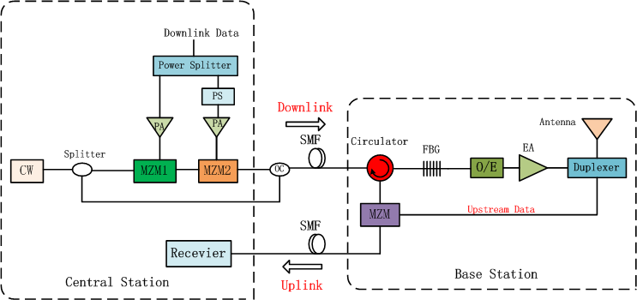
System setup
a
b
c
d
Fig. 1 The experiment setup

Slide 5


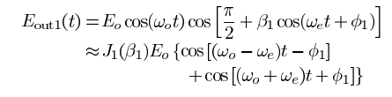
CS
The first MZM is an optical modulator , which modulates the RF signal to the optical domain as well as suppress the even-order sidebands totally ,leaving the odd-order sidebands(Fig a)
We assume the input of the first modulator is
the microwave can be expressed as
then the output of the first MZM can be approximate
expressed as

Slide 6
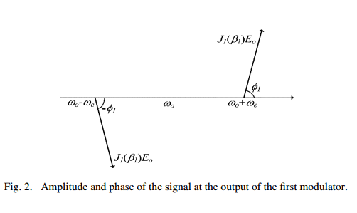
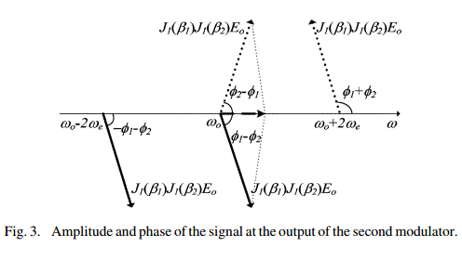
May 2014
According the same analysis , the output of the second MZM (Fig b) can be expressed as

Slide 7
BS
After the signal and the carrier (generated by the CW) coupled transmitted by the fiber ,which will have about 2dB power loss, using a FBG and Circulator to filter the carrier for the uplink reuse(Fig c) , and have the signal passed , then using a photodiode to convert the optical signal to an electrical signal frequency –quadrupling.
The output of the photodiode is
the Fig(d) show it in datail.

Slide 8
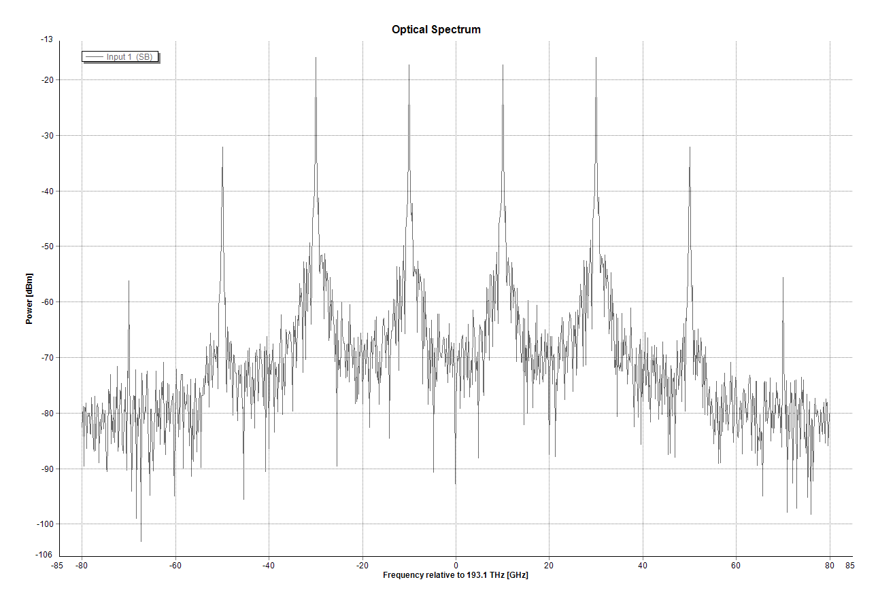
Fig(a)
The spectrum after the first MZM(suppress the even sidebands totally)

Slide 9
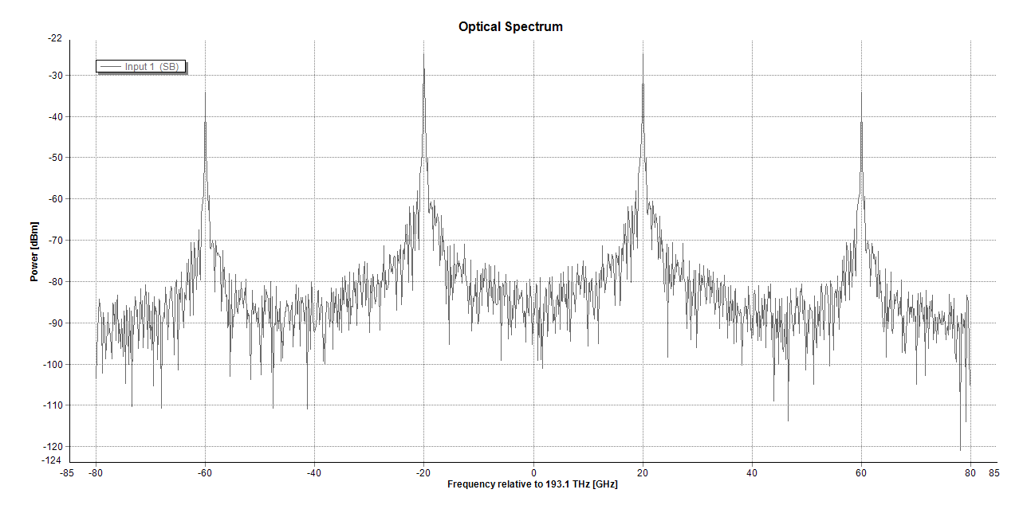
Fig(b)
The spectrum after the second MZM( suppress the even sidebands totally, suppress the carrier totally by the phase shifter)

Slide 10
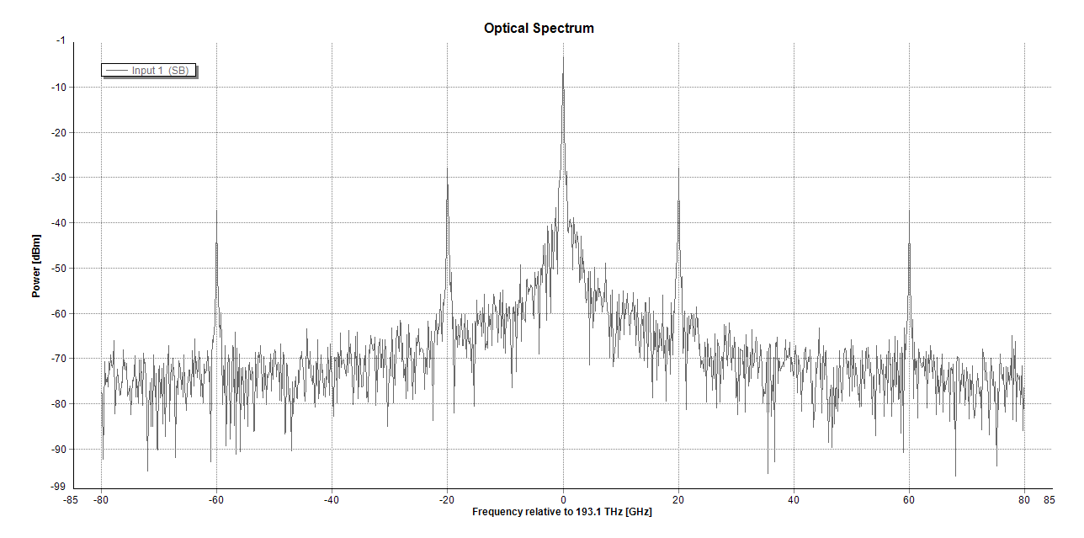
Fig(c)
The spectrum of the signal after adding the original carrier

Slide 11
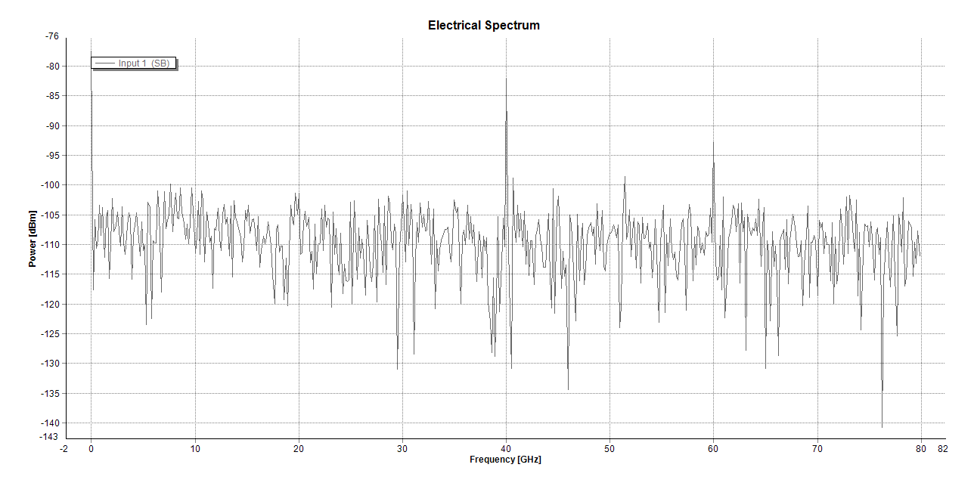
Fig(d)
The spectrum of the signal after using the photodiode and filtering the carrier for the uplink

Slide 12
Future Work
Continue find out the best approach to creating the millimeter and transmission
Analyze the best model for the millimeter wave access network
Finish the full-duplex millimeter wave access system further .

Slide 13
Thank You!
Notes:
《40—50吉赫兹频段移动业务中宽带无线接入系统频率使用相关事宜》

