Slide 1
LDPC for IEEE802.11aj(45GHz)
Date: 2014-05-20
Authors:
Name | Affiliations | Address | Phone | Email
Liguang Li | ZTE Corporation | Shenzheng China |  | li.liguang@zte.com.cn
Jun Xu | ZTE Corporation | Shenzheng China |  | xu.jun@zte.com.cn
Zhifeng Yuan | ZTE Corporation | Shenzheng China |  | yuan.zhifeng@zte.com.cn
Weimin Xing | ZTE Corporation | Xi’anChina |  | xing.weimin@zte.com.cn
Kaibo Tian | ZTE Corporation | Xi’anChina |  | Tian,kaibo@zte.com.cn
Shiwen HE | Southeast University (SEU) | Nanjing China |  | hesw01@seu.edu.cn
Haiming WANG | Southeast University (SEU) | Nanjing China |  | hmwang@seu.edu.cn

Slide 2
Background
LDPC have been used in several IEEE standards, it can provide high performance with low complexity by using different code rates and code lengths
In 802.11n/ac, 12 check matrixes were used, supporting 4 code rates and 3 code lengths.
In 802.11ad, , 4 check matrixes were used, supporting 4 code rates and fixed code length.
In 802.16e, 6 check matrixes were used, supporting 4 code rates and 19 code lengths.

Slide 3
Background
Decoding algorithm of LDPC
Probability domain BP decoding algorithm
Log-domain BP decoding algorithm
min-sum decoding algorithm
Decoder architecture
Ordinary decoder: High complexity, more iteration, low throughput
Layered decoder: High complexity, less iteration, moderate throughput, wide used

Slide 4
The issues of 802.11ad LDPC
Address conflict will occur in the pipeline decoder
no relevance between the two adjacent elements unequal to -1 in one column of base matrix.
High complexity interleaver and deinterleaver.
all the elements which are not equal to -1 in the same column of different base matrixes are random, so complexity Banyan decoding network is needed.
More cyclic shift operation is needed
the check part of base matrix is not strictly lower triangular matrix

Slide 5
Proposed LDPC base matrix
Feature
Most of elements unequal to -1 are even
address conflicts can be avoided and decoding clock will be saved.
All the elements unequal to -1 in the same column of different base matrixes are from a set with 4 elements
Low complexity fixed network can be used instead of Banyan network
The first element unequal to -1 of every column is equal to zero.
Less cyclic shift operation
The check parts of all base matrix are strictly lower triangular matrix.
Less cyclic shift operation

Slide 6
Proposed base matrix
The code size n=672, and the four code rates are r₀=1/2, r₁=5/8, r₂=3/4 and r₃=13/16 respectively, the number of systematic bits corresponding to the four code rates is k₀=336, k₁=420, k₂=504 and k₃=546 respectively, and the expansion factor z=42.
r₀=1/2：
r₁=5/8：
-1 | 0 | -1 | 0 | -1 | 0 | -1 | 0 | 0 | -1 | -1 | -1 | -1 | -1 | -1 | -1
0 | -1 | -1 | 34 | -1 | 12 | -1 | 36 | 18 | 0 | -1 | -1 | -1 | -1 | -1 | -1
8 | -1 | 0 | -1 | 0 | -1 | 0 | -1 | -1 | 13 | 0 | -1 | -1 | -1 | -1 | -1
-1 | 16 | 40 | -1 | 32 | -1 | 22 | -1 | -1 | -1 | 19 | 0 | -1 | -1 | -1 | -1
-1 | 20 | -1 | 22 | -1 | 2 | -1 | 28 | 32 | -1 | -1 | 21 | 0 | -1 | -1 | -1
30 | -1 | 18 | -1 | -1 | 14 | -1 | 30 | -1 | 37 | -1 | -1 | 31 | 0 | -1 | -1
40 | -1 | 12 | -1 | 38 | -1 | 6 | -1 | -1 | -1 | 26 | -1 | -1 | 13 | 0 | -1
-1 | 24 | -1 | 20 | 10 | -1 | 2 | -1 | -1 | -1 | -1 | 18 | -1 | -1 | 5 | 0
-1 | 0 | -1 | 0 | 0 | 0 | 0 | 0 | 0 | -1 | 0 | -1 | -1 | -1 | -1 | -1
0 | -1 | 0 | -1 | 32 | -1 | 22 | -1 | 18 | 0 | 19 | 0 | -1 | -1 | -1 | -1
8 | 16 | 40 | 34 | -1 | 12 | -1 | 36 | 32 | -1 | -1 | 21 | 0 | -1 | -1 | -1
30 | 20 | 18 | 22 | 38 | -1 | 6 | -1 | -1 | 13 | -1 | -1 | 31 | 0 | -1 | -1
-1 | 24 | -1 | 20 | -1 | 2 | -1 | 28 | 16 | 37 | -1 | -1 | -1 | 13 | 0 | -1
40 | -1 | 12 | -1 | 10 | 14 | 2 | 30 | -1 | 19 | -1 | -1 | -1 | -1 | 5 | 0

Slide 7
Proposed base matrix
r₀=3/4：
r₁=13/16：
0 | 0 | 0 | 0 | 0 | 0 | 0 | 0 | 0 | 0 | 0 | 0 | 0 | -1 | -1 | -1
8 | 16 | 40 | 34 | 32 | 12 | 22 | 36 | 18 | 13 | 19 | 0 | -1 | 0 | -1 | -1
30 | 20 | 18 | 22 | 38 | 2 | 6 | 28 | 32 | 37 | 26 | 21 | 31 | -1 | 0 | -1
40 | 24 | 12 | 20 | 10 | 14 | 2 | 30 | 16 | 19 | 34 | 18 | -1 | 13 | 5 | 0
0 | 0 | 0 | 0 | 0 | 0 | 0 | 0 | 0 | 0 | 0 | 0 | 0 | 0 | -1 | -1
30 | 20 | 18 | 22 | 38 | 2 | 6 | 28 | 32 | 37 | 26 | 21 | 34 | -1 | 0 | -1
40 | 24 | 12 | 20 | 10 | 14 | 2 | 30 | 16 | 19 | 34 | 18 | 8 | 13 | 5 | 0

Slide 8
Signaling field coding
Why the signaling field coding need special designed
The lowest code rate should be used for signaling field to maintain a robust reception
The signaling bits is much less than the systematic bits of the one LDPC code word

Slide 9
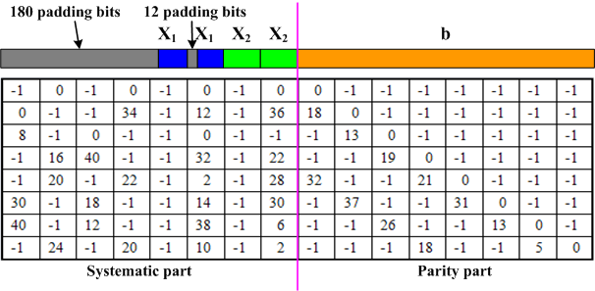
Proposed Signaling field Coding
Encoding the signaling field with 72 bits
the signaling bits can be shown as The length of and are 30 and 42 respectively.
the signaling bits repeat once and is encoded to generate the parity sequence with length of 336 bits by using rate 1/2 LDPC code with the element of base matrix .
The mother codeword is . And the sequence of first 1024 bits of three copies of is LDPC code output.
The location of , and in the base matrix show as:

Slide 10
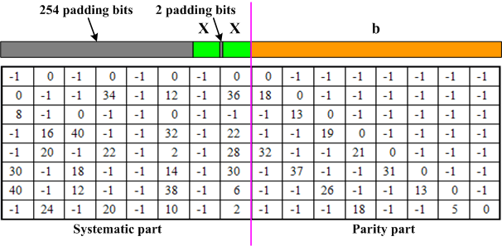
Proposed Signaling field Coding
Encoding the Signaling field with 40 bits
the signaling bits can be shown as
the signaling bits repeat once and is encoded to generate the parity sequence with length of 336 bits by using rate 1/2 LDPC code base matrix .
The mother codeword is . And the sequence of first 672 bits of three copies of is LDPC code output.
The location of and in the base matrix show as:

Slide 11
Conclusion
We proposed a new LDPC base matrix for group discussion
The advantage of the base matrix is that
Most of elements unequal to -1 are even, which is good for LDPC pipeline decoder.
All the elements unequal to -1 in the same column of different base matrixes are from a set with 4 elements, and the first element unequal to -1 of every column is equal to zero. Low complexity of cyclic shift network.
The check parts of all base matrix are strictly lower triangular matrix. Low complexity of LDPC encoder.
We also design the signaling field coding procedure using the proposed LDPC base matrix .

Slide 12
References
IEEE Std 802.11ad
“11-14-0716-02-00aj-phy-sig-frame-structure-for-ieee-802-11aj-45ghz”
“Rate=5/6 LDPC Coding for OFDMA PHY”, C80216e-05_066r2，Robert Xu, etc
http://grouper.ieee.org/groups/802/16/tge/index.html
“High Girth LDPC Coding for OFDMA PHY”, IEEE C80216e-05_126r1， Robert Xu,
Mansour, M.M.; Shanbhag N.R. "A 640-Mb/s 2048-Bit Programmable LDPC Decoder Chip", IEEE Journal of Solid-State Circuits, vol. 41, no. 3, pp. 684-698, Mar. 2006
T. Zhang and K. K. Parhi, "Joint (3,k)-Regular LDPC Code and Decoder/Encoder Design", IEEE Transactions on Signal Processing vol. 52, no. 4, pp. 1065-1079, April, 2004

