Slide 1
In Situ Spectrum Reuse Measurements in Indoor 20,000 Seat Arena
Date: 2014-05-14
Authors:

Slide 2
Abstract
Very high-density (VHD) environments such as outdoor stadiums and indoor arenas are poorly characterized.
Repeatable in situ measurements are difficult to obtain. Channel reuse measurements are even harder to obtain.
Available macro usage statistics from multiple vendors show significant underutilization as compared with AP count, suggesting spatial reuse is rarely achieved.
802.11hew SG has done some work on modelling [1, 2]
This contribution presents recent in situ reuse measurements at large indoor basketball arena in USA

Slide 3
System Overview
Seating capacity: ~20,000
Association capacity target: 25% (~5,000 assns)
Active capacity target: 1MB / client / 5 min session
WAN Uplink: 150Mbps
Total APs: 294 (~100 in bowl)
RF Coverage Strategy: Overhead (3 tiers)
Bowl Antenna Pattern: 30ºH x 30ºE, H/V dual pol
Channel Set & Width: Non-DFS, 20MHz
Avg APs per Channel: 10 in bowl
TX Rates (5GHz): 18, 24, 36, 48, 54

Slide 4
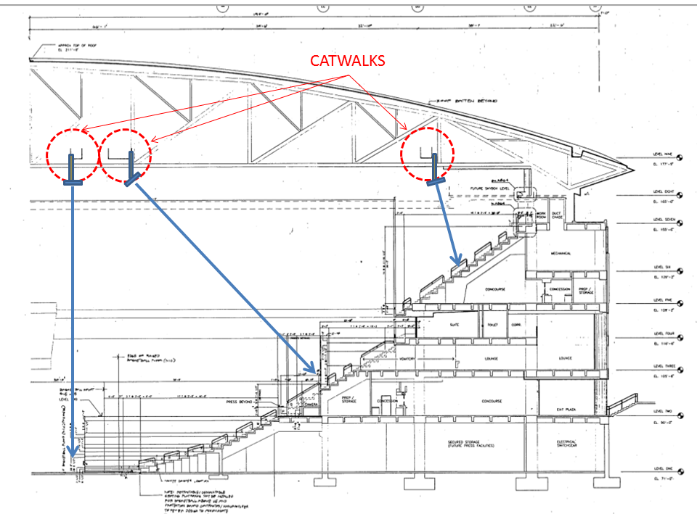
Coverage Strategy – Overhead Narrow Beam Antennas

Slide 5
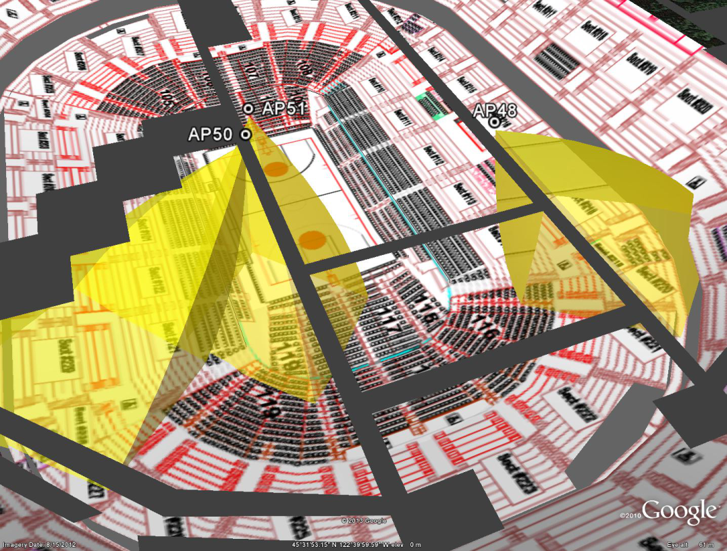
3D Model of Coverage from Catwalks

Slide 6
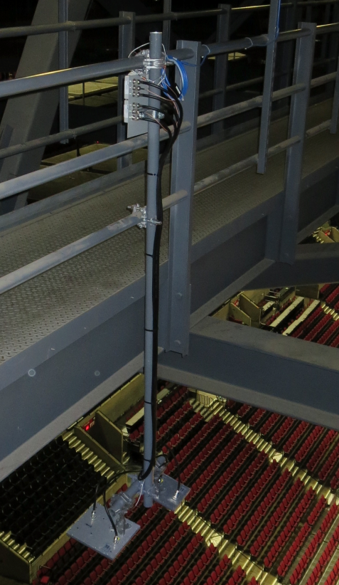
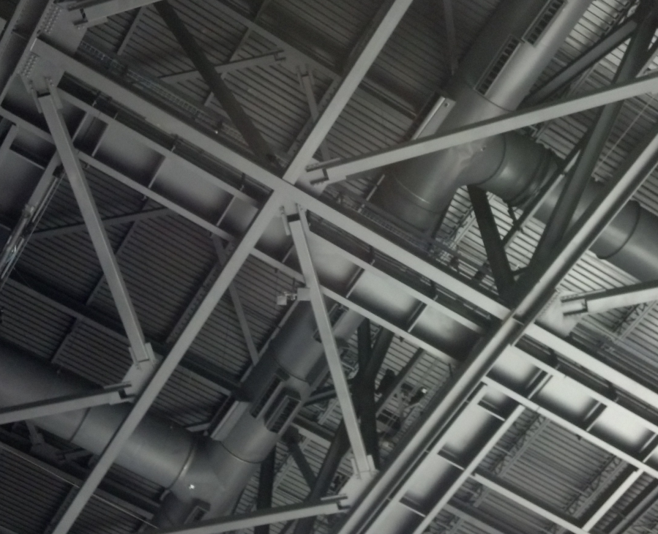
Catwalk Installation Example

Slide 7
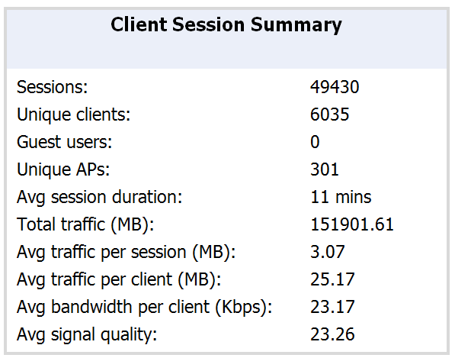
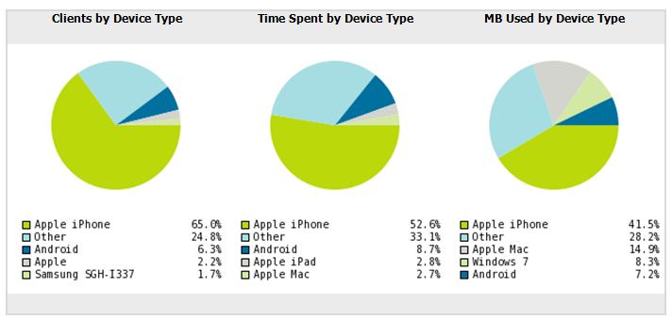
Usage Statistics – Typical Non-Playoff Night
151.9GB over 240 minutes
  84.3Mbps average
120.7% of association capacity target
300% of active user target
8.1 sessions per client
Average SNR = 23.26dB

Slide 8
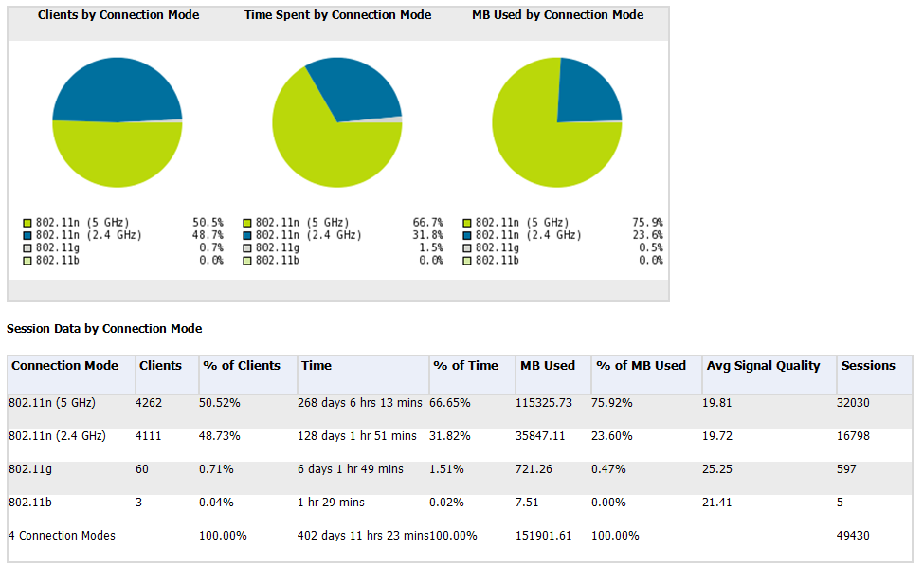
Band Breakdown – Typical Non-Playoff Night

Slide 9
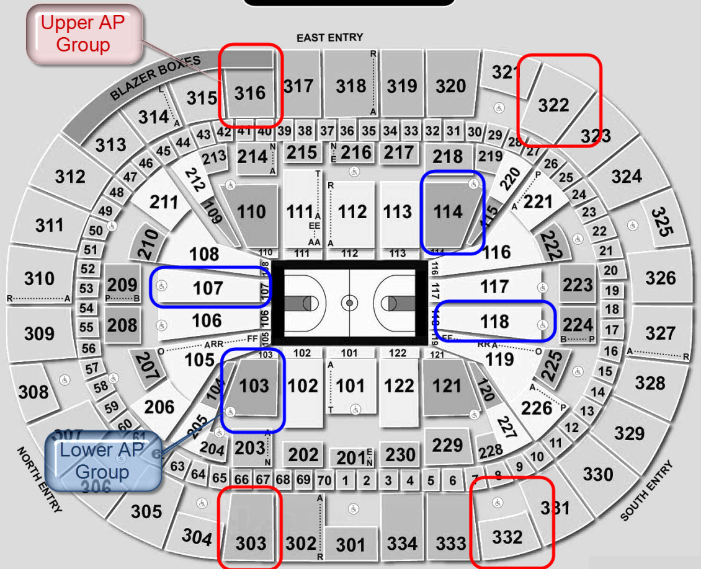
Test Configuration & Procedure
We created 2 AP groups:
  “Upper” group fixed to ch 44
  “Lower” group fixed to ch157
  Hidden SSID to force association
Test devices:
  Galaxy S4 (1SS 11ac)
  Galaxy Tab Pro 12.2 (2SS 11ac)
IxChariot 7.3EA SP1
Test methodology:
  Baseline each section (find “X”)
  Run 2 sections at a time
  Run all sections at a time
  Repeat for each device
  Repeat for both levels / groups

Slide 10
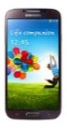

Baseline – Single Section Results
Pre-Game
  2SS tablet yields 1.9X the goodput of the 1SS phone
  Performance is consistent across device & location
  Upstream consistently beats downstream, but delta varies with bowl level and device type
    Average delta is 8Mbps for GS4 on both levels
    For tablet, there is an 11Mbps delta on the floor but almost 20Mbps delta in upper bowl
In Game (2nd Qtr)
  Downstream goodput drops by ~70% downstream for both devices
  Upstream goodput drops by 49% for GS4 and 67.6% for Tablet
  No point in testing lower bowl

Slide 11
Reuse Tests – Lower Bowl (Pre-game)
No spatial reuse in lower bowl
  GS4 2 section was 59.8% / 82.6% of baseline (down/up)
  Tablet 2 section was 94.3% / 98.8% of baseline (down/up)
  Tablet 4 section dropped to 67% / 56% of baseline (down/up)
Result consistent with prevalent low-rate OBSS CCI
No point in running in-game reuse tests

Slide 12
Reuse Tests – Upper Bowl (Pre-game)
Limited spatial reuse observed for GS4:
  2 section concurrent: n=1.5X (n is goodput multiple over X)
  4 section concurrent: n=1.8X
Little to no reuse seen for 2 section tablet tests
Limited reuse observed for 4 section tablet test (n=1.9X)
Magnitude of effect is geometry dependent

Slide 13
Reuse Tests – Upper Bowl (In Game)
Reuse factor increased significantly with crowd
  GS4 2 section concurrent: n=1.9X down / 1.3X up
  GS4 3 section concurrent: n=2.8X down / 2.5X up
  Tablet 2 section concurrent: n=1.6X down / 2.2X up
  Tablet 3 section concurrent: n=3.2X down / 4.0X up

Slide 14
Explanation / Hypothesis
To achieve spatial reuse, both of these must be true:
  There must be sufficient BSS-BSS main lobe rejection. From the cross section below it’s easy to see how this would be true of the upper level but not the floor.
  There must be sufficient client-to-client cross-bowl rejection. Combination of distance, body attenuation and overall crowd effect. MRC on multi-SS clients reduces rejection.
“Sufficient” means adequate to avoid PLCP preamble detection (e.g. SNR = 4dB)
For this arena, upper bowl with back-tilted narrow beamwidth antennas has good rejection
The lower bowl has little or no rejection

Slide 15
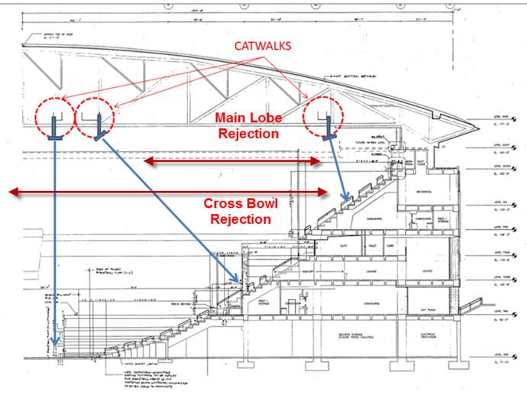
Main Lobe vs. Cross-Bowl Rejection

Slide 16
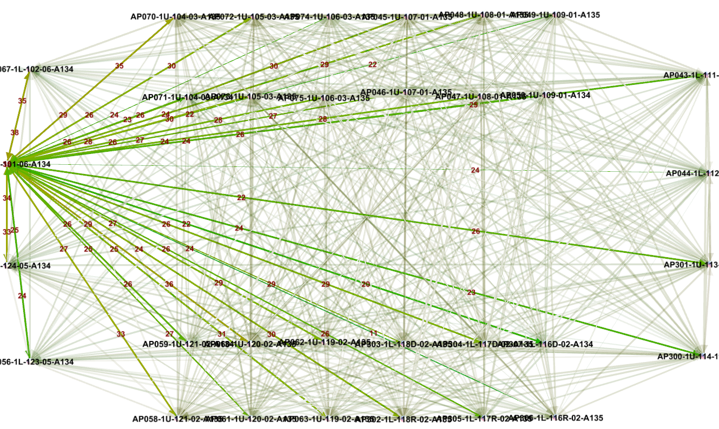
Typical Measured Cross-Bowl SNR

Slide 17
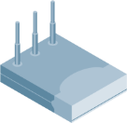
PLCP Interference Radius
20m
40m
80m
160m
Preamble Continues
to
4 SNR
and
>250m !!!!
r
2r
4r
8r
-65dBm
25 SNR
-71dBm
19 SNR
-77dBm
13 SNR
-83dBm
7 SNR
Cell Edge Radius(r₁)
  This is what we usually call the “cell edge” of the AP
  It is the target data rate radius (e.g. -67dBm = MCS15 or 54Mbps)
Interference Radius (r₂)
  802.11 preamble can be decoded (SNR >= 4dB)

Slide 18
Areas of Future Study
Having established cross-bowl reuse, what is the minimum lateral (side-to-side) section distance for reuse?
What about reuse in a single section from floor all the way to ceiling (single “slice”)?
Explore further main floor reuse.
How to automate and permanently embed instrumentation

Slide 19
References
https://mentor.ieee.org/802.11/dcn/14/11-14-0381-00-0hew-stadium-scenario-for-hew.ppt
https://mentor.ieee.org/802.11/dcn/13/11-13-1079-00-0hew-outdoor-stadium-simulation-details-discussion.pptx

