Slide 1
Comparison of Calibration Methodology for MAC Simulation
Date: 2014-05-15
Authors:

Slide 2
Abstract
We have been doing MAC simulation calibration using the ns3 based platform.
This presentation compares different proposals of calibration methodology for MAC simulation presented in TGax.
We propose a bottom up calibration methodology for MAC simulation which is a method to validate essential MAC features for integrated MAC PHY system level simulation, including identification of the importance and priority of MAC calibration cases.

Slide 3
Outline
Background
Comparison of Calibration Methodologies
Bottom up Calibration Method
Calibration Decision Matrix
Conclusions
Features Enhancement Made to NS3

Slide 4
Background
MAC Calibration Goal: Validate essential MAC features across different integrated PHY MAC simulation implementations.
Previous TGax MAC calibration contributions proposed several methods, such as:
11-14/0600r0 “Proposed Calibration For MAC simulator” proposed “to start with ‘PHY agnostic’ tests”.
11-14/0582r0 proposed “necessary to do function testing before looking at the performance metrics”.
11-14/0634r0 proposed a hybrid approach of “Examine simulation log for deterministic MAC behavior” and “Compare performance test for nondeterministic MAC behavior”.
11-14/0571r0 proposed “Integrated system simulation”.
There is a need to converge to a common calibration methodology.

Slide 5
Comparison of Calibration Methodologies
DCN | 11-14/0600r0 | 11-14/0582r0 | 11-14/0634r0 | 11-14/0571r0
Proposal Summary | Suggest to start with ‘PHY agnostic’ tests and show performance of MAC features based on Thpt and PER. | A test case as a pre-configured series of virtual TX and RX event. Calibrate by checking related MAC FSM states at each time slot. | Examine simulation log for deterministic MAC behavior. Compare performance test for nondeterministic MAC behavior. | Provide comprehensive performance evaluation of PHY and MAC techniques in an environment that is close to a real-world scenario.
Examples | MAC overhead w/wo RTS/CTS. Deferral Tests. Backoff procedure. NAV deferral. | Event timing and MAC state tracing of EDCA procedure. | Simulation Log: Basic deferral and backoff, Basic RTS/CTS. Performance test: Aggregation, RTS/CTS for hidden node, EDCA procedure. | Calibrate the system level performance. The output metrics are CDF of: Per-STA throughput, Per-BSS Throughput, Packet Loss and Transmission Latency.
Comment | Use performance simulation results to calibrate simulators. | Different simulators may define different FSM states and transitions at the same time slot. | Methodology focus on simulation log comparison. | Calibration of system level performance.

Slide 6
Bottom up calibration method
It is pertinent to start with validating more fundamental directly quantifiable MAC features.
Lower MAC is more fundamental
Lower MAC (timing critical): e.g. Tx path, CCA, EDCA, etc. ➔ more important, higher priority.
Upper MAC: e.g. protocol, ➔ less important, lower priority.
Some MAC features are directly quantifiable
Direct ➔ Higher priority
IFS, Aggregation density vs throughput, Beacon interval accuracy, TSF accuracy, etc.
Indirect ➔ Lower priority
Dependent on Directly Quantifiable features
Upper MAC protocol performance, such as Association, PS, etc.

Slide 7
Proposed Calibration Decision Matrix
Decision to prioritize calibration cases.
 | Lower MAC feature | Higher MAC feature
Direct | Calibration case A Calibration case B Calibration case C ….. | Calibration case G Calibration case H Calibration case I …..
Indirect | Calibration case D Calibration case E Calibration case F ….. | Calibration case I Calibration case K Calibration case L …..
Higher Priority

Slide 8
Conclusions
Propose bottom up calibration methodology for MAC simulation with calibration cases priority.
Lower MAC features > Upper MAC features.
Direct > Indirect.
Identification of the importance and priority of test cases by calibration case matrix.
We are developing our NS3 based simulation platform following these priority definitions.

Slide 9
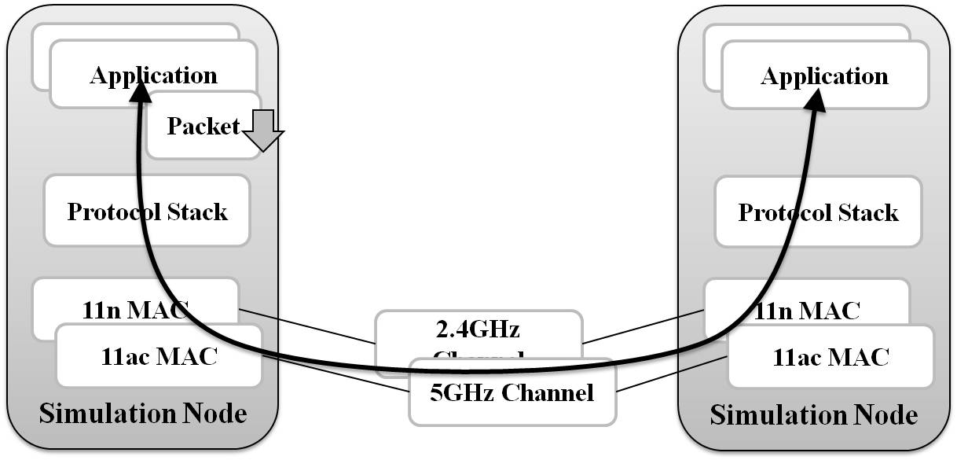
Implemented Simulation Model
Support multiple concurrent MAC simulation.

Slide 10
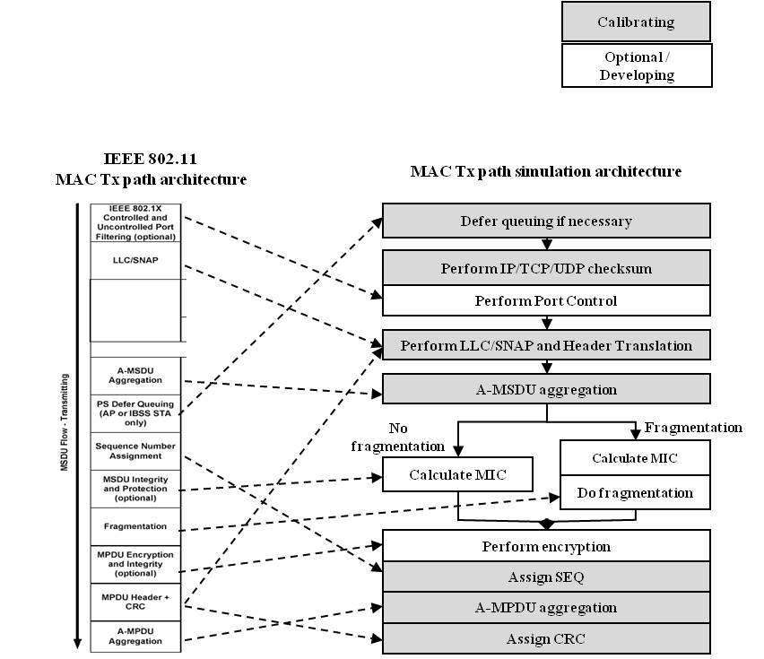
Features Enhancement Made to NS3
PHY Model: TGn/TGac Model B/D.
Lower and Upper MAC Tx Data Path
802.11n/ac enhancement
VHT BSS operation
VHT RTS procedure
NDP
20/40/80/160 Channel Width Selection.

